Slide 1
CS1201: Programming Language 2
Classes and objects
Inheritance
Nouf Aljaffan
Edited by : Nouf Almunyif

Slide 2
Inheritance
Inheritance and composition are meaningful ways to relate two or more classes.
Inheritance implements an is-a relationship:
For example - a mustang is-a car.
Inheritance lets us create new classes from existing classes.
The new classes that we create from the existing classes are called the derived classes; . Is also referred to as the subclass.
the existing classes are called the base classes. Is also called the superclass.
The derived classes inherit the properties of the base classes.
Each derived class, in turn, becomes a base class for a future derived class.
A derived class can redefine the member functions of a base class, but this redefinition applies only to the objects of the derived class.

Slide 3
Hierarchical Inheritance
Inheritance is hierarchical:
A derived class can also act as a base class to a lower-level derived class.
The higher the class in the hierarchy, the more general information it contains.
The lower the class in the hierarchy, the more specific information it contains.
Attributes in a derived class overwrite the same ones in a base class.

Slide 4
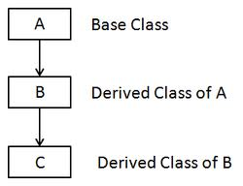
Hierarchical Inheritance

Slide 5
Hierarchical Inheritance

Slide 6
Hierarchical Inheritance
vehicle
is-a
Land vehicle
Water vehicle
is-a
is-a
car
bicycle
boat
submarine

Slide 7
class inheritance definition:
class Derived_Class_name: accessId Base_Class_name
{
DClassMembersList
};
accessId define how can the derived class access
the Base class members .
Access identifier can be either public, protected and privet.

Slide 8
Reviewing public, protected, and private
When a class member is declared :
as public, it can be accessed by any other part of a program.
as private, it can be accesses only by members of its class.
Further, derived classes do not have access to private base class members.
as protected, it can be accessed only by members of its class.
However, derived classes also have access to protected base class members.
Thus, protected allows a member to be inherited, but to remain private within a class hierarchy.

Slide 9
Cont..
When a base class is inherited by use of (accessId )
public, (default)
its public members become public members of the derived class.
its protected members become protected members of the derived class.
protected, its public and protected members become protected members of the derived class.
private, its public and protected members become private members of the derived class.
In all cases, private members of a base class remain private to that base class.

Slide 10
Inheritance and accessibility
Access Specifier | Accessible from own class | Accessible from Derived Class | Accessible from Objects outside class
Public | Yes | Yes | Yes
Protected | Yes | Yes | No
Private | Yes | No | No

Slide 11
Example ( public access)
#include <iostream>
using namespace std;
class rectangleType // base class
{
protected:
double length;
double width;
public:
rectangleType() {length = 0;
width = 0;}
rectangleType( double L, double w)
{setDimension( L , w); }
void setDimension ( double L, double w)
{ if ( L >= 0 ) length = L;
else length = 0;
if ( w >= 0 )width= w;
else width = 0;
}
double getLength()
{ return length;}
double getWidth()
{ return width;}
double area()
{return length * width;}
double perimeter()
{ return 2 * ( length + width );}
void print(){
cout<<"Length = "<< length << " ; Width = " << width;
}
};

Slide 12
class boxType: public rectangleType {
private:
double height;
public:
boxType() { height = 0 ;}
boxType( double L, double w, double h) {setDimension( L, w, h); }
~boxType(){}
void setDimension ( double L, double w, double h)
{ rectangleType::setDimension( L , w );
if ( h >= 0)‏ height = h;
else height = 0;}
double getHeight() { return height; }
double area() { return 2 * ( length * width + length * height + width * height ); }
double volume() {return rectangleType::area() * height; }
void print() { rectangleType::print();
cout << " ; Height = " << height;}
};

Slide 13
Cont. Example
Void main()‏
{
rectangleType myRectangle1;
rectangleType myRectangle2(8, 6);
boxType myBox1;
boxType myBox2(10, 7, 3);
cout << "\n myRectangle1: ";
myRectangle1.print();
cout << endl;
cout << " Area of myRectangle1: " << myRectangle1.area() << endl;
cout << "\n myRectangle2: ";
myRectangle2.print();
cout << endl;
cout << " Area of myRectangle2: " << myRectangle2.area() << endl;
}

Slide 14
Cont. Example

Slide 15
Over-written Functions
These functions are NOT overloaded, since they have exactly the same prototype (and header), and they are not in the same class.
They are over-written functions.
The over-written function that is closest to the object defined takes precedence.

Slide 16
public, (default)
its public members become public members of the derived class.
its protected members become protected members of the derived class.
Example : base class inherited as public

Slide 17
#include <iostream>
using namespace std;
class base // base class
{int pri; //private by default
protected:
int prot;
public:
int pub;
void set(int b) { pri=b;}
void setprot(int p) {prot=p;}
void show(){ cout<<"in base pri :"<<pri<<"\n";}
};
class drived: public base
// drivedclass
{
int k;
public:
drived( int x) {k =x; }
void showK(){
cout<<" in derived k : "<< k << "\n";
cout<<" in deraived prot from base : "<<prot<<endl;
//cout << pri; this is error
}
} ;//end of class
void main(){
drived ob(3);
ob.set(5); // access member of base
ob.show(); // access member of base
ob.showK(); // access member of drived class
//ob.prot=5;error
}

Slide 18
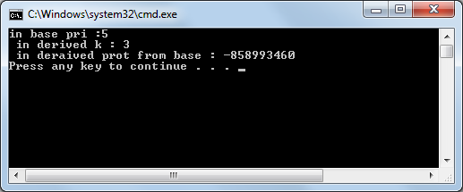

Slide 19
protected
its public and protected members become protected members of the derived class.
Example : using protected for inheritance of base class

Slide 20
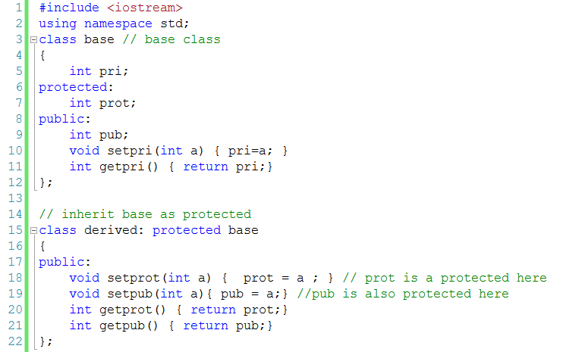

Slide 21
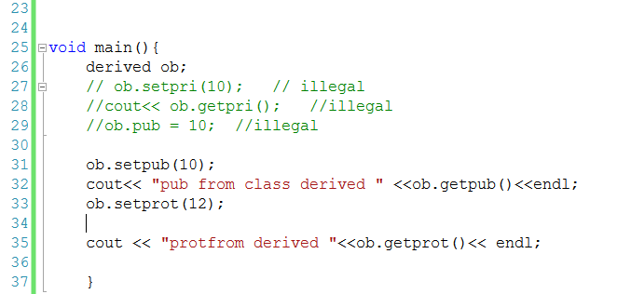

Slide 22
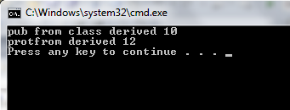

Slide 23
private
its public and protected members become private members of the derived class.
In all cases, private members of a base class remain private to that base class.

Slide 24
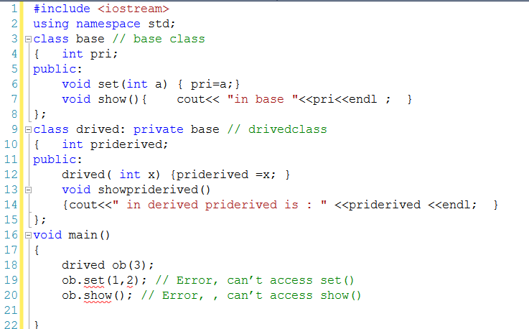

Slide 25
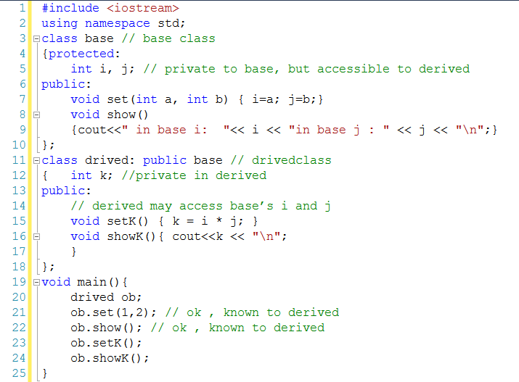
using protected member

Slide 26
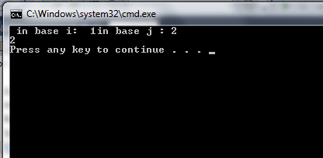

Slide 27
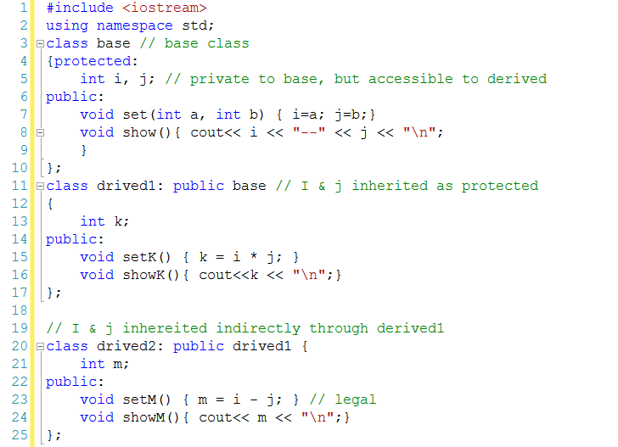
using protected member

Slide 28
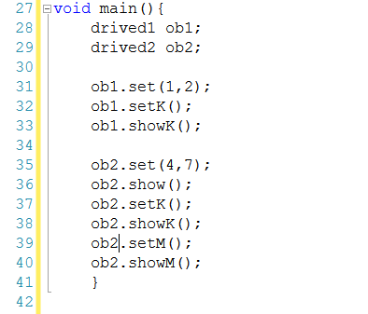
using protected member

Slide 29
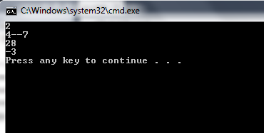

Slide 30
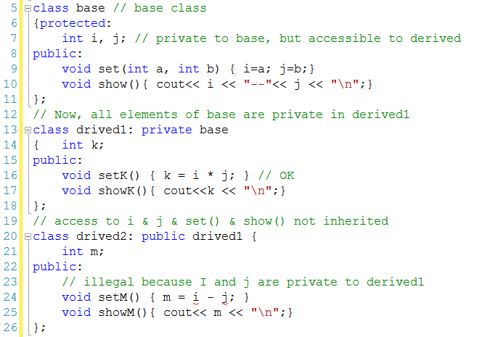
using protected member

Slide 31
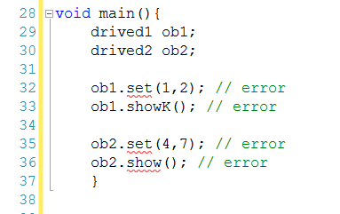
using protected member

Slide 32
Multiple Base Classes Inheritance

Slide 33
Inheriting Multiple Base Classes
It is possible for a derived class to inherit two or more base classes.
General definition :
class derivedName: access1 base1, access2 base2 {
The member list of derivedName class
};

Slide 34
An example of multiple base classes
// An example of multiple base classes.
#include <iostream>
using namespace std;
class base1 {
protected:
int x;
public:
void showx() { cout << x << "\n";}
};
class base2 {
protected:
int y;
public:
void showy() { cout<< y << "\n"; }
};
// Inherit multiple base classes.
class derived: public base1, public base2 {
public:
void set(int i, int j) { x= i; y =j; } };
int main(){
derived ob;
ob.set(10, 20);//provided by derived
ob.showx();//from basel
ob.showy();//from base2
return 0;
}

Slide 35
Constructors, Destructors, and Inheritance
when are base class and derived class constructor and destructor functions called?
how can parameters be passed to base class constructor functions?

Slide 36
When Constructor and Destructor Functions Are Executed?
It is possible for a base class, a derived class, or both, to contain constructor and/or destructor functions.
It is important to understand the order in which these functions are executed
when an object of a derived class comes into existence
when it goes out of existence.

Slide 37
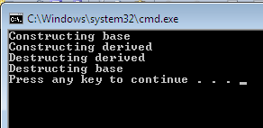
Example 1
#include <iostream>
using namespace std;
class base {
public:
base(){ cout << "Constructing base\n";}
~base(){ cout << "Destructing base\n"; }
};
class derived: public base {
public:
derived() { cout << "Constructing derived\n";}
~derived() { cout << "Destructing derived\n";}
};
int main()
{
derived ob;
// do nothing but construct and destruct ob
return 0;
}
General Rule
constructor functions are executed in the order of their derivation.
Destructor functions are executed in reverse order of derivation.

Slide 38
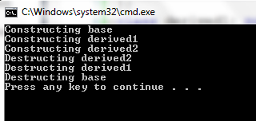
Example 2
#include <iostream>
using namespace std;
class base {
public:
base() { cout << "Constructing base\n"; }
~ base() { cout << "Destructing base\n"; }
};
class derived1: public base{
public:
derived1() {cout << "Constructing derived1\n"; }
~ derived1() {cout << "Destructing derived1\n"; }
};
class derived2: public derived1 {
public:
derived2{ cout << "Constructing derived2\n"; }
~ derived2{ cout << "Destructing derived2\n";}
};
int main() {
derived2 ob;
// construct and destruct ob
return 0;}

Slide 39
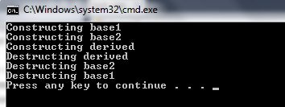
The same general rule applies in situations involving multiple base classes Example 1
#include <iostream>
using namespace std;
class base1{
public:
base1() { cout << "Constructing base1\n";}
~ base1() { cout << "Destructing base1\n"; }
};
class base2{
public:
base2() { cout << "Constructing base2\n"; }
~ base2() { cout << "Destructing base2\n"; }
};
class derived: public base1, public base2 {
public:
derived() { cout << "Constructing derived\n";}
~derived() { cout << "Destructing derived\n";}
};
int main() {
derived2 ob;
// construct and destruct ob
return 0;}
constructors are called in order of derivation, left to right, as specified in derived's inheritance list.
Destructors are called in reverse order, right to left.

Slide 40
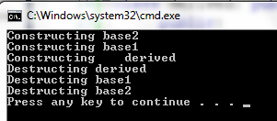
Example 2
#include <iostream>
using namespace std;
class base1{
public:
base1() { cout << "Constructing base1\n";}
~ base1() { cout << "Destructing base1\n"; }
};
class base2{
public:
base2() { cout << "Constructing base2\n"; }
~ base2() { cout << "Destructing base2\n"; }
};
class derived: public base2, public base1{
public:
derived() { cout << "Constructing derived\n";}
~derived() { cout << "Destructing derived\n";}
};
int main() {
derived ob;
// construct and destruct ob
return 0;}

Slide 41
Passing Parameters to Base Class Constructors
The general form of this expanded declaration is shown here:
base1 through baseN are the names of the base classes inherited by the derived class.
Notice that a colon separates the constructor function declaration of the derived class from the base classes, and that the base classes are separated from each other by commas, in the case of multiple base classes.
derived-constructor(arg-list) : base1 (arg-list), base2(arg-list), ….baseN(arg-list)
{
body of derived constructor
}

Slide 42
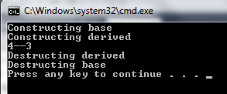
Example 1
class base{
protected:
int i ;
public:
base( int x ) { i = x; cout << "Constructing base\n";}
~ base() { cout << "Destructing base\n"; }
};
class derived: public base {
int j;
public:
//derived uses x;" y is passed along to base.
derived(int x, int y): base(y)
{ j = x; cout << "Constructing derived\n"; }
~ derived(){ cout << "Destructing derived\n"; }
void show(){cout << i <<“—”<<j<< "\n"; }
};
int main() { derived ob(3,4);
ob.show(); //displays 4 3
return 0;}
derived's constructor is declared as taking two parameters, x and y.
However, derived( ) uses only x; y is passed along to base( ).
In general, the constructor of the derived class must declare the parameter(s) that its class requires, as well as any required by the base class.

Slide 43
Example 2 uses multiple base classes
#include <iostream>
using namespace std;
class base1{
protected:
int i ;
public:
base1( int x ) { i = x; cout <<"Constructing base1\n";}
~ base1() { cout << "Destructing base1\n"; }
};
class base2{
protected:
int k;
public:
base2( int x ) { k = x; cout << "Constructing base2\n";}
~ base2() { cout << "Destructing base2\n"; }
};
class derived : public base1, public base2{
int j;
public:
derived(int x, int y, int z ): base1(y), base2(z)
{ j = x;
cout << "Constructing derived\n"; }
~ derived(){ cout << "Destructing derived\n";}
void show(){cout << i <<"--" <<j<<"--" << k << "\n"; }
};
int main() {
derived ob(3,4,5);
ob.show(); //displays 4 3 5
return 0;
}

Slide 44
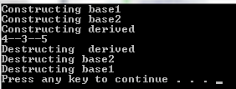

Slide 45
Example 3: Derived take no arguments but base1() and base2()
#include <iostream>
using namespace std;
class base1{
protected:
int i ;
public:
base1( int x ) { i = x; cout << "Constructing base1\n";}
~ base1() { cout << "Destructing base1\n"; }
};
class base2{
protected:
int k;
public:
base2( int x ) { k = x; cout << "Constructing base2\n";}
~ base2() { cout << "Destructing base2\n"; }
};
class derived: public base1, public base2{
int j;
public:
/* Derived constructor uses no parameters,
but still must be declared as taking them to
pass them along to base classes.*/
derived(int x, int y): base1(x), base2(y)
{ cout << "Constructing derived\n"; }
~ derived(){ cout << "Destructing derived\n";}
void show(){cout << i <<"--"<<j<<"--"<< k << "\n"; }
};
int main() {
derived ob(3,4);
ob.show(); //displays 3 4
return 0;
}

Slide 46
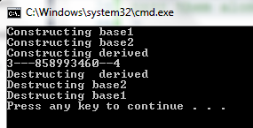

Slide 47
Notice
The constructor function of a derived class is free to use any and all parameters that it is declared as taking, whether or not one or more are passed along to a base class.
Put differently, just because an argument is passed along to a base class does not produce its use by the derived class as well.
For example, this fragment is perfectly valid:
class derived: public base{
int j;
public:
// derived uses both x and y and then passes them to base.
derived(int x, int y): base(x, y)
{ j = x*y; cout << "Constructing derived\n"; }
};

Slide 48
Virtual Base Classes

Slide 49
An element of ambiguity can be introduced into a C++ program when multiple base classes are inherited.
Consider the following incorrect program:

Slide 50
incorrect program:
int main(){
derived3 ob;
ob.i = 10;//this is ambiguous; which i???
ob.j = 20;
ob.k = 30;
// i ambiguous here, too
ob.sum = ob.i + ob.j + ob.k;
// also ambiguous, which i?
cout << ob.i << « »
cout << ob.j <<“ “ << ob.k <<“ “ ;
cout << ob.sum;
return 0; }
// This program contains an error and will not compile.
#include <iostream>
using namespace std;
class base {
public:
int i; };
//derived1 inherits base.
class derived1 : public base {
public:
int j; };
//derived2 inherits base.
class derived2 : public base {
public:
int k; };
/* derived3 inherits both derived1 and derived2. This means that there are two copies of base in derived3! */
class derived3 :public derived1, public derived2 { public:
int sum;};
Base
Derived1
Derived 3
Derived2

Slide 51
As the comments in this program indicate
Both derivedl and derived2 inherit base.
However, derived3 inherits both derivedl and derived2.
As a result, there are two copies of base present in an object of type derived3, so that in an expression like
ob.i = 20;
which i is being referred to? The one in derivedl or the one in derived2?
Since there are two copies of base present in object ob, there are two ob.is! As you can see, the statement is inherently ambiguous.

Slide 52
Solution
There are two ways to remedy the preceding program
The first is to apply the scope resolution operator to i and manually select one i.
For example, the following version of the program will compile and run as expected

Slide 53
Resolve the incorrect program using 1stapproach:
class base {
public:
int i; };
class derived1 : public base {
public:
int j; };
class derived2 : public base {
public:
int k; };
class derived3 :public derived1, public derived2 { public:
int sum;};
int main(){
derived3 ob;
ob.derived1:: i = 10;
//scope resolved, uses derived1’s I
ob.j = 20;
ob.k = 30;
// scope resolved
ob.sum = ob.derived1:: i + ob.j + ob.k;
// scope resolved
cout << ob.derived1:: i << « »
cout << ob.j <<“ “ << ob.k <<“ “ ;
cout << ob.sum;
return 0; }
By applying the ::, the program manually selects derivedl's version of base.
However, this solution raises a deeper issue: What if only one copy of base is actually required?
Is there some way to prevent two copies from being included in derived3?

Slide 54
virtual base classes
The second is to declare the base class as virtual
The solution is achieved with virtual base classes.
virtual base classes ensures that only one copy of it will be present in any derived class

Slide 55
2’nd approach using virtual base classes
// This program uses virtual base classes
#include <iostream>
using namespace std;
class base {
public:
int i; };
//derived1 inherits base.
class derived1 :virtual public base {
public:
int j; };
//derived2 inherits base.
class derived2 : virtual public base {
public:
int k; };
/* derived3 inherits both derived1 and derived2. This means that there is only one copy of base in derived3! */
class derived3 :public derived1, public derived2 { public:
int sum;};
int main(){
derived3 ob;
ob. i = 10; //scope resolved, uses derived1’s I
ob.j = 20;
ob.k = 30;
// unambiguous
ob.sum = ob.i + ob.j + ob.k;
// unambiguous
cout << ob. i << « »
cout << ob.j <<“ “ << ob.k <<“ “ ;
cout << ob.sum;
return 0; }
Now that both derivedl and derived2 have inherited base as virtual, any multiple inheritance involving them will cause only one copy of base to be present.
Therefore, in derived3 there is only one copy of base, and ob.i = 10 is perfectly valid and unambiguous.

Slide 56
difference between a normal base class and a virtual
The only difference between a normal base class and a virtual one becomes evident when an object inherits the base class more than once.
If the base class has been declared as virtual, then only one instance of it will be present in the inheriting object. Otherwise, multiple copies will be found.

