Slide 1
Pseudocode & Flowcharts
CSC 1101- C++ Programming Language (1)
Dr. Nouf Aljaffan
naljaffan@ksu.edu.sa

Slide 2
Stages in Program Development Process
1- Analysis of a problem
2- Create the algorithm
3- Compile the program
4- Execute the program
5- Testing and Debugging the Program

Slide 3
(2) Create the algorithm
Plan for solution and use basic statements and expression to develop the algorithm

Slide 4
B-Planning the Solution
Pseudocode is a semi-programming language used to describe the steps in an algorithm.
Flowchart is a graphical representation of an algorithm.

Slide 5
Pseudocode Example
Write a Program to Print the Sum of two integer Numbers
Start
Read Num1, Num2
Sum = Num1 + Num2
Write Sum
End

Slide 6
Flowcharts Symbols
PROCESS
INPUT/OUTPUT
DECISION
START/END
FLOWLINE

Slide 7
Solution
start
Draw a flowchart for a program that calculates
and print the area and the perimeter of
a rectangle.
Input
Length
width
Processing
Area = length*width
Perimeter = 2*( length + width)
Output
Area
Perimeter
Read L, W
area = L * W
perimeter = 2 (L+W)
Print area
Print perimeter
End

Slide 8
Example 2
Draw the flow chart for a program that calculates the total salary for an employee using this equation:
Total_Sal = Salary +Overtime

Slide 9
Solution
start
Input
Salary
Overtime
Processing
Total_Sal = Salary +Overtime
Output
Total_Sal
Read Salary
Read Overtime
Total_Sal =
Salary +Overtime
Print Total_Sal
End

Slide 10
Example 3
Draw a flowchart for a program that determine if the temperature degree is above or below freezing.
Input
Temp.
Processing
Check if Temp is below the 32 → below freezing.
Check if Temp is above the 32 → above freezing.
Output
Print “below freezing” or “above freezing”

Slide 11
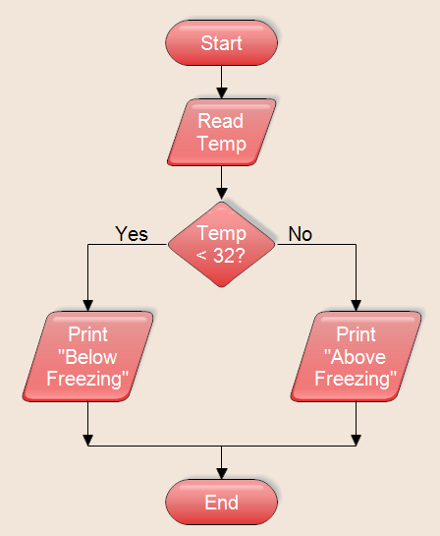
Solution

Slide 12
Example 4
Draw a flowchart for a program that calculates the Zakat, where the user enter the amount of money then the program show the zakat.
Zakat =(2.5/100) * amount.
Zakat is not calculated if the amount is less than 1000 S.R

Slide 13
Solution
Input
amount.
Processing
Check if amount is below 1000 → Zakat =0.
Check if amount is above 1000→ Zakat =(2.5/100) * amount
Output
Zakat

Slide 14
Solution
Start
Read amount
no
Amount > 1000
yes
Zakat =0.
Zakat =(2.5/100)*amount
Print Zakat
End

