Slide 1
Data Types and Arithmetic in C
Nouf Aljaffan (C) 2018
Editedby : Nouf almunyif

Slide 2
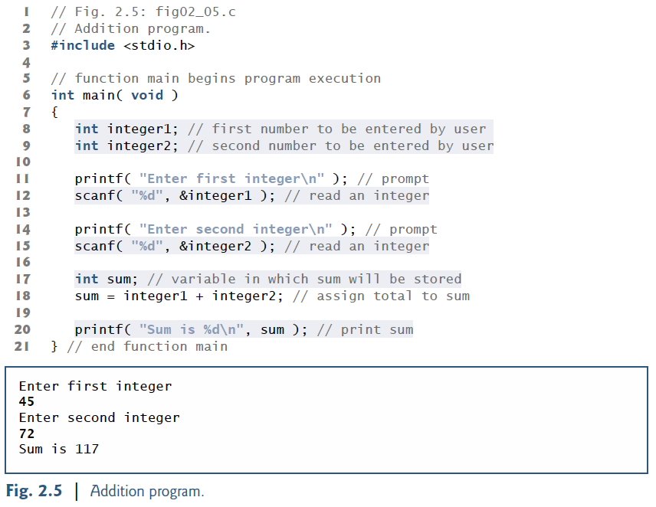
Adding Two Integers
Add Comments
Insert pre-processor definitions
Define main function
Declare variables
[DataType] [VariableName];
Variable names are case sensitive
User scanf to read variables by a user at the keyboard
scanf(“format control string,”, &variableName)
computes the sum of two values

Slide 3
Adding Two Integers
A variable name in C is any valid identifier. An identifier is a series of characters consisting of letters, digits and underscores ( _ ) that does not begin with a digit.
• C is case sensitive uppercase and lowercase letters are different in C.
All variables must be defined with a name and a data type before they can be used in a program
Every variable has a name,
a type and a value.

Slide 4
Adding Two Integers
Standard Library function scanf can be used to obtain input from the standard input, which is usually the keyboard.
• The %d conversion specifier indicates that the data should be an integer
(the letter d stands for “decimal integer”).
The % in this context is treated by scanf (and printf) as a special character that begins a conversion specifier.

Slide 5
Adding Two Integers
ampersand (&)—called the address operator followed by a variable name. The ampersand, when combined
with a variable name, tells scanf the location in memory at which the variable is located
The computer then stores the value for the variable at that location.

Slide 6
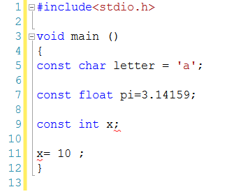
Constants
The const qualifier is used to tell C that the variable value can not change after initialisation.
Constants are literal/fixed values assigned to variables or used directly in expressions.
Examples:

Slide 7
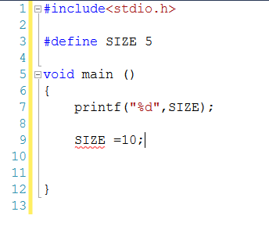
Constants
Another way to define constant value is the following :
Examples:

Slide 8
Type Conversion
Implicit
Explicit
Data will get automatically converted from one type to another.
Data may also be expressly converted, using the typecast operator

Slide 9
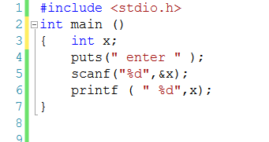
Implicit Type Conversion
1. When data is being stored in a variable, if the data being stored does not match the type of the variable.
The data being stored will be converted to match the type of the storage variable.
Input : 11.5
What will be printed ?

Slide 10
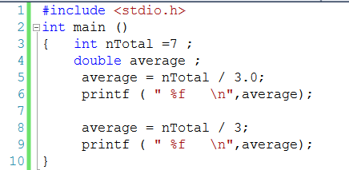
Implicit Type Conversion
2. When an operation is being performed on data of two different types.
The "smaller" data type will be converted to match the "larger" type.
For example, when an int is added to a double, the computer uses a double version of the int and the result is a double.
The following example converts the value of nTotal to a double precision value before performing the division. Note that if the 3.0 were changed to a simple 3, then integer division would be performed, losing any fractional values in the result. (try it )
int nTotal ; double average ;
average = nTotal / 3.0;
3. When data is passed to or returned from functions.

Slide 11
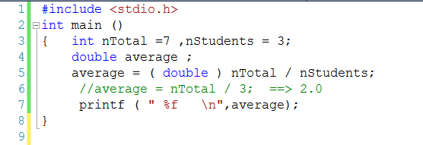
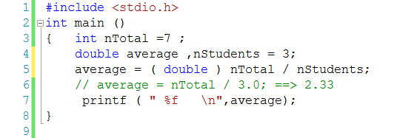
Explicit Type Conversion
The following example converts the value of nTotal to a double precision value before performing the division. ( nStudents will then be implicitly promoted, following the guidelines listed above. )
average = ( double ) nTotal / nStudents;
Note that nTotal itself is unaffected by this conversion.

Slide 12
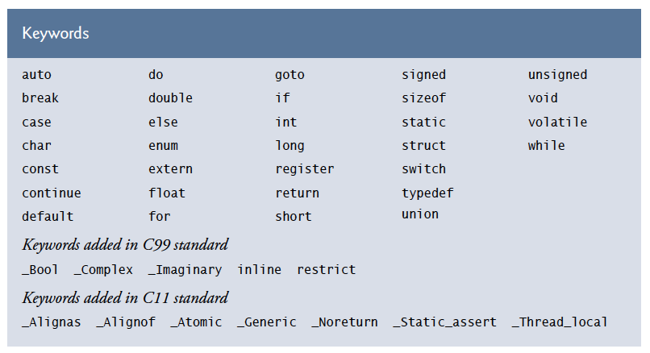
are reserved words of the language

Slide 13
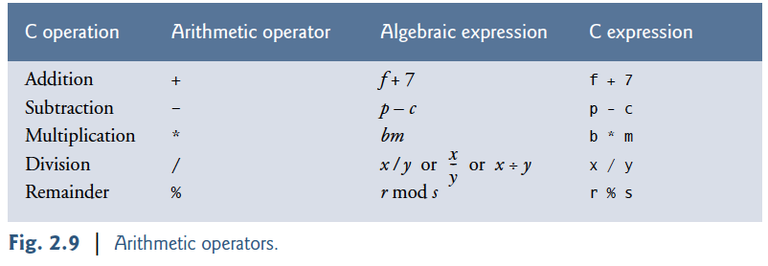
Arithmetic in C

Slide 14
Arithmetic in C

Slide 15
Arithmetic in C
Integer division yields an integer result. For example, the expression 7 / 4 evaluates to 1
and the expression 17 / 5 evaluates to 3.
C provides the remainder operator, %, which
yields the remainder after integer division. The remainder operator is an integer operator
that can be used only with integer operands. The expression x % y yields the remainder after
x is divided by y. Thus, 7 % 4 yields 3 and 17 % 5 yields 2.

Slide 16
Arithmetic in C

Slide 17
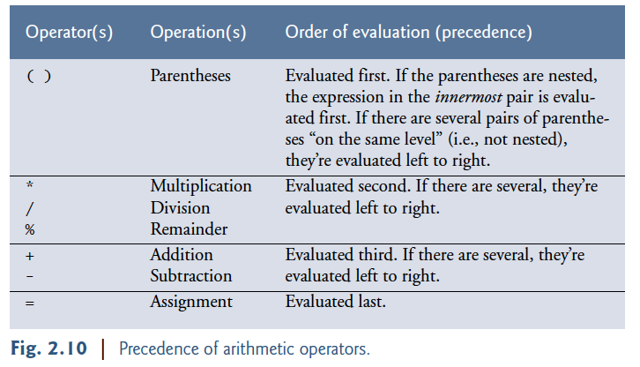
Rules of Operator Precedence

Slide 18
Rules of Operator Precedence

Slide 19
Rules of Operator Precedence
y = ( a * x * x ) + ( b * x ) + c;
redundant parentheses

