Slide 1
Chapter 8
C Characters and Strings
Created by : nouf almunyif

Slide 2
String definitions (1)
  Define as an array of character
    char str1[] = "hello world";
    char str2[6] = "world";
    char str3[] = { 'f', 'i', 'r', 's', 't', '\0' };
    char str4[4]= {'w','o','w','\0'};
    char str[30] ;
  char str[ ] ; //error
  Remember that strings represented as character arrays end with '\0'

Slide 3

Inputting strings
#include<stdio.h>
void main ()
{
char str[30] ;
printf("enter a sentence ");
scanf ( "%s",str );
printf("you entered : %s \n",str );}
Do not need &
(because a str is a pointer)
  Remember to leave room in the array for '\0'

Slide 4
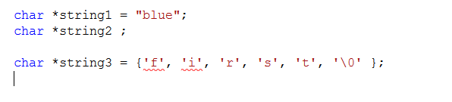
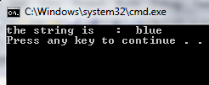
String definitions (2)
String definitions
  Define as a variable of type char *
printf("the string is : %s \n",string1 );
//error

Slide 5
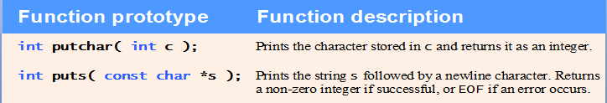
string functions

Slide 6
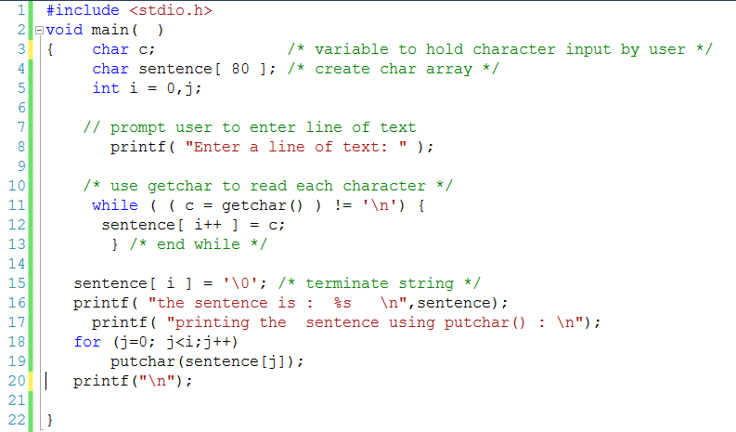
Using getchar() , putchar()

Slide 7
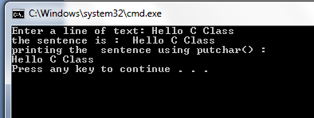

Slide 8
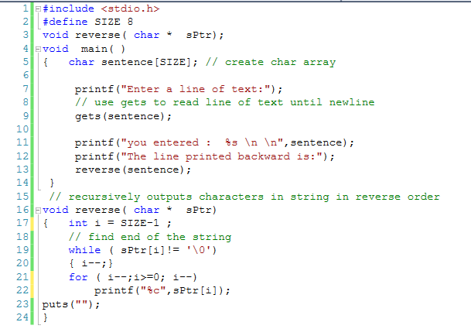
Using gets()

Slide 9
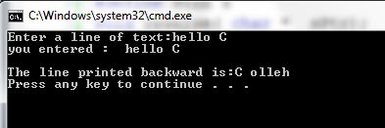

Slide 10
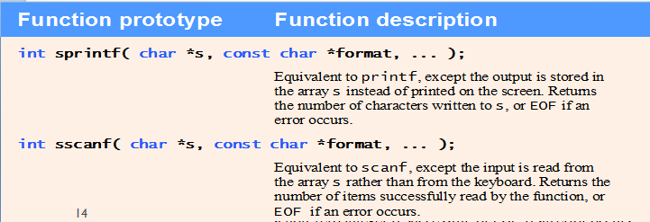
string functions

Slide 11
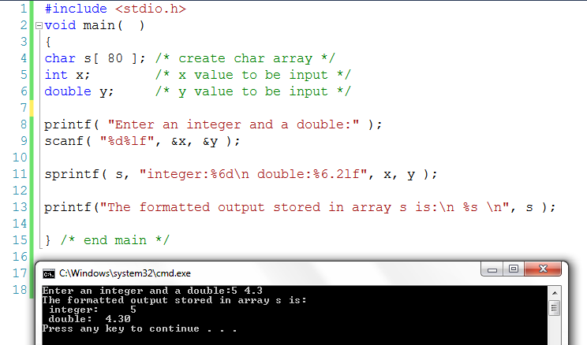
Using sprintf()

Slide 12
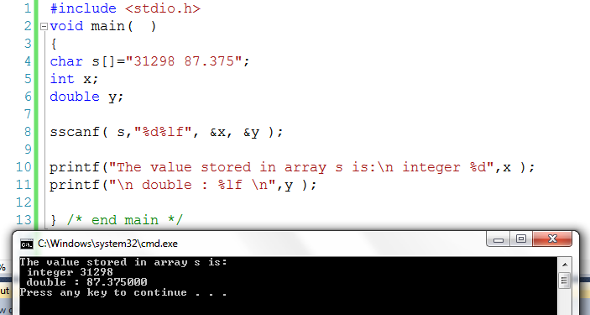
Using sscanf()

Slide 13
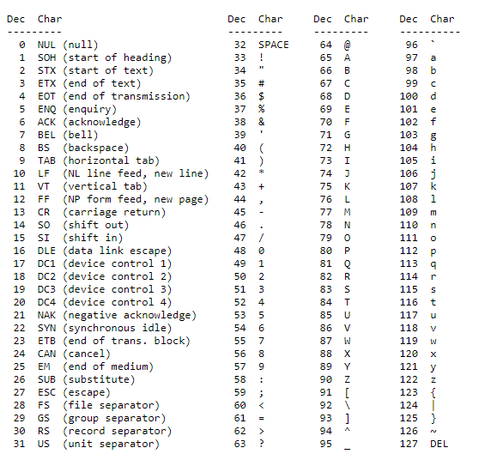
ASCII table

Slide 14
ASCII
From the ASCII table '5' has the int value 53
if we write '5'-'0' it evaluates to 53-48
if we write char c = 'B'+32;
The value of c will be ?
C= 66+ 32 = 98 = ‘b’

Slide 15
Example:
#include<stdio.h>
void main ()
{
char character ;
int Decimal ;
printf("enter a character ");
scanf ( "%c",&character);
printf("as character is %c \n",character);
printf("as integer is %d \n\n\n",character);
printf("enter a Decimal number ");
scanf ( "%d",&Decimal );
printf("as Decimal is %d \n",Decimal );
printf("as character is %c \n\n\n",Decimal );
}

Slide 16
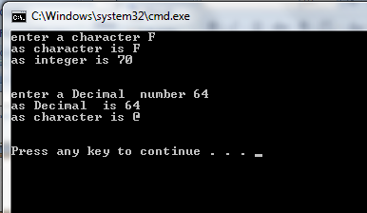

Slide 17
Character Handling Library
Character handling library
  Includes functions to perform useful tests and manipulations of character data
  Each function receives a character (an int) or EOF as an argument
The following slides contain a table of all the functions in <ctype.h>

Slide 18

Fig. 8.1 | Character-handling library functions. (Part 1 of 2.)

Slide 19
Fig. 8.1 | Character-handling library functions. (Part 2 of 2.)

Slide 20
Error-Prevention Tip
When using functions from the character-handling library, include the <ctype.h> header.

Slide 21
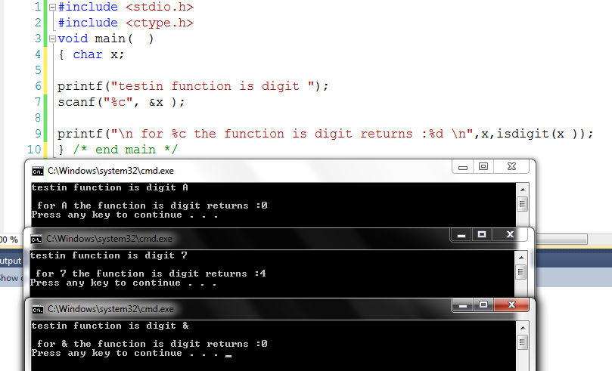
Using isdigi()

Slide 22
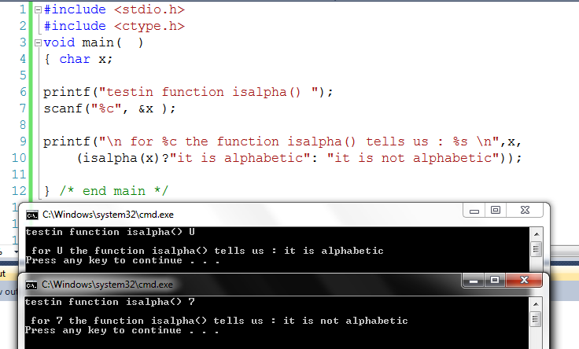
Using isalpha()

Slide 23
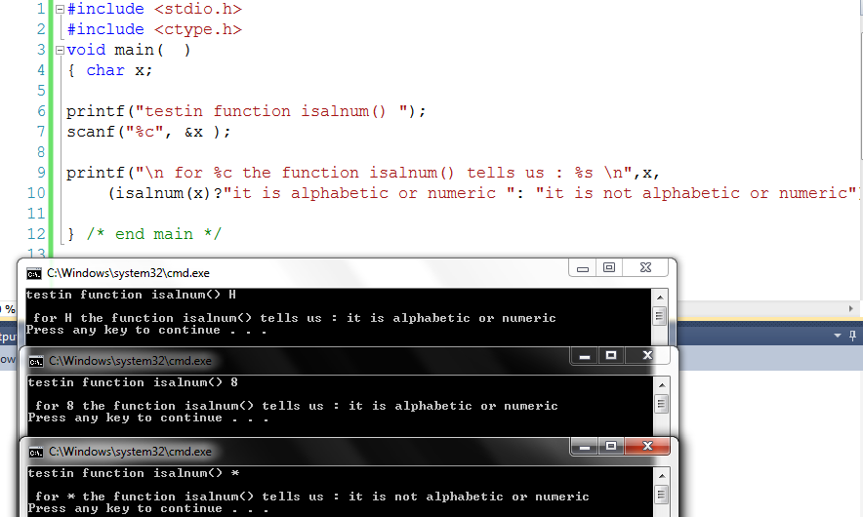
Using isalnum()

Slide 24
Outline
fig08_03.c
(1 of 2 )
islower tests if a character is a lowercase letter
isupper tests if a character is an uppercase letter

Slide 25
Outline
fig08_03.c
(2 of 2 )

Slide 26
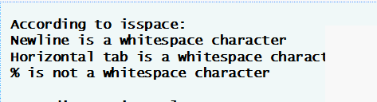

Outline
fig08_04.c
(1 of 3 )

Slide 27
String-Conversion Functions
Conversion functions
  In <stdlib.h> (general utilities library)
Convert strings of digits to integer and floating-point values

Slide 28
Fig. 8.5 | String-conversion functions of the general utilities library.

Slide 29
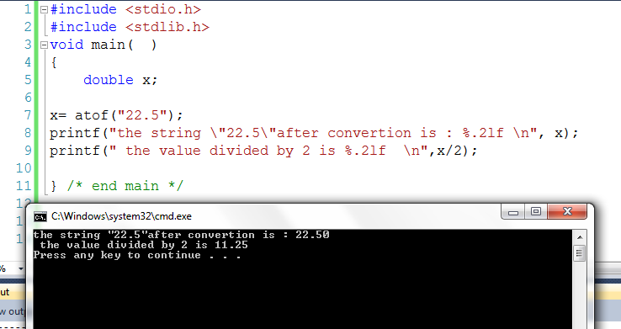
Using atof()

Slide 30
atoi converts a string to an int

Slide 31
atol converts a string to a long

Slide 32
strtod converts a piece of a string to a double

Slide 33
8.6 String Manipulation Functions of the String Handling Library
String handling library has functions to
  Manipulate string data
  Search strings
  Determine string length

Slide 34
Fig. 8.17 | String-manipulation functions of the string-handling library.

Slide 35
Outline
fig08_18.c
strcpy copies string x into character array y
strncpy copies 14 characters of string x into character array z
Note that strncpy does not automatically append a null character

Slide 36
Outline
fig08_19.c
(1 of 2 )
strcat adds the characters of string s2 to the end of string s1
strncat adds the first 6 characters of string s1 to the end of string s3

Slide 37
Outline
fig08_19.c
(2 of 2 )

Slide 38
8.7 Comparison Functions of the String-Handling Library
Comparing strings
  Computer compares numeric ASCII codes of characters in string
  Appendix D has a list of character codes

Slide 39
Fig. 8.20 | String-comparison functions of the string-handling library.

Slide 40
Outline
fig08_21.c
(1 of 2 )
strcmp compares string s1 to string s2

Slide 41
Outline
fig08_21.c
(2 of 2 )
strncmp compares the first 6 characters of string s1 to the first 6 characters of string s3

Slide 42
Fig. 8.22 | String-manipulation functions of the string-handling library.

Slide 43
Outline
fig08_23.c
(1 of 2 )
strchr searches for the first instance of character1 in string

Slide 44
Outline
fig08_23.c
(2 of 2 )

Slide 45
Fig. 8.36 | Other functions of the string-handling library.

Slide 46
Outline
fig08_38.c
strlen returns the length of string1

