Slide 1
King Saud University
College of Medicine
Keratoconus
Abdulrahman Al-Muammar, MD, FRCSC

Slide 2
Physiologic functions of the cornea
Cornea is a transparent avascular connective tissue
Act as the primary infectious and structural barrier of the eye
Together with the overlying tear film, it provides a proper anterior refractive surface for the eye

Slide 3
Anatomy
Anterior surface of the cornea is elliptical with horizontal diameter of 11.5 to 12 mm and vertical diameter of 10.5 to 11 mm
Posterior surface of the cornea is circular with an average diameter of 11.5 mm
It is about 520 µm thick at the center and gradually increases in thickness toward the periphery 670 µm
Shape of the cornea is prolate-flatter in the periphery and steeper centrally-which creates an aspheric optical system

Slide 4
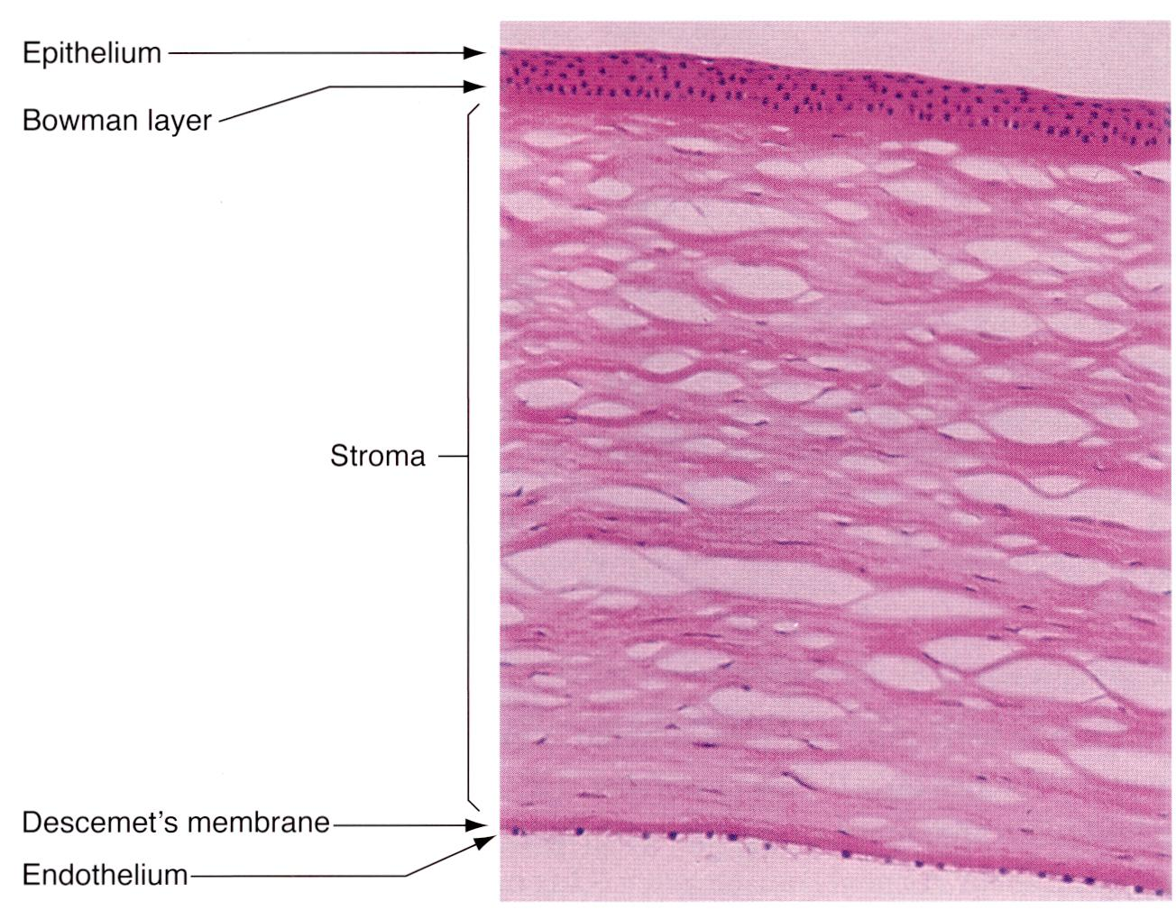
Anatomy
Human cornea consists of 5 recognized layers
Epithelium
Bowman’s membrane
Stroma
Descemet’s membrane
Endothelium

Slide 5
Transparency
To function as proper anterior refractive surface
Avascular
Corneal hydration
Peculiar arrangement of stromal fibers and extracellular matrix

Slide 6
A vascularity
Cornea required energy to maintain its transparency and structure
Most actively metabolizing layer are epithelium and endothelium
Source of nutrients required for the corneal metabolism are:
Oxygen
Epithelium derives oxygen from the atmosphere through tear film and through limbal capillaries
Endothelium derives oxygen from the aqueous humor
Glucose
Glucose is the prime energy source
80% from the aqueous
20% from limbal blood vessels
Little from the tear film
Amino acids
Main supply from aqueous humor by passive diffusion

Slide 7
Corneal hydration
Water content of normal cornea is 78 %
Water content kept constant by a balance of factors
Factors which draw water in the cornea
Swelling pressure of the stromal matrix
Intraocular pressure
Factors which prevent the flow of water in the cornea or draw water our of the cornea
Mechanical barrier action of epithelium and endothelium
Active pumping action of endothelium
Evaporation through corneal epithelium
Lamellar organization of the stromal fibers

Slide 8
Peculiar arrangement of stromal fibers
The stroma differs from other collagenous structures in its transparency
precise organization of the stromal fibers in regular lattice
Fibrils are small in relationship to the light and do not interfere with light transmission
Limited number of cells and crystallins component of cells allow light transfer and minimize light scatter

Slide 9
Refractive function
Convex shape
Collagen lamella insertion in the limbus
Intraocular pressure
Smooth anterior surface provided by tear film
Corneal hydration to maintain constant refractive index

Slide 10
Keratoconus
Common disorder (prevalence of about 50 per 100,000)
Positive family history have been reported in 6%-8%
PATHOLOGY
Histopathologically, keratoconus shows the following:
fragmentation of Bowman layer
thinning of the stroma and overlying epithelium
folds or breaks in Descemet's membrane
variable amounts of diffuse scarring

Slide 11
Keratoconus
Keratoconus is a degenerative noninflammatory disease of the cornea
The prevalence is 1 in 2000
With the current diagnostic technique the prevalence is probably higher
Usually the condition start at puberty and progress until the third to fourth decade of life
Penetrating/Lamellar keratoplasty may become necessary in 21% of keratoconus patients

Slide 12
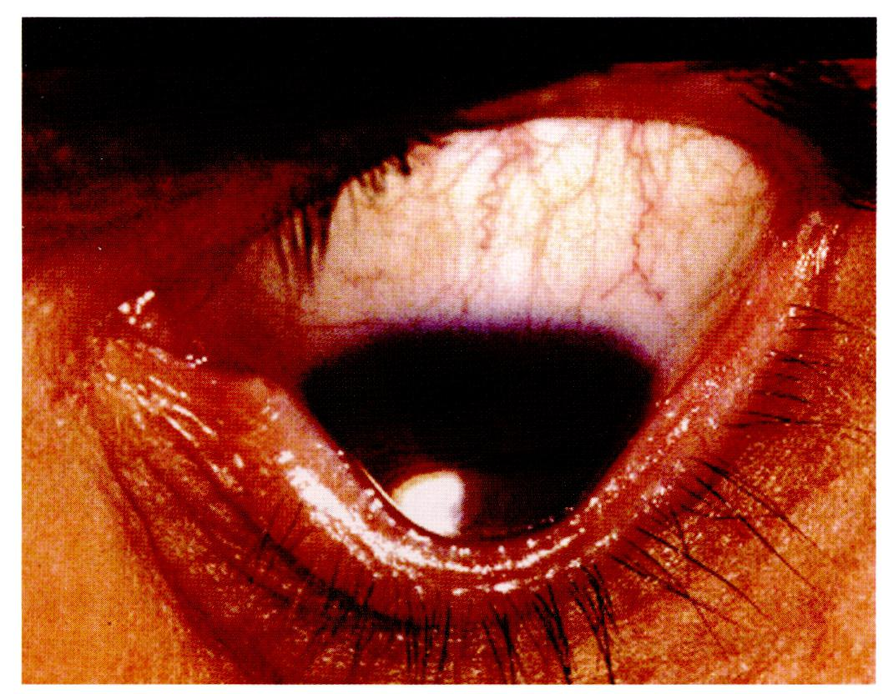
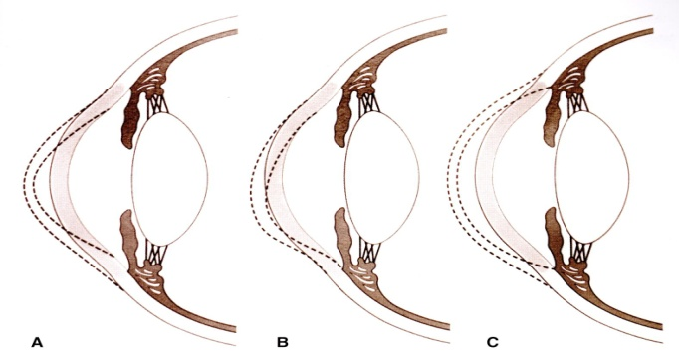
Keratoconus
The precise etiology of keratoconus unclear
Isolated sporadic disorder
May be associated with other rare genetic disorders
Eye rubbing, allergy, and other factors have been suggested
8% may have positive family history

Slide 13
The Amsler-Krumeich classification for the grading of keratoconus
Stage I Eccentric steeping. Myopis and/or induced astigmatism <5.00 D Mean central K readings <48.00 D. | Stage III Myopia and/or induced astig-matism from 8.00 to 10.00 D. Mean central K readings >53.00 D. Absence of scarring. Minimum corneal thickness 300 to 400 μm.
Stage II Myopia and/or induced astigmatism from 5.00 to 8.00 D Mean cental K readings <53.00 D Absence of scarring. Minimum corneal thickness >400 μm | Stage IV Refraction not measurable. Mean central K readings >55.00 D. Central corneal scarring. Minimum corneal thickness 200 μm.

Slide 14
Treatment options for keratoconus
Spectacles.
Contact lenses.
Phototherapeutic keratectomy.
Intrastromal corneal rings.
Corneal collagen cross-linking.
Phakic intraocular lenses.
Keratoplasty.

Slide 15
Spectacles
In very early cases, spectacles may provide adequate visual correction.
Stage I.
Toric contact lenses.

Slide 16
Contact lenses
The vast majority of patients wear rigid contact lenses for adequate vision correction.
Rigid gas permeable hard contact lens is the most commonly used for keratoconus.
Stage I, II, and III. (? Stage IV)
Contact lens become a problem
Dry eye
Allergy
Poor fitting

Slide 17
Phototherapeutic keratectomy
Can be used in case of advanced keratoconus to reduce contact lens intolerance. While it may be helpful in some cases, PTK may cause keratolysis, increased scarring and ectasia.
Stage III and IV.

Slide 18
Corneal collagen cross linking
Recently been proposed as a method for stopping the progression of keratoconus.
The 5 years results showed that it is safe and effective.
Stage I and II.
Can be done with intrastromal corneal rings.

Slide 19
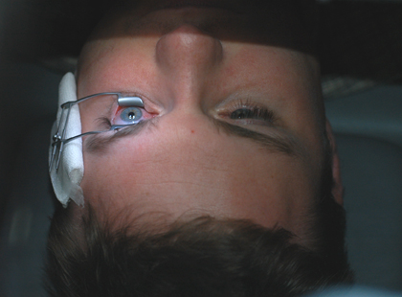
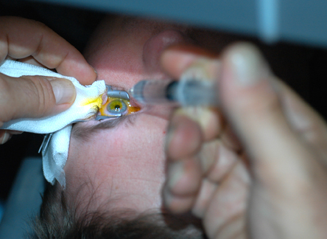
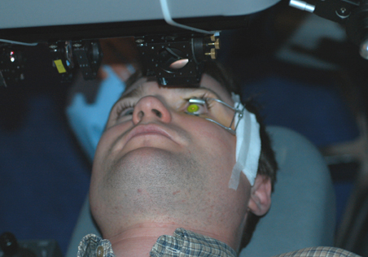
Treatment procedure

Slide 20
Clinical Studies
Post-operative regression in RE | Post-operative regression in K value | Post-operative increase in VA | Progres-sion of KC in control eyes | Progression of KC in treated eyes | Mean Follow up | # of Pts # of eyes | Study
Improved by 1.42 D P=.03 | In 70% by 2.01 D P=.001 | Improved By 1.26 lines in 65% | 22% | None 70% have reduction | 23.3 (range 3 to47 months) | 22 pts 23 eyes | Wollensak et al AJO 2003
Improved by 2.49 D | By 2.1 D | Improved by 3.6 lines P=.00001 | 37% 30% | None None | 3 months 12 months | 10 pts 10 eyes 44 eyes | Caporossi et al JCRS May 2006 ESCRS 2008
In 44% by 2.14 D | In 44% by 3.1 D | Slightly improved in 65% |  | None | 6 months | 22 pts 27 eyes | Braun ARVO 2005

Slide 21
Laser refractive surgery (surface ablation)
Under research, mainly for stage I
Mild keratoconus with no progression in patients who are over age 40.
In conjunction with CCX
No progression
Enough corneal thickness

Slide 22
Phakic intraocular lenses
Can be done for keratoconus patients with no signs of progression.
Patients who may have good result are those who can be corrected with spectacles.
Stage I. (? Stage II)
Iris/ angle supported and posterior chamber regular/toric phakic IOL can be used.

Slide 23
Intrastromal corneal rings
A method for flattening the cornea that is too steep and making a patient more contact lens tolerant.
Good for mild cases who want to improve their present vision with or without spectacles or contact lenses.
Stage I,II, and III. (?stage IV).
INTACS and Ferrara intrastromal corneal segments.

Slide 24
Outcomes of Intacts treatment for keratoconus
Mean Refractive Change | VA Change | Technique | Incision Site | FU | Intacs/ Ferrara | Eyes | Study
K-values improved from 52.53 D TO 48.05 D | 85.23% & 87.9% gained lines of UCVA and BCVA | Sym or asym (0.25 to 0.45 mm) | Steep meridian | 5 y | Intacs | 186 | Ibrahim
Mean MRSE improved from -6.93 D to -4.01 D | 80.5% and 68.3% gained lines of UCVA and BCVA, respectively | Sym (0.45/0.40 mm) | Temporal | 2 y | Intacs | 100 | Colin
MRSE improved by more than 2.00 D in 70.3% of eyes | 81.3% and 73.7% gained lines of UCVA and BCVA, respectively | Asym (0.25/0.45 mm) | Temporal | 1 y | Intacs | 118 | Ertan
MRSE decreased from -6.08 D to -4.55 D | 84.4% gained lines of UCVA and BCVA | Sym (0.20/0.30 mm) | Steep meridian | 13 mo | Ferrara | 51 | Kwitko
MRSE decreased from -6.91 D to -1.11 D | BCVA improved from 0.37 to 0.60 | Sym (0.15/0.35 mm) | Steep meridian | 6 mo | Ferrara | 26 | Siganos

Slide 25
Keratoplasty
Corneal transplant is the best and most successful surgical option for keratoconus patient who cannot tolerate contact lens.
It is the only option for patients who have scarring in the centre of the cornea.
BCVA < 20/40.
Mainly for stage IV (? Stage III).
The results of corneal transplants are excellent in keratoconus patients with an over 97% success rate.

Slide 26
Keratoplasty
PKP disadvantages:
Long term survival.
Invasive procedure.
Long visual rehabilitation.
Frequent follow up.
Topical steroid complications.
50% of patient may need HCL following PKP.

Slide 27
Keratoplasty
Intralase enables keratoplasty – is one of the advances in corneal surgery
Quicker procedure.
Quicker recovery.
Less astigmatism with better vision.

Slide 28
Lamellar corneal transplant
Gaining popularity among corneal surgeon.
Slightly safer than a full thickness transplant.
Risk of rejection is low which give advantage for long term success.
Disadvantages:
Quality of vision preferred to be low than those who have undergone full thickness transplant
Intralase enabled keratoplasty may lead to better quality of vision by making smooth interface.

Slide 29
-
KERATOCONUS
STAGE I
STAGE II
STAGE III
STAGE IV
NON-PROGRESSIVE
NON-PROGRESSIVE
Contact Lenses
Rings
Keratoplasty
Contact Lenses
Rings
Keratoplasty
Spectacle
Contact
Lenses
Rings
Phakic IOL
Contact
Lenses
Rings
Phakic IOL
PROGRESSIVE
PROGRESSIVE
Spectacle
Contact
Lenses
Rings
CCX
Contact
Lenses
Rings
CCX

Slide 30
Thank you

Slide 31
-

Slide 32
-

Slide 33
-

Slide 34
-

Slide 35
-

Slide 36
-

Slide 37
-

Slide 38
-

Slide 39
-

Slide 40
-

Slide 41
-

Slide 42
-

Slide 43
-

Slide 44
-

Slide 45
-

Slide 46
-

Slide 47
-

Slide 48
-

Slide 49
-

Slide 50
-

Slide 51
-

Slide 52
-

Slide 53
-

Slide 54
-

Slide 55
-

Slide 56
-

Slide 57
-

Slide 58
-

Slide 59
-

Slide 60
-

Slide 61
-

Slide 62
-

Slide 63
-

Slide 64
-

Slide 65
-

Slide 66
-

Slide 67
-

Slide 68
-

Slide 69
-

Slide 70
-

Slide 71
-

Slide 72
-

Slide 73
-

Slide 74
-

Slide 75
-

Slide 76
-

Slide 77
-

Slide 78
-

Slide 79
-

Slide 80
-

Slide 81
-

Slide 82
-

Slide 83
-

Slide 84
-

Slide 85
-

Slide 86
-

Slide 87
-

Slide 88
-

Slide 89
-

Slide 90
-

Slide 91
-

Slide 92
-

Slide 93
-

Slide 94
-

Slide 95
-

Slide 96
-

Slide 97
-

Slide 98
-

Slide 99
-

Slide 100
-

Slide 101
-

Slide 102
-

Slide 103
-

Slide 104
-

Slide 105
-

Slide 106
-

Slide 107
-

Slide 108
-

Slide 109
-

Slide 110
-

Slide 111
-

Slide 112
-

Slide 113
-

Slide 114
-

Slide 115
-

Slide 116
-

Slide 117
-

Slide 118
-

Slide 119
-

Slide 120
-

Slide 121
-

Slide 122
-

Slide 123
-

Slide 124
-

Slide 125
-

Slide 126
-

Slide 127
-

Slide 128
-

Slide 129
-

Slide 130
-

Slide 131
-

Slide 132
-

Slide 133
-

Slide 134
-

Slide 135
-

Slide 136
-

Slide 137
-

Slide 138
-

Slide 139
-

Slide 140
-

Slide 141
-

Slide 142
-

Slide 143
-

Slide 144
-

Slide 145
-

Slide 146
-

Slide 147
-

Slide 148
-

Slide 149
-

Slide 150
-

Slide 151
-

Slide 152
-

Slide 153
-

Slide 154
-

Slide 155
-

Slide 156
-

Slide 157
-

Slide 158
-

Slide 159
-

Slide 160
-

Slide 161
-

Slide 162
-

Slide 163
-

Slide 164
-

Slide 165
-

