Slide 1
BIOCHEMISTRY of BLOOD
471 BCH
[Practical]

Slide 2
Course Outline
 | Title of the Experiments
1 | Separation of plasma and serum from whole blood
2 | Separation of main proteins in plasma and serum
3 | Hemolysing agents and detection of blood
4 | Determination of plasma enzymes (Lactate dehydrogenase)
5 | Prothrombin time and coagulation time
6 | ABO blood grouping and Rh groups
7 | Hemoglobin, anemia, HCT and ESR
8 | Determination of iron serum
9 | Glucose-6-phosphate dehydrogenase deficiency, sickle cell test
10 | Estimation of serum bilirubin ( total and direct )
11 | Red and white blood cell count

Slide 3
Mark Distribution
 | Marks
Conducting the experiment | 1 Mark
Report | 6 Marks
Quiz | 8 Marks
Final | Practical | 10 Marks
 | Theoretical | 5 Marks
Total | 30 Marks
Final exam date:
/ / 1439 H – / / 2018

Slide 4
How to write a scientific report?
The laboratory reports should contain the following sections:
Title
Objectives
Brief Introduction [ Theoretical background information ]
Materials and Methods
Results [ Tables and Calculations ]
Discussion
In this section you are required to describe of what happened in the experiment [Principle] , explain your results and make conclusions by comparing your results to expected values
Even if you obtained unexpected results, the discussion section is the section to justify or explain the reasons why you have obtained such results.
Questions

Slide 5
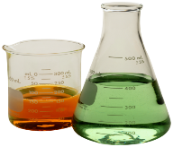
Safety in the Lab
You must wear a lab coat and hand gloves.
Open toed shoes must not be worn because they cannot protect you against chemical spills.
Long hair should be tied back to avoid any interference with the experiment.
In case of acid or base contact with your skin, wash it with large amount of clean, cold water and inform the instructor immediately.
Do not handle broken glassware with your bare hands.
Do not eat, drink, or chewing gum the laboratory.
Do not depart from the lab leaving an experiment unattended. If you need to leave the lab you must inform your instructor before leaving the lab.
You must wash your hands with soap after finishing the experiment.

Slide 6
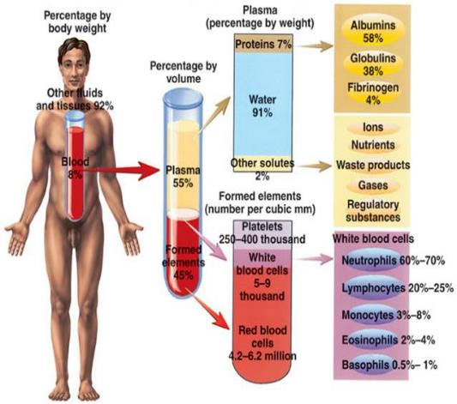
Blood composition
Other names to blood cells
Red blood cells (erythrocytes)
White blood cells (leukocytes)
Platelets (thrombocytes)
Site of production
bone marrow

Slide 7
Plasma & Serum
Plasma is the liquid portion of blood, it constitutes about 55 % of blood volume.
90% of plasma is water
It contains:
Albumin (most abundant protein, act as a transporter and regulator )
Globulins (act as transporters and some as antibodies)
Fibrinogen (responsible, in part, for the clotting of blood)
Serum resembles plasma in composition but lacks the coagulation factors.
(Serum = Plasma – clotting factors)

Slide 8
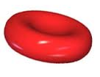
red blood cells (RBC)
Red blood cells contain hemoglobin, a complex iron-containing protein that carries oxygen throughout the body and gives blood its red color.
They live for approximately 120 days in the circulatory system and are eventually removed by the spleen.

Slide 9
White blood cells (WBC)
They are responsible for protecting the body from invasion by foreign substances such as bacteria, fungi, and viruses.
Types of WBCs:
Granulocytes
Neutrophils
Eosinophils
Basophils
Agranulocytes
Monocytes
Lymphocytes

Slide 10
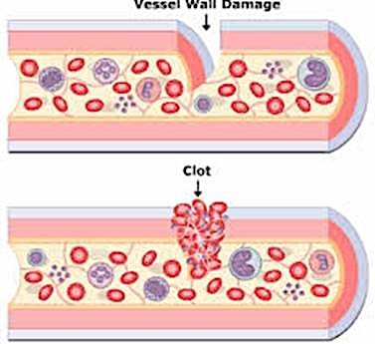
platelets
They are very small cellular components of blood that help the clotting process by sticking to the lining of blood vessels.
They survive in the circulatory system for an average of 9-10 days before being removed from the body by the spleen.

Slide 11
Blood functions
Transportation
Gases
Nutrients
Regulation
pH
Osmotic pressure (water content of cells)
Protection
Protect against infections
Clot formation
Waste products
Hormones
Metabolites
Temperature

