Slide 1
COOP ORINTATION
Marketing Department

Slide 2
Introduction
What is the COOP program?
Why is it important?
6 hours credit
320 hours OR 500 hours

Slide 3
ATTENDENCE
If you can’t attend:
Both your Academic & Work supervisor should be informed in advance

Slide 4
Monthly Report
Two Monthly reports
Report Number | Date | Time
1 | Saturday 29-Oct-2016 | 5:00 pm
2 | Saturday 3-Dec-2016 | 5:00 pm
Final | Saturday 7 –January -2017 | 5:00 pm

Slide 5
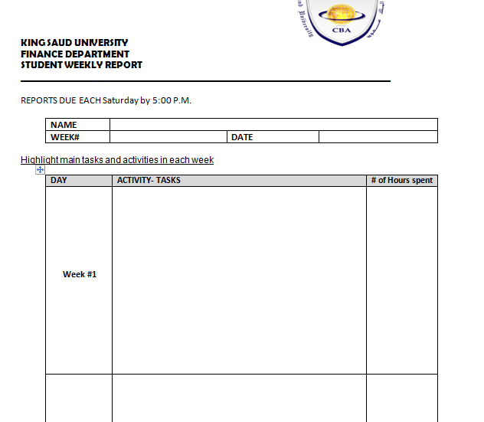
Monthly Report

Slide 6
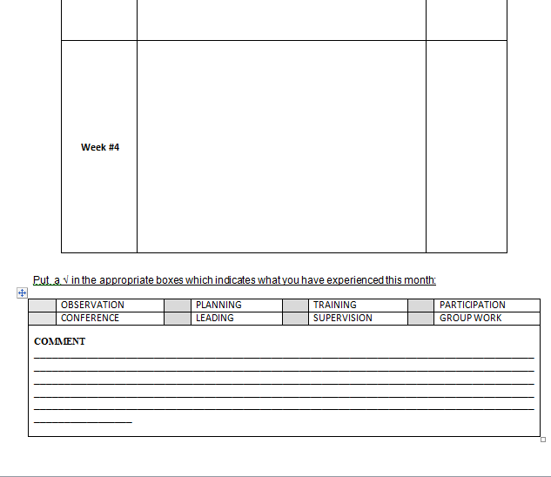
Monthly Report

Slide 7
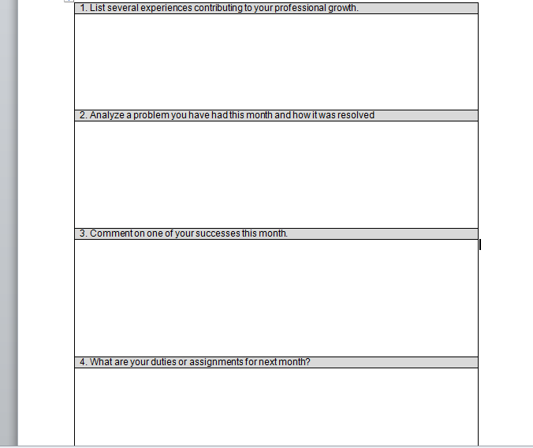
Monthly Report

Slide 8
Final Report
Due on Saturday 7- May-2016
20 pages
Font: “Times New Roman”
Font size: “12”
Space: “1.5”
Margins : “Narrow”

Slide 9
Final report criteria

Slide 10
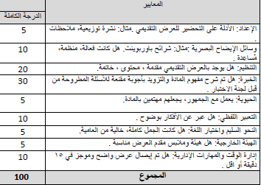
Presentation
During the week from 8 – 12 May 2016

Slide 11
Supervisor's evaluation sheet

Slide 12
Assessment
 | 100%
Evaluation by work supervisor | 30%
Evaluation by academic supervisor | 30%
Final Presentation to committee (Saturday 7 –January -2017) | 40%

Slide 13
THANK YOU

