Slide 1
Concentration methods of fecal parasites
Amal Almuhana
2012

Slide 2
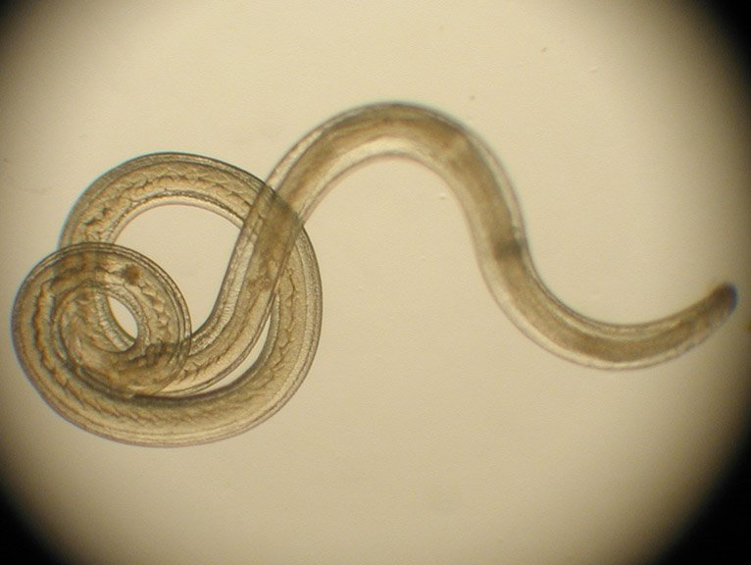
Concentration techniques
A concentration technique is performed mainly to separate the parasites from fecal debris.
The concentration procedure not only increases the number of parasites in the sediment but it also unmasks them, making them more visible by removing organic and inorganic debris.

Slide 3
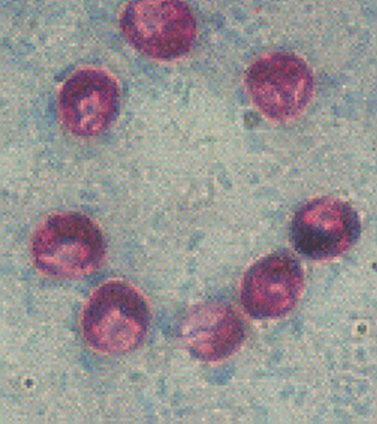
Advantages &Disadvantages
1- Advantages
Maximizes the numbers of organisms detected which may be too scanty to be seen by direct microscopy alone .
separate the parasites from fecal debris.
2- Disadvantages
Destroys trophozoite stages and distorts cellular exudate .

Slide 4
Types of Concentration techniques
There are two types of fecal Concentration techniques:-
Sedimentation techniques.
Flotation techniques.

Slide 5
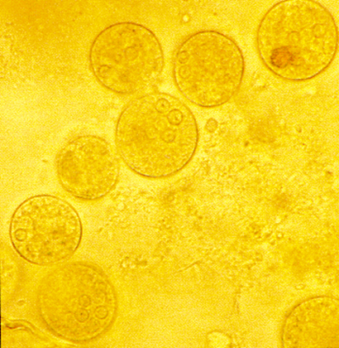
1- Sedimentation techniques
Fecal sedimentation is used to detect large or heavy ova such as many spirurid ova, many fluke eggs, and many tapeworm eggs that will not float in fecal flotation techniques.
The sediment contains a lot of debris so examining these slides is quite tedious.
Note:- you can use formalin as a preservative and ether or ethyl acetate as an extractor of fat and debris from faeces after filtration to leave the parasites in a sediment at the bottom of the tube after centrifugation.

Slide 6
Advantages &Disadvantages
1- Advantages
Recovers most ova, cysts and larvae .
Morphology of most parasites is retained.
Less risk of infection from bacteria and viruses.
2- Disadvantages
Preparation contains debris.
Some parasites do not concentrate well.
Ether is flammable and formalin is an irritant .
Liquid faeces do not concentrate well .

Slide 7
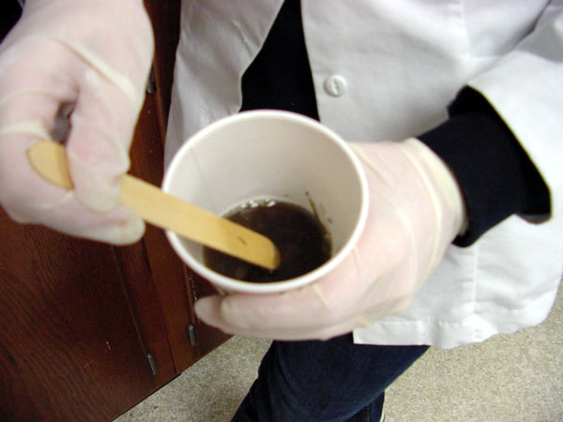
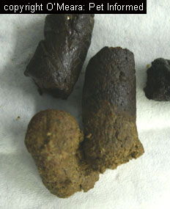
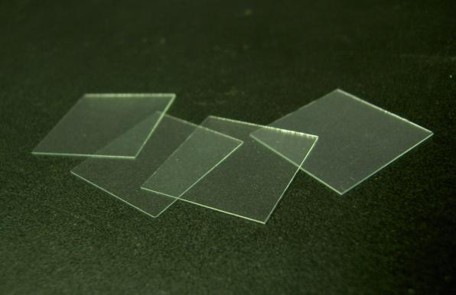
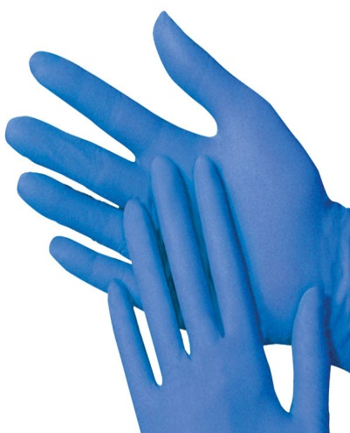
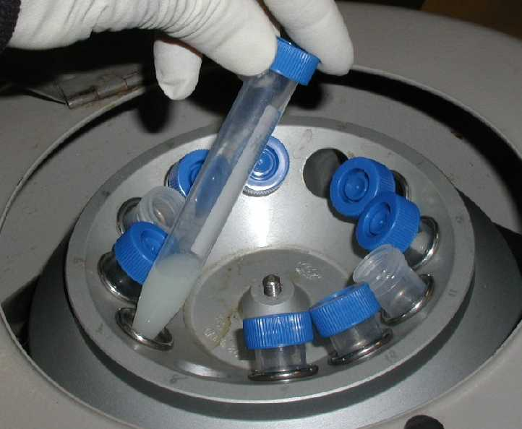
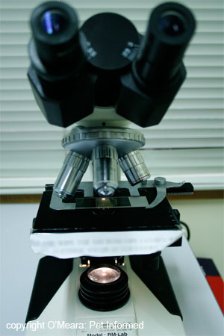
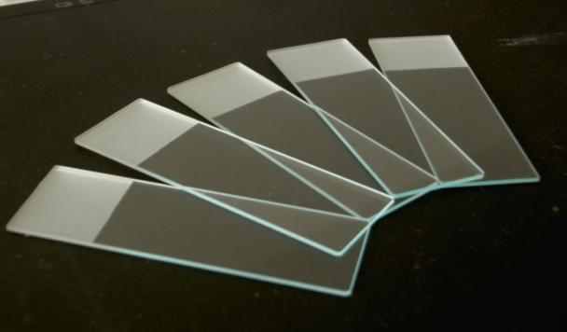
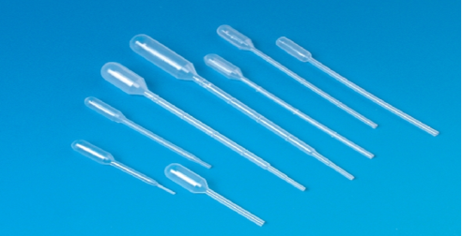
Materials
Stool samples
Glass slides
Coverslips
Pipettes
Stick
Gloves
Microscope
Plastic container (with small amount of water).
Centrifuge.
Centrifuge tube

Slide 8
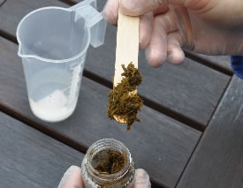
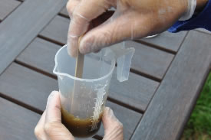
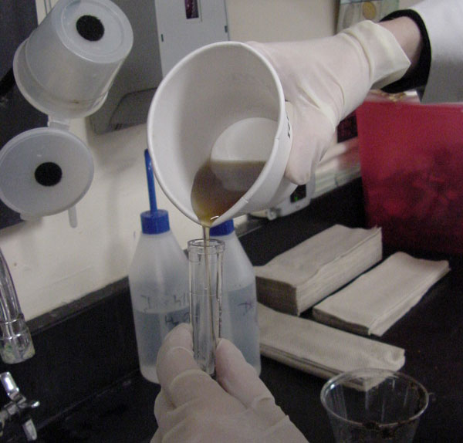
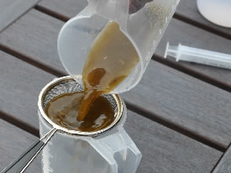
Procedure
1- Obtain about a one to two gram fecal sample
2-Mix it with water by stick.
4-Pour the strained preparation into a centrifuge tube.
3- Strain the mixture

Slide 9
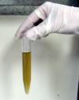
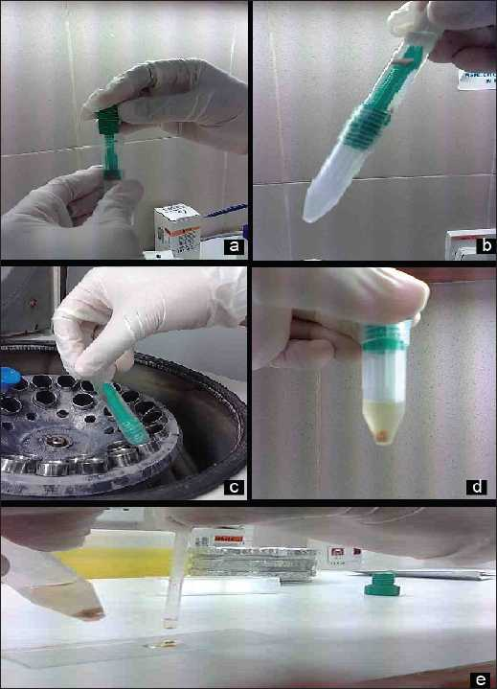
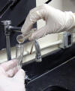
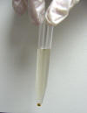
Procedure
5- Here is the appearance of the suspension before centrifugation.
6- Centrifuge at 1500 rpm for 5 minutes.
7-The appearance of the suspension after centrifugation.
8- Decant the supernatant

Slide 10
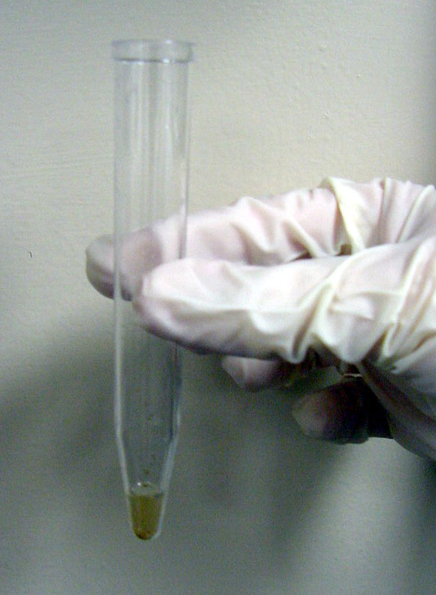
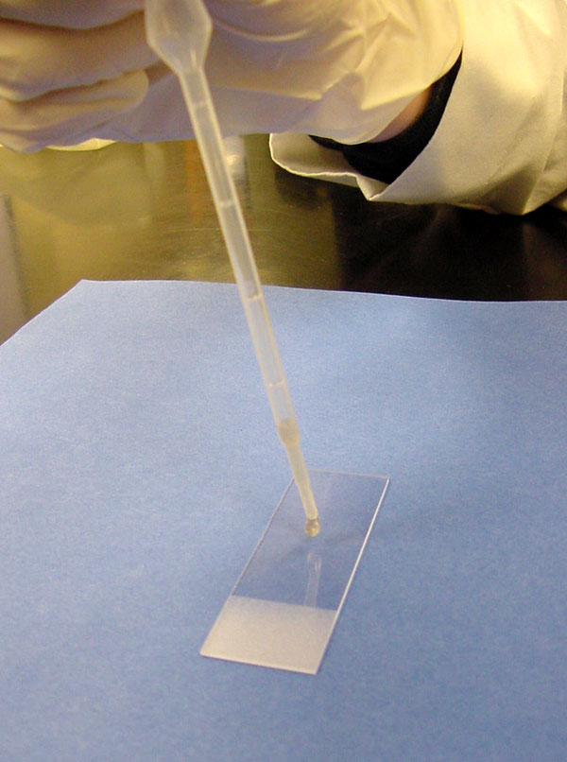
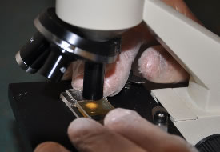
Procedure (cont.)
9- A few drops of the suspension will remain in the tube over the sediment pellet
10- Using a pipette remove some of the sediment from the top layer and place a drop on a slide for examination.
12- Examine under microscope.
11-Place a cover slip over the drop of sediment suspension

Slide 11
Procedure (cont.)
Note :-There are many variations on fecal sedimentation technique, many of which include a step using organic solvents (instead of water) to remove some of the material from the sediment.
Note:- at step (11) :-
A drop of stain of your choice could be mixed in before placing the cover slip.
New Methylene blue or iodine solution enhances visualization of the parasite ova and oocytes.
If there is a lot of debris, water may be added first.

Slide 12
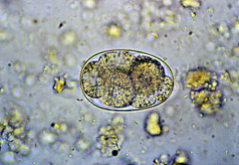
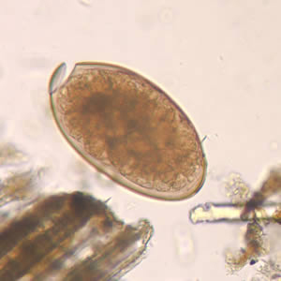
Examples of parasitic stages that might be seen under the microscope
Entamoeba cysts.
Faciola egg

Slide 13
2- Flotation techniques
A fecal flotation test uses the high specific gravity of a solution to float the lighter ova and cysts
It is a diagnostic test commonly performed in-house in most veterinary clinics as a way of diagnosing parasitism in animals.

Slide 14
Advantages &Disadvantages
1- Advantages:-
The concentrate is clear of debris
2- Disadvantages:-
Delay in examination can result in distortion
Larvae and some fluke eggs do not concentrate
Frequent checking of specific gravity

Slide 15
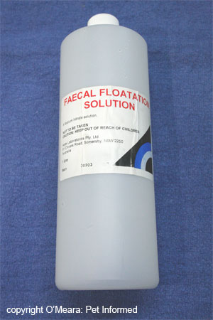
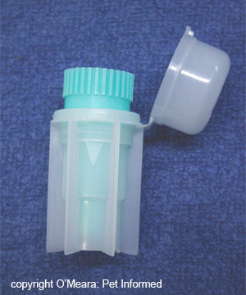
Materials
Stool samples
Glass slide
Coverslips
fecal flotation test kit
Fecal floating solution.
Microscope
Gloves

Slide 16
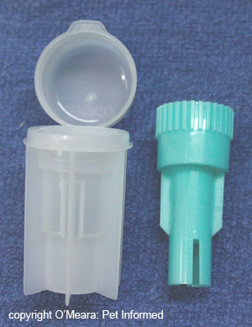
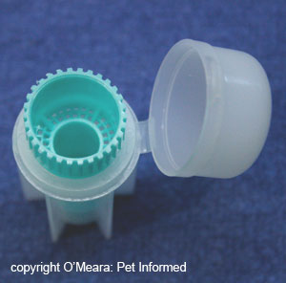
Materials (cont. )
The FECALYZER (fecal flotation test kit).
The in-house fecal flotation 'Fecalyzer' (also spelled Fecalyser) apparatus.
used by many veterinarians, consists of an outer casing (the white plastic capsule or outer casing) containing a green fecal filtration 'basket'.

Slide 17
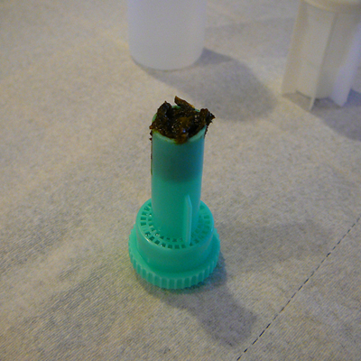
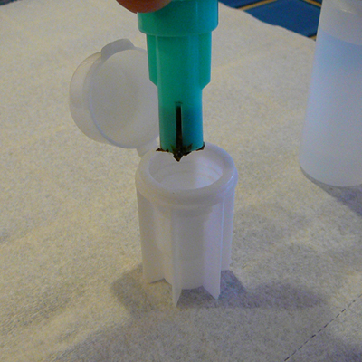
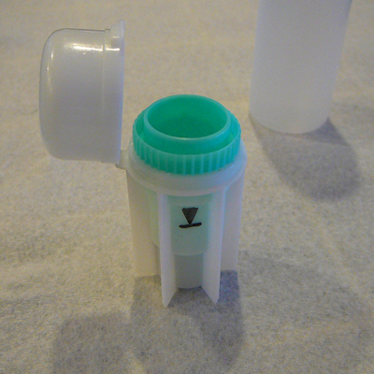
How to use the FECALYZER? (procedure )
1- Remove the inner piece of the fecal float test kit and press it into the fecal sample until the end is full.
2- Place insert back inside the test container.
3- Locate the fill line on the side

Slide 18
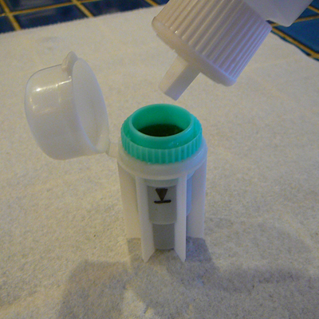
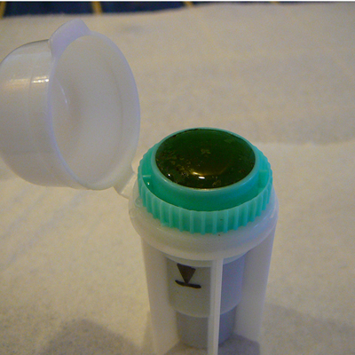
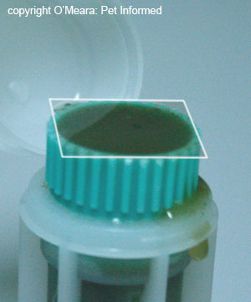
Procedure cont.
4- Fill insert with fecal solution until it gets to the top.
5- Carefully add just enough solution to form a meniscus on top without allowing it to over flow.
6-Gently place the slide cover slip on top of the insert and let it sit for approximately 12 to 15 minutes.

Slide 19
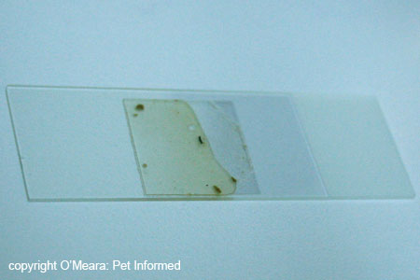
Procedure cont.
7-The glass coverslip (containing fecal float solution and, parasite (eggs/oocystes) is placed on top of the glass microscope slide.
8- Examine slide under microscope

Slide 20
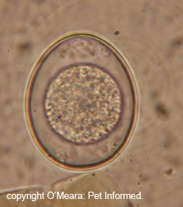
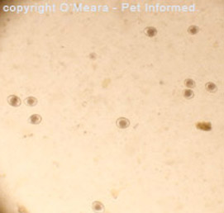
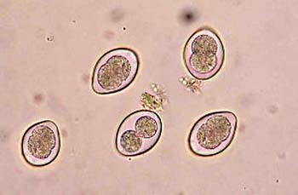
Examples of parasitic stages that might be seen under the microscope
Isospora oocyst (extreme close-up - 1000x) .
Bacterial rods seen at 400x.
Isospora canis (coccidia) oocysts seen at low power
Coccidia are single-celled organisms

Slide 21
The important points to be considered when performing a concentration technique are:
In a specimen the whole of the sample (equivalent to 1 gram of faeces) should be concentrated and the whole of the deposit examined.
It is important to vortex the sample for at least 15 seconds after the addition of ether or ethyl acetate thus obscuring ova and cysts.
Adequate centrifugal force must be used because if this is below the required value, there may be insufficient gravitational force to sediment the ova and cysts.
The centrifugal time is also critical, since the ova and cysts may remain in suspension if the sample is not centrifuged for the minimum required time.

