Slide 1
Specimen Collection
Mrs. BasmahAlmaarik

Slide 2
Specimen Collection
Collection & transportation of GOOD quality specimen for microbiological examination is crucial.

Slide 3
Some tips
Laboratory investigation should start as early as possible.
Specimens obtained early, preferably prior to antimicrobial treatment likely to yield the infective pathogen.
Before doing anything, explain the procedure to patient and relatives.
When collecting the specimen, avoid contamination.
Take a sufficient quantity of material.
Follow the appropriate precautions for safety.

Slide 4
When to Collect the Earliest Specimen
Start collection of specimens for all cultures before starting an antibiotic.
The advice is ideal but may not be possible, as many prescribe antibiotics before considering the microbiological diagnostic options.

Slide 5
Important questions before collecting a specimen.
Are you suspecting an infection?
If so what is the nature of infection, eg. bacterial, viral mycological or parasitological.
Which tests are your priority?
When to collect the specimen?
How to collect the specimen?
Am I choosing the correct container?
Should I send the specimen promptly?! If I can’t do that , what shall I do??!

Slide 6
Request Form
Very important to have all the information on the request form.
Each hospital has it’s own request form
It should contain the following:
Name Age Sex
MRN (hospital number)
Date Time
Ward
Nature of specimen
Investigation needed
Current antimicrobial therapy.
Doctor/Staff signature and contact no.

Slide 7
Containers
Must be leak proof.
Must be sterile.
Microbiology specimens should never be sent in formalin.

Slide 8
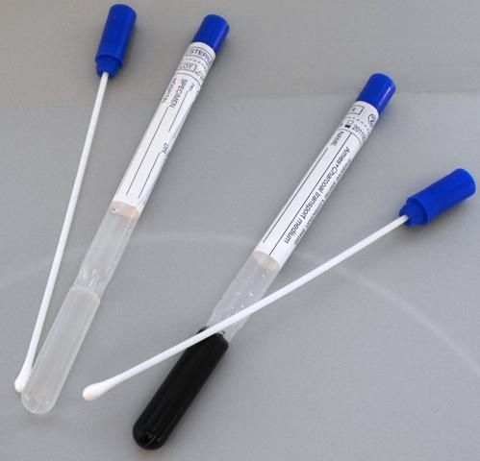
Swabs

Slide 9
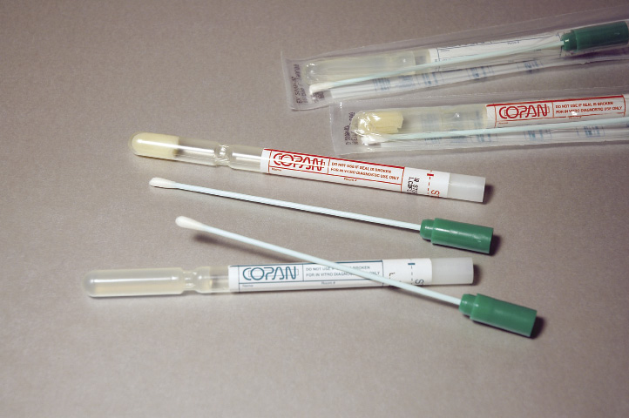
Swabs

Slide 11
Criteria for rejecting samples.
Mismatch of information on the label and the request.
Inappropriate transport temperature.
Excessive delay in transportation.
Inappropriate transport medium.
Specimen received in a fixative.
Dry specimen
Sample with questionable relevance.
Insufficient quantity
Leakage.
Duplicate specimens on the same day.
Specimen sent for anaerobic culture from a site known to have anaerobes as NF (mouth, stool)

Slide 12
Sometimes we have to do the best possible job on a less than optimal specimen
Like when we deal with irreplaceable specimens such as CSF, surgical specimens, etc.
Always indicate in the final report a note regarding the improper collection of the sample.

Slide 13
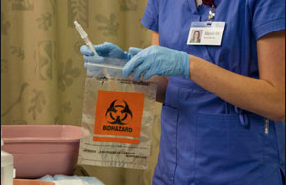
Always use biohazard label

Slide 14
General Consideration in Specimen Transport and Storage.
Sputum, lower respiratory specimens, stool and urine are kept in the Fridge 4° C tell the time of processing.
All specimen for Viral culture are kept in the fridge at 4° C .
Upper respiratory swabs are all kept at R.T.
Never refrigerate CSF specimen.
Any specimen for anaerboic culture should be kept at R.T.
Gastric aspirate must be neutralized with sodium bicarbonate within 1 hr of collection.

Slide 15
Wound Culture
Superficial wound → wipe area with sterile saline or 70% alcohol, swab along leading edge of wound. (collect as much exudate as possible from the advancing margin of the lesion).
Avoid swabbing surrounding skin.

Slide 16
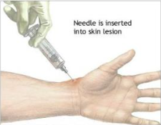
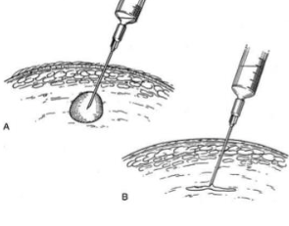
Wound Culture
Deep wound → wipe area with sterile saline or 70% alcohol and aspirate material from wall or excise tissue → Should cover anaerobs

Slide 17
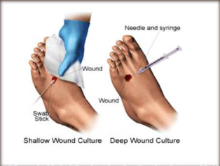
All wound specimens are kept at R.T.

Slide 18
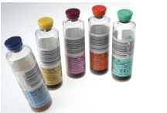
Blood Culture

Slide 19
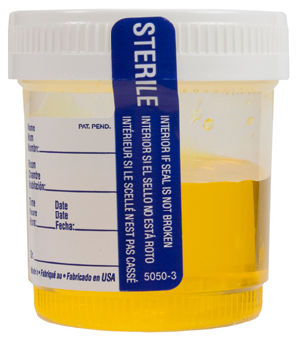
Urine Culture
Normally a sterile body fluid.
A clean-catch midstream urine collection provides the best method.
Collected in a sterile countainer with screw cap.
Always give a written instruction for the patient to avoid contamination during collection.

Slide 20
Urine Culture
Send to the lab maxiumum within 2 hours, and stored in fridge.
Other types of urine specimens may be collected, such as a straight in-and-out catheter specimen or suprapubic bladder drainage.
Patients who are catheterized should have the specimen withdrawn using a sterile syringe from the catheter sampling port .

Slide 21
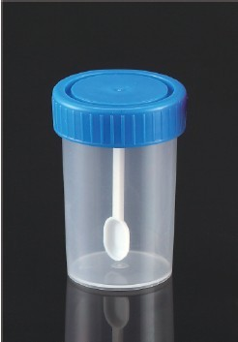
Stool Culture
Clean leak proof contianer is used.
Patient should defecate into a sterilized container or bedpan. Stool specimens should not contain urine or water from the toilet bowl.
Stool specimens can also be obtained directly from the rectum using a sterile swab.
Specimen are stored in Fridge.

Slide 22
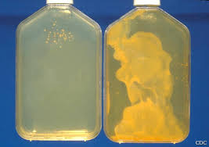
Sputum Culture
Specimen needs to be from the lower respiratory tract, not oropharyngeal secretions.
The laboratory will perform a Gram stain on all sputum specimens to determine if they are representative of pulmonary secretions.
Sputum specimens are stored in firdge.

Slide 23
Sputum Culture
Specimen are collected in a sterile screw cap container.
Its always better to have patient brush teeth and then rinse or gargle with wter before collection.
The most common method of collection is expectoration from a cooperative patient with a productive cough
Early morning is the optimal time to collect sputum specimens.
A sputum specimen can be collected in a sputum trap from patients who have artificial airways and require suctioning.

Slide 24
Other Lower Respiratory Specimens
BAL or BW can also be collected in sterile container, and should be stored in fridge.

Slide 25
Upper Respiratory Specimens
Those are usually collected in a swab.
They include: nasopharynx, pahrynx (throat), ear, and eye.
They should be stored at R.T.

Slide 26
Throat Swab
Carefully yet firmly rub swab over areas of exudate or over the tonsils and posterior pharynx, avoiding the cheeks, teeth, and gums

Slide 27
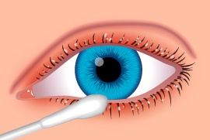
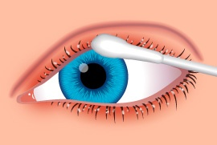
Eye swabs
Culture the lower and upper lids by passing the swab over the lid margins several times.
Routinely culture both eyes by this procedure even though involvement is only in one eye.
Be sure to use a separate swab for each eye. And to label them “L” & “R”

Slide 28
Thank You

