Slide 1
Course Overview and Introduction Clinical Bacteriology II CLS 413
Mrs. Deemah Dabbagh
CLS Department
College of Applied Medical Sciences
King Saud University

Slide 2
Course Content
Enterobacteriacae
Lactose Fermenters:
Escherichia coli
Klebsiella Pneumoniae
Lactose Non Fermenters
Salmonella
Shigella
Proteus
Other gram –ve bacteria
Pseudomonas, Hemophilus, Vibrio, Campylobacter
Spirochetes
Anaerobes
Clostridia and Bacteroides
Notes:
The genus Pseudomonas belongs to the family Pseudomonadacea
The Genus hemophilus belongs to family Pasteurellaceae

Slide 3
Introduction
Enterobacteriaciae are a large family of Gram-negative rod-shaped bacteria that includes, along with many harmless normal flora, many of the medically significant pathogens
General Characteristics of Enterobacteriacea:
Rod shaped
Gram negative
Catalase positive
Oxidase negative
Facultative anaerobes
Most ferment glucose, some are LF
Most reduce nitrate to nitrite

Slide 4
Oxidase test:
identifies organisms that produce the enzyme cytochrome oxidase, which participates in the electron transport chain by transferring electrons from a donor molecule to oxygen. The reagent contains a chromogenic reducing agent (a compound that changes color when it becomes oxidized). If the test organism produces cytochrome oxidase, the oxidase reagent will turn blue or purple within 15 seconds.
Catalase test:
Catalase is the enzyme that breaks hydrogen peroxide (H2O2) into H2O and O2. If the test organism produces catalase, it will lead to the formation of bubbles when added to a drop of H2O2 on a glass slide. (bubbles form due to the release of O2)

Slide 5
Gram Stain
Differential stain used to differentiate between gram negative and gram positive bacteria
The difference in staining results from differences in the cell walls of gram – and gram + bacteria
Four Step Process
Crystal violet, the primary stain
Iodine, the mordant
A decolorizer made of acetone and alcohol
Safranin, the counterstain

Slide 6
Gram Stain Cont.
Gram positive cells:
take up crystal violet, which is then fixed in the cell with the iodine mordant.
a crystal-violet iodine complex is formed which remains in the cell even after decolorizing.
This happens because the cell walls of gram positive organisms include a thick layer of peptidoglycans (protein-sugar complexes). This layer makes up 60-90% of the gram + cell wall.
Decolorizing the cell causes this thick cell wall to shrink, which closes the pores in the wall and prevents the stain from exiting the cell.
At the end of the gram staining procedure, gram positive cells will be stained a purplish-blue color.

Slide 7
Gram Stain Cont.
Gram negative cells:
Also take up crystal violet, and the iodine forms a crystal violet-iodine complex.
However, the cell walls of gram negative organisms do not retain this complex when decolorized because peptidoglycans are present in small amounts (only 10-20% of the cell wall).
Gram negative cells have an outer layer which gram positive organisms do not have; this layer contains high content of lipids.
Exposing gram negative cells to the decolorizer dissolves the lipids in the cell walls, allowing the crystal violet to leach out of the cells.
This allows the cells to subsequently be stained with safranin.
At the end of the gram staining procedure, gram negative cells will be stained a reddish-pink color

Slide 8
How To Report a Gram Stain
When reporting a gram stain, you need to describe 2 things:
Whether the cells are gram positive or negative
The shape and arrangement of the cells
Shapes can be (bacilli, cocci, coccobacilli, spirohetes …etc)
Arrangements can be (in chains, in clusters, in pairs (diplococci)..etc)
NEVER mention the name of an organisms when you are asked to comment on a gram stain under the microscope. The gram stain by itself is insufficient to identify an organism. Identification can only be made after doing cultures and biochemical tests

Slide 9
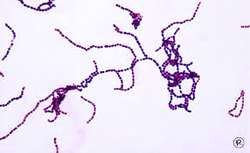
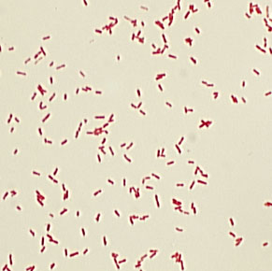
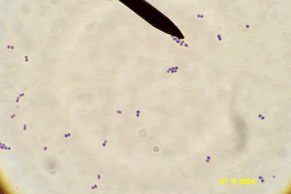
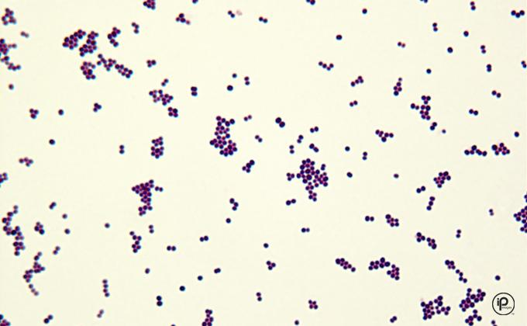

Slide 10
To do:
Prepare a bacterial smear from the culture plate given to you
Stain the smear using the gram stain
Examine slide under microscope

Slide 11
Reports Should Include
Your name
Practical Title
Principle of the test performed
Organism used for experiment
Materials and reagents used (include not just gram stain materials, but also the materials you used to make the bacterial smear)
Procedures (must include procedure of both bacterial smear preparation and gram stain)
Result

