Slide 1
Lab# 8
BCH 220
Coagulation Profile

Slide 2
Objectives:
1- To estimate Clotting time, Bleeding time, and Prothrombin time
.

Slide 3
Coagulation:
Coagulation is a complex process by which blood forms clots.
It is an important part of hemostasis (the cessation of blood loss from a damaged vessel).
Disorders of coagulation can lead to an increased risk of bleeding (hemorrhage) or clotting (thrombosis).

Slide 4
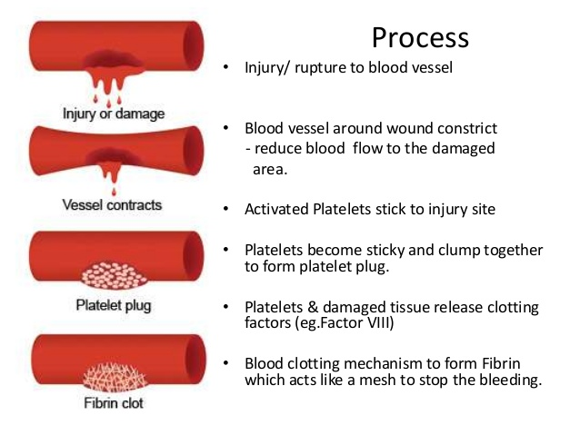
Hemostasis is maintained in the body via three mechanisms:
1- Vascular spasm, Damaged blood vessels constrict.
2- Platelet plug formation, Platelets adhere to damaged endothelium to form platelet plug (primary hemostasis)
3- Blood Coagulation, Clots form upon the conversion of fibrinogen to Fibrin (secondary hemostasis).

Slide 5
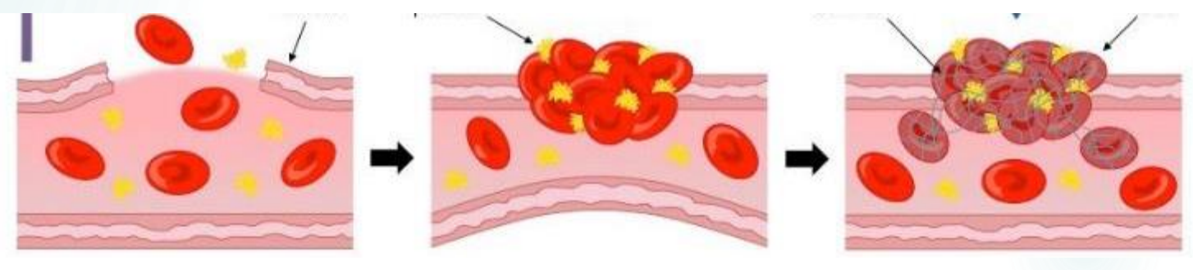

Slide 6
Clotting Cascade
A cascade is a mechanism in which enzymes activate other enzymes sequentially usually leading to an amplification of an initial signal.
Pathways
  Extrinsic
  Intrinsic
Each of these pathways leads to the conversion of factor X (inactive) to factor Xa (active)
Initially independent, then they converge on common pathway leading to the formation of a fibrin clot

Slide 7
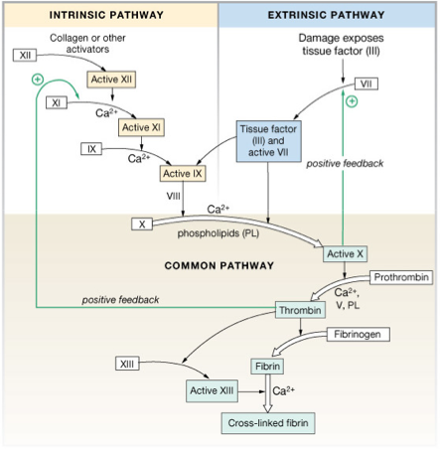

Slide 8
What triggers extrinsic and intrinsic pathways:
Extrinsic—Release of biochemicals from broken blood vessels/damaged tissue.
Intrinsic—No tissue damage, blood contacts damaged endothelial layer of blood vessel walls.

Slide 9
Clotting time
Simple test but takes time and rarely done now.
Method:
  Venous blood is taken and placed on glass test tube at 37°C and it observed at time intervals until clotting occurs
Normal blood takes 5-10min to clot
Longer periods → Coagulation defects (e.g. Hemophilia)

Slide 10

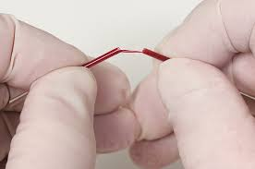
Clotting time - capillary method

Slide 11
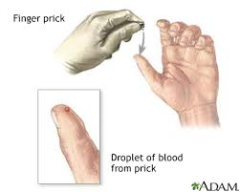
BLEEDING TIME
Provides assessment of platelet count and function
Method:
It is determined by noting time at which blood coming out a small cut, no longer forms a spot on a piece of filter paper placed in contact with cut surface.
The normal range from 2-4 min

Slide 12
PROTHROMBIN TIME (PT)
Method:
  An excess of tissue factor and Ca2+ ions are added to diluted plasma containing citrate (anticoagulant) and then the time taken for the mixture to clot is measured
Normal value →10-15 secs
High PT → low levels of thrombin.
Results from liver disease due to deficiency of prothrombin, fibrinogen, V, VII and X factors

