Slide 1
Claims Reserving
KSU | Mathematics Department
November 27th, 2019 | 12-2
Rahaf Alhodaif

Slide 2
Important definitions
3
IBNR
Incurred but not reported claims is the amount owed by an insurer to all valid claimants who have had a covered loss but have not yet reported it.
3
Outstanding Claims
Are claims which have arisen or will arise from events which have occurred on or before the valuation date. and it includes
claims which have been reported and have not yet been finalized or settled
claims which have been incurred but not yet reported (IBNR)
claims which have been administratively finalized and which may be reopened.
2
Loss Ratio
Loss ratio is used in the insurance industry, representing the ratio of losses to premiums earned.
Paid Claims
1
The amount that is paid to the providers is known as a paid claim.
Earned Premium
Is what the insured party has paid for a portion of time in which the insurance policy was in effect, but has since expired.

Slide 3
Claims Reserving
A claims reserve is the money set aside by insurance companies to pay policyholder’s claims in the future. SAMA force the insurance companies to calculate the Claims Reserving every valuation date usually each quarter. So, it’s estimation of how much they thinks they will likely have to pay out.
Claims such as, incurred claims that have not yet been settled , Expected future claims.

Slide 4
Suppose we are in January and the appointed actuary calculate the IBNR for the next quarter April for (1M). So he report this value to the financial department . And they will work to reach and exactly match this IBNR.
In April,
If IBNR above 1M : Actuarial deficit [Below estimation]
If IBNR = 1M
If IBNR below 1M : financial department collect the IBNR from different ways they may sell important investment [Above estimation]

Slide 5
Claim Life-Cycle
Policy Commence
Policy Expires
Post Expiry Period
Paid Claims
Claims Incurred
Claims Reported
Claims Paid
Claims Incurred
Claims Reported
Claims Paid
Claims Incurred
Claims Reported
Claims Paid
CLAIM RESERVES
Claims Incurred
Claims Reported
Claims Paid
Valuation Date

Slide 6
Reserving Methodologies
Chain
Ladder
(CL)
Cape Cod
(CC)
BornhuetterFerguson
(BF)
Expected
Loss
(EL)
Those are the most popular methods of claims reserving, but this knowledge is still new and since it’s methodologies based on predictive they will keep improving it by time and experience.
Who knows maybe one day u create your methodology

Slide 7
Before introducing the methodologies, we have to provide two main concepts:
Loss Tringle
Is the primary method in which actuaries organize claim data that will be used in an actuarial analysis. The reason it is called a loss triangle is that a typical submission of claim data from a client company shows numeric values forming a triangle when viewed.
Lag
A method under which historical claim data, such as the number and number of claims for the subject block of business, are grouped into the time periods in which claims were incurred and the time periods in which they were processed. The processing date is typically the date the claim is received, adjudicated, or paid by the claim payer. The method uses these groupings to create a claims processing or development pattern, which is used to help estimate the unprocessed portion of incurred claims.
Method:
Yearly: (Payment Year- Loss year) +1
Quarterly: (Payment Year- Loss year) *4+(Paid Quarter -Loss Quarter) +1
The reason of adding (1) because the time follows discrete uniform distribution.

Slide 8
Chain Ladder
This method assumes that experience is an indicator of future experience. Loss development patterns in the past are used to estimate how claim amounts will increase (or decrease) in the future. It used when there is large and reliable historical loss data and the claims are stable along the time.
Key Assumptions:
The loss development pattern in the past will continue in the future
The forecasting of ultimate claims based on different factors.
The first year assumed to be 100% settled.

Slide 9
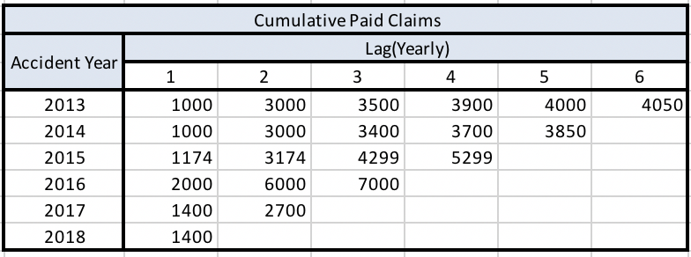
Steps:
Compile claims data in a development triangle of the accumulated paid claims
Compile claims data in a development triangle of an outstanding claims
Sum the two tables to have the reported claims
Calculate age-to-age factors
project the ultimate claims
Finding the IBNR by subtract the recent accumulated paid from the ultimate claims
Chain Ladder
Example:
Suppose we have 2013-2018 paid claims and outstanding claims, and we want to find the IBNR using chainladder methodology.(This data generated randomly)

Slide 10
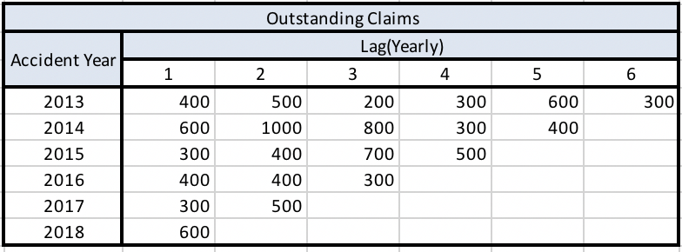
Steps:
Compile claims data in a development triangle of the accumulated paid claims
Compile claims data in a development triangle of an outstanding claims
Sum the two tables to have the reported claims
Calculate age-to-age factors
project the ultimate claims
Finding the IBNR by subtract the recent accumulated paid from the ultimate claims
Chain Ladder
Example:
Suppose we have 2013-2018 paid claims and outstanding claims, and we want to find the IBNR using chainladder methodology.(This data generated randomly)

Slide 11
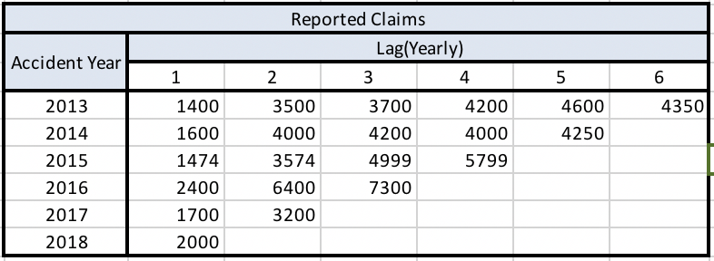
Steps:
Compile claims data in a development triangle of the accumulated paid claims
Compile claims data in a development triangle of an outstanding claims
Sum the two tables to have the reported claims
Calculate age-to-age factors
project the ultimate claims
Finding the IBNR by subtract the recent accumulated paid from the ultimate claims
Chain Ladder
Example:
Suppose we have 2013-2018 paid claims and outstanding claims, and we want to find the IBNR using chainladder methodology.(This data generated randomly)

Slide 12
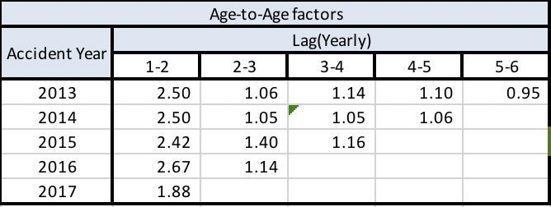
Steps:
Compile claims data in a development triangle of the accumulated paid claims
Compile claims data in a development triangle of an outstanding claims
Sum the two tables to have the reported claims
Calculate age-to-age factors
project the ultimate claims
Finding the IBNR by subtract the recent accumulated paid from the ultimate claims
Chain Ladder
Next step is to find the Age-to-Age factor, also called loss development factors (LDFs), represent the ratio of loss amounts from one valuation date to another, and they are intended to capture growth patterns of losses over time. These factors are used to project where the ultimate amount losses will settle.
Method:
In general for any year the factor of growth from lag n-1 to lag n
= $\frac{Reported Claims in Lag\left(n\right) for year X}{Reported Claima Lag\left(n−1\right) for year X}$

Slide 13
Steps:
Compile claims data in a development triangle of the accumulated paid claims
Compile claims data in a development triangle of an outstanding claims
Sum the two tables to have the reported claims
Calculate age-to-age factors
project the ultimate claims
Finding the IBNR by subtract the recent accumulated paid from the ultimate claims
Chain Ladder
However, we can estimate the ultimate claims by other factors. Such as, Weighted Average, Simple Average and Geometric growth ratio.
Let’s suppose we want to calculate the ratio of (2-3) Lag.

Slide 14
Steps:
Compile claims data in a development triangle of the accumulated paid claims
Compile claims data in a development triangle of an outstanding claims
Sum the two tables to have the reported claims
Calculate age-to-age factors
project the ultimate claims
Finding the IBNR by subtract the recent accumulated paid from the ultimate claims
Chain Ladder
Weighted Average:
From accumulative paid we find the factor by summing all the claims of lag (n-1) and divided it by the sum of claims lag (n).
$\frac{3700+4200+4999+7300}{3500+4000+3574+6400}$=1.159
Simple Average :
Simply calculate the average of each period from Age-to-Age table
$\frac{1.06+1.05+1.4+1.14}{4}$=1.625
Geometric growth ratio :
Basically, the geometric mean calculated as the product of the determined years (2) of each lag and taking the root of the inverse of the determined
${\left(1.4∗1.14\right)}^{1/2}$ =1.26

Slide 15
Steps:
Compile claims data in a development triangle of the accumulated paid claims
Compile claims data in a development triangle of an outstanding claims
Sum the two tables to have the reported claims
Calculate age-to-age factors
project the ultimate claims
Finding the IBNR by subtract the recent accumulated paid from the ultimate claims
Chain Ladder
We find the ultimate claims by multiply the selected ratio by the reported claims. There are no criteria of selecting the ratio it’s a judimental thing defer from actuary to actuary.

Slide 16
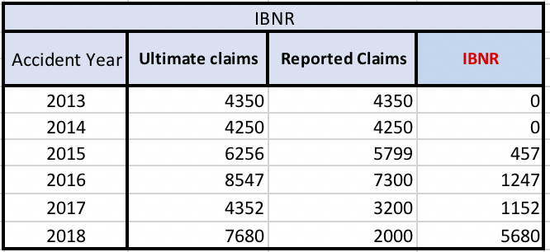
Steps:
Compile claims data in a development triangle of the accumulated paid claims
Compile claims data in a development triangle of an outstanding claims
Sum the two tables to have the reported claims
Calculate age-to-age factors
project the ultimate claims
Finding the IBNR by subtract the recent accumulated paid from the ultimate claims
Chain Ladder
Finally, the IBNR = Ultimate Claims - Reported claims.
IBNR would be the total of the last column.

Slide 17
Expected Loss Ratio
The expected loss ratio method assumes that the actuary can better estimate future losses and find the IBNR from future losses based on the adjustment loss ratio instead of claims experience observed to date.
Key Assumptions:
This data depends on loss ratio to get the ultimate claims and the loss ratio in this methodology is judgmental based on the actuary assumption ratio.

Slide 18
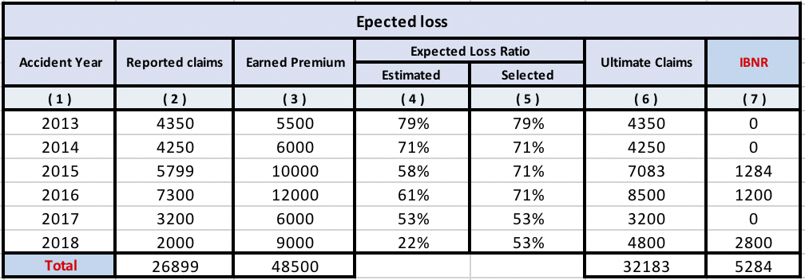
Expected Loss Ratio Methodology
( 1 ) Accident Year
( 2 ) Outstanding claims + Cumulative paid claims
( 3 ) Earned Premium
( 4 ) Reported Claims/Earned Premium
( 5 ) Selected judgmentally based on experience in ( 4)
( 6 ) Earned Premium * Selected loss ratio
( 7 ) Ultimate Claims – Reported Claims

Slide 19
Bornhuetter-Ferguson
The Bornhuetter-Ferguson method is one of the most widely methods, second only to the chain ladder method. The BF method is essentially a mixture of the chain ladder and expected loss ratio methods. It’s about calculating the credibility weight which is the percentage of the reported claims to apply it as Z in the Ultimate Claims calculation.
Key Assumptions:
first year as fully settled
Stand on a loss ratio generated on the year and sit it as a constant ratio over the remaining years to find the ultimate claims witch is equal to the loss Ratio multiply by Earned premium

Slide 20
Bornhuetter-Ferguson Ratio Methodology
( 1 ) Accident Year
( 2 ) Reported Claims
( 3 ) Chain ladder $ultimate claims$
( 4 ) Expected Loss $ultimate claims$
( 5 ) Cumulative development factor
(6) 1/CDF to obtain Reported claims percentage
(7) ${BF}_{ultimate claims}$
$=$ ${Z∗CL}_{ultimate claims}$+ ${(1−Z)EL}_{ultimate claims}$
(8) BF Ultimate claims – Reported claims

Slide 21
And NOW lets
make the IBNR real
Kindly open the attached excel file.

Slide 22
Thank you

