Slide 1
Chemistry of Transition Metals

Slide 2
321 chem مدرسه المقرر: د. امال الفواز
Chemistry of transition elements مبنى 5 الدورالثاني غرفه 254
يومي الاحد,الثلاثاء,الخميس الساعه 10-11
القاعه: 034مبنى 5 الدور الارضي العنوان البريدي: amalf@ksu.edu.sa
اهداف دراسه المقرر:
دراسه المفاهيم والنظريات الاساسيه للعناصر الانتقاليه
مايدرس في المقرر:
Introduction of transition metals, types of ligands, isomers and nomination.
Valence bond theory, hybridization, magnetic properties.
Crystal field theory, ionic bonding, CSFE, thermodynamics measurement, color of complexes d-d transfer.
Molecular orbitals theory, covalent bonding.
Ligand field theory, nephluxity effect, interpretation of the spectrochemical series, bonding, selection rule.
Energy level of free ion, Russell Saunders coupling scheme and J-J coupling in tetrahedral and octahedral complexes.
Interpretation of the spectra using Orgal and Tanab-Sugano diagrams for allowed and not –allowed transformation.
The Jahn Teller theorem.
تقويم المقرر:
امتحان نهائي 40درجه
امتحانين فصلييين الاول 20درجه والثاني 20درجه 10 درجات للتمارين 10Q
المراجع الرئيسيه:
Advanced inorganic chemistry. F.Cotton& G. willkinson
Inorganic chemistry. J.H.Huheey.
مع تمنياتي للجميع بالاستفادة الكاملة من المقرر وان يكون النجاح حليفكم وان يجعل ما نقدم خالصا لوجهه الكريم.

Slide 3
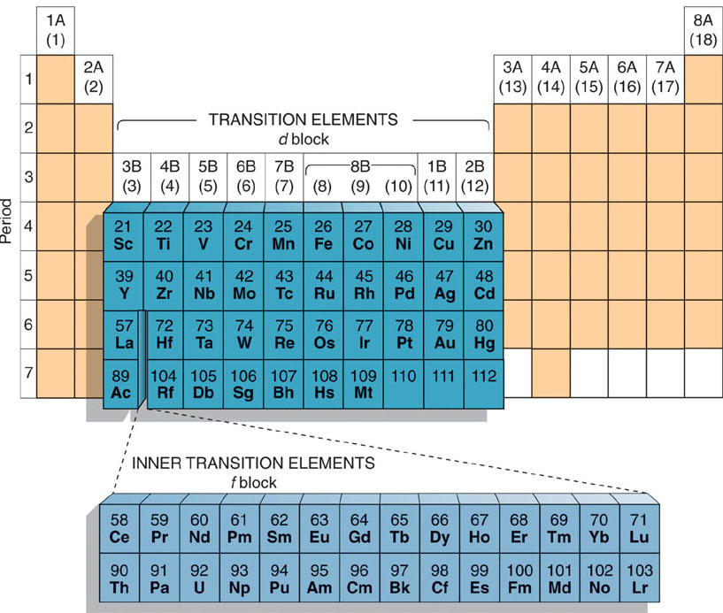

Slide 4
Properties of transition metal
Electronic configuration.
variable oxidation state (oxidation number)
complex ion formation
colored ions
catalytic activity
Magnetic properties

Slide 5
Coordination Compounds
• Coordination compounds are species in which a:
central metal ion (or atom) is attached to a group of
surrounding molecules or ions by coordinate
covalent bonds.
• Surrounding groups are called Ligands.
• Central metal is a Lewis acid.
• Ligand is a Lewis base.
• The number of ligand donor atoms surrounding the
central metal is called the coordination number.

Slide 6
Factors effecting complexation
1-size of the metal ion.
2-charge on the metal ion.
3-presence of vacant d orbitals on metal.

Slide 7
Werner coordination theory
Postulates:
1. In co-ordination compounds, central metal atoms exhibit primary valency and secondary valency.
The primary valency is ionizable. Secondary valency is not ionizable.
The primary valency corresponds to oxidation state.
The secondary valency corresponds to coordination number. (the central metal ion and ligands are not ionizable)

Slide 8
2. Every metal atom has a fixed number of secondary valencies (coordination number(s)).
3. The metal atom tends to satisfy boths its primary valency as well as its secondary valency. Primary valency is satisfied by negative ions (metal ion has a positive charge) whereas secondary valency (coordination number) is satisfied either by negative ions or by neutral molecules. (In certain case a negative ion may satisfy both types of valencies).
4. The coordination number or secondary valencies are always directed towards the fixed positions in space and this leads to definite geometry of the coordination compound.

Slide 10
Types of ligands
Ligands are classified into two broad categories:
Monodentate and polydentate.
Monodenatet ligands are those which use only one donor atom for complexation.
Polydentate ligands are those which use more than one atom for complexation.

Slide 11
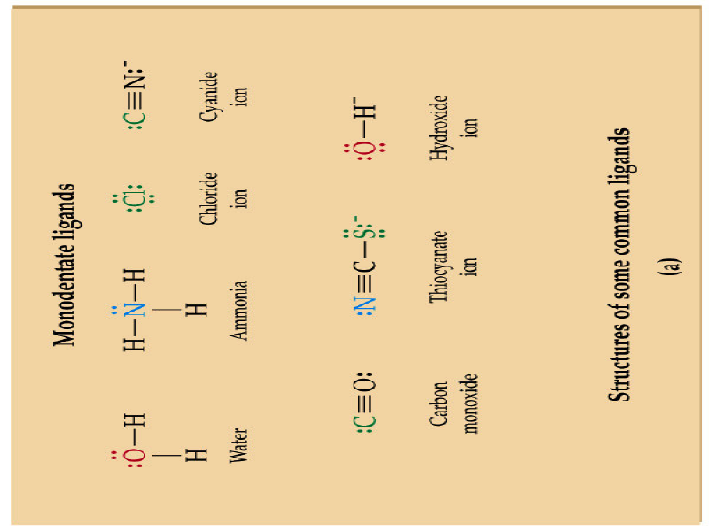

Slide 12
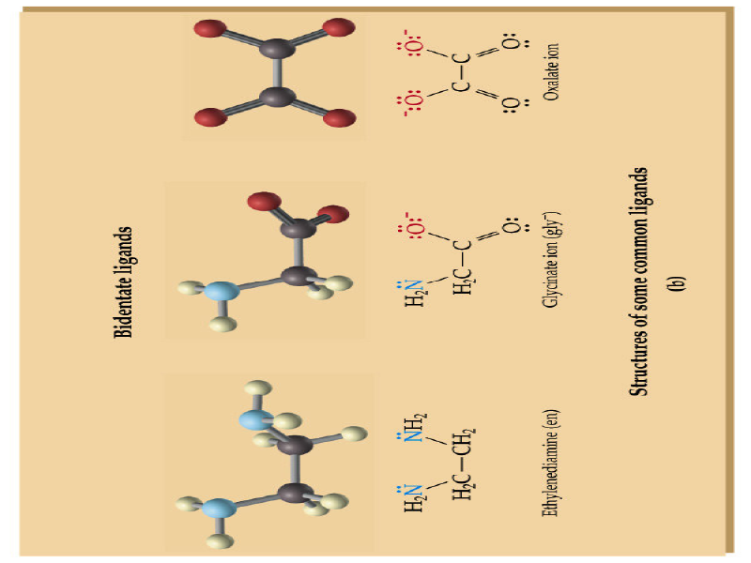

Slide 13
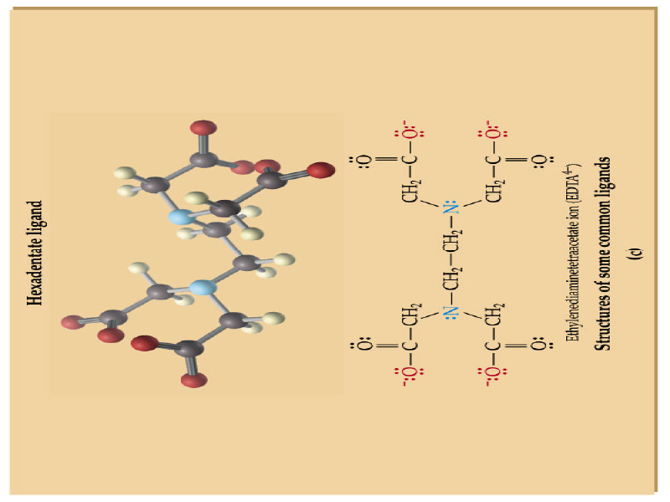

Slide 14
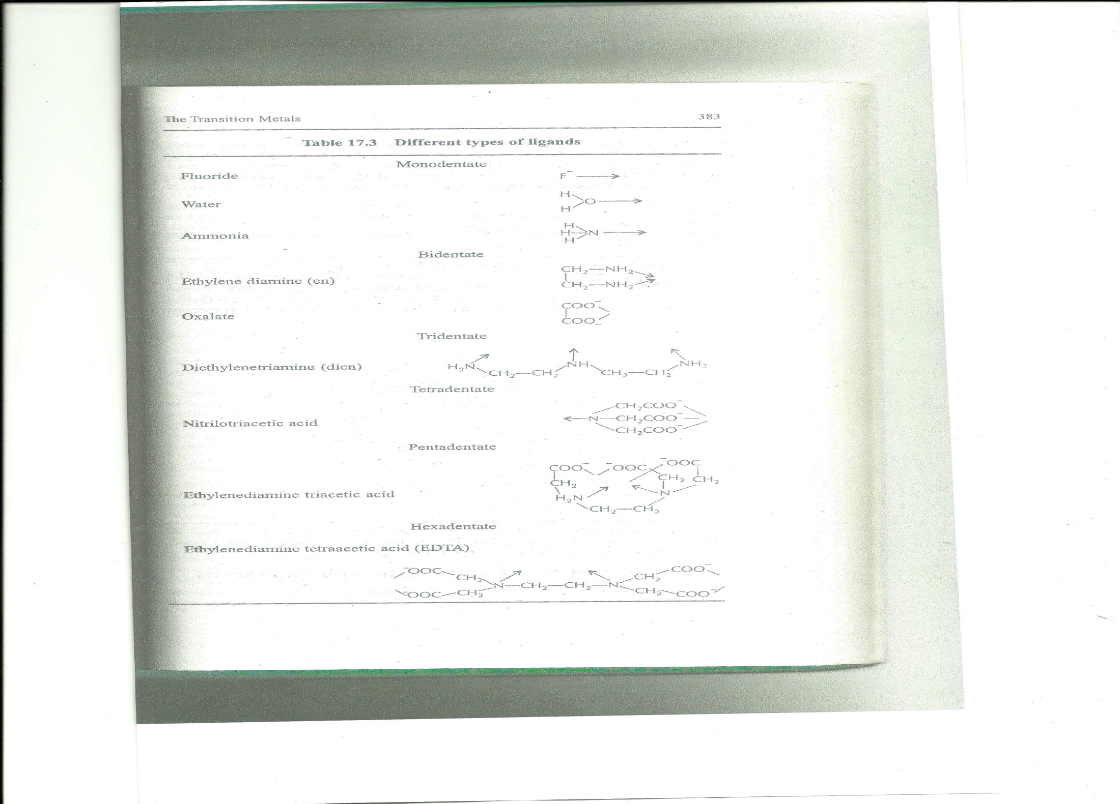

Slide 15
Comparison of 3d transition series with 4d/5d series
Size.
Oxidation states.
Magnetic properties.
Metal-metal bonding.
Coordination number of complex.
Abundance.

Slide 16
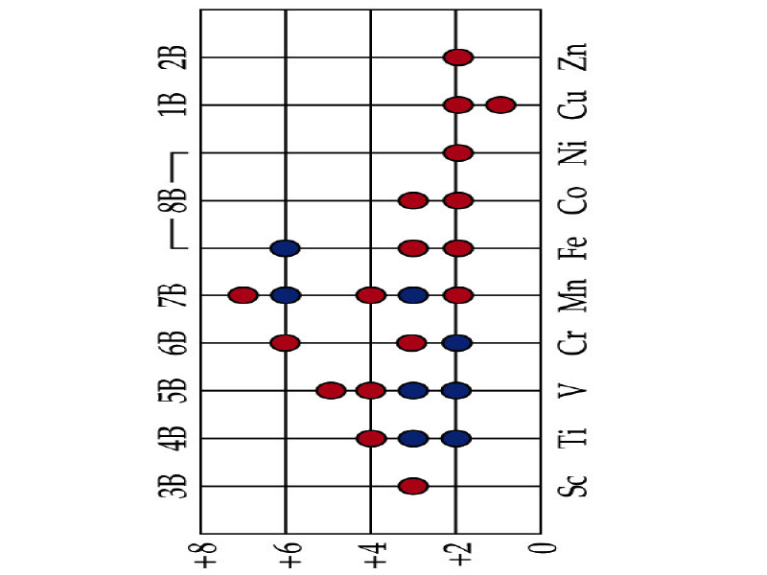
Oxidation state for the 3d transition metal

Slide 17
Nomenclature of complexes
Positive ion is named first.
Rules for naming the Ligands
1a. Ligands that act as anions which end in "-ide" are replaced with an ending "-o".
Ex: Chloride-> Chloro.
1b. Anions ending with "-ite" and "-ate" are replaced with endings "-ito" and "-ato" respectively.
Ex: Nitrite->Nitrito Nitrate->Nitrato
2. Neutral molecules that are ligands carry their normal name with a few exceptions:
H₂0-aqua
NH₃-ammine
CO-carbonyl
NO-nitrosyl

Slide 18
Nomenclature of complexes
Rules for naming the metal center
When naming the metal center, you must know the formal metal name and the oxidation state. To show the oxidation state, we use Roman Numerals inside parenthesis. For example, in the examples above, Chromium and Cobalt have the oxidation state of +3, so that is why they have (III) after them. Copper, with an oxidation state of +2 , is denoted as Cu(II). If the overall coordination complex is an anion, the ending "-ate" is attached to the metal center. Copper +2 will change into cuprate(II). Therefore, the last piece of information you need to memorize are some metals in complex anions. Here are the most common:
Iron -> Ferrate
Copper -> Cuprate
Tin -> Stannate
Silver -> Argentate
Lead -> Plumbate
Gold -> Aurate

Slide 19
Nomenclature of complexes
Rules for naming the Ligands
1a. Ligands that act as anions which end in "-ide" are replaced with an ending "-o".
Ex: Chloride-> Chloro.
1b. Anions ending with "-ite" and "-ate" are replaced with endings "-ito" and "-ato" respectively.
Ex: Nitrite->Nitrito Nitrate->Nitrato
2. Neutral molecules that are ligands carry their normal name with a few exceptions:
H₂0-aqua
NH₃-ammine
CO-carbonyl
NO-nitrosyl
3. The number of ligands present in the complex are noted with the prefixes which you memorized above. Prefixes always go before the ligand name. It is also important to know that prefixes are not included when ligands are named in alphabetical order. Also, ligands are always named first before the metal is named.

Slide 20
Nomenclature of complexes
Representative examples:
Complexes with neutral coordination sphere:
[Co(NH₃)₃ClCNNO₂]
[Ni(PF₃)₄]
PdI₂(ONO)₂(H₂O)₂]
Complexes with cationic coordination spher:
[Fe(CH₃NC)₆]Br₂
[Ni(NH₃)₂(en)](CH₃COO)₂

Slide 21
Nomenclature of complexes
Complexes with anionic coordination sphere:
K₃[Fe(CN)₆]
Na[OsCl₅N]
Na[Au(CN)₆]
Complexes with cationic and anionic coordination spheres:
[Co(en)3][Cr(CN)6]
[Pt(NH3)4Cl2][PtCl4]

Slide 22
Nomenclature of complexes
Complexes with bridging ligands:
(CO)₃Fe-µ-(CO)₃Fe(CO)₃
[Br₂Pd-µ -Br₂PdBr₂]⁻²
PF₃ClPd- µ-PdPF₃Cl

Slide 23
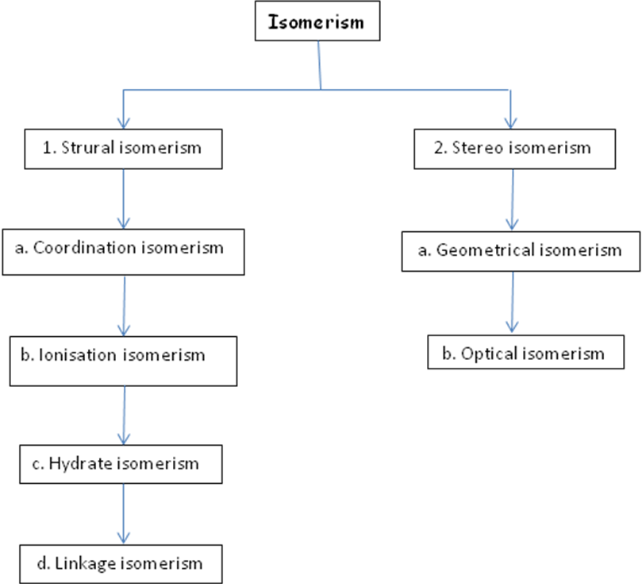
Types of Isomerism

Slide 24
1. Structural Isomerism
Coordination isomerism
The interchange of ligands between cationic and anionic entities of different metal ions present in a complex.
Example : [Co(NH₃)Cl]Br [Co(NH₃)Br]Cl and [Co(NH₃)₆][Cr(CN)₆]

Slide 25
Ionization isomerism
The exchange of groups between the complex ion and the ions outside the complex
Example: [Pt (NH₃)₄Cl₂]Br₂ and [Pt(NH₃)₄Br₂]Cl2 produce different ions in solution
C) Hydrate isomerism :
It occurs when water forms a part of the coordination entity or is outside it
[Cr(H₂O)₆]Cl₃ violet (three ionic chlorines)
[Cr(H₂O)₅Cl]Cl₂.H₂O green (two ionic chlorines)
[Cr(H₂O)₄Cl₂]Cl.2H₂O dark green (one ionic chlorine)

Slide 26
Linkage isomerism
Linkage isomerism arises in a coordination compound containing ambidentate ligand.
Example: [Co(NH₃)₅(NO₂)]Cl₂
[Co(NH₃)₅(NO₂)]Cl^{2 –} (Red)
Co(NH₃)₅(ONO)]Cl²⁻ (Yellow)

Slide 27
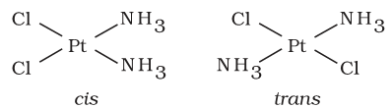
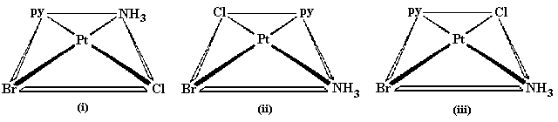
2. Stereoisomerism
Geometrical isomerism: cis and trans
Square planar complex:
Example :
Ma₂b₂ [Pt(NH₃)₂Cl₂]
Mabcd [PtBrClNH₃(py)]

Slide 28
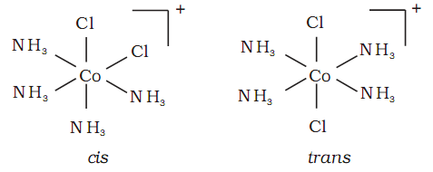
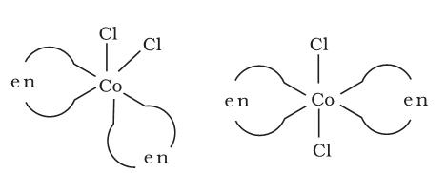
Geometrical isomerism in Octahedral complex
Ma₄b₂ type (cis and trans isomers)
MAA₂b₂ type -Three isomers ( two cis and onetrans)
cis-[CoCl₂(en)₂]
trans- [CoCl₂(en)₂]

Slide 29
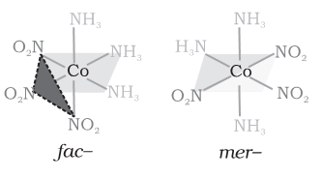
Geometrical isomerism in Octahedral complex
Ma₃b₃ type [Co(NH₃ )₃(NO₂ )₃
b) Optical isomerism
Optical isomers are mirror images that cannot be superimposed on one another.
The molecules or ions that cannot be superimposed are called chiral.

Slide 30
Optical Isomerism

Slide 33
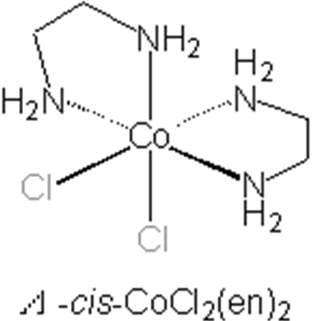
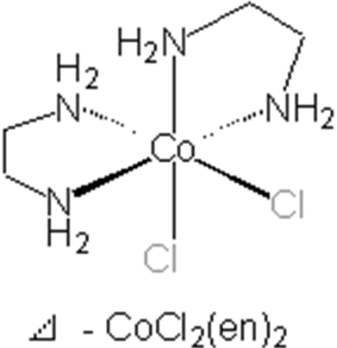

Optical Isomerism
The absolute configuration be designated Lambda Λ (left-handed)
and Delta Δ (right-handed)
cis-isomers of octahedral complexes with 2 bidentate ligands and 2 monodentate ligands
Example : cis-[CoCl₂(en)₂] complex (cis-bis chel.ates)

Slide 34
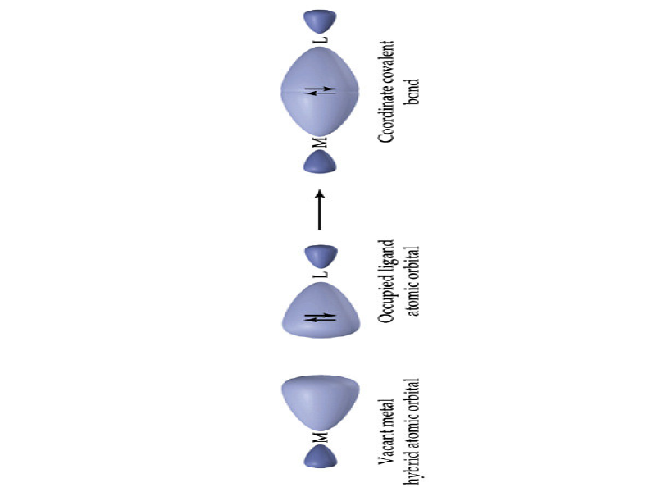
Bonding in Complexes
• Valence Bond Theory predicts metal complex
bonding arises from overlap of filled ligand orbitals
and vacant metal orbitals.
• Resulting bond is a coordinate covalent bond.

Slide 35
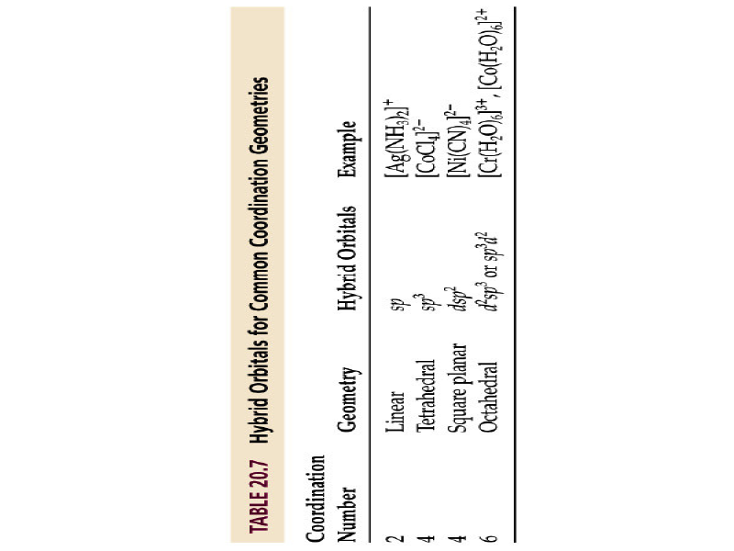
Bonding in Complexes
• Complex geometry can be linked to five main
orbital hybridization processes.

Slide 36
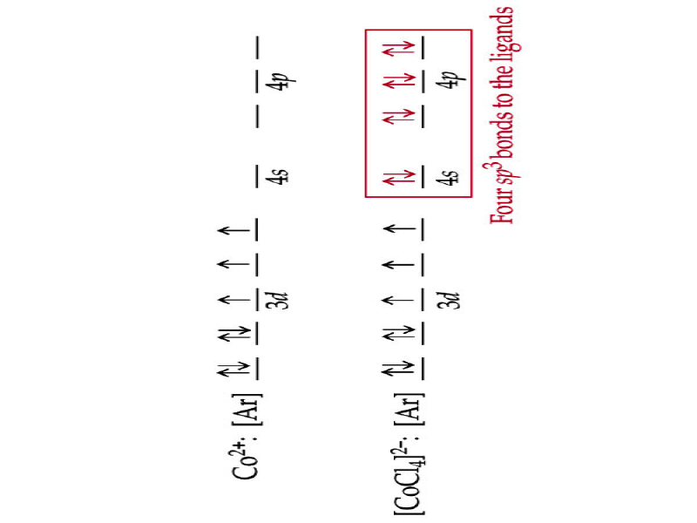
Bonding in Complexes 05
• Tetrahedral Geometry: Gives [CoCl₄]^{2–} three
unpaired electrons, which makes it paramagnetic
and attracted by magnets. Bonding in Complexes 05
• Tetrahedral Geometry: Gives [CoCl₄]^{2–} three
unpaired electrons, which makes it paramagnetic
and attracted by magnets.

Slide 37
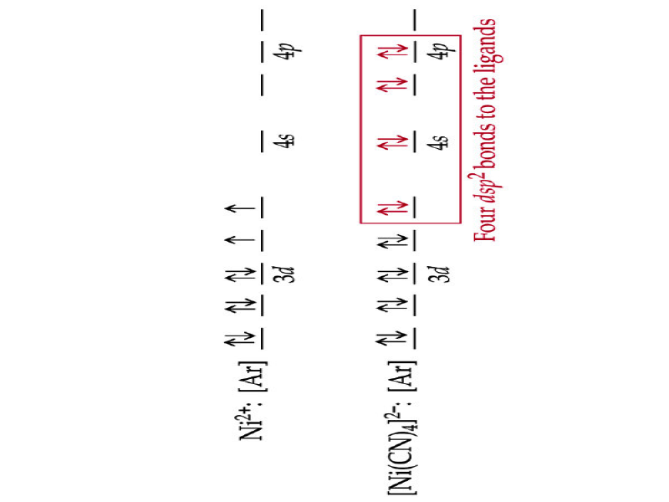
Bonding in Complexes
• Square Planar Geometry: Gives [Ni(CN)₄]^{2–} all
paired electrons, which makes it diamagnetic and
weakly repelled by magnets.

Slide 38
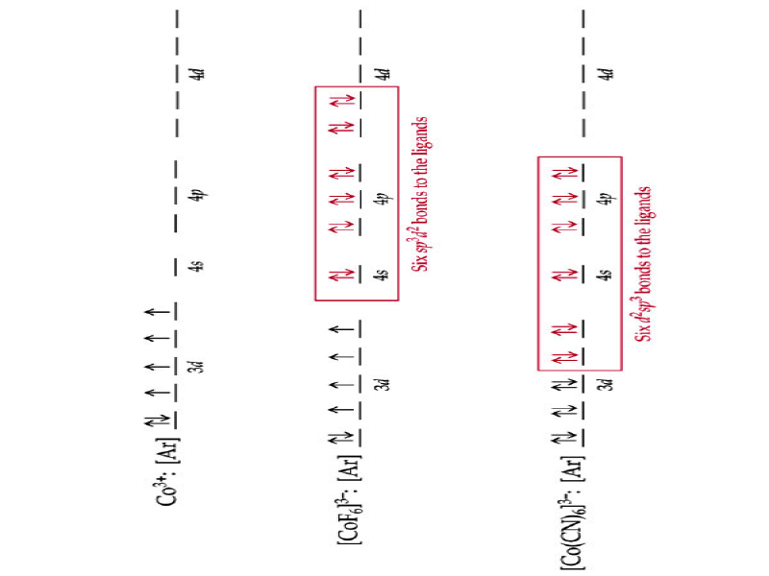
Bonding in Complexes 07
• Octahedral sp3d2 Geometry: Gives [CoF₆]^{3–} four
unpaired electrons, which makes it paramagnetic
and is called a high-spin complex.

Slide 39
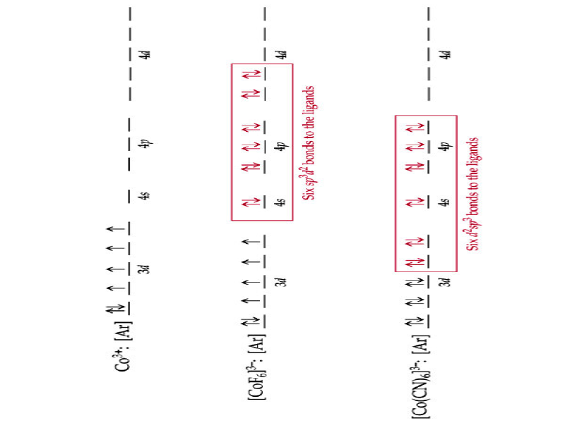
Bonding in Complexes 08
• Octahedral d2sp3 Geometry: Gives [Co(CN)₆]^{3–}
paired electrons, which makes it diamagnetic and is
called a low-spin complex.

Slide 40
Bonding in Complexes
• The difference between sp3d2 and d2sp3 hybrids
lies in the principal quantum number of the d
orbital.
• In sp3d2 hybrids, the s, p, and d orbitals have the same
principal quantum number—High Spin.
• In d2sp3 hybrids, the principal quantum number of the d
orbitals is one less than s and p orbitals—Low Spin.
• A complex’s magnetic properties determine which
hybrid is being used.

Slide 41
Positive of Valence bond theory
Present a simple description of metal ligand bonding
Predicts the geometry of the complexes correctly
Account for the magnetic properties of the coordination complexes

Slide 42
Negatives of valence bond theory
It offers no explanation for the colors of the complexes
It doesn’t explain the spectra of complexes
It fails to give a satisfactory explanation for the formation of [Cu(NH₃)₄]⁺².

Slide 43
Crystal field theory: an electrostatic model
Crystal Field Theory is a model that helps explain
why some complexes are high spin and some are
low spin.
• Crystal Field Theory views bonding in complexes
as the result of electrostatic interactions and
considers the effect of ligand charges on energies
of metal ion d orbitals.
• Crystal Field Theory uses no covalent bonds.

Slide 44
The metal ion will be positive and therefore attract the negatively charged ligands
But there are electrons in the metal orbitals, which will experience repulsions
with the negatively charged ligands

Slide 45
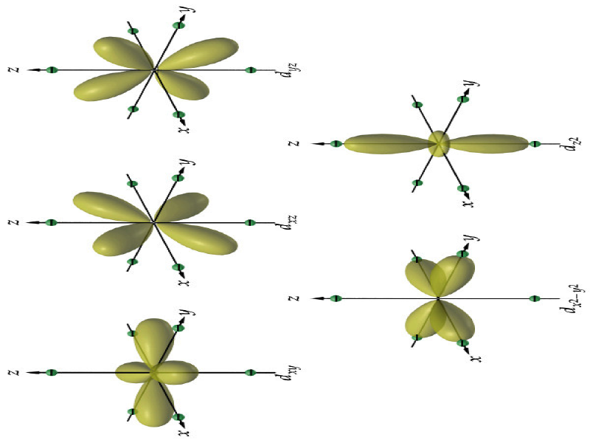

Slide 46
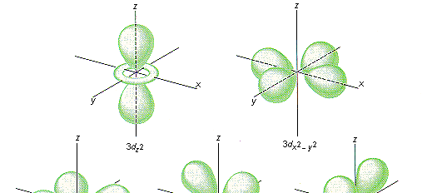
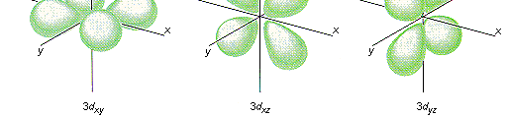

Slide 47
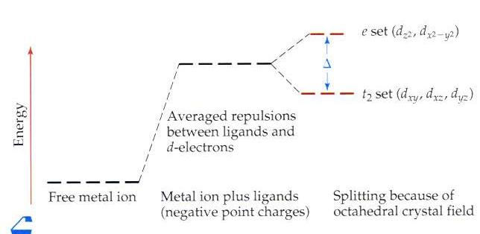
d-electron to ligand-electron repulsions affect d-orbital
energy levels.
• dz2 and dx2 – y2 orbitals
point at the ligands
and have higher
energies than other
d-electrons.
• This energy gap ∆is called crystal field splitting.

Slide 48
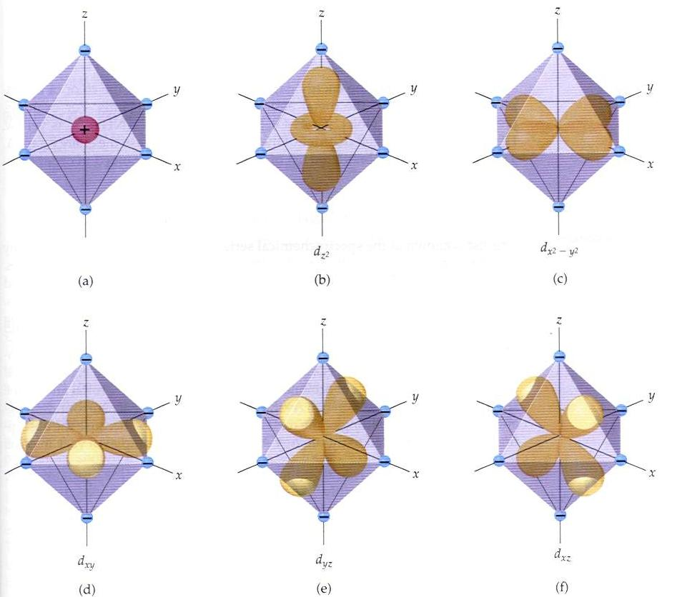
Ligand/d orbital interactions for Oh
Orbitals point at ligands
(maximum repulsion)
Orbitals point
between ligands
(less pronounced repulsion)

Slide 49
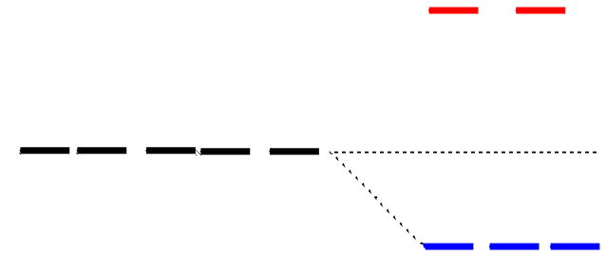
Splitting of d orbitals in an octahedral field
e_{g}
3/5 Δo
Δo
2/5 Δo
t_{2g}
Δo is the crystal field splitting
E(t_{2g}) = -0.4Δo x 3 = -1.2Δo
E(e_{g}) = +0.6Δo x 2 = +1.2Δo

Slide 50
The magnitude of the splitting
(ligand effect)
Strong
field
Weak
field
The spectrochemical series
CO, CN⁻ > phen > NO₂⁻ > en > NH₃ > NCS⁻ > H₂O > F⁻ > RCO₂⁻ > OH₋ > Cl⁻ > Br⁻
increases with increasing formal charge on the metal ion
increases on going down the periodic table

Slide 51
Placing electrons in d orbitals
Strong field Weak field
Strong field Weak field
d¹
d²
d³
d⁴

Slide 52
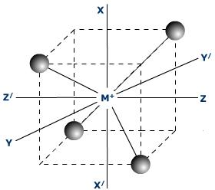
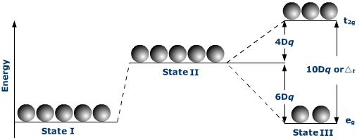
Tetrahedral complexes

Slide 53
Tetrahedral complexes
In a tetrahedral complex, Δ is relatively small even with strong-field ligands as there are fewer ligands to bond with. It is rare for the Δ of tetrahedral complexes to exceed the pairing energy. Usually, electrons will move up to the higher energy orbitals rather than pair. Because of this, most tetrahedral complexes are high spin.

Slide 54
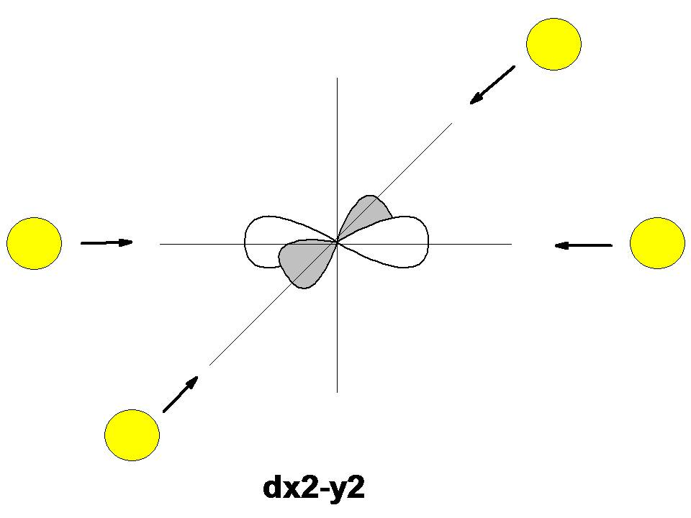
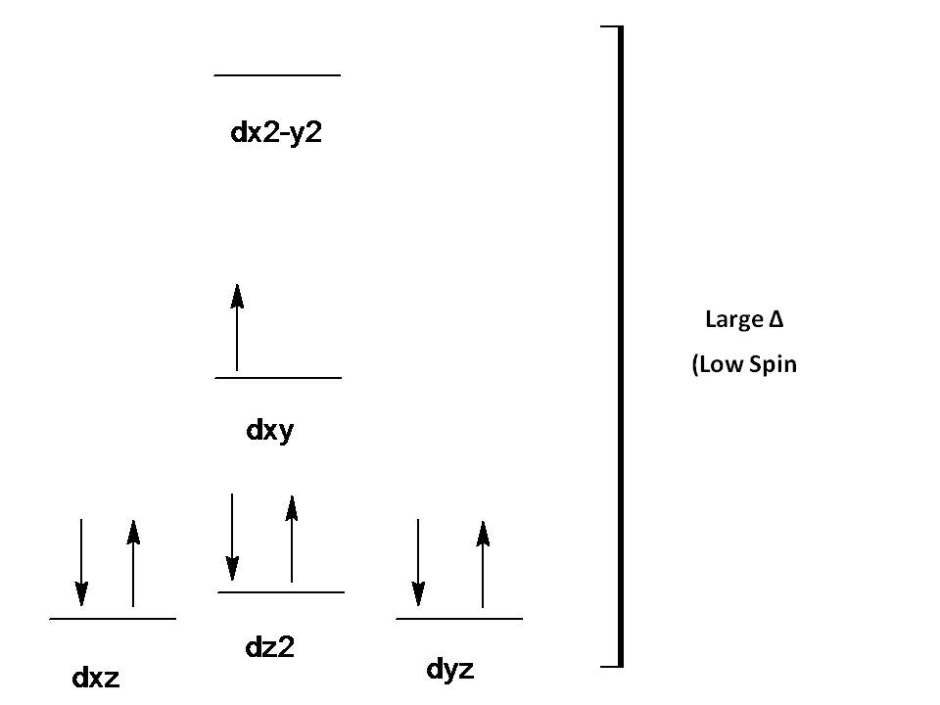
Square Planar Complexes
In square planar complexes Δ will almost always be large, even with a weak-field ligand. Electrons tend to be paired rather than unpaired because paring energy is usually much less than Δ. Therefore, square planar complexes are usually low spin.

Slide 55
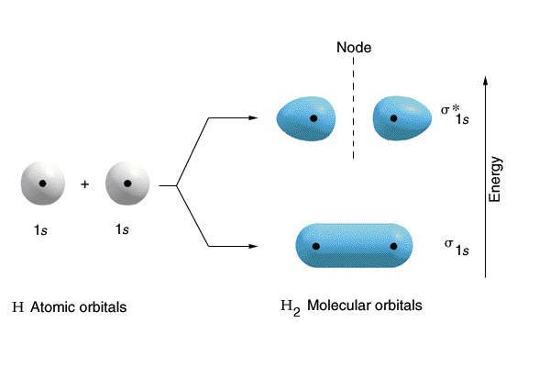
Moleculuar Orbital (MO) Theory
The one that is lower in energy is called the bonding orbital,
The one higher in energy is called an antibonding orbital.

Slide 56
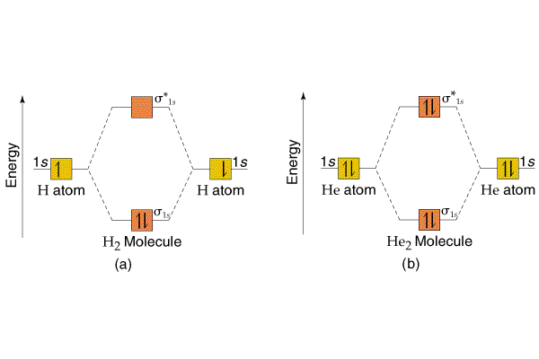
Energy level diagrams / molecular orbital diagrams

Slide 57
Molecular Orbitals (MO’s) from Atomic Orbitals (AO’s)
1. # of Molecular Orbitals = # of Atomic Orbitals
2. The number of electrons occupying the Molecular orbitals is equal to the sum of the valence electrons on the constituent atoms.
3. When filling MO’s the Pauli Exclusion Principle Applies (2 electrons per Molecular Orbital)
4. For degenerate MO’s, Hund's rule applies.
5. AO’s of similar energy combine more readily than ones of different energy
6. The more overlap between AOs the lower the energy of the bonding orbital they create and the higher the energy of the antibonding orbital.

Slide 58
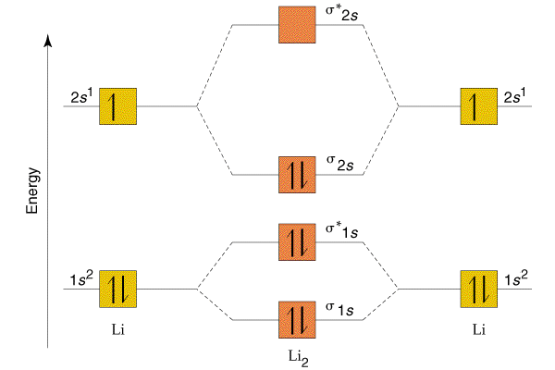
Example: Li₂

Slide 59
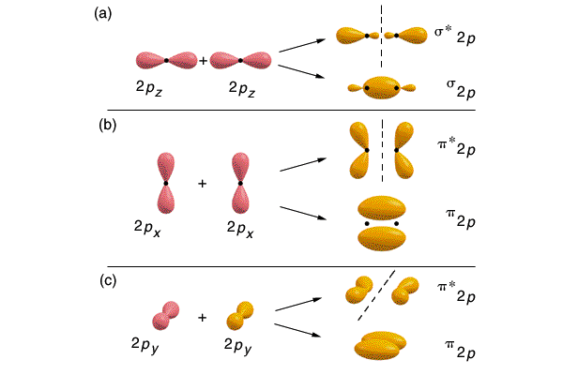
σ
π
1) 1 sigma bond through overlap of orbitals along the internuclear axis.
2) 2 pi bonds through overlap of orbitals above and below (or to the sides) of the internuclear axis.

Slide 60
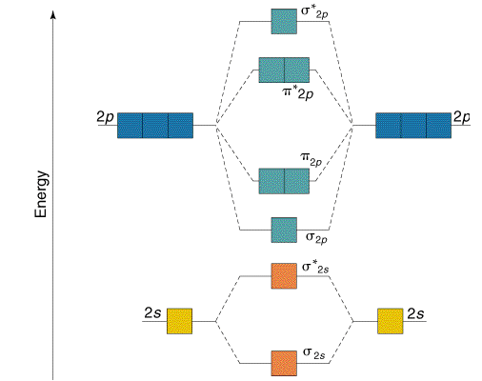

Slide 61
Molecular orbital diagram of σ bonds in Oh

Slide 62
π bonding

Slide 63
Molecular orbital diagram of π in Oh

