Slide 1
Chemical bonds
The structure and physiological processes of the body are based to
a large degree, on the properties and interactions of atoms, ions and molecules.
- In order to understand how living organisms are built from inanimate matter, therefore, it is crucial to know how the chemical bonds that hold atoms together in molecules are formed.
Atom:
is the smallest unit of matter that still retains its distinctive chemical properties.

Slide 2
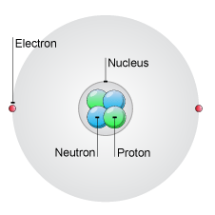
- Each atom has its center. A dense, positively charged neucleus, which is surrounded at some distance by a cloud of negatively charged electrons.

Slide 3

-The nucleus consists of two kinds of subatomic particles:
a) Protons (positively charged)
b) Neutrons (electrically neutral)
-In a neutral atom:
number of electrons = number of protons

Slide 4
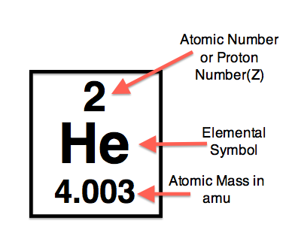
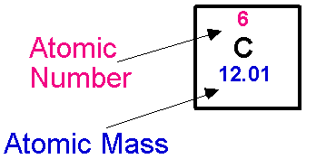
The number of protons present in atomic nucleus determine its atomic number.
Atomic number: is the number of protons
(Atomic mass = number of protons + number of neutrons
or atomic weight)

Slide 5
- There are 92 naturally occuring elements, each differing from the others in the number of protons and electrons in its atoms.
- Living organisms, are made only a small selection of these elements, four of which-carbon(C), hydrogen(H), nitrogen(N), and oxygen(O)-made up 96.5% of an organism′s weight.

Slide 6
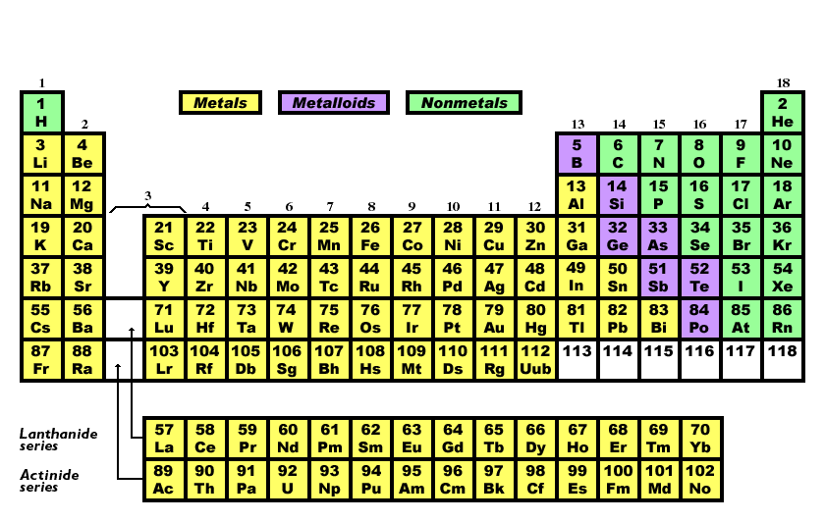

Slide 7
- Electrons are in continuous motion around the nucleus.
The electrons in an atom can exist only in certain discrete regions (discrete orbits) and that there is a strict limit to the number of electrons that can recommended in an orbit of a given type, a so called electron shell.
● The electrons closest on average to the positive nucleus are attracted most strongly to it and occupy the inner, most tightly bound shell.
- This innermost shell can hold a maximum of two electrons.
● The second shell is farther away from the nucleus, and its electrons are less tightly bound. This second shell can hold up to eight electrons.
● The third shell contains electrons that are even less tightly bound; it can hold up to eight electrons.

Slide 8
● The fourth and fifth shells can hold 18 electrons each.
Atoms with more than four shells are very rare in biological molecules.
- The electrons of an atom fill the shells in order-the first before the second, the second before the third, and so on.
An atom whose outermost shell is entirely filled with electrons is especially stable and therefore chemically unreactive.
e.g helium with 2 electrons (and atomic number of 2)
- Hydrogen by contrast, has only one electron (which leaves the outermost shell half-filled), so it is highly reactive.

Slide 9
The atoms found in living tissues all have incomplete outer electron shells and are therefore able to react with one another to form molecules.
Atoms with incomplete outer shells have a strong tendency to interact with other atoms so as to either gain or lose enough electrons (either by sharing or by transfer) to achieve a completed outermost shell.
example:
●H atom needs only one more electron to fill its shell (generally acquires it by sharing-forming one covalent bond with another atom.
● The other most common elements in living cells:
C, N,and O, which have an incomplete second shell,
P and S which have an incomplete third shell,

Slide 10
share electrons and achieve a filled outer shell of eight electrons by forming several covalent bonds.
- The number of electrons an atom must acquire or lose (either by sharing or by transfer) to attain a filled outer shell is known as its valence.
[i.e The electrons in the incomplete outermost shell,
participate in chemical reactions and form chemical bonds.
These outermost electrons are known as the valence electrons of the atom].

Slide 11
Atom | H | C | N | O | F | Cl | Br | I
Valence | 1 | 4 | 3 | 2 | 1 | 1 | 1 | 1
The number of bonds that each atom can have is determined
by the number of electrons needed to complete the outermost
shell.(e.g. hydrogen must obtain only one more electron-and
can thus form only one chemical bond-to complete the first
shell of two electrons. Carbon, by contrast, must obtain four
more electrons-and can thus form four chemical bonds-to
complete the second shell of eight electrons.

Slide 12
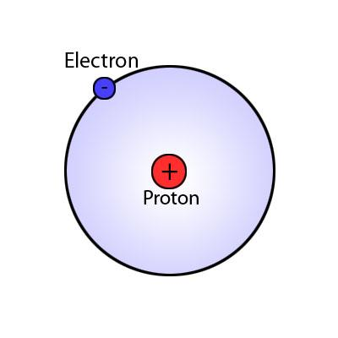
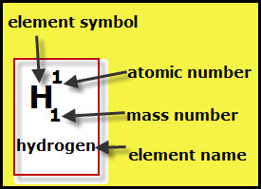
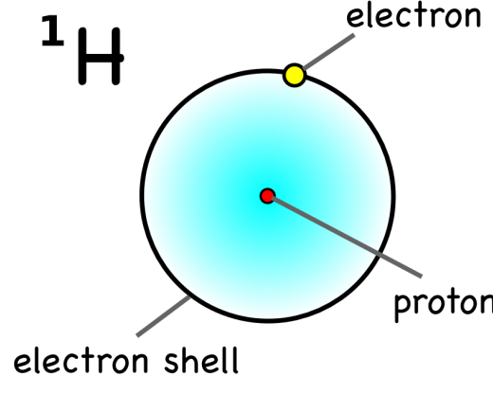
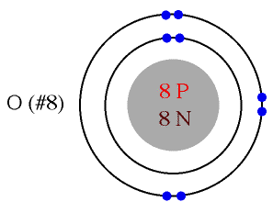
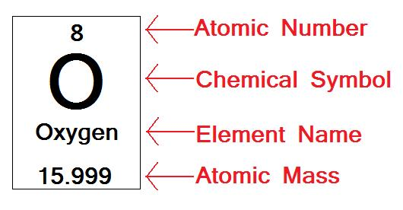

Slide 13
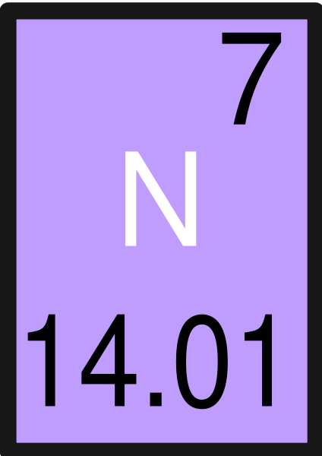
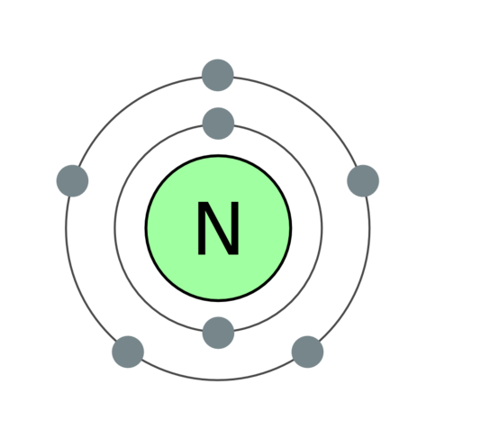

Slide 14
Chemical bond:
Chemical bonding refers to the force that holds the chemical molecules or atoms together.
- Strength of the bond varies considerably, depends on the molecules or atoms involved in the process of bond formation.
Classes of chemical bonds in biological science:
1) Covalent bonds
2) Non-covalent bonds:
a) ionic bonds
b) Hydrogen bonds
c) Hydrophobic bonds
d) Van der waals bonds

Slide 15
The covalent bond
The Covalent bond:
The covalent bond is a bond formed between two atoms by electron sharing.
(usually formed between two non-metal atoms by sharing electron pairs)
- Covalent Bonds are the strongest chemical bonds,
formed by the sharing of a pair of electrons.
- The energy of a typical single covalent bond is ~80 kilocalories per mole (kcal/mol). However, this bond energy can vary from ~50 kcal/mol to ~110 kcal/mol depending on the elements involved.
- Once formed, covalent bonds rarely break spontaneously.

Slide 16
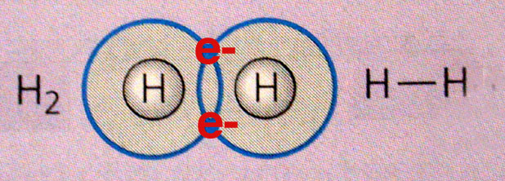
- In a single bond, one electron pair is shared.
- In double bond, two electron pairs are shared.
- In triple bond, three electron pairs are shared.
For example:
Single bond
● H₂

Slide 17
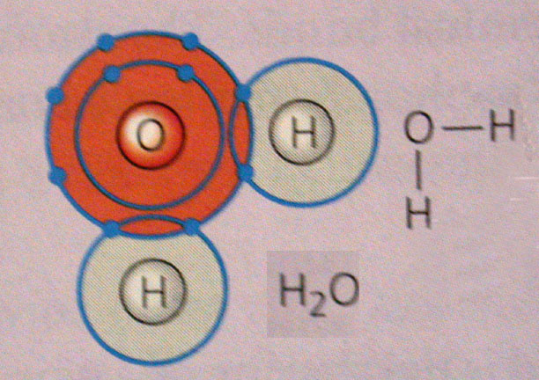
●H₂O

Slide 18
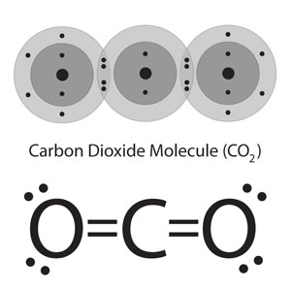
double bond
● CO₂

Slide 19
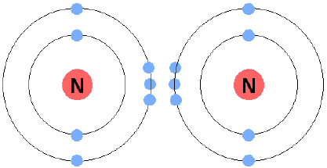
Triple bond
● N₂

Slide 20
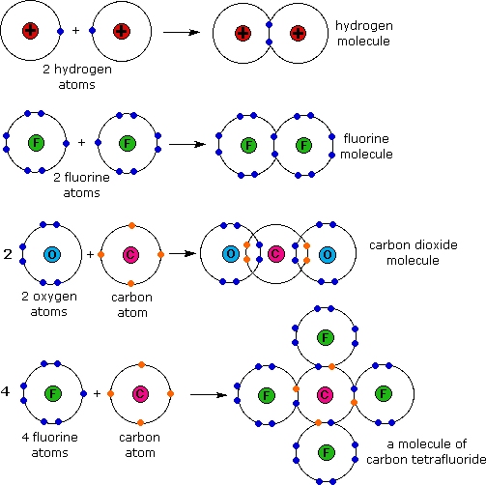
Covalent bonding occurs by a sharing of valence electrons:
Examples of covalent bonding:

Slide 21
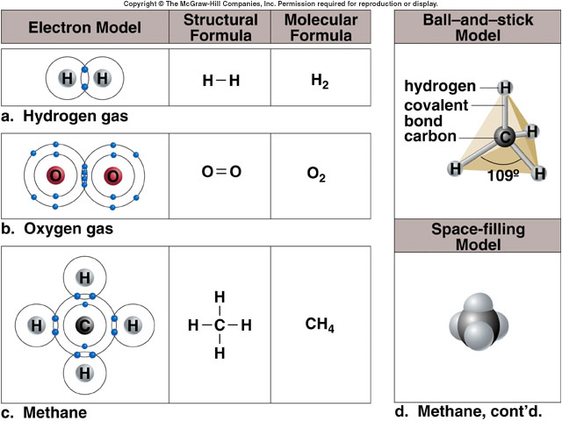

Slide 22
Types of covalent bonds:
1) Non-polar covalent bond.
2) polar covalent bond.
1) Non-polar covalent bond:
It is a covalent bond in which electrons are shared equally between two atoms.
Non-polar covalent bonds are formed when the sharing atoms have the same electronegativity so the
electrons are shared equally.
Electron cloud is not displaced

Slide 23
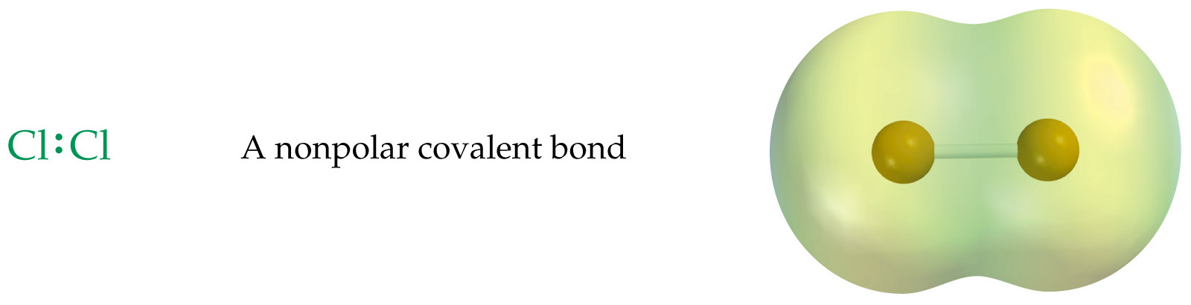
Example:
Covalent bonds that are formed between identical atoms, as in oxygen gas (O₂) and hydrogen gas (H₂), Cl₂
[Since the electrons are equally shared between the two identical atoms, these
molecules are said to be nonpolar and the bonds between them are non polar
covalent bonds].

Slide 24
2) Polar covalent bond:
Example:
bond between the two atoms H and Cl
A type of covalent bond between two different atoms in which
electrons are shared unequally. The shared electrons tend to
be pulled more toward one atom than the other (because of
electronegativity) and results on partial charges on
the atom (i.e one end of the molecule has a slightly negative
charge and the other a slightly positive charge.

Slide 25
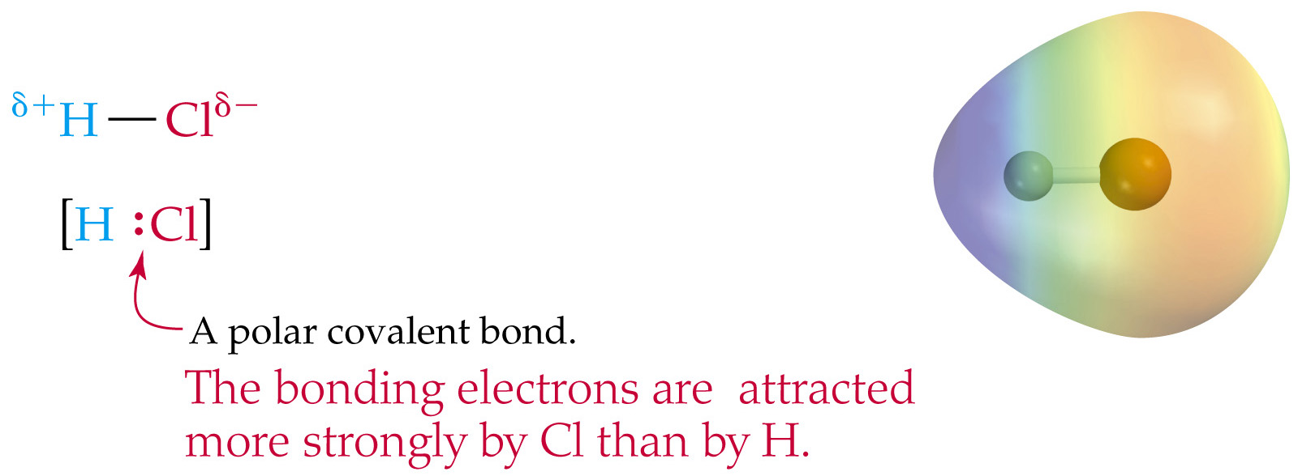

Slide 26
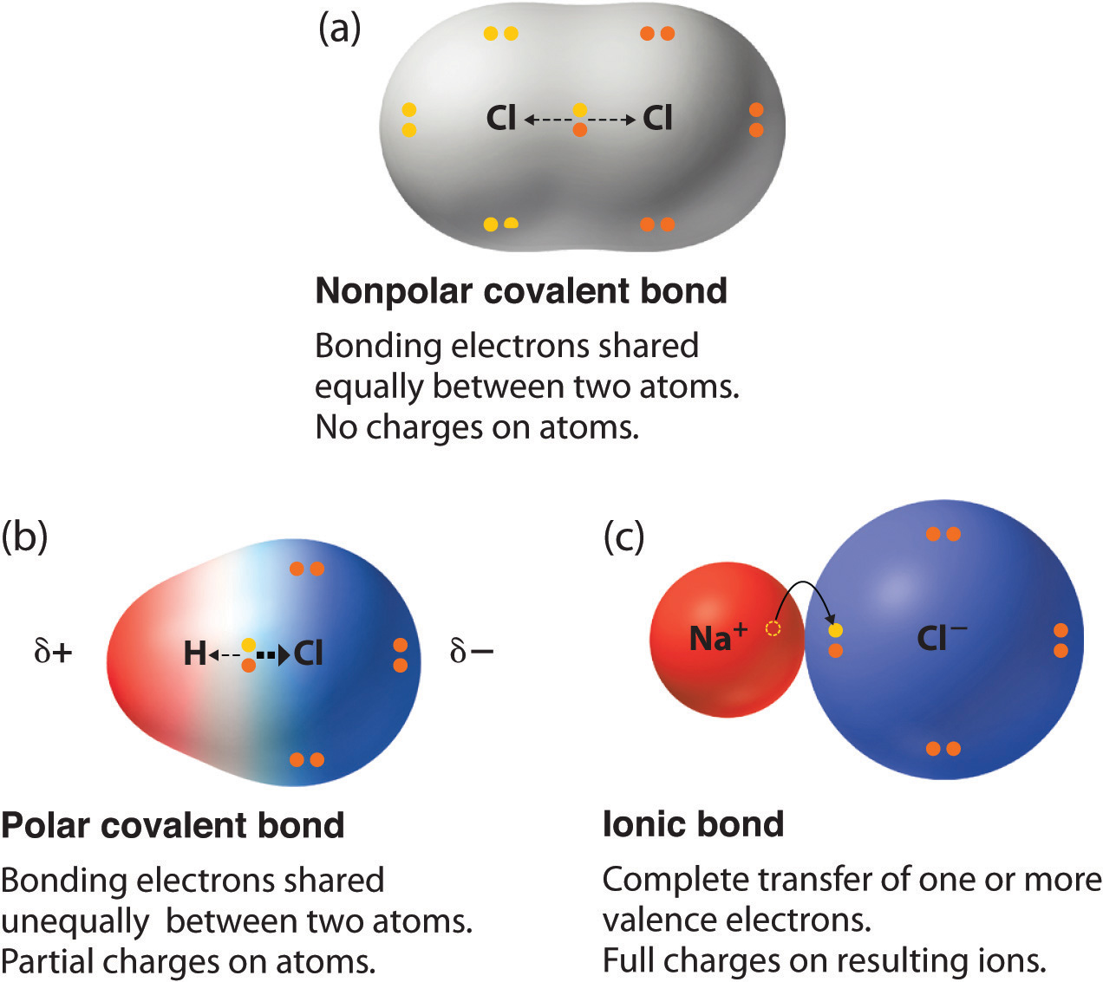

Slide 27
Note: Atoms of oxygen, nitrogen and phosphorus
have a particularly strong tendency to pull electrons
toward themselves when they bond with other atoms.
● Water is the most abundant molecule in the body and serves as the solvent for body fluids.
- Water is a good example because it is polar; the oxygen atom pulls electrons from the two hydrogens toward its side of the water molecule, so that the oxygen side is more negatively charged than the hydrogen side of the molecule.

Slide 28
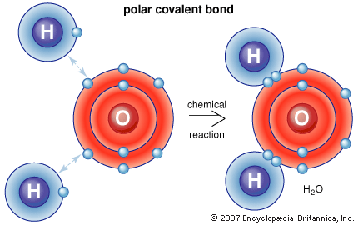

Slide 29
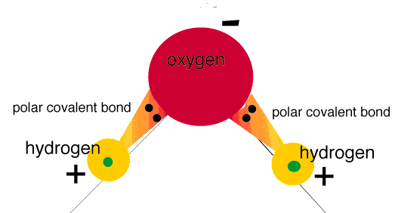

Slide 30
Electronegativity and bond type:
Electronegativity:
Electronegativity is a measure of the tendency of an atom to attract a bonding pair of electrons.
The difference in electronegativities of two elements can be used to predict the nature of the chemical bond.
● If the difference in electronegativities is between:
  1.7 to 4.0: Ionic
  0.3 to 1.7: Polar Covalent
  0.0 to 0.3: Non-Polar Covalent

Slide 31
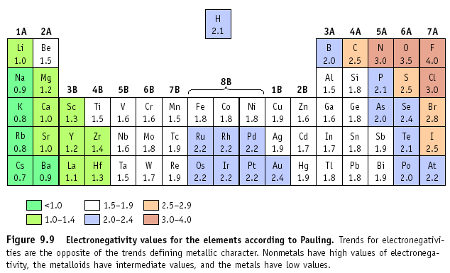

Slide 32
  Example:
  NaCl
  Na = 0.9, Cl = 3.0
  Difference in electronegativity (ΔEN) is 2.1, so
  this is an ionic bond

Slide 33
Ionic bond
Ionic bond:
ionic bond result when one or more valence electrons from
one atom are completely transferred to a second atom.
Thus, the electrons are not shared at all.
-The first atom loses electrons so that its number of
electrons become smaller than its number of of protons
it becomes a positively chaged ion.
-The second atom now has more electrons than it has protons
and becomes a negatively charged ion.

Slide 34
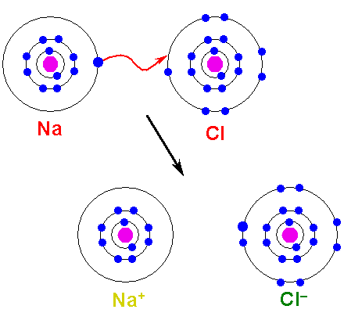
● Atoms that has positive or negative charges are called ions
a positively chaged ions are called cations.
a negatively charged ion are called anions.
Example: NaCl

Slide 35
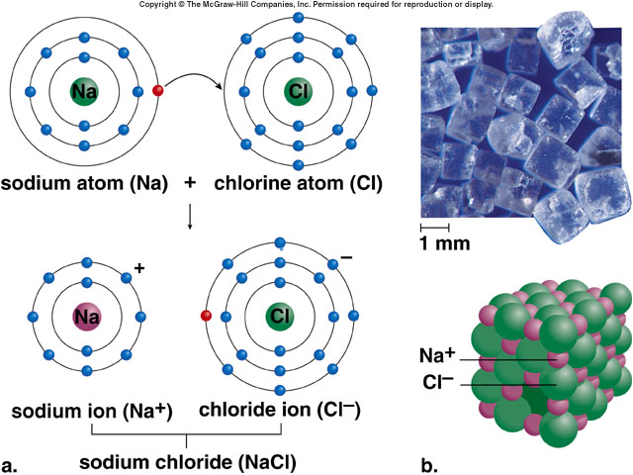
Ionic Bonds

Slide 36
The sodium ion and the chloride ion will be attracted to each other and form an ionic bond.
The ionic bond is due to the attractive forces between the positively charged sodium & the negatively charged chloride.
Therefore, ionic compounds are usually between metals and nonmetals (opposite ends of the periodic table).

Slide 37
Comparison between ionic and covalent bonds
NaCl
This is the formation of an ionic bond.
-
+
Na
Cl
electron transfer
and the formation of ions
Cl₂
This is the formation of a covalent bond.
Cl
Cl
sharing of a pair of electrons
and the formation of molecules

Slide 38
Hydrogen bonds
Hydrogen bond:
A hydrogen bond is a type of attractive interaction between
an electronegative atom and a hydrogen atom bonded covalently to another electronegative atom.
Examples:
  N – H -------------- O=C -
  O – H -------------- O=C -
[a chemical bond consisting of a hydrogen atom between two electronegative atoms
(e.g., oxygen or nitrogen) with one side be a covalent bond and the other being an ionic Bond]
.
- This bond always involves a hydrogen atom.
- Hydrogen bonds can occur between molecules or within parts of
a single molecule.

Slide 39
[When a hydrogen atom forms a polar covalent bond with an atom of oxygen or nitrogen, the hydrogen gains a slight positive charge as the electron is pulled towards the other atom.
-This other atom is thus described as being electronegative.
Since the hydrogen has a slight positive charge, it will have a weak attraction for a second electronegative atom (oxygen or nitrogen) that may be located near it. This weak interaction is called a hydrogen bond].

Slide 40
A hydrogen bond tends to be stronger than van der Waals
forces, but weaker than covalent bonds or ionic bonds.
Although each hydrogen bond is relatively weak, the sum of their attractive forces is largely responsible for:
● the folding and bonding of long organic molecules such as proteins
● and for the holding together of the two strands of a DNA molecule
hydrogen bonds are weak bonds, but there are so many! So, as a collective force, they can be quite strong.

Slide 41
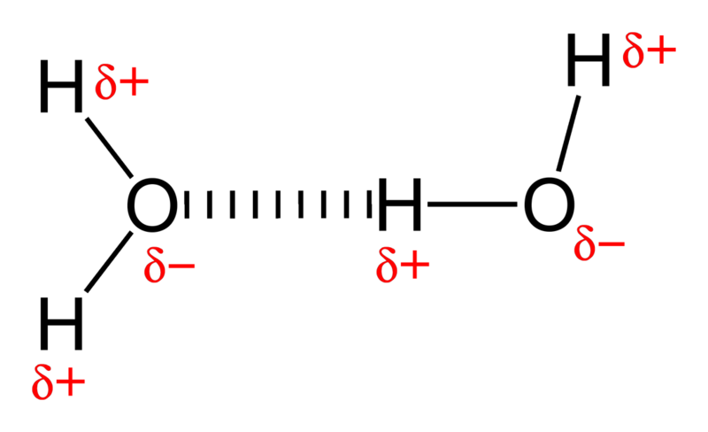
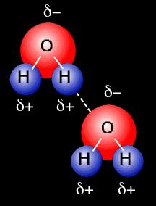
Example:
The hydrogen bonding between water molecules.

Slide 43
Hydrophobic bonds
Hydrophobic bonds
The attraction of hydrophobic (non-polar) molecules
(or non-polar parts of molecules) to each other in the
presence of water (or another polar fluid).
Hydrophobic (non-polar) molecules do not interact with
polar water and cannot form H-bonds.
So they interact with each other and repel the water
(hydro= water; phobic= hating)

Slide 44
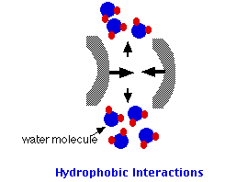
  - nonpolar molecules (or parts of molecules) will aggregate to avoid water. A similar situation occurs in parts of many proteins.
  Note:
  -Nonpolar dissolves in Nonpolar e.g. oil dissolves in benzene, but not in water.
- Polar dissolves in Polar e.g. sugars dissolves in water;
NaCl dissolves in water, but not in benzene.

Slide 45
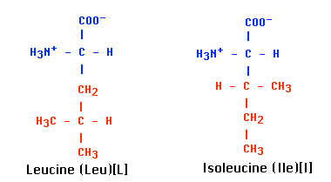
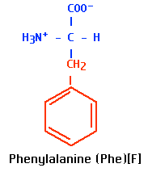
For example: in proteins
The side chains (R groups) of hydrophobic amino acids,
such as phenylalanine and leucine are nonpolar
Hydrophobic

Slide 46
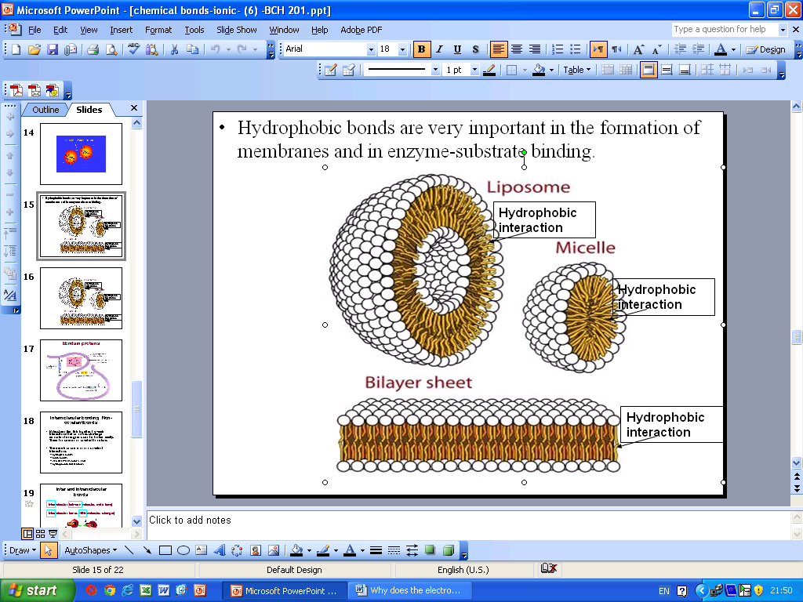
Hydrophobic bonds are very important in the formation of
membranes and in enzyme-substrate binding.

Slide 47
Van der waals force
Van der waals force:
Attractive force due to fluctuating electrical charges that comes into play between two atoms that are 0.3 – 0.4 nm apart . At a shorter distance repulsive forces begin to separate.
- Van der Waals bonds are the weakest of the bonds
- They are caused by small irregularities in the electron clouds around molecules, creating small forces of attraction.

Slide 48
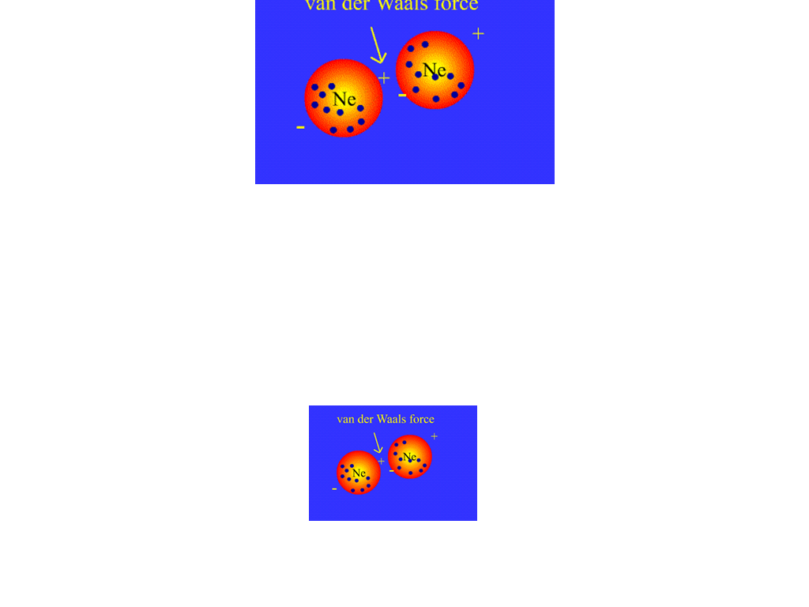

Slide 49
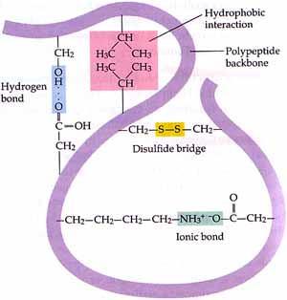
Bonds in proteins

Slide 50
Inter and Intramolecular bonds
Intermolecular bonds: bonds between molecules
Intramolecular bonds: bonds within the same
molecule.

Slide 51
