Slide 1
Mathematical Review

Slide 2
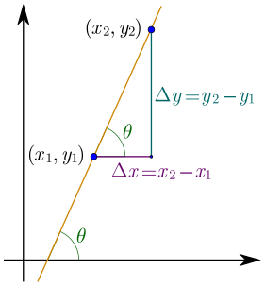
Differentiation
Differentiation is all about measuring change!
Measuring change in a linear function
The equation of a straight line is of the form of
$$y=mx+c$$
where $m$ is the gradient (slope ) of the straight line (constant) and $c$ is the y-intercept.
The slope or gradient of a line is a number that describes both the direction and the steepness of the line.
As the gradient of a straight line is the same at every point on the line it is easy to find.
The slope $m$ of a line is related to its angle of incline $θ$ by the tangent function $m=\tan{θ}.$Thus, a 45° rising line has a slope of +1 and a 45° falling line has a slope of −1.
$$Slope \left(m\right)= \frac{∆y}{∆x}=\tan{θ}$$

Slide 3
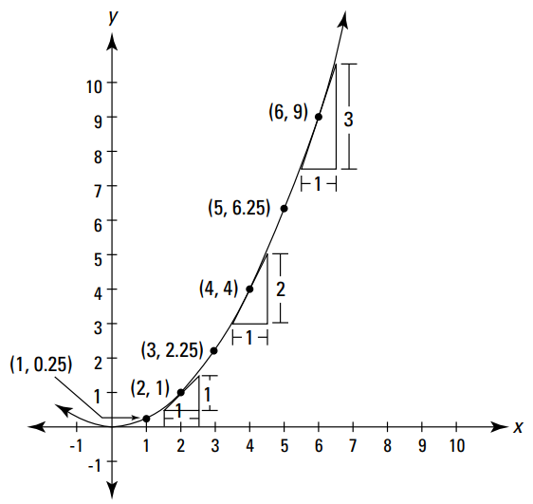
Differentiation
If the function is non-linear
Consider the graph of $y=\frac{1}{4}x^{2}$
The gradient (steepness) of the curve is not the same at all points. This means it is quite hard to find the gradient of a curve using the slope triangle method.
Therefore, an alternative method is needed to solve this problem.
$\frac{dy}{dx} \frac{1}{4}x^{2}$ = $\frac{1}{2}x$
if you want the slope at the point (3, 2.25), plug 3 into the $x$, and the slope is 1.5.

Slide 4
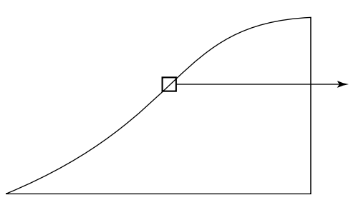
Differentiation
Finding the gradient of non-linear functions
We need to break up the curved line into small chunks and do each chunk separately.
When you zoom in far enough, the small length of the curving incline becomes practically straight. Then you can solve that small chunk just like the straight incline problem. Each small chunk can be solved the same way, and then you just add up all the chunks.
What is differentiation?
Differentiation is the process of finding a derivative of a curve. And a derivative is just the fancy calculus term for a curve’s slope or steepness.
$$y$$
$$↑$$
$$y$$
$$↑$$
A small portion of the curving incline blown up to several times its size.
$$→x$$
$$→x$$

Slide 5
Differentiation
Derivative of a function $y(x)$ at some point x is given by
$$\frac{dy}{dx}=\lim_{∆x→0}{\frac{y\left(x+∆x\right)−y(x)}{∆x}}$$
The symbol $\frac{dy}{dx}$ expresses the change of $y$ when $x$ change.
The function $y(x)$ depends only on one variable, $x$.
$x$ is called the independent variable.
Value of $y$ depends on the value of $x$.
$y$ is called the dependent variable.

Slide 6
Differentiation
Calculus is heavily used in quantum chemistry, and the following formulas should be memorized. (ɑ is a constant).

Slide 7
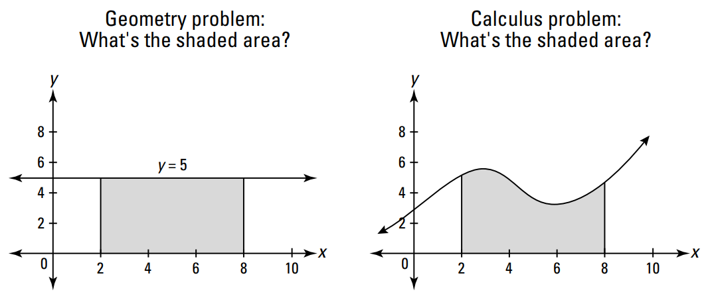
Integration
What is integration?
The process of Integration is finding the area beneath a curve.
Area = length x width
There’s no area formula for this shape.
So what do you do?

Slide 8
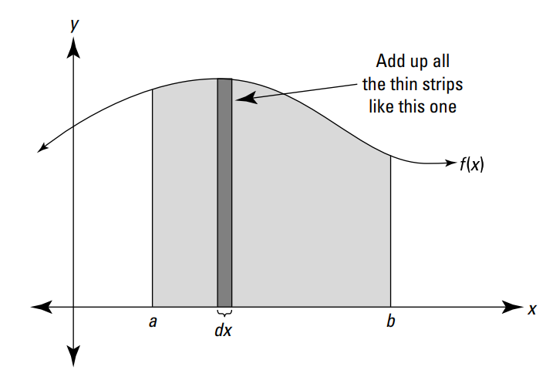
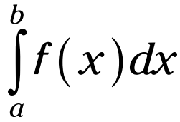
Integration
How can we find the area beneath a curve?
The area beneath a curve can be found by cutting up this area into tiny sections, figuring out their areas, and then adding them up to get the whole area.
An approximate value of area can be calculated by creating small rectangles and summing their area.
This process does not give a perfect answer however the smaller the width of the rectangles the lower the error in our answer would be.
Integration creates an infinite number of rectangles under the curve all with an infinitely small width and we sum their area to find the area under the curve leading to an answer with no error.
Integrating f(x) from a to b means finding the area under the curve between a and b.

Slide 9
Integration
The following formulas should be memorized. (ɑ is a constant).

Slide 10
Coordinate Systems
A coordination system is necessary to specify the location of a particle in space.
There are several types of coordinate systems. Each one has its own special uses.
The choice of a specific coordinate system is decided by the geometry of the given problem.
We will be using the following coordinate systems in this course:
1. Cartesian Coordinate System
2. Spherical Polar Coordinate System
3. Cylindrical Coordinate
4. Confocal Ellipsoidal Coordinate System

Slide 11
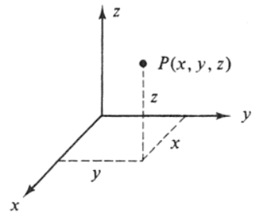
Coordinate Systems
Cartesian Coordinate System
The simplest set of coordinates are the usual cartesian coordinates. In this system, a particle in this system is specified in space using the three well known axes x, y, and z.

Slide 12
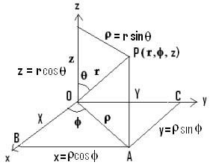
Coordinate Systems
2. Spherical Polar Coordinate System
In this coordinate system, a particle is specified in space using the three quantities $r, θ, and φ$.
where
$r$ is the radial distance from the origin.
$θ$ is the polar angle (inclination angle from z-axis).
$φ$ is a horizontal angle measured counterclockwise from the x-axis to the y-axis.

Slide 13
Coordinate Systems
The following equation show how to convert spherical coordinates to Cartesian coordinates.
$$\cos{θ= \frac{z}{r} } ⇒ z=r\cos{θ}$$
$$\sin{θ= \frac{ρ}{r} }⇒ ρ=r\sin{θ}$$
$\sin{φ= \frac{y}{ρ} }⇒ y=ρ\sin{φ}=r\sin{θ}$ $\sin{φ}$
$\cos{φ= \frac{x}{ρ} }⇒ x=ρ\cos{φ}=r\sin{θ}$ $\cos{φ}$

Slide 14
Coordinate Systems
When performing an integration operation using any of these coordinate systems, the integration must be taken for all space. Therefore, it is important to define the limits for the integration and the differential volume element dτ.
The integration limits and the differential volume element dτ for each coordinate system is as follows:
For cartesian coordinates:
$dτ=dx dy dz$
$$− ∞ ≤x ≤ ∞$$
$$− ∞ ≤y ≤ ∞$$
$$− ∞ ≤z ≤ ∞$$

Slide 15
Coordinate Systems
B) For spherical polar coordinates:
$dτ=r^{2}\sin{θ} dr dθ$ $dφ$
$$0 ≤r ≤ ∞$$
$$0 ≤θ≤ π$$
$$0 ≤φ≤2π$$

Slide 16
Coordinate Systems
Example:
Convert the spherical polar coordinates (r, $θ$, $φ$) = (-1, 30º, 120º) to Cartesian coordinates.
Solution:
$x=rsin θ{\cos{φ}}$
$x=−sin {30}^{∘}{\cos{{120}^{∘} }}$
$x$ $=0.25$
...............................................
$y=rsin θ{\sin{φ}}$
$x=−sin {30}^{∘}{\sin{{120}^{∘} }}$
$x$ $=−0.43$
...............................................
$z=r\cos{θ}$
$x=− cos {30}^{∘}$
$x$ $=−0.87$
The Cartesian coordinates for this point are:
(0.25, -0.43, -0.87)

Slide 17
Complex Numbers
Imaginary Numbers
Imaginary numbers allow us to find an answer to the question `what is the square root of a negative number?' We define $i$ to be the square root of minus one.
$$i= \sqrt{−1} or i^{2}=−1$$
We find the other square roots of a negative number say $−x$ as follows:
$\sqrt{−x}$ = $\sqrt{x ×−1 }$ = $\sqrt{x}$ $× \sqrt{−1 }$= $\sqrt{x}$ $× i$
Example:
Find the square root of:
a. $\sqrt{−9}$
b. $\sqrt{−13}$
Solution:
a.$\sqrt{−9}$ = $\sqrt{9 ×−1 }$ = $\sqrt{9}$ $× \sqrt{−1 }$= $\sqrt{9}$ $× i$
b.$\sqrt{−13}$ = $\sqrt{13 ×−1 }$ = $\sqrt{13}$ $× \sqrt{−1 }$= $\sqrt{13}$ $× i$

Slide 18
Complex Numbers
Complex numbers are numbers that involve the imaginary unit, i, which is defined to be the square root of $−1 \left(i= \sqrt{−1} or i^{2}=−1\right).$
A complex number (z) consists of two parts: A real part and imaginary part. Generally, we write a complex number as
$z=x+iy$
with
$x=Re\left(z\right)$and $y=Im\left(z\right)$
Complex numbers arise naturally when solving certain quadratic equations. For example, the two solutions to
$$z^{2} −2z+5=0$$
are given by
$z=1 ± \sqrt{−4} or z=1 ±$ $2i$
where 1 is said to be the real part and ±2 the imaginary part of the complex number z.

Slide 19
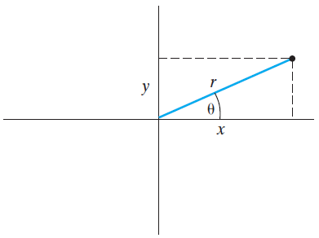
Complex Numbers
The complex number $z=x+iy$ can be presented as a point in a two-dimensional coordinate system.
The location of z can be specified by using either cartesian coordinates $\left(x,y\right),$where $x=Re\left(z\right)$and $y=Im\left(z\right)$, or polar coordinates $\left(r,ϴ\right).$
$r$ is the distance of the point $z$ from the origin which is called the absolute value or modulus of $z$ and is denoted by $\left|z\right|$.
$ϴ$is the angle that the radius vector to the point $z$ makes with the positive horizontal axis (the x-axis). It is called the phase angle of $z$.
$\left|z\right|=r=\sqrt{x^{2}+ y^{2}}$ , $\tan{ϴ= \frac{y}{x} }$
$x=r\cos{ϴ}, y=r\sin{ϴ}$

Slide 20
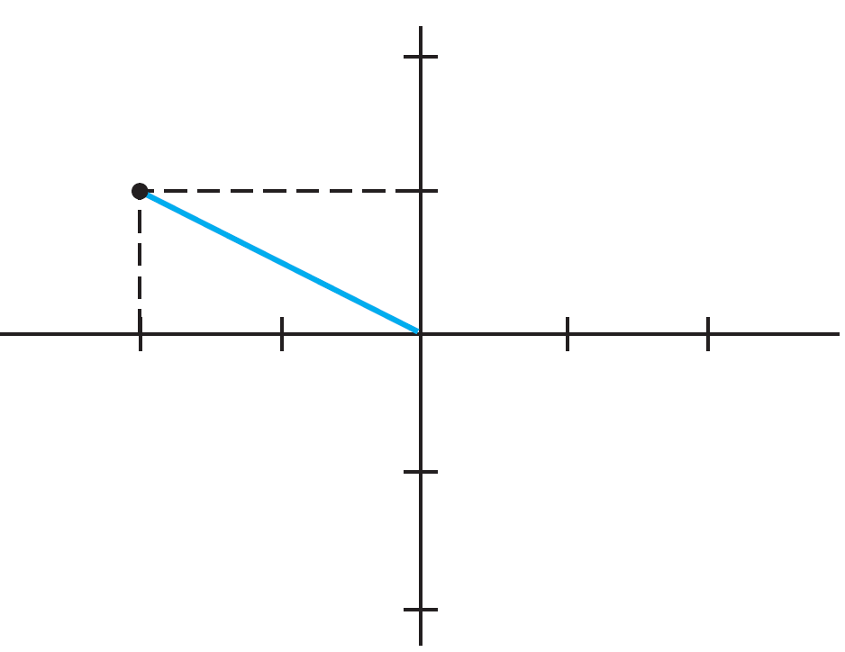
Complex Numbers
Example:
Plot the number $−2+i.$
Solution:
$$x=−2 and y=1$$
Therefore,
$$y$$
$$x$$

Slide 21
Complex Numbers
Expressing Complex Numbers using Exponential Function
We can always express $z=x+iy$ in terms of $r\operatorname{and}{ϴ}$ by using Euler's formula.
Since
$$x=r\cos{ϴ} and y=r\sin{ϴ}$$
so we may write $z=x+iy$ as
$$z=r\cos{ϴ+i}r\sin{ϴ}$$
$=r(cos{ϴ+i}\sin{ϴ)}$
since
$e^{iϴ}$ = $\cos{ϴ+i}\sin{ϴ}$ (Euler's formula)
therefore
${z=re}^{iϴ}$

Slide 22
Complex Numbers
Example:
Calculate the absolute value$\left|z\right|$and phase angle $Θ$ for the following complex numbers
3
$3+2i$
Solution:
$\left|z\right|=r=\sqrt{x^{2}+ y^{2}}$ , $\tan{Θ= \frac{y}{x} }$
a. $z=3$
$r=\sqrt{3^{2}+ 0^{2}}$ = 3 , $\tan{Θ= \frac{0}{3} }$ $⇒$ ${Θ= tan}^{−1}0{=0 }$
Thus, $\left|z\right|$ = 3 and $Θ$ = 0.
b. $z$ = $3+2i$
$r=\sqrt{3^{2}+ 2^{2}}$ = $\sqrt{15}$ , $\tan{Θ= \frac{2}{3} }$ $⇒$ ${Θ= tan}^{−1}$ $\frac{2}{3}$ = 0.588$π$ or 33.69º
Thus, $\left|z\right|$ = $\sqrt{15}$ and $Θ$ = 0.588$π$ or 33.69º.

Slide 23
Complex Numbers
Complex Conjugate $z$*
If $z=x+iy=re^{iθ}$the complex conjugate $z$* of the complex number $z$ is defined as
$$z\text{∗}=x−iy=re^{−iθ}$$
Therefore, in order to get the complex conjugate of any complex number we just change the root $i$ by $−i$.
Example:
Find the imaginary and real parts of the following complex numbers along with their complex conjugates.
a) $5$
b) $−3+i6$
c) $1 −2$ $\sqrt{3}$ $i$
d) $i$
Solution:
a) For $z=5$, we have Re(z) = 5, Im(z) = 0 and $z$*$=5$
b) For $z=−3+i6$, we have Re(z) = 3, Im(z) = 6 and $z$*$=−3−i6$
c) For $z=1 −2 \sqrt{3} i$, we have Re(z) = 1, Im(z) = $−2 \sqrt{3}$ and $z$*$=1+2 \sqrt{3} i$
d) For $z=i$, we have Re(z) = 0, Im(z) = 1 and $z$*$=−i$

Slide 24
Complex Numbers
Example: Find the value of $i$² and -$i$*
Solution:
Addition and Subtraction of Complex Numbers
When adding or subtracting complex numbers, , the real part is added to (or subtracted from) the real part and the imaginary part is added to (or subtracted from) the imaginary part. For example, if $z1=x1+iy1$ and $z2=x2+iy2$ , then
$z1 ±z2=(x1±x2$) $±$ $i$($y1±y2$)
Example:
If $z1=2+3i$ and $z2=1−4i$, calculate $z1−z2$ and $2z1+3z2$.
Solution:
$$z1−z2=\left(2−1\right)+\left(3+4\right)i=1+7i$$
$$2z1+3z2=2\left(2+3i\right)+3\left(1−4i\right)=4+6i+3 −12i=7−6i$$
$i$² = ($\sqrt{−1}$)² = -1
-$i$* = -(-$i$) = $i$

Slide 25
Complex Numbers
Multiplication and Division of Complex Numbers
To multiply complex numbers together, we simply multiply the two quantities as binomials and use the fact that $i^{2}=−1$.
For example,
$$\left(2 −i\right)\left(−3+2i\right)=−6+3i+4i −2i^{2}=−4+7i$$
For the product and quotient of two complex numbers $r1e^{iθ1}$ and $r2e^{iθ2}$, we have
$z1z2=$ $r1{r2e}^{i(θ1+ θ2)}$, $\frac{z1}{z2}= \frac{r1}{r2}e^{i(θ1− θ2)}$
Example:
Write the product of$zz$*.
Solution:
$zz$* = $\left(x+iy\right)\left(x−iy\right)=x2+iyx−iyx−i2y2=x2+y2=r2=|z|2$

Slide 26
Complex Numbers
Important Relations of Complex Numbers used in Quantum Mechanics
There are four important relations of complex numbers that are usually encounter in quantum mechanics and should be mentioned here.
$$e^{ikx}=\cos{kx+i\sin{kx}}$$
$$e^{−ikx}=\cos{kx−i\sin{kx}}$$
When these two equation are added to each other, we get a third important relation
$$\cos{kx=}\frac{1}{2}{(e}^{ikx} +e^{−ikx})$$
Also when these two equation are subtracted from each other, we get a fourth important relation
$$\sin{kx=}\frac{1}{2i}{(e}^{ikx} − e^{−ikx})$$

Slide 27
Operators
An operator is a symbol denoting an instruction to carry out an appropriate action, mathematical operation, on the object to its right.
For example, The operator + for example denotes the addition operation. Some other operators are symbols like –, x, ÷, ( )², cos, sin, ... etc.
An operator, $\hat{A}$, is usually represented by a symbol with a caret (‘hat’). . For example, $\hat{x}f(x)$ means multiplying the function $f(x)$ by the variable $x$.
One of the important operators in quantum chemistry is $\frac{d}{dx}$ which differentiates a function with respect to the variable $x$. This operator is usually represented by the symbol .

Slide 28
Operators
Example:
Perform the following operations
$\sqrt{25}$
cos 90°
$\hat{3}\left(x2+3ex\right)$
$\hat{D}\left(x2+3e2x\right)$
Solution:
$\sqrt{25}$ $=$ 5
cos 90° $=$ 0
$\hat{3}\left(x2+3ex\right)=3x2+9ex$
$\hat{D}\left(x2+3e2x\right)=2x+6e2x$

Slide 29
Operators
Linear Operators
An operator is said to be a linear operator if it fulfils the following two conditions:
and
where $a$ is a constant and $f$ and $s$ are functions.
Example:
Determine whether the following operators are linear or nonlinear:
$\hat{3}$
$\frac{d}{dx}$
$\sqrt{4}$

Slide 30
Operators
Solution:
Assuming $f$ and $g$ are any two functions and $a$ is a constant,
a)
$$\hat{3}\left(f+g\right)=3f+3g,$$
$$\hat{3}af=a3f$$
$⇒$ $\hat{3}$ is a linear operator.
b)
$$\frac{d}{dx}\left(f+g\right)=\frac{d}{dx}f+\frac{d}{dx}g,$$
$$\frac{d}{dx}af=a\frac{d}{dx}f$$
$⇒$ $\frac{d}{dx}$ is a linear operator.
c)
$$\sqrt{f+g} ≠ \sqrt{f}+\sqrt{g}$$
$⇒$ $\sqrt{f}$ is a nonlinear operator.

Slide 31
Operators
Hermitian Operators
An operator is said to be a Hermitian operator if it satisfies the following relation:
Commutation and non-commutation
The two operators and are said to commute if they fulfil the next condition:
The commutation relation of the two operators and is written as , and the commutation requirement is

Slide 32
Operators
Example: Check whether the following operators commute
$\hat{5}$ and $\frac{d}{dx}$ b) $\hat{x}$ and $\frac{d}{dx}$
Solution:
Using equation

Slide 33
Operators
Eigenfunctions and Eigenvalues
when an operator operates on a function, the outcome is another function
The function $f(x)$ is said to be an eigenfunction of the operator $\hat{O}$ if it satisfies the following condition
where $k$ is a constant called the eigenvalue.
For example, the function $e^{ax}$ is an eigenfunction of the operator $\frac{d}{dx}$.
$\frac{d}{dx}e^{ax}$ = ${ae}^{ax}$
the outcome is a constant ($a$) multiplying the original function.

Slide 34
Eigenfunctions and Eigenvalues
When an operator operates on a function, the outcome is another function
The function $f(x)$ is said to be an eigenfunction of the operator $\hat{O}$ if it satisfies the following condition
where $k$ is a constant called the eigenvalue.
Example: Is the function $e^{ax}$ an eigenfunction of the operator $\frac{d}{dx}$ and, if so, what is the corresponding eigenvalue?
Solution:
$\frac{d}{dx}e^{ax}$ = ${ae}^{ax}$ $⇒{ e}^{ax}$ $\text{is} \text{an} \text{eigenfunction} \text{of} \text{the} \text{operator}$ $\frac{d}{dx}$
the corresponding eigenvalue is ($a$).

Slide 35
Differential Equations
The Schrodinger equation, the most important equation in quantum mechanics describing the system under investigation, is a differential equation.
Kinds of Differential Equations
Ordinary differential equations: involve one variable.
Partial differential equations: involve more than one variable.
An ordinary differential equations represents the relation between an independent variable $x$ and dependent variable $y(x)$ and the first, second, …, and n^{th} differentiation of the dependent variable $y$ like
Any differential equations that can be written like this is said to be a linear differential equation of order $n$. If $g\left(x\right)=0$, then the equation is a homogenous.

Slide 36
Differential Equations
The simplest example of a homogenous linear differential equation is
$$\frac{dy}{dx} −a=0$$
where $a$ is a constant. The general solution for this equation is
$$y=ax+k$$
where $k$ and $a$ are constants.
For second order equations
$$\frac{d2y}{dx2}+k2y=0$$
This kind of equations is very important in quantum chemistry, and it has two kinds of solutions:
Trigonometric solution given by
$$y1\left(x\right)=A\sin{kx+B\cos{kx}}$$
Exponential solution given by
$$y2\left(x\right)=Ce^{ikx}+Be^{−ikx}$$

