Slide 1
The Harmonic Oscillator

Slide 2
The Harmonic Oscillator
Introduction
Why do we need to study harmonic oscillator model?
The harmonic oscillator system is important as a model for molecular vibrations. The vibrational energy levels of a diatomic molecule can be approximated by the levels of a harmonic oscillator
At first, we are going to study harmonic oscillator from a classical mechanical perspective and then will discuss the allowed energy levels and the corresponding wave function of the harmonic oscillator from a quantum mechanical point of view.
Later on we are going to describe the infrared spectrum of a diatomic molecules using the quantum mechanical energies. Also we are going to figure out how to determine molecular force constant.
Finally, we are going to learn selection rules for a harmonic oscillator and the normal coordinates which describe the vibrational motion of polyatomic molecules.

Slide 3
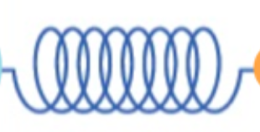
The Harmonic Oscillator
Consider two atoms of masses $m_{1}$ and $m_{2}$ linked together by a covalent bond. The spring represents the bond between these two atoms.
$k$ is called the force constant of the spring. A small value of $k$ implies a loose spring, and a large value of $k$ implies a stiff spring.
$re$ is the equilibrium distance between the two atoms (the length of spring at optimal distance between the two atoms).
The displacement for the equilibrium position, $x$, is given by
$$x = r –r_{e}$$
where $r$ is the length of spring and can be written as
$$r = |x2−x1|$$
$$re$$
$$m1$$
$$m2$$
$$k$$
$$x$$
$$x1$$
$$x2$$

Slide 4
The Harmonic Oscillator
Our task is to built a model for the potential energy as a function of position
$V\left(r\right) 0<r≤∞$
The coordinates for expressing potential energy is the “bond length”. Thus we want to built a model for all the possible bond lengths which can by any length between zero and infinity.
We know that if the diatomic molecules is subjected to very high energy (e.g. very large temperature), the bond between linked atoms will dissociate and the molecule returns back to its atoms. This implies that, the potential energy at infinite separation (some finite value) between the two atoms equals zero $V\left(∞\right)=0$.
Also, we know that, we cannot push the two linked atom together below some kind of threshold of distance separating them. This implies that, at short range, the potential energy approaches infinity, $V\left(0\right)=∞$.

Slide 5
The Harmonic Oscillator
$$r <re$$
$$re$$
$$r >re$$
At non-equilibrium length of the bond between the two linked atoms ($r <r_{e}$or $r >r_{e}$), the atoms feel a restoring force, $F(x)$ to the equilibrium bond length.
This restoring force is function of the displacement, $x$, of the spring from its equilibrium length. The direction of the restoring force that each atom feels is indicated by the arrow above atom. The equilibrium length $re$ implies the minimum energy.

Slide 6
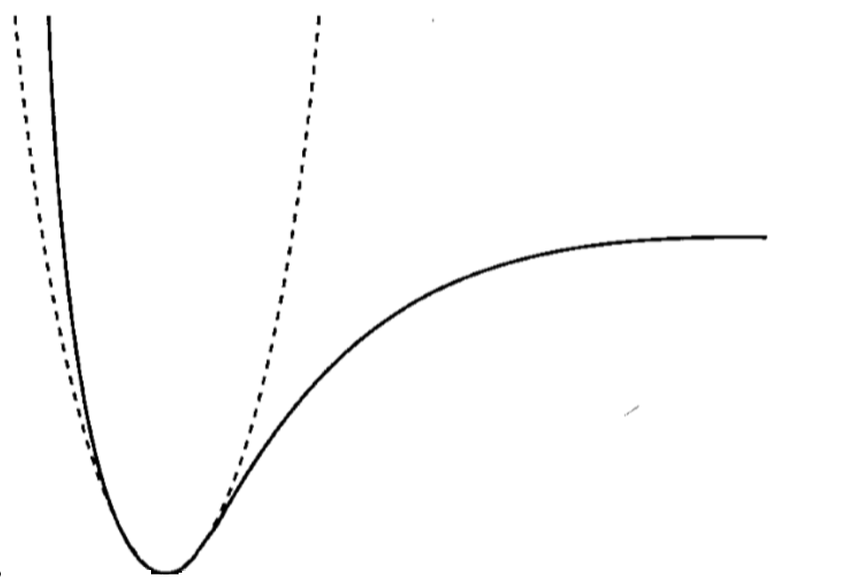
The Harmonic Oscillator
At the local minimum, the first derivative of the potential energy with respect to distance equals zero and the second derivative is a positive value.
$$\frac{dV_{(r_{e})}}{dr}=0 and \frac{d{2V}_{(r_{e})}}{dr2}>0$$
$$↑$$
$$E$$
$$V(r)$$
$$re$$
$$0$$
$$r$$
Here, the internuclear potential for a diatomic molecule is illustrated by the solid line. However, we are going to approximate the potential energy function as quadratic polynomial (the equation of a parabola that is superimposed on the potential energy function
$$V\left(r\right)=−De+\frac{1}{2}{k(r−r_{e})}^{2}$$
$$−De$$
$$re$$
Where $De$ is the dissociation energy, and $k$ is the value of the second derivative of potential energy function with respect to distance at equilibrium distance.
$$k={\left.\frac{d^{2}V(r)}{{dr}^{2}}\right|}_{r=r_{e}}$$
Remember that, the displacement is given by ($x = r –re$). If we put the minimum at zero instead of $–De$then we can write the potential energy functions as
$V\left(x\right)=V\left(r\right)+De=\frac{1}{2}{k(r−r_{e})}^{2}$ $⇒$ $V\left(x\right)=\frac{1}{2}{kx}^{2}$
6

Slide 7
The Harmonic Oscillator
1. Simple harmonic motion from the view of classical mechanics
Now, we want to look at the time trajectory of a harmonic oscillator in classical mechanics.
The force that is felt by the individual atoms is the force which restores it to the minimum energy position.
$$F\left(x\right)=−\frac{dV\left(x\right)}{dx}=−\frac{d}{dx}\left(\frac{1}{2}kx^{2}\right)=−kx^{2}$$
this is what is known as $(Hooke^{′}s law).$
the negative sign indicates that the force points to the opposite direction of the motion.
Notice that, the force is getting linearly bigger as the displacement gets bigger and bigger.
Now, let’s assume that, the harmonic oscillator particle is oscillating along the $x$ axis between the point $+A$ and $−A$
$$\vec{F}(x)$$
$$V(x)$$
$$x →$$
7

Slide 8
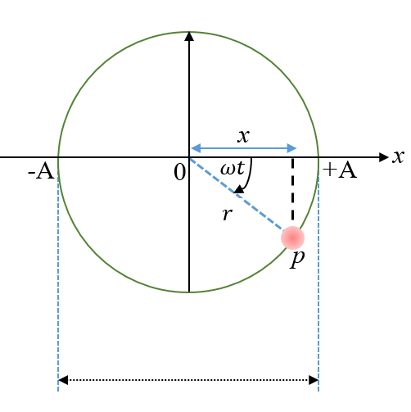
The Harmonic Oscillator
$$Displacement$$
This harmonic oscillator can be presented by a point, $p$, oscillating back and forth between $+A$ and $− A$ with a radius $r$ from the origin and with an angular velocity of $ω.$ The displacement, $x$, of point $p$ is given by
$$x=r cos⁡ωt$$
The displacement expression can be used to plot the relation between displacement $x$ and time $t$ as shown below ($see next slide$).

Slide 9
The Harmonic Oscillator
An illustration of the trajectory of a harmonic oscillator versus time.
The cosine function repeats itself every 2$π$ radians.
The mass oscillates back and forth between $A$ and $− A$ with a frequency given by
$$ν=\frac{ω}{2π}$$
The quantity $A$ is called the amplitude of the vibration.
Now, Let's look at the total energy of a harmonic oscillator.

Slide 10
The Harmonic Oscillator
According to Newton’s second law of motion, the force is given by
$$F = ma$$
where $m$ is the mass of the moving body and $a$ is its acceleration.
since the acceleration ($a$) is defined as
$$a=\frac{d^{2}x}{{dt}^{2}}$$
therefore we can write
$$F =m\frac{d^{2}x}{{dt}^{2}}$$
If we equate $Newton′s equation$with $Hooke′s law force$we obtain that
$$m\frac{d^{2}x}{{dt}^{2}}=−ky$$
If we rearrange this equation, we get
$$\frac{d^{2}x}{{dt}^{2}}=−\frac{k}{m}x$$
where,
$ω$=$\sqrt{k/m}$

Slide 11
The Harmonic Oscillator
$$\frac{d^{2}x}{{dt}^{2}}=−ω2x$$
this is a linear homogenous differential equation whose solution is very well known and given by
$$x(t)=A\cos{ωt}+B\sin{ωt or x(t)=Ce^{iωt}+De^{−iωt} }$$
Now, we need specify the “initial condition” of our harmonic oscillator particle. We will specify the initial position and initial velocity v. Thus, let’s assume that the particle is found somewhere along the curve but it going to be still.
$$\text{v}\left(0\right)={\left.\frac{dx}{dt}\right|}_{t=0}=0$$
The first derivative of the first solution with respect to $t$ is
$$\frac{dx}{dt}=−Aω\sin{ωt}+Bω\cos{ωt}$$

Slide 12
The Harmonic Oscillator
At $t=0$ we can write
${\left(\frac{dx}{dt}\right)}_{t=0}=−Aω\sin{0}+Bω\cos{0=}$ $Bω=0$
For this equation to be true, we must have either $B =0$ or $ω=0$. we will choose $B=0$ because $ω$ is given by
$ω$=$\sqrt{k/m}$
where $k$ is defined as the spring constant measured as the second derivative of the potential energy function with respect to time. It is a measure of the curvature of the parabola and we do not want this to be set to zero. Also, we could make $ω=0$ by making the mass $m$ very large, but in practice this is not useful since we are interested in in quantum mechanical behavior (very small masses).

Slide 13
The Harmonic Oscillator
Now, by setting B=0, the equation
$x(t)=A\cos{ωt}+B\sin{ωt }$
becomes
$$x(t)=A\cos{ωt}$$
where $A$ is the amplitude which is the maximum displacement from the reference. The value of $x$ at any time will be any value between $+A$ and $–A$.
$–A≤x≤$ $+A$
The frequency of the oscillation depends on the spring constant and the mass of the particle.
Now, let’s try to find the classical harmonic oscillator energy expression.
We know that, The total energy is give by
$$E=T+V$$

Slide 14
The Harmonic Oscillator
$$E=\frac{1}{2}m{\text{v}}^{2}+\frac{1}{2}kx^{2}$$
The velocity, v at any given time is obtained as the first derivative of position with respect to time.
$$\text{v}\left(t\right)=\frac{dx(t)}{dt}=\frac{d}{dt}(A\cos{ωt)}=−Aω sin{ωt}$$
Now we can write the total energy expression as
$$E=\frac{1}{2}m{\left(−Aω sin{ωt}\right)}^{2}+\frac{1}{2}k{\left(A\cos{ωt}\right)}^{2}$$
$$=\frac{1}{2}mA^{2}ω^{2}\sin^{2}\left(ωt\right)+\frac{1}{2}kA^{2}\cos^{2}\left(ωt\right)$$
$$mA^{2}ω^{2}=mA^{2}{\left(\sqrt{k/m}\right)}^{2}=mA^{2}\left(\frac{k}{m}\right)=kA^{2}$$
$⇒$ $E=\frac{1}{2}kA^{2}(\sin^{2}\left(ωt\right) +\cos^{2}\left(ωt\right))$

Slide 15
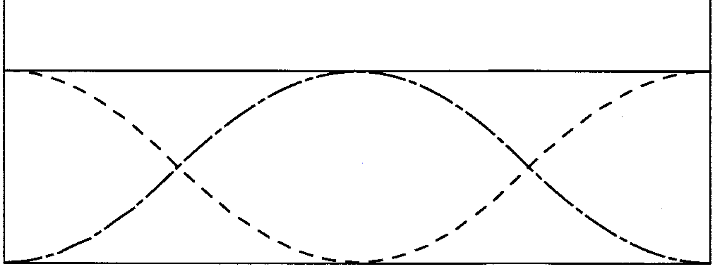
The Harmonic Oscillator
$⇒$ $E=\frac{1}{2}kA^{2}$
The total energy is conserved so that the total energy of a harmonic oscillator is constant. It is converted between kinetic and potential energy. At large displacement, the kinetic energy is zero and the energy is equal to the potential energy. As can be seen from the figure below, the total energy is distributed between the kinetic energy and the potential energy of
during one oscillation. Both kinetic energy and potential energy oscillates in time between zero and its maximum value
$$E=T\left(x\right)+V(x)$$
$$V(x)$$
$$T(x)$$
$$− A$$
$$0$$
$$+ A$$
$$x$$

Slide 16
Reduced Mass
We have seen that, the angular velocity of a harmonic oscillator, $ω$ is given by
$ω$=$\sqrt{k/m}$
The question that arises is that, in a diatomic molecule case, what mass should be used in this angular velocity expression?
To answer this questions, let’s revise few things of what we have already seen before.
$$x = r –r_{e}=x2−x1−r_{e}$$
$$V\left(x\right)=\frac{1}{2}{kx}^{2}$$
$$re$$
$$m1$$
$$m2$$
$$k$$
$$−\frac{dV\left(x\right)}{dx}=F\left(x\right)=ma=m\frac{d^{2}x}{{dt}^{2}}$$
$$x$$
$$x(t)=A\cos{ωt}$$
$$x1$$
$$x2$$
$r = |x2−x1|$
$ω$=$\sqrt{k/m}$

Slide 17
Reduced Mass
Let’s write Newton's second law for each atom
$$m_{1}\frac{d^{2}x_{1}}{{dt}^{2}}=k\left(x2−x1−r_{e}\right)=kx and m_{2}\frac{d^{2}x_{2}}{{dt}^{2}}=k\left(x2−x1−r_{e}\right)=−kx$$
If we add these two equation together, we obtain
$$m_{1}\frac{d^{2}x_{1}}{{dt}^{2}}+m_{2}\frac{d^{2}x_{2}}{{dt}^{2}}=0$$
thus, we can write
$$\left(m_{1}+{ m}_{2}\right)\frac{d^{2}}{{dt}^{2}}\left(\frac{m_{1}x_{1}+{ m}_{2}x_{2}}{m_{1}+{ m}_{2}}\right)=0$$
Where
$M= m_{1}+{ m}_{2}$ , $M$ is the total mass
and
$\frac{m_{1}x_{1}+{ m}_{2}x_{2}}{m_{1}+{ m}_{2}}$ is the center of the mass ($C.M$).
Now, we can write
$$M\frac{d^{2}C.M}{{dt}^{2}}=0$$
This means that, the center of the mass doesn’t move.

Slide 18
Reduced Mass
Now, if we subtract these two equation from each other
$$m_{1}\frac{d^{2}x_{1}}{{dt}^{2}}=k\left(x2−x1−r_{e}\right)=kx and m_{2}\frac{d^{2}x_{2}}{{dt}^{2}}=k\left(x2−x1−r_{e}\right)=−kx$$
we get
$$\frac{d^{2}x_{2}}{{dt}^{2}}−\frac{d^{2}x_{1}}{{dt}^{2}}=−\frac{k}{m_{2}}x−\frac{k}{m_{1}}x$$
$$\frac{d^{2}}{{dt}^{2}}\left(x_{2}−x_{1}\right)=−k\left(\frac{1}{m_{2}}+\frac{1}{m_{1}}\right)x$$
$$\frac{1}{m_{2}}+\frac{1}{m_{1}}= \frac{1}{μ}$$
$$μ={\left(\frac{1}{m_{2}}+\frac{1}{m_{1}}\right)}^{−1}=\frac{m_{1}m_{2}}{{m_{1}+m}_{2}}$$
$$μ \frac{d^{2}x}{{dt}^{2}}=−kx ⇒ μ a=F(x)$$
Thus, $ω$=$\sqrt{k/μ}$

Slide 19
The Harmonic Oscillator
2. Simple Harmonic Motion from the View of Quantum Mechanics
In order to know the wave function that describe the harmonic vibrational motion for the simple harmonic oscillator and the allowed energy levels, we have to solve the Schrödinger equation
$$\hat{H}ψ=Eψ$$
the Hamiltonian operator is given by
$$\hat{H}=\hat{T}+\hat{V}$$
the kinetic energy operator is given by
$$\hat{T}=−\frac{ℏ^{2}}{2μ}\frac{d^{2}}{{dx}^{2}}$$
notice that, we are assuming that the motion of the simple harmonic oscillator (e.g. the vibration of a diatomic molecule) is in one direction and we assumed that the motion is along the $x−axis$.
The potential energy operator
$$\hat{V}=\frac{1}{2}kx^{2}$$

Slide 20
The Harmonic Oscillator
Now substituting $\hat{T}$ and $\hat{V}$ into the one-dimensional Schrödinger equation gives
$$−\frac{ℏ^{2}}{{2μ}^{2}}\frac{d^{2}ψ\left(x\right)}{{dx}^{2}}+\frac{1}{2}kx^{2}ψ\left(x\right)=E ψ\left(x\right)$$
After some effort, the eigenfunctions are
$ψ_{υ}\left(x\right)=N_{υ}H_{υ}{\left(α^{\frac{1}{2}} x\right)e}^{−\frac{αx^{2}}{2}}$ $υ$ = 0, 1, 2, …
where
$H_{υ}$ is the Hermite polynomial of degree $υ$.
$α$ is defined as:
$$α=\frac{2πμν}{ℏ}$$
$N_{υ}$ is the normalization constant which is defined as:
$$N_{υ}={\left(2^{υ}υ!\right)}^{−\frac{1}{2}}{\left(\frac{α}{π}\right)}^{\frac{1}{4}}$$

Slide 21
The Harmonic Oscillator
The eigenvalues are
$E_{υ }= \left(υ + \frac{1}{2}\right)$ $hν$ $υ=0, 1, 2, 3, …$
where $υ$the quantum number $υ$.
Notice that, the energy is restricted to the quantized values
Recall that,
$ν=\frac{ω}{2π} and ω\text{=}\sqrt{k/μ}$ $⇒ ν=\frac{1}{2π}\sqrt{k/μ}$
And
$ℏ=\frac{h}{2π}$ $⇒h=ℏ$ $2π$
Therefore,
$E_{υ }=ℏ{\left(k/μ\right)}^{\frac{1}{2}}$ $\left(υ + \frac{1}{2}\right)$
${ E}_{υ }$ $=ℏω\left(υ + \frac{1}{2}\right)$

Slide 22
The Harmonic Oscillator
The first few harmonic-oscillator wave functions.
$$ψ_{0}\left(x\right)={\left(\frac{α}{π}\right)}^{\frac{1}{4}}e^{\frac{{−αx}^{2}}{2}}$$
$$ψ_{1}\left(x\right)={\left(\frac{{4α}^{3}}{π}\right)}^{\frac{1}{4}}{xe}^{\frac{{−αx}^{2}}{2}}$$
$$ψ_{2}\left(x\right)={\left(\frac{α}{4π}\right)}^{\frac{1}{4}}{(2αx^{2}−1)e}^{\frac{{−αx}^{2}}{2}}$$
$$ψ_{3}\left(x\right)={\left(\frac{α^{3}}{9π}\right)}^{\frac{1}{4}}{(2αx^{3}−3x)e}^{\frac{{−αx}^{2}}{2}}$$
The parameter $α=\frac{2πμν}{ℏ}=\frac{{\left(kμ\right)}^{\frac{1}{2}}}{ℏ}$

Slide 23
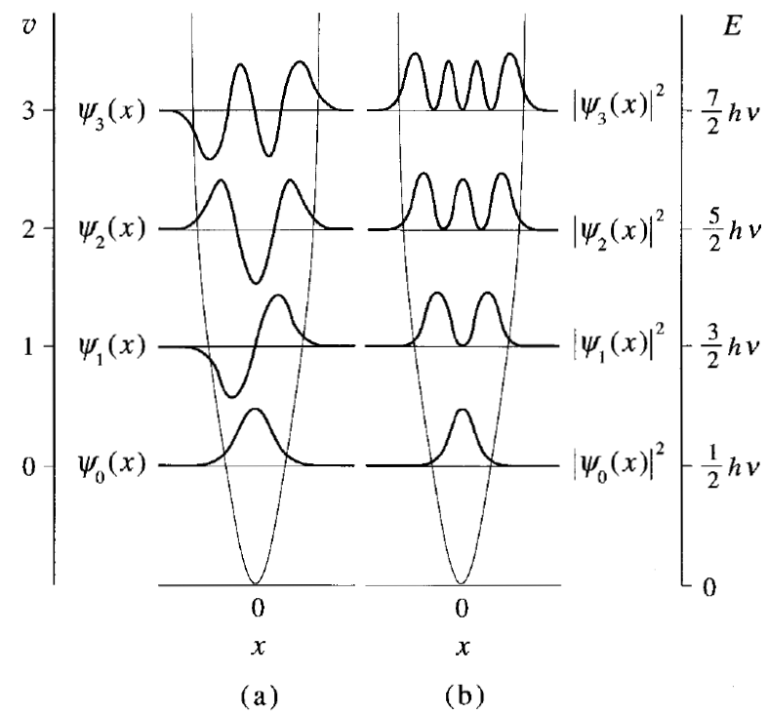
The Harmonic Oscillator
(a) The normalized harmonic-oscillator wave functions.
(b) The probability densities for a harmonic oscillator.

Slide 24
The Harmonic Oscillator
Vibrational Energy
If we model the potential energy function of a diatomic molecule as a harmonic oscillator, then the vibrational energy levels of the diatomic molecule are given by
$E_{υ }=ℏ{\left(k/μ\right)}^{\frac{1}{2}}$ $\left(υ + \frac{1}{2}\right) υ=0, 1, 2, 3, …$
where the force constant $k$ is given by
$$k={\left(2πν\right)}^{2}μ={\left(2πc\overline{ν}\right)}^{2}μ$$
and the reduced mass μ is given by
$$μ=\frac{m_{1}m_{2}}{{m_{1}+m}_{2}}$$
A diatomic molecule can make a transition from one vibrational energy state to another by absorbing or emitting electromagnetic radiation whose observed frequency satisfies the Bohr frequency condition
$$∆E=hν_{obs}$$

Slide 25
The Harmonic Oscillator
The lowest vibrational energy is at $υ=0$ given by
$E_{0 }=\frac{1}{2}hν$
This is the zero point energy for the simple harmonic motion. Note that even at zero Kelvin the vibrational energy does not equal zero but still have value given by the above equation.
Vibrational spectroscopy is very important in all aspects of chemistry. It appears in the $IR$ region of the electromagnetic radiation.
The spectrum usually appears when a transition between two energy levels takes place.
The harmonic-oscillator model allows transitions only between adjacent energy states, so that we have the condition that $∆υ=±1$. Such a condition is called a selection rule.

Slide 26
The Harmonic Oscillator
According to selection rules, the vibrational energy (the energy difference between to adjacent vibrational levels) is given by
${∆E=E}_{υ+1}−E_{υ }= \left(υ\text{ +} 1+ \frac{1}{2}\right)$ $hν − \left(υ+ \frac{1}{2}\right)$ $hν$
$$∆E=hν_{obs} joules$$
The observed frequency of the radiation absorbed is
$$ν_{obs}=\frac{1}{2π}\sqrt{k/μ}$$
The vibrational energy is usually measured in ${cm}^{−1}$. Thus, we need to use ${\overline{ν}}_{obs}$ instead of $ν_{obs}$.
Recall that,
$$c=ν λ ⇒ ν=\frac{c}{λ}=c \overline{ν}$$
thus we can write
$${\overline{ν}}_{obs}=\frac{1}{2πc}\sqrt{k/μ}$$

Slide 27
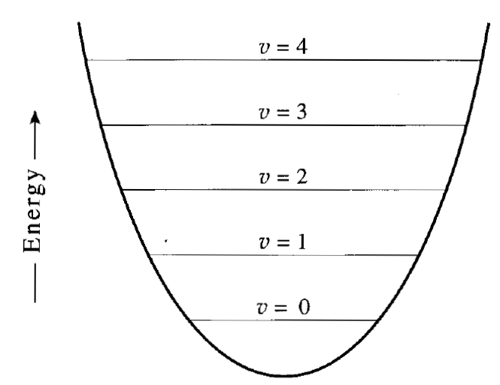
The Harmonic Oscillator
The energy levels of a quantum-mechanical harmonic oscillator.
$$\frac{9}{2}hν$$
$$\frac{7}{2}hν$$
$$\frac{5}{2}hν$$
$$\frac{3}{2}hν$$
$$\frac{1}{2}hν$$
because successive energy states of a harmonic oscillator are separated by the same energy, $∆E$ is the same for all allowed transitions, so this model predicts that the spectrum consists of just one line whose frequency is given by
$${\overline{ν}}_{obs}=\frac{1}{2πc}\sqrt{k/μ}$$
This prediction is in good accord with experiment, and this line is called the fundamental vibrational frequency.

Slide 28
The Harmonic Oscillator
Example: If the transition energy between two adjacent vibrational levels in the hydrogen molecule, H₂ equals 4159.5 cm⁻¹, calculate the force constant of the bond H-H bond in H₂ molecule.
Solution:
The reduced mass of H₂ molecule.
$μ_{H_{2}}=\frac{m_{H}m_{H}}{{m_{H}+m}_{H}}= \frac{1.0079 ×1.0079}{1.0079+1.0079}=\frac{1.0079 }{2}$ amu $×\frac{1.66 ×{10}^{−27} \text{kg}}{1\text{amu}}$
$=8.365$ $×{10}^{−28}kg$
The force constant is given by
$$k={\left(2πc\overline{ν}\right)}^{2}μ$$
$k_{H_{2}}{=\left(2 ×\text{3.}\text{14 }×\text{(}\text{3 }×{10}^{10}\frac{cm}{s}\text{)} ×\text{4159.}\text{5 }{cm}^{−1} \right)}^{2}×8.365$ $×{10}^{−28} kg$
$$k_{H_{2}}=513.7\frac{kg}{s2} =513.7 {N m}^{−1}$$
Remember that, 1N= kg/ms²

Slide 29
The Harmonic Oscillator
Anharmonic Oscillator
It was mentioned earlier that the vibration of molecules in chemistry can be represented by the simple harmonic vibration. But it is found that the vibration of real molecules differs slightly from the simple harmonic vibration. The vibration of real molecule is not harmonic. It is anharmonic.
The difference between the harmonic and anharmonic movements is that:
During the real vibration movement, when the two nuclei representing the molecule approach each other, the force of repulsion between the two nuclei increases much more than what the simple harmonic movement represents.
Also, when the nuclei move away in the case of the extension of the bond during the vibration movement, they may reach a range where the bond can be broken and this is not allowed in the case of simple harmonic motion.
Also, the simple harmonic motion curve is symmetrical and this symmetry is not present in the real vibration movement.

Slide 30
The Harmonic Oscillator
Now we need to find the potential energy ($V$) equation that represents the anharmonic movement and replace it in the Schrödinger equation and then solve Schrödinger equation to find the wave functions and energy levels possible for the anharmonic vibrational motion.
Several potential energy equations have been suggested, however, the best one is the Morse Empirical Potential Energy Function which is given by
$$V\left(x\right)=D_{e}{\left[1−e^{−ax}\right]}^{2}$$
Where $D_{e}$ is the dissociation energy, $a$ is constant that depends on the nature of the molecule, and $x$ represents the displacement of the equilibrium position of the two atoms making the bond.
$$x = r –r_{e}$$
where $r$ is the length of the bond and $re$ is the equilibrium distance between the two atoms.

Slide 31
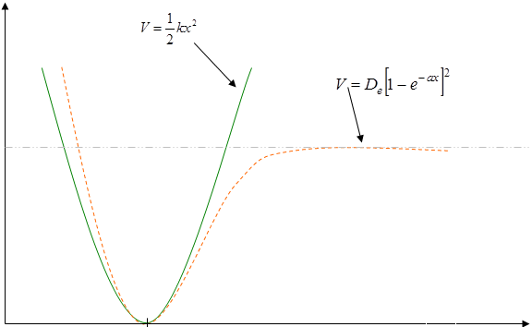
The Harmonic Oscillator
A comparison of the harmonic oscillator potential (solid line) with the anharmonic oscillator (dashed line) of a diatomic molecule.
As can be deduced from the figure, the harmonic oscillator potential is a satisfactory approximation at small displacements.
$$↑$$
$$E$$
$$V(r)$$
$$−De$$
$$re$$
$$r$$

Slide 32
The Harmonic Oscillator
When the Schrödinger equation is solved using the Morse potential the energy of the different energy levels is given by
$$ε_{υ}= \left(υ+ \frac{1}{2}\right){\overline{ω}}_{e} − {\left(υ+ \frac{1}{2}\right)}^{2}{\overline{ω}}_{e}x_{e} {cm}^{−1} υ=0, 1, 2, …$$
Where $υ$is the vibrational quantum number, ${\overline{ω}}_{e}$ is the equilibrium vibrational frequency in cm⁻¹, $x_{e}$ is the anharmonicity constant which takes small values at low values of $υ$ (about 0.01 cm⁻¹).
Note that the first term in the above equation is the same for harmonic oscillator, the second term is the correction for the anharmonicity which takes small values for law values of the quantum number $υ$, but increases as the value of $υ$increases.

Slide 33
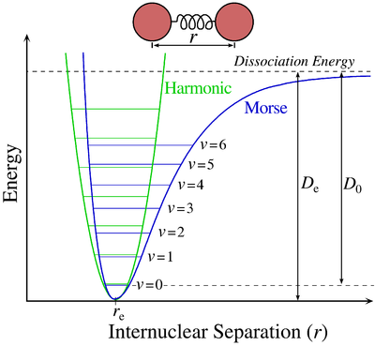
The Harmonic Oscillator
The Morse potential (blue) and harmonic oscillator potential (green). Unlike the energy levels of the harmonic oscillator potential, which are evenly spaced, the Morse potential level spacing decreases as the energy approaches the dissociation energy. The dissociation energy D_{e} is larger than the true energy required for dissociation D₀ due to the zero point energy of the lowest ($υ$ = 0) vibrational level.
Source: https://en.wikipedia.org/wiki/Morse_potential

