Slide 1
The Rigid Rotor

Slide 2
The Rigid Rotor
Introduction
Why do we need to study rigid rotor model?
Rigid rotor is used to model the rotational motion of a diatomic molecule.
In this chapter we will discuss the quantum-mechanical energies of a rigid rotator and show their relation to the rotational spectrum of a diatomic molecule. We will use the rotational spectrum of a diatomic molecule to determine the bond length of the molecule.
The total energy of a molecular system is a sum of four energies
$$E_{total}=E_{trans}+E_{vib}+E_{rot}+E_{elec}$$
Translational Energy: $E_{trans}= \frac{1}{2}{m\text{v} }^{2}$
Vibrational Energy: (was discussed in the previous chapter).
Rotational Energy: (will be discussed in this chapter).
Electronic Energy: It is beyond the scope of this course except that of hydrogen atom as we shall see in the next chapter.

Slide 3
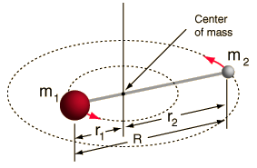
The Rigid Rotor
The rigid rotor model consists of two point masses $m_{1}$ and $m_{2}$ at fixed distances $r_{1}$ and $r_{2}$ from their center of mass.
The distance between the two point masses $m_{1}$ and $m_{2}$is give by
$$R= r1 + r2$$
Image source: http://hyperphysics.phy-astr.gsu.edu/hbase/molecule/rotrig.html

Slide 4
The Rigid Rotor
Solution of the Schrödinger equation of the rigid rotor
Suppose we have a diatomic molecule where $m_{1}$ is the mass of one atom and and $m_{2}$ is the mass of the other atom where the distances between these two atoms and their center of mass are $r_{1}$ and $r_{2}$ respectively.
The bond length between the two atoms is given by
$$r= r1 + r2$$
Now, we want to solve Schrödinger equation of this system
$\hat{H}ψ=Eψ$
$$\left(−\frac{ℏ}{2m}∇^{2}+V\right)ψ=Eψ$$
By finding first the appropriate form of $\hat{H}$ and then solving the equation to find $ψ$ and $E$.

Slide 5
The Rigid Rotor
The Schrödinger equation of the rigid rotator model written with respect to $r$, $θ$ and $φ$ is
$$−\frac{ℏ}{2I}\left[\frac{1}{\sin{θ}}\frac{∂}{∂θ}\left(\sin{θ}\frac{∂ψ}{∂θ}\right)+\frac{1}{\sin^{2}θ}\frac{∂^{2}ψ}{{∂φ}^{2}}\right]=Eψ$$
After a little effort, the eigenfunctions can be shown to be the spherical harmonics
$$Y_{j}^{m}(θ,)={\left[\frac{2\left(j+1\right)\left(j−\left|m\right|\right)!}{4π \left(j+\left|m\right|\right)!}\right]}^{\frac{1}{2}} P_{j}^{|m|}(\cos{θ)}e^{imφ}$$
where
$$m=±j,±\left(j−1\right),±\left(j−2\right), …,±1, 0$$
And $P_{j}^{|m|}$ are the associated Legendre functions.

Slide 6
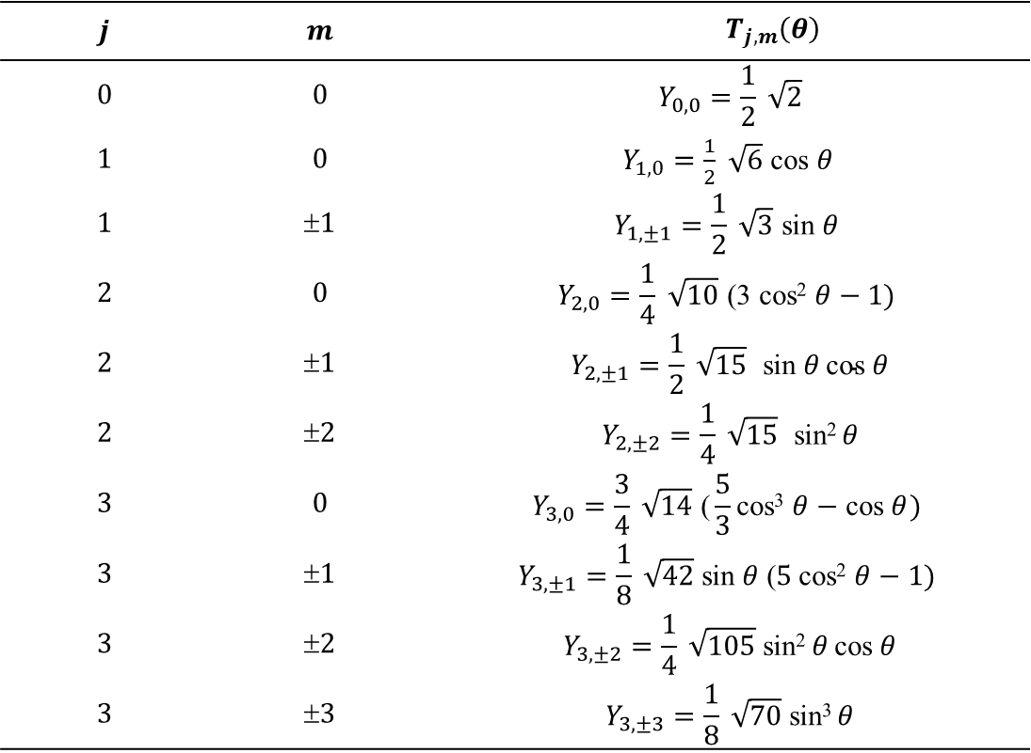
The Rigid Rotor
Values of $Y_{j,m}\left(θ\right)$ at different values of $j$ and $m$.
$$T_{j,m}\left(θ\right)$$ | $$m$$ | $$j$$
$$Y_{0,0}=\frac{1}{2} \sqrt{2}$$ | $$0$$ | $$0$$
$Y_{1,0}=\frac{1}{2} \sqrt{6}$ cos $θ$ | $$0$$ | $$1$$
$$Y_{1,±1}=\frac{1}{2} \sqrt{3} \text{sin} θ$$ | $$1$$ | $$1$$
$$Y_{2, 0}=\frac{1}{4} \sqrt{10} \text{(}\text{3 }\text{cos}\text{2} θ−1)$$ | $$0$$ | $$2$$
$$Y_{2, ±1}=\frac{1}{2} \sqrt{15} \text{sin} θ \text{cos} θ$$ | $$1$$ | $$2$$
$$Y_{2, ±2}=\frac{1}{4} \sqrt{15} \text{sin}\text{2} θ$$ | $$2$$ | $$2$$
$$Y_{3, 0}=\frac{3}{4} \sqrt{14} \text{(}\frac{5}{3}\text{cos}\text{3} θ−\text{cos} θ)$$ | $$0$$ | $$3$$
$$Y_{3, ±1}=\frac{1}{8} \sqrt{42} \text{sin} θ \text{(}5 \text{cos}\text{2} θ−1)$$ | $$1$$ | $$3$$
$$Y_{3, ±2}=\frac{1}{4} \sqrt{105} \text{sin}\text{2} θ \text{cos} θ$$ | $$2$$ | $$3$$
$$Y_{3, ±3}=\frac{1}{8} \sqrt{70} \text{sin}\text{3 }θ$$ | $$3$$ | $$3$$

Slide 7
The Rigid Rotor
Rigid rotor Energy levels
The eigenvalues are simply
$E_{j}=\frac{ℏ^{2}}{2I}j\left(j+1\right)$ $joules, j=0, 1, 2 ,3, …$
$\frac{ℏ^{2}}{2I}=\frac{h^{2}}{8π^{2}μr^{2}}=B ⇒$ $E_{j}=Bj\left(j+1\right)$ $joules$
$"j"$ is called “rotational quantum number”.
…………………………………………………………………………………………………………………………........
In spectroscopy, it is preferred to report $Ej$ in the unit of ${cm}^{−1}$. Therefore,
$$ε_{j}=\frac{E_{j}}{hc}= \frac{h}{8π^{2}μr^{2}c}j\left(j+1\right)$$
$$ε_{j}=\tilde{B}j\left(j+1\right) {cm}^{−1}, j=0, 1, 2 ,3, …$$
where $B$ is a constant called “rotational constant”.
$$\tilde{B}= \frac{h}{8π^{2}μr^{2}c}= \frac{h}{8π^{2}Ic}{ cm}^{−1}$$
Notice that: $hc\tilde{B}=B$

Slide 8
The Rigid Rotor
The energy levels and absorption transitions of a rigid rotator.
$$j$$
$$E_{j}=20\tilde{B}$$
$$∆E=8\tilde{B}$$
$$E_{j}=12\tilde{B}$$
$$∆E=6\tilde{B}$$
$$E_{j}=6\tilde{B}$$
$$∆E=4\tilde{B}$$
$$E_{j}=2\tilde{B}$$
$$∆E=2\tilde{B}$$
$$E_{j}=0$$
$2B$ 4B 6B 8B …
$\overline{ν}$ $→$

Slide 9
The Rigid Rotor
Rotational Transition Energy
The selection rules for the rotational transition is
$$∆j=±1$$
In the case of absorption of electromagnetic radiation, the molecule goes from a state with a quantum number $j$ to one with $j+1$, we have
$$\overline{ν}=ε_{j+1}−ε_{j}=\tilde{B}\left(j+2\right)\left(j−1\right)−\tilde{B}j\left(j+1\right)$$
$=2\tilde{B}\left(j+1\right)$ ${cm}^{−1}$
This means that, the rotational spectrum is composed of several lines and the distance between each line and it subsequent one is $2\tilde{B}$($see slide 8$).

Slide 10
The Rigid Rotor
Example
In the rotational spectrum of C≡O gas, the spacing between the adjacent lines is found to be 3.84235 cm⁻¹. Find the bond length for the molecule C≡O.
Solution:
$$3.84235{ cm}^{−1}= 2\tilde{B}$$
thus, $\tilde{B}= 1.92118{ cm}^{−1}$
$$\tilde{B}=\frac{h}{8 π^{2} I c}$$
$$I=\frac{6.626 ×{10}^{−34} Js }{8 π^{2}×{ 1.921\text{1} {cm}^{−1}×3.0×10}^{10} cm/s}$$
$=14.560 ×{10}^{−47} Js2$

Slide 11
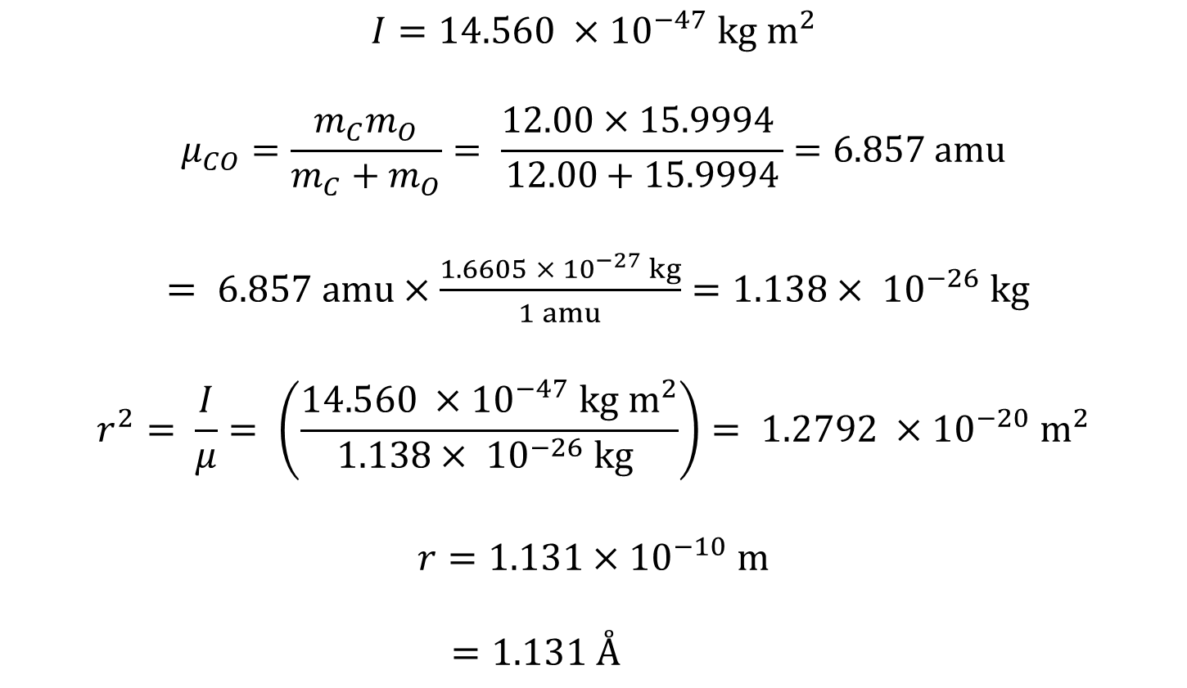
The Rigid Rotor
$$I=14.560 ×{10}^{−47} kg m^{2}$$
$$μ_{CO}=\frac{m_{C}m_{O}}{{m_{C}+m}_{O}}= \frac{12.00×15.9994 }{12.00+15.9994}=6.857 amu$$
$= 6.857 amu×\frac{1.6605 ×{ 10}^{−27} kg}{1 amu}=1.138×{ 10}^{−26} kg$
$$r^{2}= \frac{I}{μ}= \left(\frac{14.560 ×{10}^{−47} kg m^{2}}{1.138×{ 10}^{−26} kg }\right)= 1.2792 ×{10}^{−20} m^{2}$$
$$r=1.131×{10}^{−10} m$$
$=1.131 Å$

Slide 12
The Rigid Rotor
Non–Rigid Rotor
For the rigid rotor model we assumed that the bond in the molecule does not change. However, upon rotation, the centrifugal force lengthen the bond. When this effect is taken into account and the Schrödinger equation is solved, the rotational energy obtained is in the form
$$ε_{j}=\tilde{B}j\left(j+1\right)−Dj^{2}{\left(j+1\right)}^{2} {cm}^{−1}, j=0, 1, 2 ,3, …$$
where $D$ is the centrifugal distortion constant which is given by
$$D= \frac{h}{32π^{4}I^{2}r^{2}kc}=\frac{4{\tilde{B}}^{3}}{{\overline{ν}}^{2}}$$
where $\overline{ν}$ is the wavenumber of the vibration of the molecule and $k$ is the force constant of the bond.

Slide 13
The Rigid Rotor
$$ε_{j}=\tilde{B}j\left(j+1\right)−Dj^{2}{\left(j+1\right)}^{2} {cm}^{−1}, j=0, 1, 2 ,3, …$$
The effect of adding the new term in the equation above is that it makes the rotational energy levels are more closer to each other in the non-rigid rotor compared with the rigid rotor.
The selection rules for the rotational transition is the same as for rigid rotor.
$$∆j=±1$$
Thus, for a transition between the two rotational levels $j$ and $j + 1$, we have
$${\overline{ν}}_{j=0 →j=1}=ε_{j+1}−ε_{j}$$
$$=2\tilde{B}\left(j+1\right)−4D_{j}{\left(j+1\right)}^{3} {cm}^{−1}, j=0, 1, 2 ,3, …$$

Slide 14
The Rigid Rotor
The energy levels and absorption transitions of a rigid rotator and non-rigid rotor.
$$2\tilde{B} 4\tilde{B} 6\tilde{B} 8\tilde{B} 10\tilde{B} 12\tilde{B}$$
$$non−rigid rotor$$
$$rigid rotor$$

