Slide 1
Chapter 7
Energy
and
Energy Transfer

Slide 2
Introduction to Energy
The concept of energy is one of the most important topics in science
Every physical process that occurs in the Universe involves energy and energy transfers or transformations
Energy is not easily defined

Slide 3
Energy Approach to Problems
The energy approach to describing motion is particularly useful when the force is not constant
An approach will involve Conservation of Energy
This could be extended to biological organisms, technological systems and engineering situations

Slide 4
Systems
A system is a small portion of the Universe
We will ignore the details of the rest of the Universe
A critical skill is to identify the system

Slide 5
Valid System
A valid system may
be a single object or particle
be a collection of objects or particles
be a region of space
vary in size and shape

Slide 6
Problem Solving
Does the problem require the system approach?
What is the particular system and what is its nature?
Can the problem be solved by the particle approach?
The particle approach is what we have been using to this time

Slide 7
Environment
There is a system boundary around the system
The boundary is an imaginary surface
It does not necessarily correspond to a physical boundary
The boundary divides the system from the environment
The environment is the rest of the Universe

Slide 8
Work Example
The normal force, n, and the gravitational force, m g, do no work on the object
cos θ = cos 90° = 0
The force F does do work on the object

Slide 9
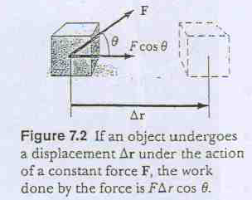
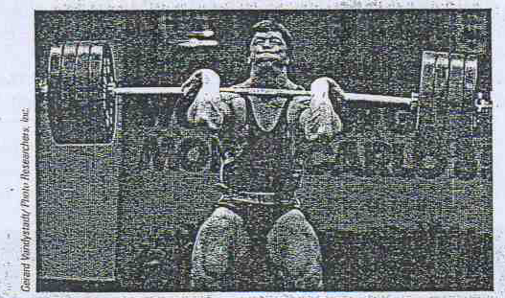
Work done on a system by an agent exerting constant force on the system is given by

Slide 10
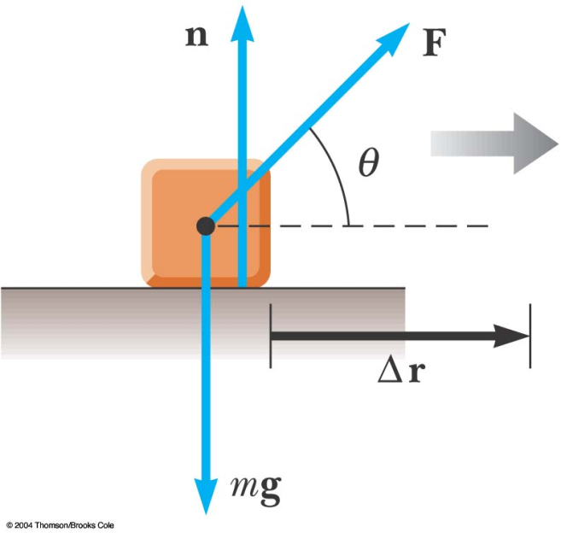
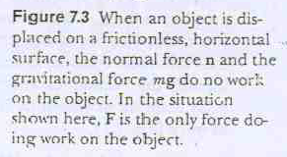
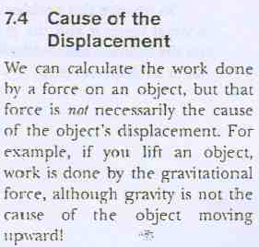
Unit : N-m (joul (J))

Slide 11
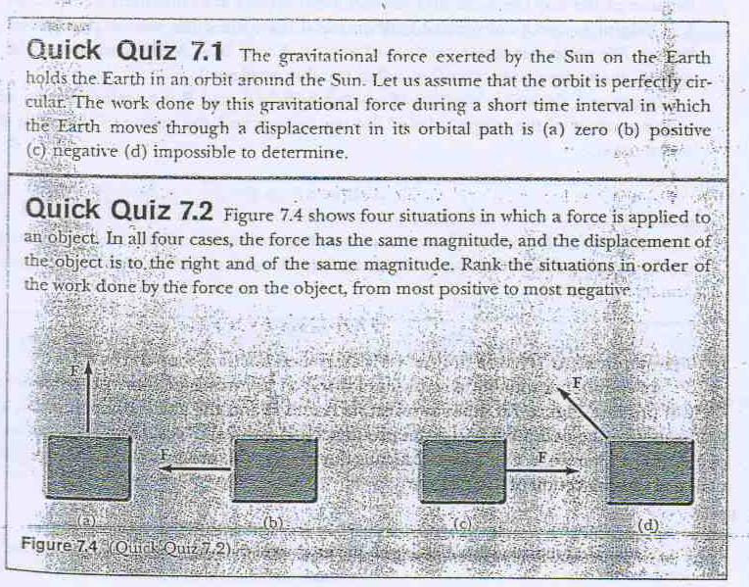

Slide 12
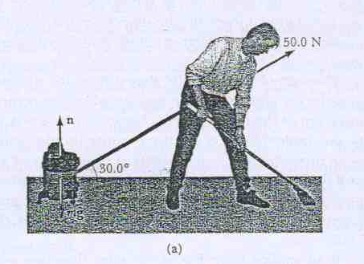
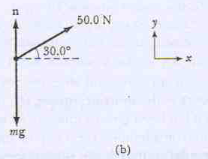
Mr Clean

Slide 13
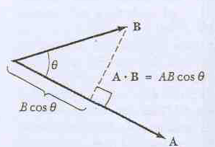

Slide 14
Commutative law
Distributive law

Slide 15
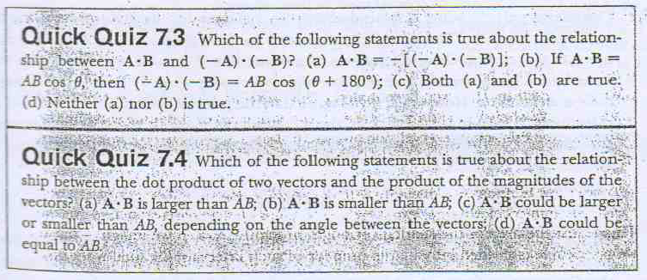

Slide 16
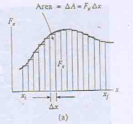
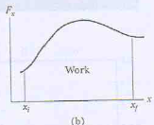

Slide 17
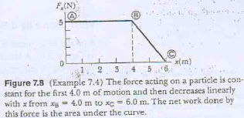

Slide 18
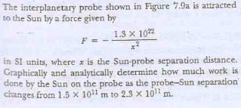
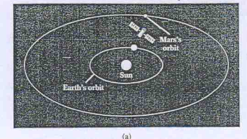
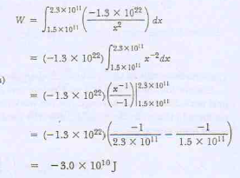

Slide 19
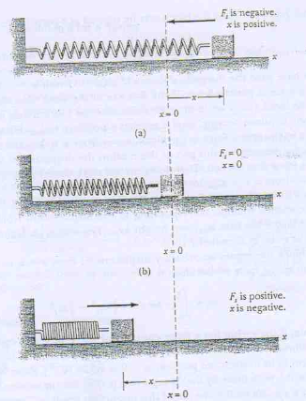
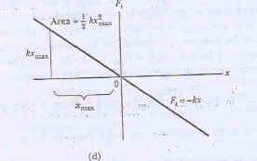

Slide 20
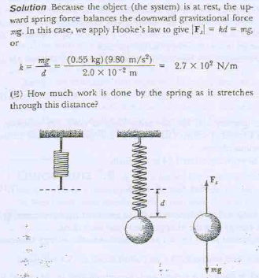
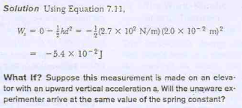
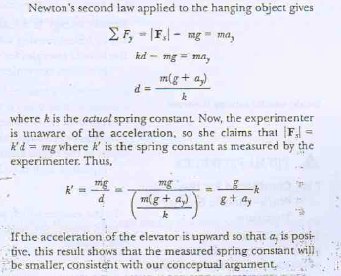

Slide 21
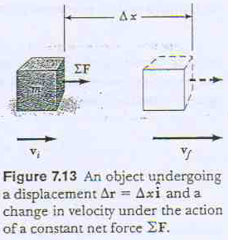
Kinetic energy and the work-kinetic energy theorem
The net force acting on the object is
According to Newton’s law it must have an acceleration a
If the displacement is
The work done

Slide 22
This equation was derived for the specific situation of one dimension of motion
But this is a general result.
Work done by the net force acting on a particle of mass m is equal to the difference of the quantity ½ mv² at x_{i} and x_{f} .

Slide 23
The quantity ½ mv² is called kinetic energy of the particles.
It is often convenient to write the above equation

Slide 24
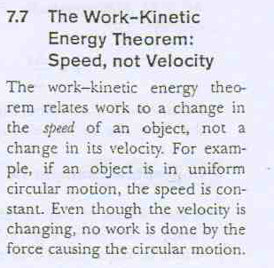
This is an important result and it is known as the work kinetic energy theorem

Slide 25
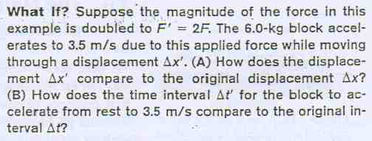
The quantity ΔK in the work –kinetic energy theorem only refers to the initial and final speed. It does not depend on the details of path followed
Problems

Slide 26
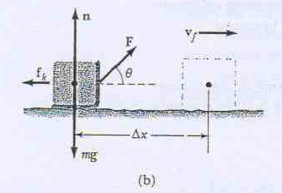
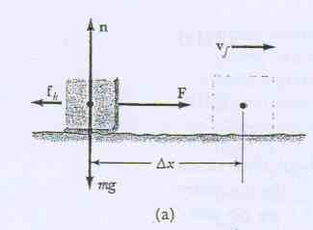

Slide 28
Power
Average Power is
Instantaneous Power is

Slide 30
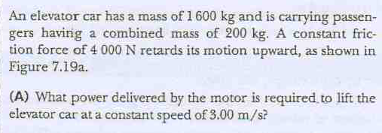

Slide 31
