Slide 1
INTERNATIONAL PERFORMANCE MANAGEMENT
Chapter 6

Slide 2
Multinational performance management

Slide 3
MNE performance mgmt. constraints
Whole vs. part
Non-comparable data
Volatility/ unpredictability in the global business environment
Separation by time & distance
Variable levels of maturity across markets: the need for relevant comparative data

Slide 4
Control & performance management

Slide 5
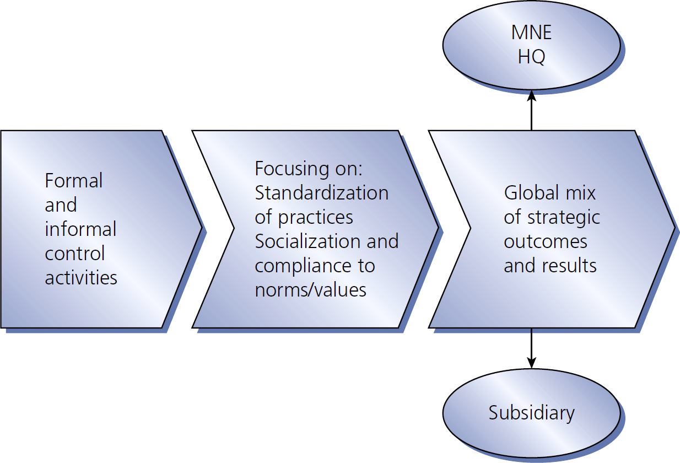
Figure 6.2
MNE control & performance

Slide 6
Performance management of international employees

Slide 7
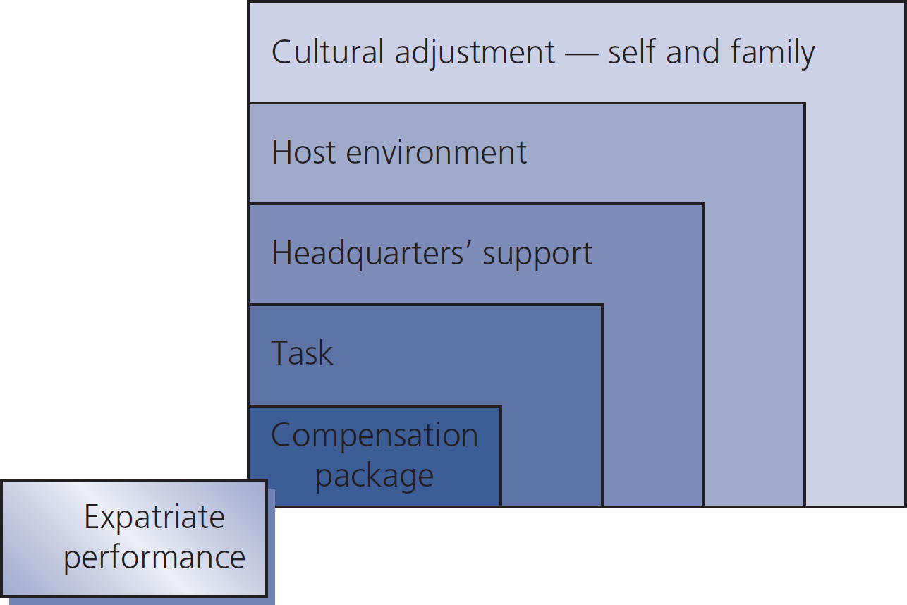
Figure 6-3
Variables affecting expatriate performance

Slide 8
Expatriate tasks
CEO or subsidiary manager oversees & directs entire foreign operation
Structure reproducer reproduces structure similar to what s/he knows from another part of the company
Troubleshooter analyzes & solves a particular operational problem
Operative performs functional job tasks in existing operational structure, in generally lower level, supervisory positions

Slide 9
Types of expatriate assignments
Technical (5-10%) short-term knowledge transfer
Developmental (5-10%) in-country performance & acquisition of local understanding by assignee
Strategic (10-15%) high-profile activities for developing global perspective
Functional (55-80%) more enduring two-way transfer of existing processes & practices

Slide 10
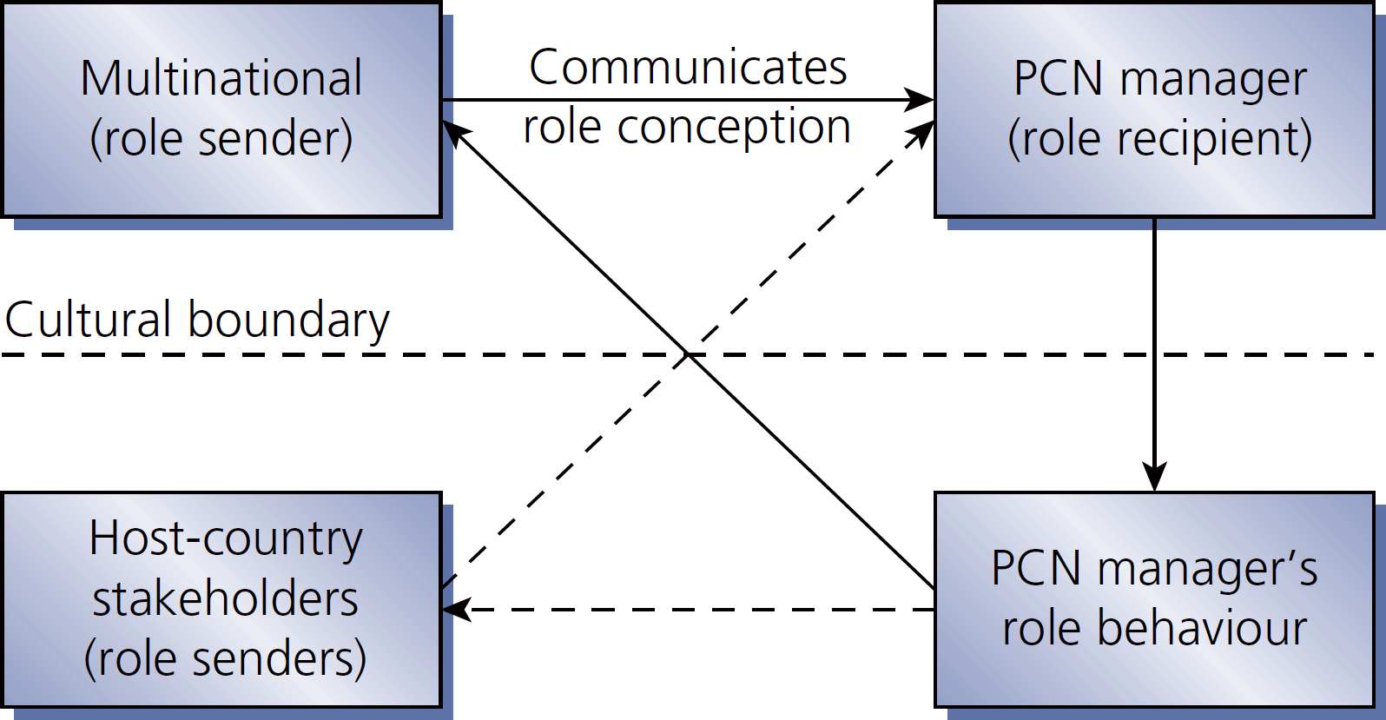
Figure 6.4
PCN (parent country national) role conception

Slide 11
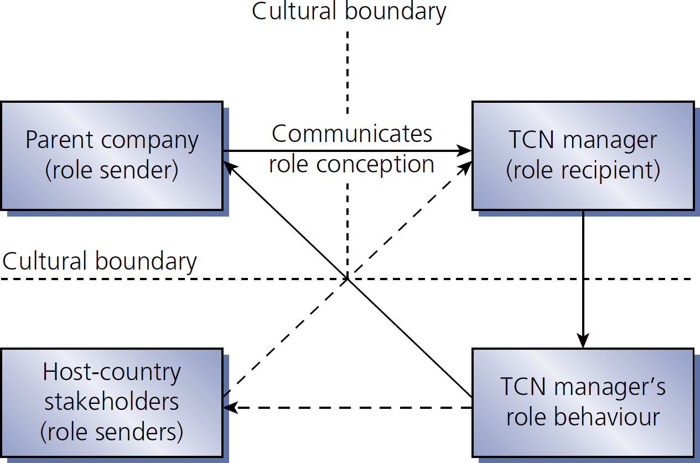
Figure 6.5
TCN role conception

Slide 12
Non-expatriate performance management challenges
Performance criteria & goals for non-standard work
Criteria for performance is subject to cultural differences
Isolating international dimensions of job performance is not as straightforward as for traditional expatriate jobs
Outstanding/under-performance & failures will challenge performance appraisal process
Performance appraisals are complicated by international context, outside appraisers
Ways to improve & rewards are unclear
Impact of non-standard work on HCN co-workers

Slide 13
Performance appraisal of international employees

Slide 14
Performance appraisal aspects of international employees
Performance criteria hard, soft, & contextual goals
Who conducts the performance appraisal? typically subsidiary manager, but could be team of evaluators
Standardized or customized appraisal forms?
Frequency of appraisal?
Performance feedback the communication medium matters
Appraisal of HCN employees

Slide 15
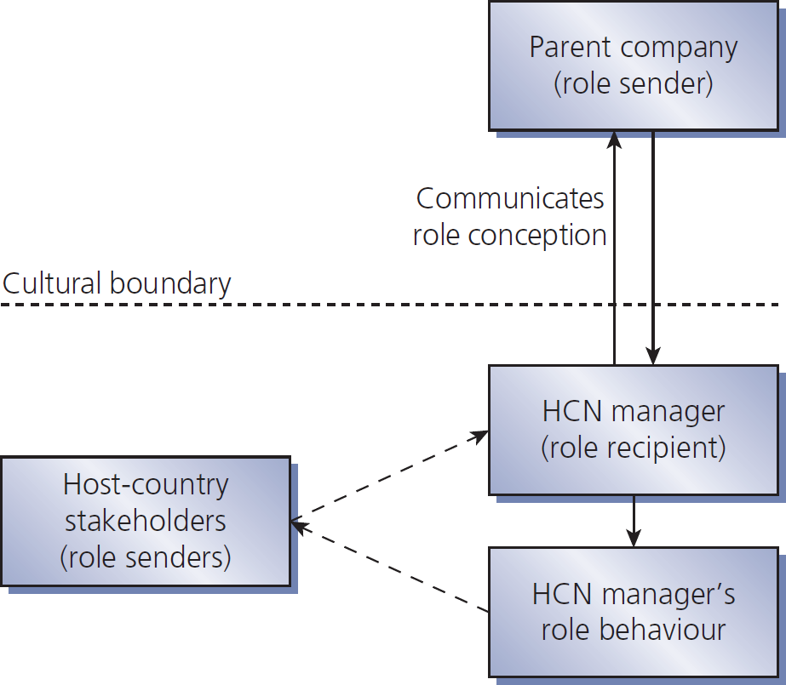
Figure 6.6
HCN role conception

