Slide 1
Thiols and Sulfides
340 Chem 1st 1439

Slide 2
General formula of Thiols & Sulfides
Nomenclature of Thiols & Sulfides
Physical Properties of Thiols & Sulfides
Preparations of Thiols & Sulfides
Reactions of Thiols & Sulfides
340 Chem 1st 1439

Slide 3
Thiols
Thiols, general formula RSH, are the sulphur analogues of alcohols. The functional group of a thiol is SH. The simplest members of this class are methanethiol (CH₃SH), ethanethiol (C₂H₅SH) and propanethiol (C₃H₇SH).
The functional group of a thiol is an -SH (sulfhydryl) group bonded to an sp³ hybridized carbon

Slide 4
Nomenclature of thiols
In the IUPAC system, thiols are named by selecting as the parent alkane the longest chain of carbon atoms that contains the -SH group. To show that the compound is a thiol, retain the final -e in the name of the parent alkane and add the suffix -thiol.
The location of the -SH group takes precedence over alkyl groups and halogens in numbering the parent chain.
In the IUPAC system, -OH takes precedence over -SH in both numbering and naming. In compounds containing these two functional groups, an -SH group is indicated by the IUPAC prefix sulfanyl-.
Alternatively, it may be indicated by the common- name prefix mercapto-.
Common names for simple thiols are derived by naming the alkyl group bonded to !SH and adding the word mercaptan.

Slide 5
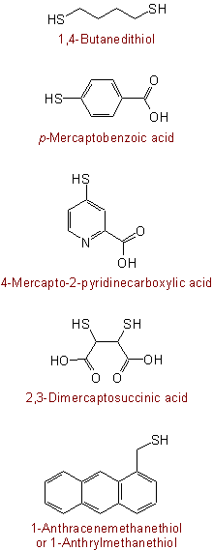
IUPAC name
common name

Slide 6
Sulfides nomenclature
The sulfur analogues of ethers are called sulfides or thioethers . Sulfur is an excellent nucleophile because its electron cloud is polarizable
Thioethers are named in much the same way as their oxygen cousins, ethers. "Simple" thioethers
If both groups are simple alkyl groups, then the thioether is usually named as alkyl alkyl thioether
The alkyl groups are listed in alphabetical order
If the two alkyl groups are the same, then it's a dialkyl thioether
IUPAC name
common name
IUPAC name

Slide 7
Physical properties of thiols
The SH bond in thiols is less polar than OH bond in alcohols, since sulphur is less electronegative than the oxygen atom. Thus, thiols form much weaker hydrogen bonding than alcohols, and have lower boiling points than analogous alcohols

Slide 8
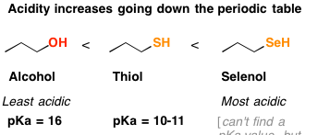
Acidity and basicity of thiols
Thiols are stronger acids (p K a 10) than alcohols (p K a 15).
The greater acidity of thiols compared to alcohols can be explained by the fact that sulfur (a third-period element) is larger than oxygen (a second-period element). The negative charge on an alkylsulfide ion (RS-) is delocalized (spread) over a larger area and is therefore more stable than the negative charge on an alkoxide ion (RO-).
Thiolate ions (e.g. CH₃CH₂S⁻) are stronger nucleophiles and weaker bases than corresponding alkoxides (CH₃CH₂O⁻). Conversely, thiols are stronger acids than corresponding alcohols.

Slide 10
Preparation of thiols
Thiols are prepared from alkyl halides and sodium hydrosulphide (Na⁺SH⁻) {excess of KOH (NaOH) and hydrogen sulfide H₂S} by SN₂ reaction. A large excess of Na ⁺ SH⁻ is used with unhindered alkyl halide to prevent dialkylation (R-S-R).
R-X Na⁺⁻SH R-SH
Alkyl halide Thiol
Thiols can also be formed by reducing disulfides with zinc in the presence of acid
R-S_S_R Zn/ H⁺ RSH

Slide 11
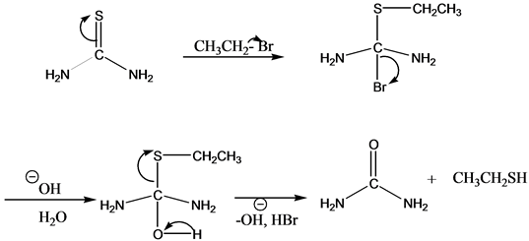
For a pure alkylthiol :
The thiourea (NH₂(C=S)NH₂) acts as the nucleophile in an SN2 reaction to produce an S-alkylisothiouronium salt which is then hydrolyzed with aqueous base to give the thiol.

Slide 12
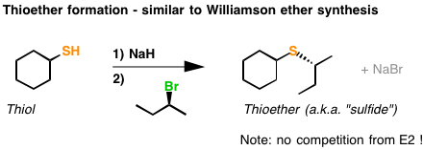
Preparation of sulfide
substitution of alkyl halides with thiolates to form thioethers (sulfides).
This process resembles the Williamson ether synthesis.
First, a strong base deprotonates the thiol (we use NaH here, but many other bases could also be used).
Secondly, we add an alkyl halide (1º ,2º), and an S_{N}2 nucleophilic substitution reaction results in formation of S-C and breakage of C-Br with inversion of stereochemistry.

Slide 13
Symmetrical sulfides, RSR (also called symmetrical thioethers), are prepared by treating one mole of Na2S (where S2– is the nucleophile) with two moles of haloalkane.
This same reaction can also be used to prepare five- and six-membered cyclic sulfides. Treating a 1,4-dihaloalkane with Na2S gives a five-membered cyclic sulfide; treating a 1,5-dihaloalkane with Na2S gives a six-membered ring.

Slide 14
the intramolecular version is important to note. Note that we’re still forming C–S here and breaking a carbon-halide bond. Don’t forget that inversion occurs on the stereocenter on the secondary carbon!

Slide 15
Reactions of thiols Oxidation
Thiols can be easily oxidized to disulfides through treatment with a mild oxidant like bromine or iodine (I₂). Vigorous oxidation with KMnO₄, HNO₃ or sodium hypochlorite (NaOCl) produces sulphonic acids not give = bond .
Note:Thiols react with base to form thiolate ions which can act as powerful nucleophiles
A second oxidation pathway involves oxidation of sulfides to sulfoxides and sulfones through treatment with oxidants such as O₃ (ozone) and peroxyacids such as m-chloroperoxybenzoic acid (mCPBA), sodium periodate, NaIO₄. Note that sulfur can exceed an octet of electrons whereas oxygen cannot.

Slide 16
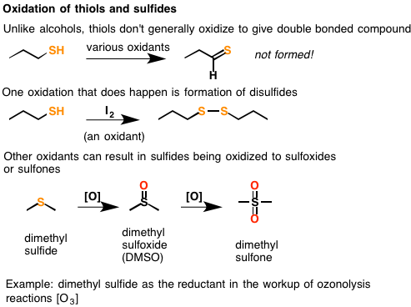
Dimethyl sulfoxide (DMSO) is manufactured on an industrial scale by air oxidation of dimethyl sulfide in the presence of oxides of nitrogen.

Slide 17
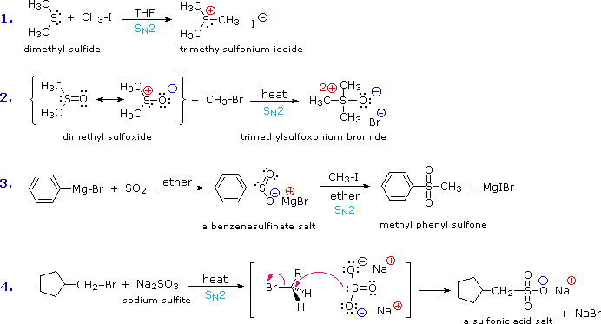
ALKYLATION OF SULFIDES: SULFONIUM SALTS

Slide 18
