Slide 1
Chapter 4
Motion in Two Dimensions

Slide 2
Motion in Two Dimensions
Using + or – signs is not always sufficient to fully describe motion in more than one dimension
Vectors can be used to more fully describe motion
Still interested in displacement, velocity, and acceleration
Will serve as the basis of multiple types of motion in future chapters

Slide 3
Position and Displacement
The position of an object is described by its position vector, r
The displacement of the object is defined as the change in its position
Δr = r_{f} - r_{i}

Slide 4
General Motion Ideas
In two- or three-dimensional kinematics, everything is the same as as in one-dimensional motion except that we must now use full vector notation
Positive and negative signs are no longer sufficient to determine the direction

Slide 5
Average Velocity
The average velocity is the ratio of the displacement to the time interval for the displacement
The direction of the average velocity is the direction of the displacement vector, Δr

Slide 6
Average Velocity, cont
The average velocity between points is independent of the path taken
This is because it is dependent on the displacement, also independent of the path

Slide 7
Instantaneous Velocity
The instantaneous velocity is the limit of the average velocity as Δt approaches zero
The direction of the instantaneous velocity is along a line that is tangent to the path of the particle’s direction of motion

Slide 8
Instantaneous Velocity, cont
The direction of the instantaneous velocity vector at any point in a particle’s path is along a line tangent to the path at that point and in the direction of motion
The magnitude of the instantaneous velocity vector is the speed
The speed is a scalar quantity

Slide 9
Average Acceleration
The average acceleration of a particle as it moves is defined as the change in the instantaneous velocity vector divided by the time interval during which that change occurs.

Slide 10
Average Acceleration, cont
As a particle moves, Δv can be found in different ways
The average acceleration is a vector quantity directed along Δv

Slide 11
Instantaneous Acceleration
The instantaneous acceleration is the limit of the average acceleration as Δv/Δt approaches zero

Slide 12
Producing An Acceleration
Various changes in a particle’s motion may produce an acceleration
The magnitude of the velocity vector may change
The direction of the velocity vector may change
Even if the magnitude remains constant
Both may change simultaneously

Slide 13
Kinematic Equations for Two-Dimensional Motion
When the two-dimensional motion has a constant acceleration, a series of equations can be developed that describe the motion
These equations will be similar to those of one-dimensional kinematics

Slide 14
Kinematic Equations, 2
Position vector
Velocity
Since acceleration is constant, we can also find an expression for the velocity as a function of time: v_{f} = v_{i} + at

Slide 15
Kinematic Equations, 3
The velocity vector can be represented by its components
v_{f} is generally not along the direction of either v_{i} or at

Slide 16
Kinematic Equations, 4
The position vector can also be expressed as a function of time:
r_{f} = r_{i} + v_{i}t + ½ at²
This indicates that the position vector is the sum of three other vectors:
The initial position vector
The displacement resulting from v_{i} t
The displacement resulting from ½ at²

Slide 17
Kinematic Equations, 5
The vector representation of the position vector
r_{f} is generally not in the same direction as v_{i} or as a_{i}
r_{f} and v_{f} are generally not in the same direction

Slide 18
Kinematic Equations, Components
The equations for final velocity and final position are vector equations, therefore they may also be written in component form
This shows that two-dimensional motion at constant acceleration is equivalent to two independent motions
One motion in the x-direction and the other in the y-direction

Slide 19
Kinematic Equations, Component Equations
v_{f} = v_{i} + at becomes
v_{xf} = v_{xi} + a_{x}t and
v_{yf} = v_{yi} + a_{y}t
r_{f} = r_{i} + v_{i} t + ½ at² becomes
x_{f} = x_{i} + v_{xi} t + ½ a_{x}t² and
y_{f} = y_{i} + v_{yi} t + ½ a_{y}t²

Slide 20
Projectile Motion
An object may move in both the x and y directions simultaneously
The form of two-dimensional motion we will deal with is called projectile motion

Slide 21
Assumptions of Projectile Motion
The free-fall acceleration g is constant over the range of motion
And is directed downward
The effect of air friction is negligible
With these assumptions, an object in projectile motion will follow a parabolic path
This path is called the trajectory

Slide 22
Verifying the Parabolic Trajectory
Reference frame chosen
y is vertical with upward positive
Acceleration components
a_{y} = -g and a_{x} = 0
Initial velocity components
v_{xi} = v_{i} cos θ and v_{yi} = v_{i} sin θ

Slide 23
Verifying the Parabolic Trajectory, cont
Displacements
x_{f} = v_{xi} t = (v_{i} cos θ) t
y_{f} = v_{yi} t + ½a_{y} t² = (v_{i} sin θ)t - ½ gt²
Combining the equations gives:
This is in the form of y = ax – bx² which is the standard form of a parabola

Slide 24
Analyzing Projectile Motion
Consider the motion as the superposition of the motions in the x- and y-directions
The x-direction has constant velocity
a_{x} = 0
The y-direction is free fall
a_{y} = -g
The actual position at any time is given by: r_{f} = r_{i} + v_{i}t + ½gt²

Slide 25
Projectile Motion Vectors
r_{f} = r_{i} + v_{i} t + ½ g t²
The final position is the vector sum of the initial position, the position resulting from the initial velocity and the position resulting from the acceleration

Slide 26
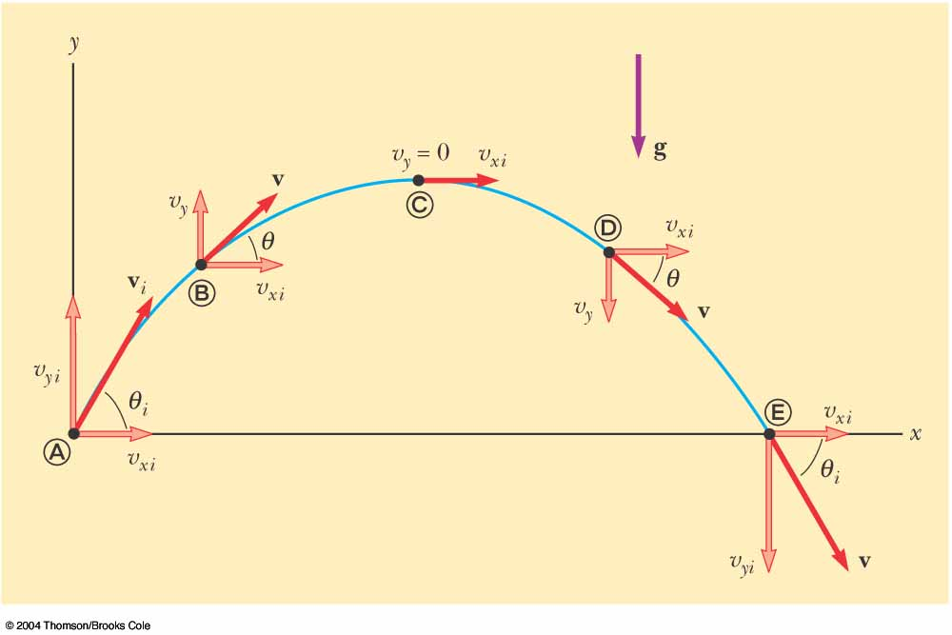
Projectile Motion Diagram

Slide 27
Projectile Motion – Implications
The y-component of the velocity is zero at the maximum height of the trajectory
The accleration stays the same throughout the trajectory

Slide 28
Range and Maximum Height of a Projectile
When analyzing projectile motion, two characteristics are of special interest
The range, R, is the horizontal distance of the projectile
The maximum height the projectile reaches is h

Slide 29
Height of a Projectile, equation
The maximum height of the projectile can be found in terms of the initial velocity vector:
This equation is valid only for symmetric motion

Slide 30
Range of a Projectile, equation
The range of a projectile can be expressed in terms of the initial velocity vector:
This is valid only for symmetric trajectory

Slide 31
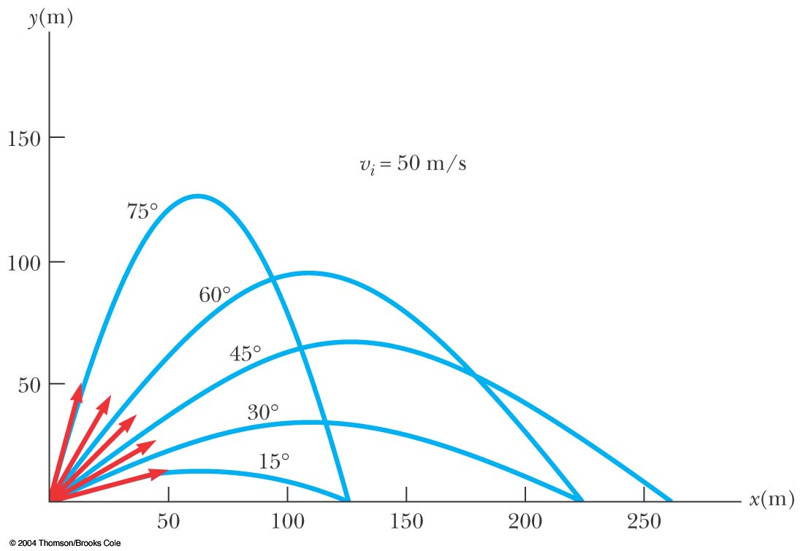
More About the Range of a Projectile

Slide 32
Range of a Projectile, final
The maximum range occurs at θ_{i} = 45º
Complementary angles will produce the same range
The maximum height will be different for the two angles
The times of the flight will be different for the two angles

Slide 33
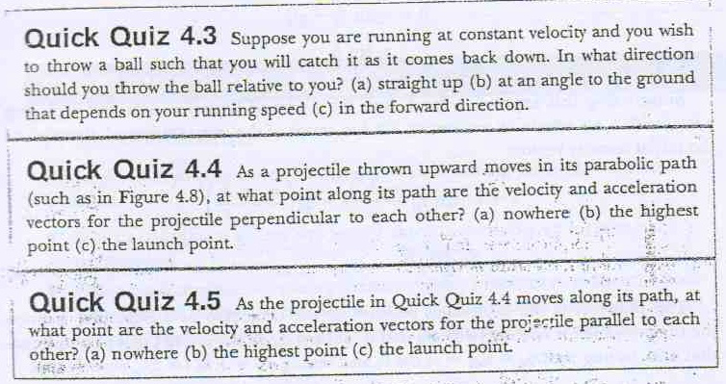

Slide 34
Projectile Motion – Problem Solving Hints
Select a coordinate system
Resolve the initial velocity into x and y components
Analyze the horizontal motion using constant velocity techniques
Analyze the vertical motion using constant acceleration techniques
Remember that both directions share the same time

Slide 35
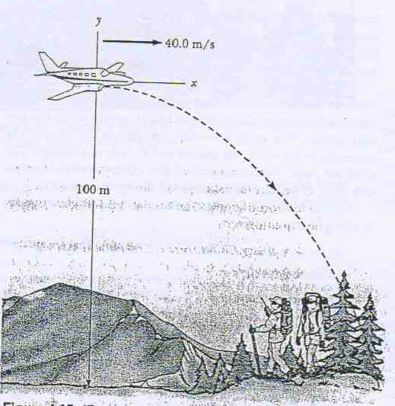

Slide 37
Non-Symmetric Projectile Motion
Follow the general rules for projectile motion
Break the y-direction into parts
up and down or
symmetrical back to initial height and then the rest of the height
May be non-symmetric in other ways

Slide 38
Uniform Circular Motion
Uniform circular motion occurs when an object moves in a circular path with a constant speed
An acceleration exists since the direction of the motion is changing
This change in velocity is related to an acceleration
The velocity vector is always tangent to the path of the object

Slide 39
Changing Velocity in Uniform Circular Motion
The change in the velocity vector is due to the change in direction
The vector diagram shows Δv = v_{f} - v_{i}

Slide 40
Centripetal Acceleration
The acceleration is always perpendicular to the path of the motion
The acceleration always points toward the center of the circle of motion
This acceleration is called the centripetal acceleration

Slide 41
Centripetal Acceleration, cont
The magnitude of the centripetal acceleration vector is given by
The direction of the centripetal acceleration vector is always changing, to stay directed toward the center of the circle of motion

Slide 42
Period
The period, T, is the time required for one complete revolution
The speed of the particle would be the circumference of the circle of motion divided by the period
Therefore, the period is

Slide 43
Quiz

Slide 44
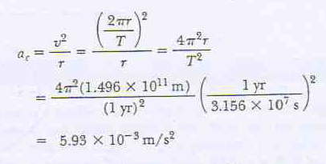
Example

Slide 45
Tangential Acceleration
The magnitude of the velocity could also be changing
In this case, there would be a tangential acceleration

Slide 46
Total Acceleration
The tangential acceleration causes the change in the speed of the particle
The radial acceleration comes from a change in the direction of the velocity vector

Slide 47
Total Acceleration, equations
The tangential acceleration:
The radial acceleration:
The total acceleration:
Magnitude

Slide 48
Total Acceleration, In Terms of Unit Vectors
Define the following unit vectors
r lies along the radius vector
θ is tangent to the circle
The total acceleration is

Slide 49
Example

Slide 50
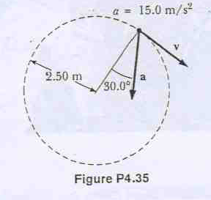

Slide 51
End of the chapter
Finished

