Slide 1
C H A P T E R 3
Vectors in 2-Space and 3-Space

Slide 2
3.1
INTRODUCTION TO VECTORS (GEOMETRIC)

Slide 3
DEFINITION
If v and w are any two vectors, then the sum v + w is the vector determined as follows: Position the vector w so that its initial point coincides with the terminal point of v. The vector v + w is represented by the arrow from the initial point of v to the terminal point of w

Slide 4
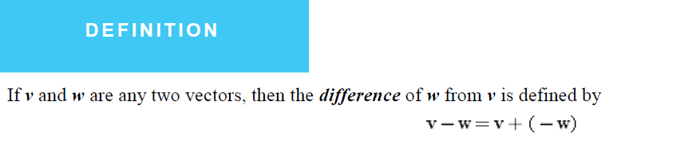

Slide 5
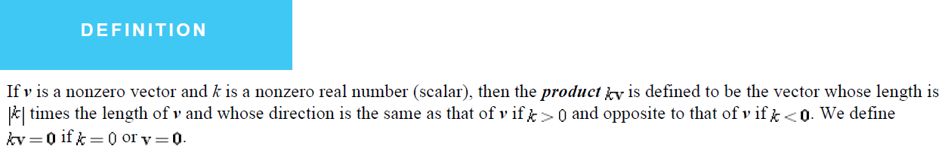

Slide 6

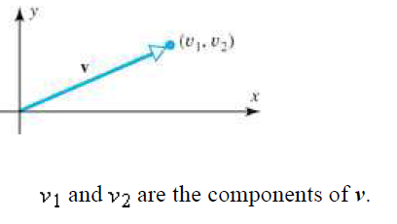
Vectors in Coordinate Systems

Slide 7
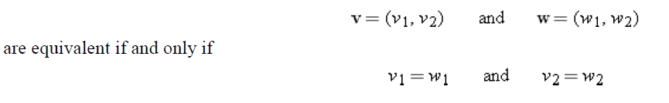

Slide 8
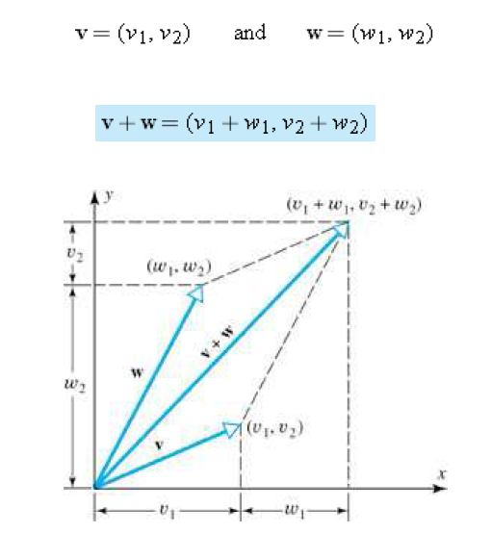

Slide 10
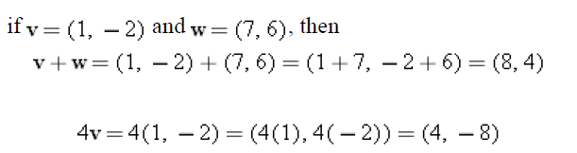

Slide 11
Vectors in 3-Space
each point P in 3-space has a triple of numbers (x, y, z), called the coordinates of P

Slide 12
In Figure a the point (4, 5, 6) and in Figure b the point (-3 , 2, -4).

Slide 13
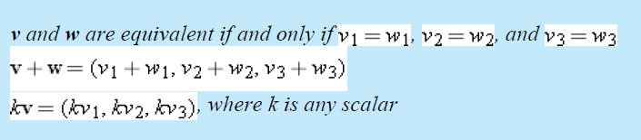

Slide 14
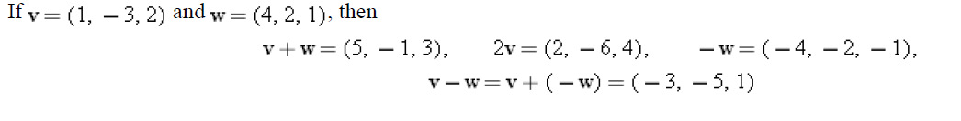
EXAMPLE 1 Vector Computations with Components

Slide 15
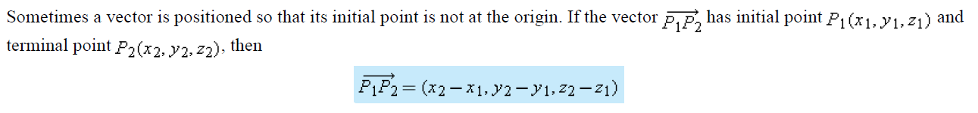

Slide 16
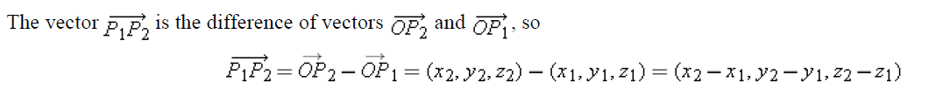
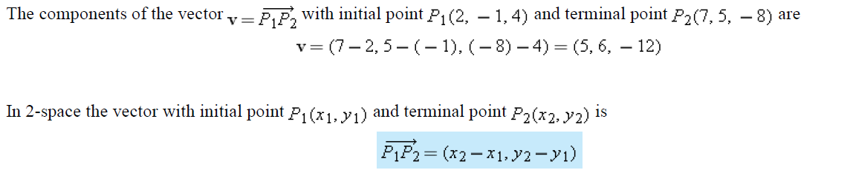
EXAMPLE 2 Finding the Components of a Vector

Slide 17

Translation of Axes
The solutions to many problems can be simplified by translating the coordinate axes to obtain new axes parallel to the original ones.
These formulas are called the translation equations.

Slide 18
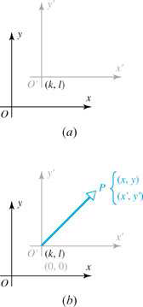

Slide 19


Slide 20
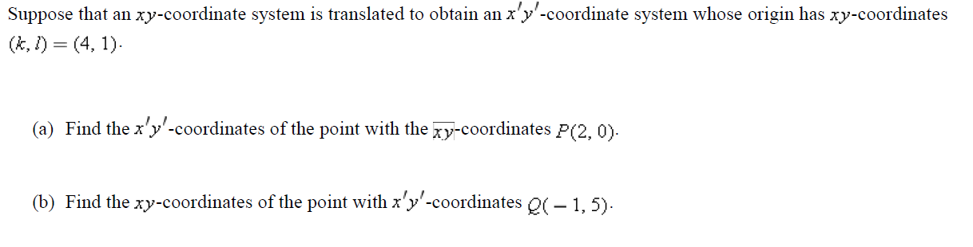
EXAMPLE 3 Using the Translation Equations

Slide 21
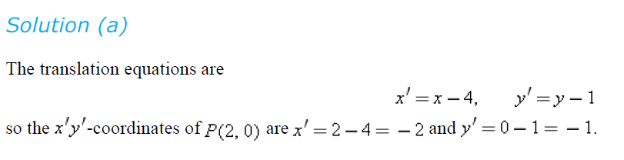
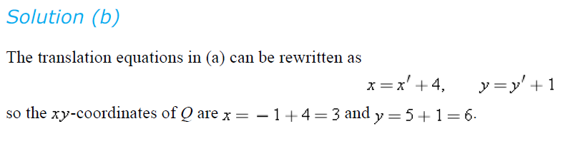

Slide 22
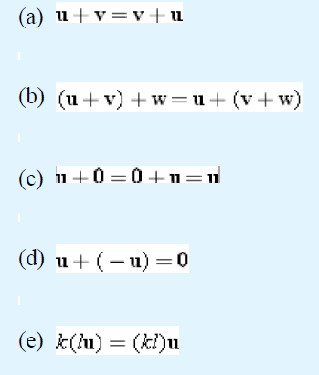
3.2
NORM OF A VECTOR; VECTOR ARITHMETIC
Properties of Vector Operations
THEOREM 3.2.1
Properties of Vector Arithmetic
If u, v, and w are vectors in 2- or 3-space and k and l are scalars, then the following relationships hold.

Slide 23
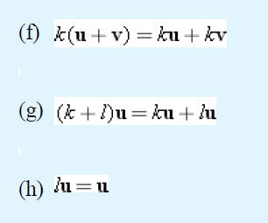

Slide 24



Norm of a Vector

Slide 26
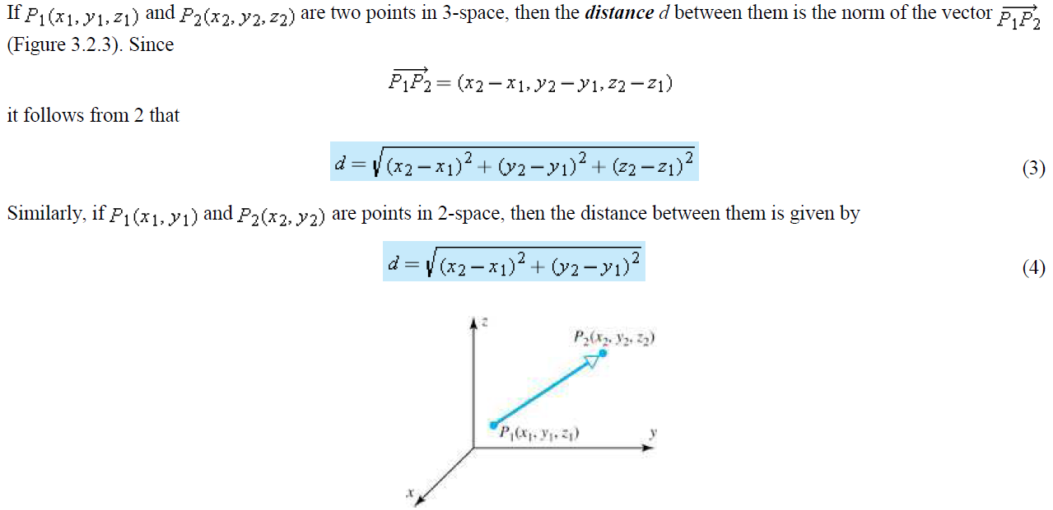

Slide 27
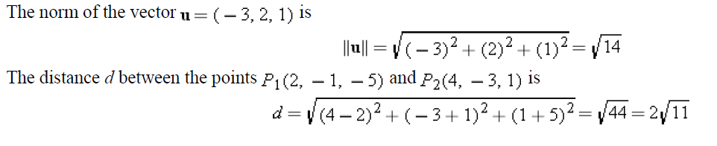
EXAMPLE 1 Finding Norm and Distance

Slide 28
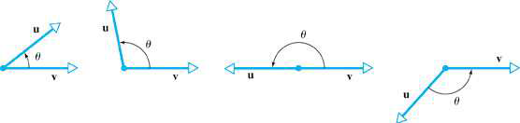
3.3
DOT PRODUCT; PROJECTIONS
Dot Product of Vectors
Let u and v be two nonzero vectors in 2-space or 3-space, and assume these vectors have been positioned so that their initial points coincide. By the angle between u and v, we shall mean the angle θ determined by u and v that satisfies

Slide 29
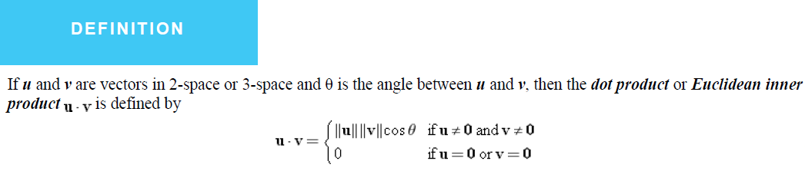
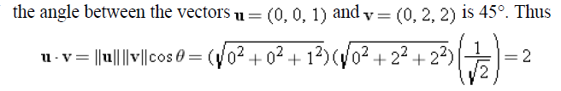
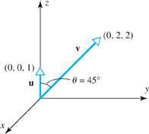
EXAMPLE 1 Dot Product

Slide 30
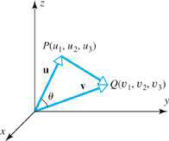
Component Form of the Dot Product

Slide 31

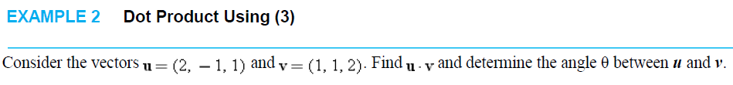

Finding the Angle Between Vectors
If u and v are nonzero vectors, then

Slide 32

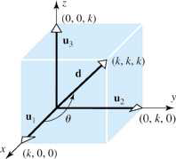

EXAMPLE 3 A Geometric Problem
Find the angle between a diagonal of a cube and one of its edges.
Note that this is independent of k

Slide 33
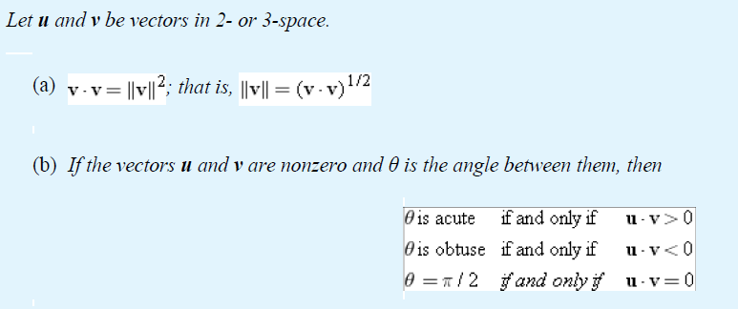
THEOREM 3.3.1

Slide 34
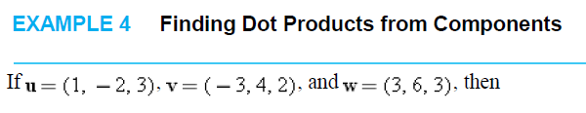


Slide 35
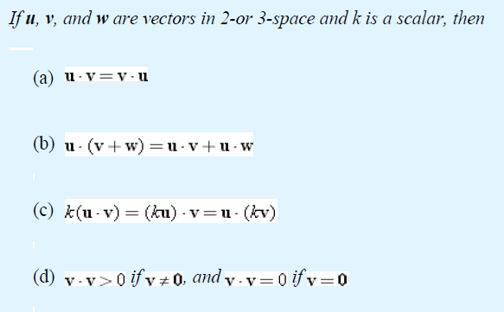
Properties of the Dot Product

Slide 36
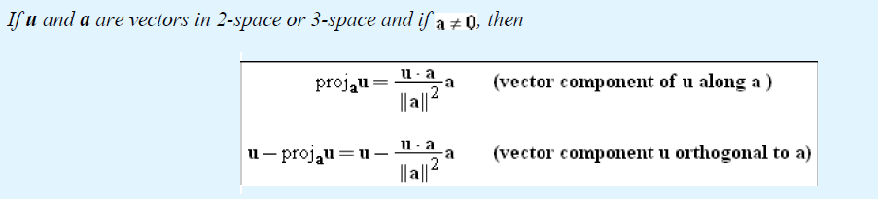
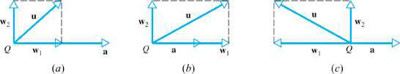
An Orthogonal Projection
THEOREM 3.3.3

Slide 37
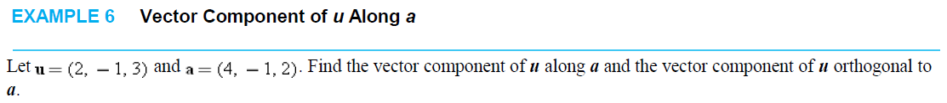



Slide 38

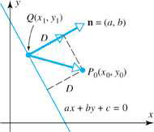
Distance Between a Point and a Line

Slide 39



Slide 40
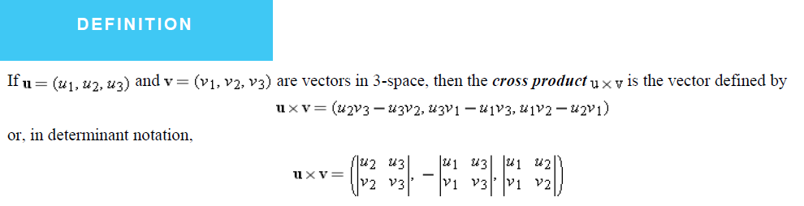
3.4
CROSS PRODUCT

Slide 41
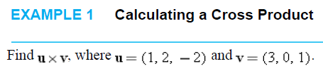


Slide 42
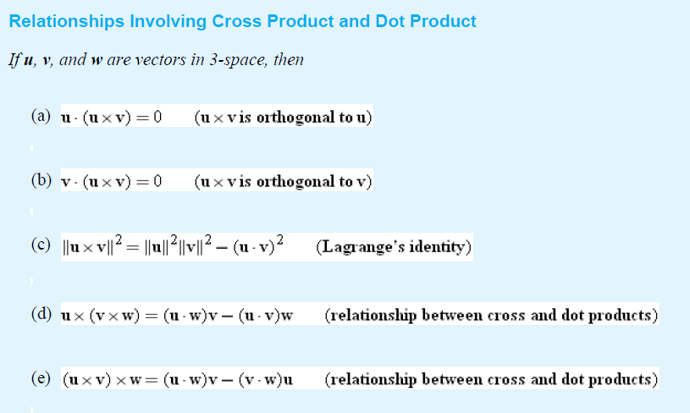
THEOREM 3.4.1

Slide 43
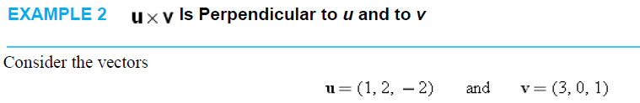

Slide 44
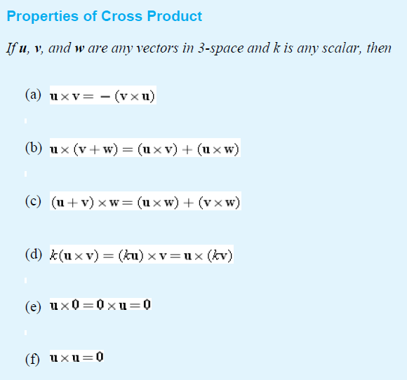
THEOREM 3.4.2

Slide 45
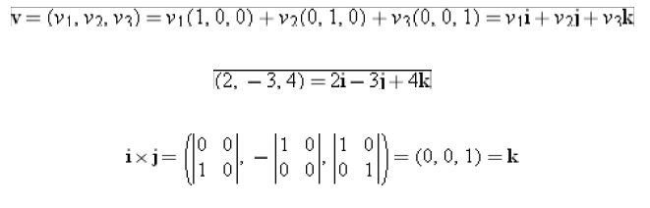
Standard Unit Vectors

Slide 46
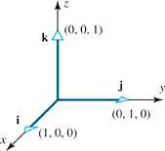


Slide 47

The direction of uxv

Slide 48
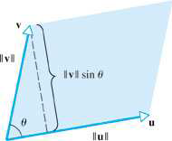
Geometric Interpretation of Cross Product
THEOREM 3.4.3

Slide 49
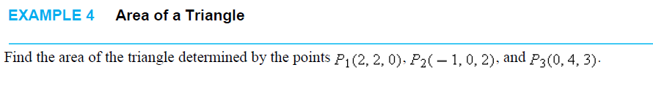
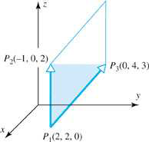

Area of a Triangle

Slide 50
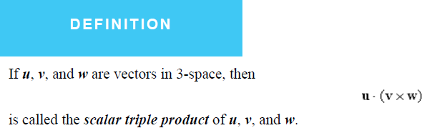
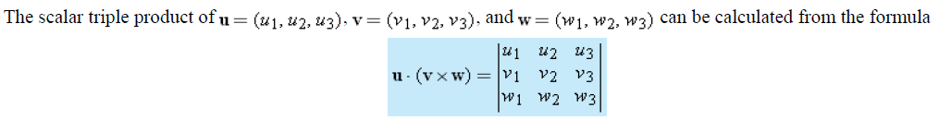

Slide 51
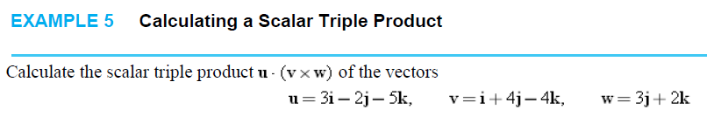
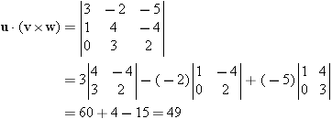

Slide 52
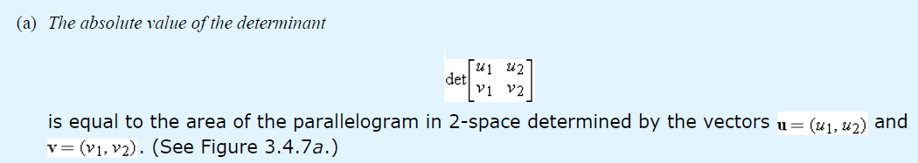
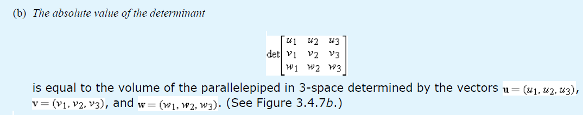
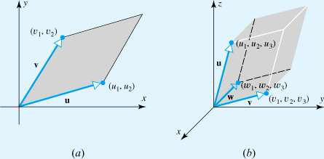
THEOREM 3.4.4

Slide 53

THEOREM 3.4.5

Slide 54

3.5 LINES AND PLANES IN 3-SPACE

Slide 55


Slide 56

THEOREM 3.5.1

Slide 58



Slide 59


Vector Form of Equation of a Plane

Slide 60
Lines in 3-Space
are called parametric equations for l

Slide 61


Slide 62



Slide 63


Slide 64


Vector Form of Equation of a Line
EXAMPLE 7 A Line Parallel to a Given Vector

Slide 65

Problems Involving Distance
Problems
(a) Find the distance between a point and a plane.
(b) Find the distance between two parallel planes.
THEOREM 3.5.2

Slide 66



Slide 67



