Slide 1
Chapter 2
Views

Slide 2
Objectives
Create simple and complex views
Creating a view with a check constraint
Retrieve data from views
Data manipulation language (DML) operations on a view
Dropping a view

Slide 3
Database Objects
Object
Description
Table
Basic unit of storage; composed of rows
View
Logically represents subsets of data from one or more tables
Sequence
Generates numeric values
Index
Improves the performance of data retrieval queries
Synonym
Gives alternative names to objects

Slide 4
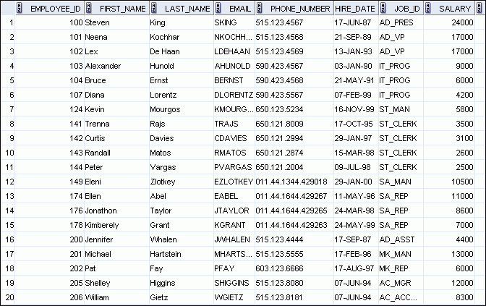
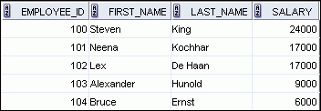
What Is a View?
EMPLOYEES table

Slide 5
What Is a View?
A view is a logical table based on a table or another view
A view contains no data of its own, but its like a window through which data from tables can be viewed or changed
The tables on which a view is based are called base tables

Slide 6
Advantages of Views
Security: views prevent undesired access by providing security as the data that is not of interest to a user can be left out of the view.
Views are usually virtual and occupy no space.
Display different data for different types of users.
Simplicity: Complex queries that need to be executed often can be saved in a view. Hence by calling the view name, query can be executed.

Slide 7
Advantages of Views
Independence: View can make the application and database tables to a certain extent independent. If there is no view, the application must be based on a table. With the view, the program can be established in view of above, to view the program with a database table to be separated.
One view can be used to represent data from several tables

Slide 8
Simple Views and Complex Views
Feature
Simple Views
Complex Views
Number of tables
One
One or more
Contain functions
No
Yes
Contain groups of data
No
Yes
DML operations through a view
Yes
Not always

Slide 9
Creating a view
You embed a subquery in the CREATE VIEW statement:
The subquery can contain complex SELECT syntax.
CREATE [OR REPLACE] [FORCE|NOFORCE] VIEW view
[(alias[, alias]...)]
AS subquery
[WITH CHECK OPTION [CONSTRAINT constraint]]
[WITH READ ONLY [CONSTRAINT constraint]];

Slide 10
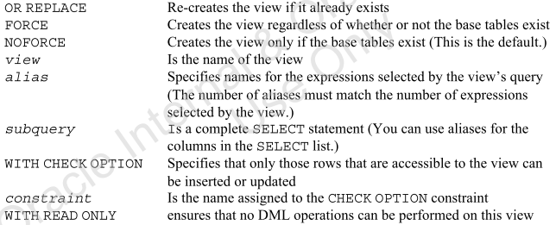
Creating a view

Slide 11
Creating a view
Create the EMPVU80 view, which contains details of the employees in department 80:
Describe the structure of the view by using the iSQL*Plus DESCRIBE command:
CREATE VIEW empvu80
AS SELECT employee_id, last_name, salary
FROM employees
WHERE department_id = 80;
DESCRIBE empvu80

Slide 12
Guidelines
The sub query that defines a view can contain complex SELECT syntax, including Joins ,groups and Subqueries
If you don’t specify a constraint name for the view created with the WITH CHECK OPTION, the system assigns a default name
You can use the OR REPLACE option to change the definition of the view without dropping and re-creating it , or re-granting the object privileges

Slide 13
Creating a View
Create a view by using column aliases in the subquery:
Select the columns from this view by the given alias names.
CREATE VIEW salvu50
AS SELECT employee_id ID_NUMBER, last_name NAME,
salary*12 ANN_SALARY
FROM employees
WHERE department_id = 50;

Slide 14
Creating a View
Another way to use aliases :
CREATE OR REPLACE VIEW salvu50 (ID_NUMBER, NAME, ANN_SALARY)
AS SELECT employee_id, last_name,
salary*12
FROM employees
WHERE department_id = 50;

Slide 15
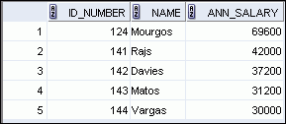
Retrieving Data from a View
You can display all the content of a view or specify selected column from the view.
SELECT *
FROM salvu50;

Slide 16
Modifying a View
Modify the EMPVU80 view by using a CREATE OR REPLACE VIEW clause. Add an alias for each column name:
Column aliases in the CREATE OR REPLACE VIEW clause are listed in the same order as the columns in the subquery.
CREATE OR REPLACE VIEW empvu80
(id_number, name, sal, department_id)
AS SELECT employee_id, first_name || ' '
|| last_name, salary, department_id
FROM employees
WHERE department_id = 80;

Slide 17
Creating a Complex View
Create a complex view that contains group functions to display values from two tables:
CREATE OR REPLACE VIEW dept_sum_vu
(name, minsal, maxsal, avgsal)
AS SELECT d.department_name, MIN(e.salary),
MAX(e.salary),AVG(e.salary)
FROM employees e JOIN departments d
ON (e.department_id = d.department_id)
GROUP BY d.department_name;
Note that alternative names have been specified for the view. This is a requirement if any column of the view is derived from a function or an expression.

Slide 18
Rules for Performing DML Operations on a View
You can usually perform DML operations on simple views.
You cannot remove a row if the view contains the following:
Group functions
A GROUP BY clause
The DISTINCT keyword
The pseudo column ROWNUM keyword

Slide 19
Rules for Performing DML Operations on a View
You cannot modify data in a view if it contains:
Group functions
A GROUP BY clause
The DISTINCT keyword
The pseudocolumn ROWNUM keyword
Columns defined by expressions (for example, SALARY * 12).

Slide 20
Rules for Performing DML Operations on a View
You cannot add data through a view if the view includes:
Group functions
A GROUP BY clause
The DISTINCT keyword
The pseudocolumn ROWNUM keyword
Columns defined by expressions
NOT NULL columns in the base tables that are not selected by the view without default values in the base table
Remember that you are adding values directly to the underlying table through the view.

Slide 21
Using the WITH CHECK OPTION Clause
You can ensure that DML operations performed on the view stay in the domain of the view by using the WITH CHECK OPTION clause:
Any attempt to INSERT a row with a department_id other than 20, or to UPDATE the department number for any row in the view fails because it violates the WITH CHECK OPTION constraint.
CREATE OR REPLACE VIEW empvu20
AS SELECT *
FROM employees
WHERE department_id = 20
WITH CHECK OPTION CONSTRAINT empvu20_ck ;

Slide 22
Using the WITH CHECK OPTION Clause
The WITH CHECK OPTION clause specifies that INSERTs and UPDATEs performed through the view cannot create rows that the view cannot select. Therefore it enables integrity constraints and data validation checks to be enforced on data being inserted or updated. If there is an attempt to perform DML operations on rows that the view has not selected, an error is displayed, along with the constraint name if that has been specified.
UPDATE empvu20
SET department_id = 10
WHERE employee_id = 20;
causes: ERROR

Slide 23
Using the WITH CHECK OPTION Clause
No rows are updated because, if the department number were to change to 10, the view would no longer be able to see that employee. With the WITH CHECK OPTION clause, therefore, the view can see only the employees in department 20 and does not allow the department number for those employees to be changed through the view.

Slide 24
Denying DML Operations
You can ensure that no DML operations occur by adding the WITH READ ONLY option to your view definition.
Any attempt to perform a DML operation on any row in the view results in an Oracle server error.

Slide 25
Denying DML Operations
CREATE OR REPLACE VIEW empvu10
(employee_number, employee_name, job_title)
AS SELECT employee_id, last_name, job_id
FROM employees
WHERE department_id = 10
WITH READ ONLY ;
Any attempt to remove a row from a view with a read-only constraint results in an error:
DELETE FROM empvu10
WHERE employee_number = 200;
Similarly, any attempt to insert a row or modify a row using the view with a read-only constraint results in the same error.

Slide 26
Any change in the view will affect the main tables. If you add or update or delete a row in the view, the same change will happen on the base tables.

Slide 27
Removing a View
You can remove a view without losing data because a view is based on underlying tables in the database.
DROP VIEW view;
DROP VIEW empvu80;
dropping views has no effect on the tables on which the view was based. On the other hand, views or other applications based on the deleted views become invalid

