Slide 1
Motion in one dimension
Kinematics (الحركيات): A branch (فرع, شعبة) of mechanics (علم الميكانيكا) in which we study motion of an object without knowing its cause (سبب).
Position (موقع): It is the location(موقع) of particle with respect to the chosen reference (المرجعية المختارة) point, that we consider the origin (الأصل) of co-ordinate system.
Choosing (اختيار) of reference frame (الإطار المرجعي): There is no rule or restriction(تقييد) to choose the reference point or reference frame. We can choose according to convenience (ملاءمة).

Slide 2
Position
Defined in terms of a frame of reference
One dimensional, so generally the x- or y-axis
The object’s position is its location with respect to the frame of reference

Slide 3
Motion in one dimension
Rest and motion (الراحة والحركة): When an object change its position with respect to time then we called the object is in the motion otherwise (وإلا) in the rest.
Motion is a combined property(لملكية جنبا إلى جنب) of the object (شيء) under study and the observer (مراقب).
There is no meaning of rest or motion without observer or viewer (المراقب أو المشاهد).

Slide 4
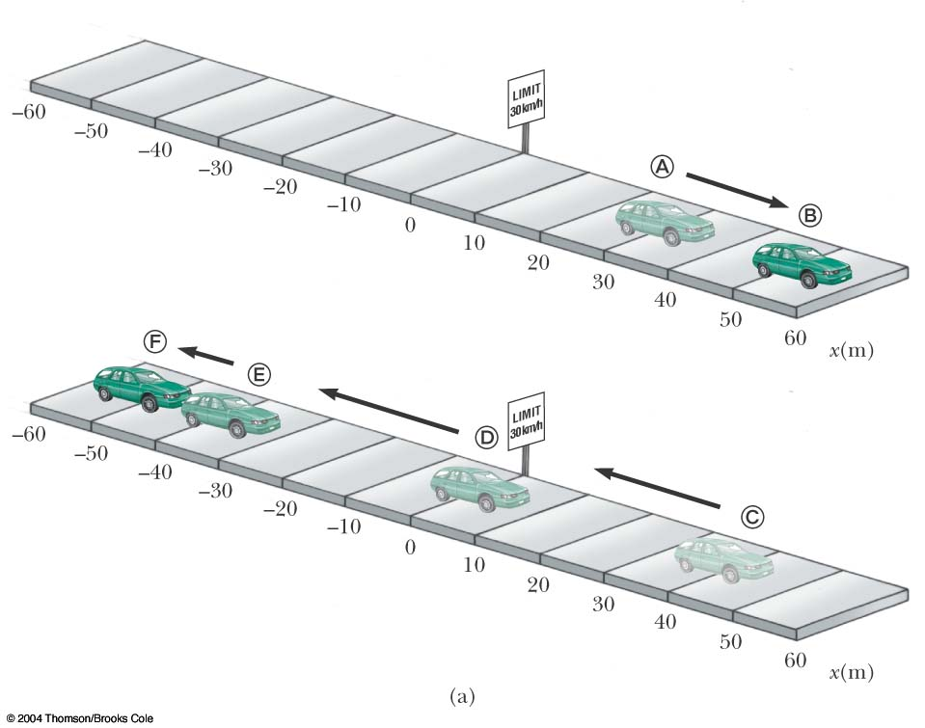
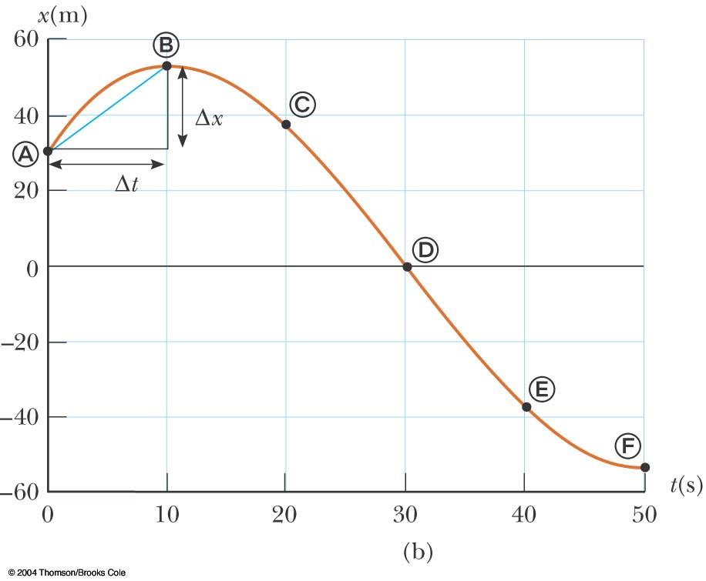
Distance and displacement
Distance (مسافة) is the actual length of path (مسار)travelled (سافر) by the object.
Displacement (الإزاحة) depends on the initial and final position and it is vector quantity (كمية المتجه).

Slide 5
Average Velocity and Speed
Average Velocity (متوسط ​​السرعة ): Average velocity a particle is defined as the Particle’s displacement divided by the time interval (الفاصل الزمني) during which displacement occurs(يحدث)
Units- m/s or ms⁻¹ dimension – [LT⁻¹]
It is a vector quantity
Average Speed (متوسط ​​سرعة ) : Total distance travelled by total time taken to travel the distance.
Units and dimension: same as the velocity.
It is scalar quantity (كمية سلمية)
The magnitude (مقدار) of average velocity is not equal to average speed

Slide 6
Instantaneous Velocity and Speed
Instantaneous Velocity (سرعة لحظية ): It is the limiting value (الحد من قيمة)of the ratio (نسبة) Δx/Δt as Δt approaches zero
Instantaneous velocity is simply said velocity.
Units- m/s or ms⁻¹ dimension – [LT⁻¹]
It is a vector quantity (متجه كمية)
Instantaneous speed: It is defined as the magnitude of the instantaneous velocity.
Units and dimension: same as the velocity.
It is scalar quantity (كمية سلمية)

Slide 7
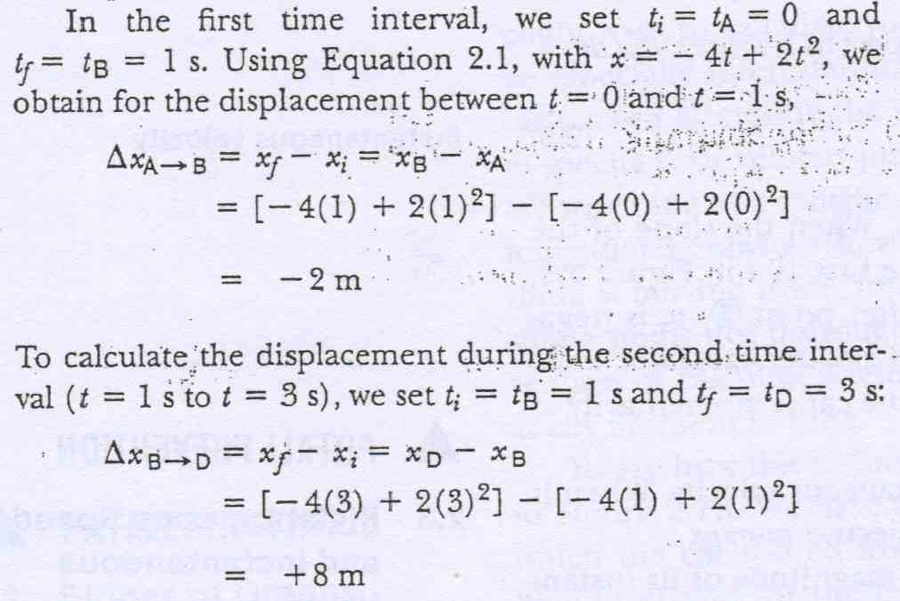
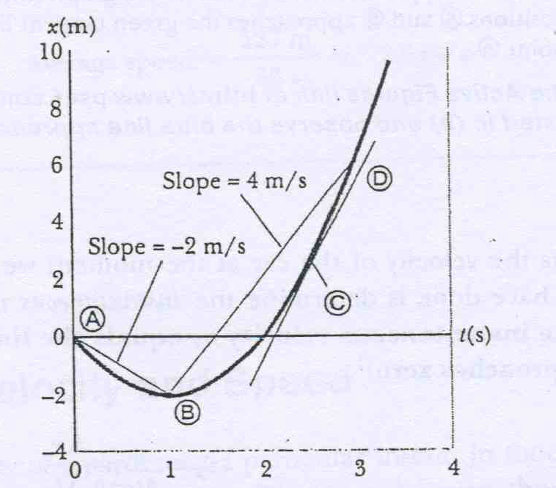
Fig 2.4

Slide 8
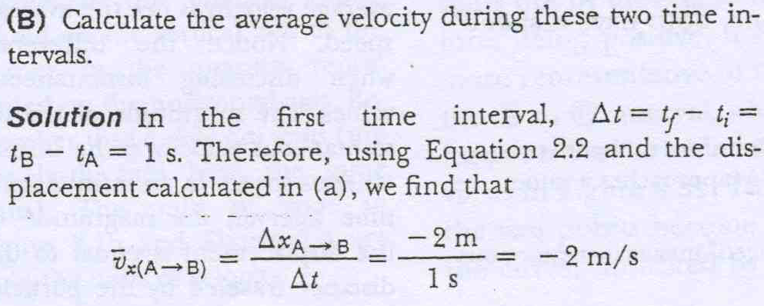
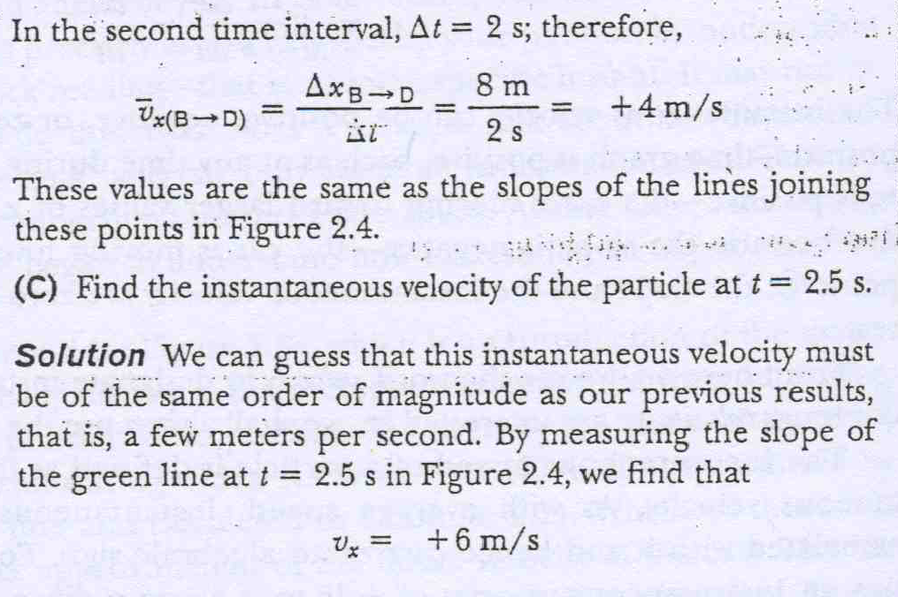

Slide 9
Acceleration
Acceleration is the rate of change of the velocity
Dimension =
Unit = m/s²

Slide 10
Acceleration and Velocity, 1
When an object’s velocity and acceleration are in the same direction, the object is speeding up
When an object’s velocity and acceleration are in the opposite direction, the object is slowing down

Slide 11
Acceleration and Velocity, 2
The car is moving with constant positive velocity (shown by red arrows maintaining the same size)
Acceleration equals zero

Slide 12
Acceleration and Velocity, 3
Velocity and acceleration are in the same direction
Acceleration is uniform (blue arrows maintain the same length)
Velocity is increasing (red arrows are getting longer)
This shows positive acceleration and positive velocity

Slide 13
Acceleration and Velocity, 4
Acceleration and velocity are in opposite directions
Acceleration is uniform (blue arrows maintain the same length)
Velocity is decreasing (red arrows are getting shorter)
Positive velocity and negative acceleration

Slide 14
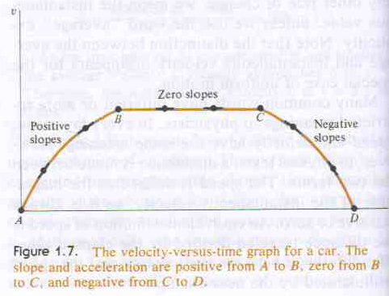
Problem

Slide 15
Graphical Look at Motion – displacement – time curve
The slope of the curve is the velocity
The curved line indicates the velocity is changing
Therefore, there is an acceleration

Slide 16
Graphical Look at Motion – velocity – time curve
The slope gives the acceleration
The straight line indicates a constant acceleration

Slide 17
Graphical Look at Motion – acceleration – time curve
The zero slope indicates a constant acceleration

Slide 18
Q

Slide 19
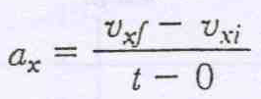
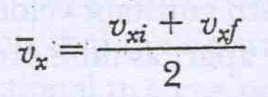
One dimensional motion with constant acceleration
If a varies with time – complex motion
When acceleration is constant , the average
acc^{n} is equal to instantaneous acc^{n}.
(1)
For constant a, average velocity
(2)
This apply only for constant acceleration

Slide 20
(3)
(4)

Slide 21
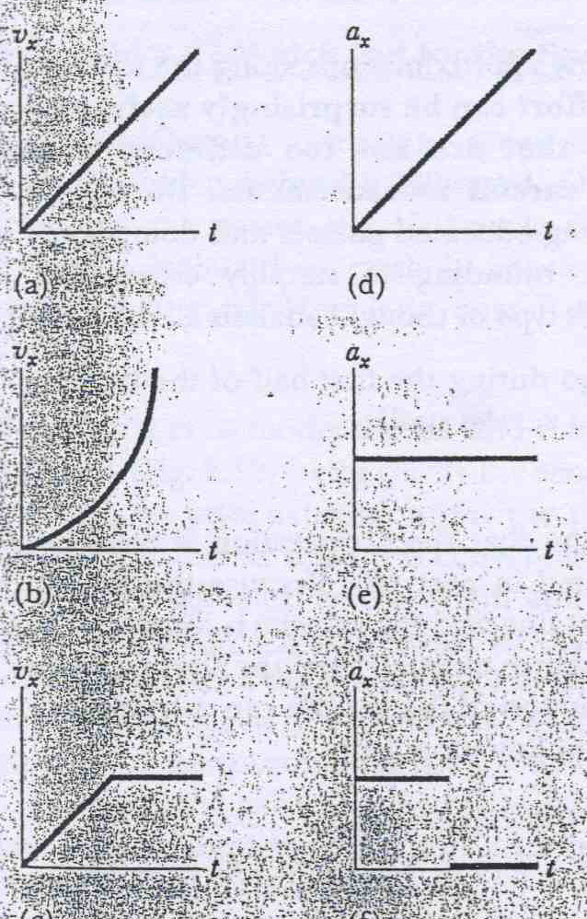

Slide 22
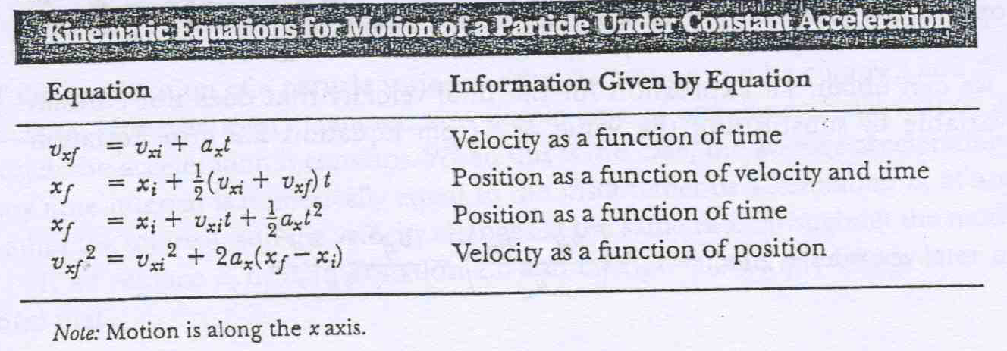
Question

Slide 23
Questions
Watch out for speed limit

Slide 24
Freely Falling Objects
A freely falling object is any object moving freely under the influence of gravity alone.
It does not depend upon the initial motion of the object
Dropped – released from rest
Thrown downward
Thrown upward

Slide 25
Acceleration of Freely Falling Object
The acceleration of an object in free fall is directed downward, regardless of the initial motion
The magnitude of free fall acceleration is g = 9.80 m/s²
g decreases with increasing altitude
g varies with latitude
9.80 m/s² is the average at the Earth’s surface

Slide 26
Acceleration of Free Fall, cont.
We will neglect air resistance
Free fall motion is constantly accelerated motion in one dimension
Let upward be positive
Use the kinematic equations with a_{y} = g = -9.80 m/s²

Slide 27
Freely Falling Bodies Quiz

Slide 28
Free Fall Example
Initial velocity at A is upward (+) and acceleration is g (-9.8 m/s²)
At B, the velocity is 0 and the acceleration is g (-9.8 m/s²)
At C, the velocity has the same magnitude as at A, but is in the opposite direction
The displacement is –50.0 m (it ends up 50.0 m below its starting point)

Slide 29
END

