Slide 1
CHAPTER 2 Language & Regional Variation

Slide 2
E.g. English spoken in Hawaiian accent/dialect.
Every language is spoken in many variations
E.g. America English – British English – Australian English
Also there exists a range of varieties in different parts of these countries.
Linguistic geography:
Investigating aspects of language variation based on where that language is used.

Slide 3
The Standard Language
Standard language:
An idealized variety/ having no specific region
A variety associated with administrative, commercial and educational centers, regardless of regions.
Mostly found written than spoken
Found in:
Printed docs
Mass media
Schools
E.g. ‘Standard English’
The general variety used in public broadcasting in specific countries, e.g.: ‘Standard American English’ ‘Standard British English’

Slide 4
Accent & Dialect
Accent:
Clip
We all speak with an accent/ every language user speaks with an accent’ some more distinct than others.
It is restricted to the description of aspects of pronunciation that identify where an individual speaker if from regionally or socially.

Slide 5
Dialect:
Used to describe features of grammar and vocabulary as well as aspects of pronunciation
e.g. 1/ ‘ You don’t know what you’re talking about’
= ‘Ye dinnae ken whit yer haverin aboot’
dialect of ‘Scottish English’ – differences in
pronunciation + voc + grammar
e.g.2/
A: ‘how long are youse here?’ (irish dialect)
B: ‘Till after Easter’
C: ‘We came on Sunday’

Slide 6
Dialectology
Despite occasional differences, there exists a general mutual intelligibility among speakers of different dialects.
Dialectology:
To distinguish between two different dialects of the same language (and two different languages)
From a linguistic point of view, No dialect is better than the other, they are only different.
From a social point of view, some varieties become more prestigious/ e.g. ‘the standard language’/ associated with a city with economic & political power./ e.g. ‘London for British English’

Slide 7
Regional Dialects
Clip
Sometimes people view different regional dialects as a source of humor and mockery.
Some regional dialects have stereotyped pronunciations associated with them.
Regional Dialect surveys:
Investigation of consistent features of speech found in one geographical area compared to another.
Norms “non-mobile, older, rural, male speakers” / less likely to have been exposed to outside influences.
Info collected served as the basis of ‘Linguistic Atlases’ of whole countries.

Slide 8
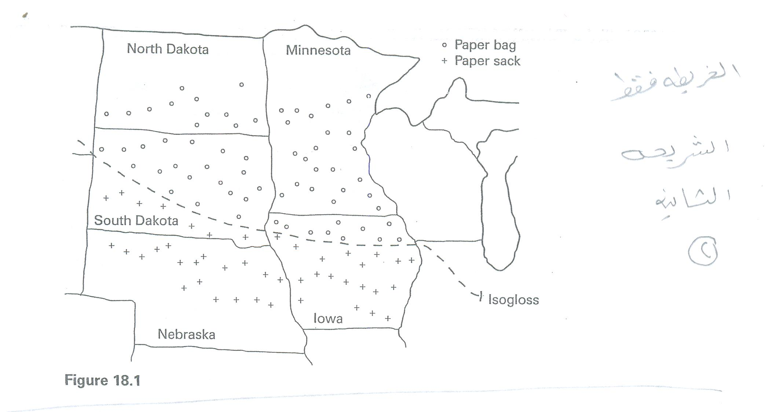
Isoglosses and Dialect Boundaries

Slide 9
Isogloss:
An imaginary line that represents a boundary between two areas with regards to one particular linguistic item.
Dialect boundary:
When a number of isoglosses come together to form a more solid line = a dialect boundary
E.g. Northern & Midland dialects in USA / ‘paper bag’ paper sack’

Slide 10
The Dialect Continuum
Dialect continuum:
At most dialect boundary areas, one dialect (or language variety) merges into another.
There are no sharp breaks from one region to the next
Regional variations can be seen as existing along a dialect continuum.
Bidialectal:
clip
Speaking two dialects
most of us are bidialectal / one dialect among family & friends and another dialect in school.
Bilingual:
People knowing two distinct languages.

Slide 11
Bilingualism & Diglossia
Bilingualism:
Bilingual: People knowing two distinct languages.
Clip
Canada/ an official bilingual country/ both French & English as official languages.
Usually associated with minority groups.
Or, Individual bilingualism: result of having two parents speaking different languages./ one lang will e the dominant one.

Slide 12
Diglossia:
‘low’ variety and a ‘high’ variety.
E.g. ‘Classic Arabic’

Slide 13
Language Planning
Monolingual:
U.S.A. – San Antonio, Texas/ Spanish
Guatemala – 26 Mayan languages spoken + Spanish (should education be in Spanish?)
Necessity of language planning

Slide 14
Language planning:
Government, legal & educational organizations in many countries have to plan which variety of the languages spoken in the country are to be used for official business.
‘The official government language’.
E.g.
Israel / Hebrew
India / Hindi / riots
Philippines / Filipino

Slide 15
A series of stages have to be implemented over a number of years.
E.g. ‘Swahili’ as the official national language of ‘Tanzania’ in East Africa.
Gradually introduces ‘Swahili’:
1/ Selection (official)
2/ Codification (grammar – dictionaries)
3/ Elaboration (social uses - literary)
4/ Implementation (encourage)
5/ Acceptance (majority)

Slide 16
Pidgins & Creoles
Pidgin:
A variety of language that developed for some practical purpose among groups of ppl who had a lot of contact but who did not know each other’s languages.
E.g. for trading
No native speakers.
Origin of ‘pidgin’ Chinese word for ‘business’

Slide 17
Lexifier:
The main source of words in the pidgin.
E.g. “English pidgin” / English is the ‘lexifier language’
Does not necessaraly maintain same meaning or pronunciation / ‘grass’ in Tok Pisin = ‘hair’
Pidgins are charecterized by a simple grammar and limited vocabulary
e.g.
‘tu buk’ = two books
‘di gyal place’ = The girl’s place
‘Buk bilong yu’ = your book
‘by and by head belong you he alright again’ = Your head will soon get well again.
Maid langauges ‘inta fe ruh/ inta fe ije’

Slide 18
Creole:
When a ‘pidgin’ develops beyond its role as a trade or contact language and becomes the first language of a social community.
Initially develops as the first language of children growing up in a pidgin-using community.
Has a large number of native speakers. / unlike pidgin.
E.g.
‘Tok Pisin’
‘Hawaii creole English’
French creole in Haiiti (famous poet hanged himself with a French dictionary)
English creoles in Jamaica.

Slide 19
The post creole continuum
Creolization:
Development from a pidgin to a creole.
Decreolization:
When speakers tend to use fewer creole forms and structure in favor of a ‘higher’ variety that is associated with greater social prestige.
Closer to the standard model of the language.
E.g. ‘British English’ in Jamaica

