Slide 1
Organic halides

Slide 2
Learning objectives
In this chapter will discusses the following topics and by the end of this chapter the students will:
Recognize the structure and classes of alkyl halides.
Know the common names and understand the IUPAC rules for nomenclature of halo compounds.
Understand the physical properties of halo compounds (solubility and boiling points).
Know the different methods used in preparation of halo compounds.
Know the reactions of halo compounds; nucleophilic substitution, elimination, reduction reactions of Grignard reagents and know the previously disused methods of reducing alkyl halides.
    SN1 and SN2 mechanisms
    E1 and E2 mechanisms

Slide 3
Organic halogen compounds and their uses
Organic halogen compounds are a large class of natural and synthetic chemicals that contain one or more halogens (fluorine, chlorine, bromine, or iodine) combined with carbon and other elements.
Halogen compounds are very important for a number of reasons:
  Simple alkyl and aryl halides (especially: Cl & Br) are versatile reagent in syntheses.
  Halogen can be converted to unsaturated compounds through dehydrogenation (Elimination reactions).
  Halogen can be replaced by many other functional groups (substitution reactions).
  Some halogens have some uses for example: as solvent fire retardants, cleaning fluids, refrigerants, and in polymers such as Teflon

Slide 4
Examples of some General Uses of Organic halogen compounds:

Slide 5
Classification Alkyl Halides
According to type of hydrocarbon attached to halide:
1.Alkyl Halides, R- X:compounds which have a halogen atom bonded to one sp3 hybrid C atom. Alkyl halides are also called haloalkanes.
primary (1°), secondary (2°) or tertiary (3°)….
( depending on the type of carbon to which halogen attached)
2. Vinylic Halides: has a halogen atom bonded to one sp² hybrid C atom
3. Aryl Halides: has a halogen atom bonded directly to an aromatic ring
4. Allylic Halides: has a halogen atom bonded to one sp³ hybrid C atom
5. Benzylic halides: has a halogen atom bonded to Carbone one away from aromatic ring

Slide 6
Classification Alkyl Halides
1-Alkyl halides ( R-X): | CH₃-Cl | CH₃-CH₂-Br | (CH₃)₂-CH-F
Common | Methyl Chloride | Ethyl bromide | Isopropyl fluoride
IUPAC | Chloromethane | Bromoethane | 2-Fluoropropane
Class | 1° | 1° | 2°
Common | Cyclohexyl Iodide | t.Butyl bromide | Methylcyclopentyl chloride
IUPAC | Iodocyclohexane | 2-Bromo-2-methylpropane | 1-Chloro-1-methylcyclopentane
Class | 2° | 3° | 3°

Slide 7
Classification Alkyl Halides
2-Vinylic halides
3-Allyl halides
C=C-X
C=C-C- X
CH₂=CHBr
Vinyl bromide
Bromoethene
CH₂=CHCH₂Cl
Allyl chloride
3-Chloro-1-propene
Bromocyclohexene
3-Chlorocyclopentene
5-Aryl halides:
4-Benzylic halides: Ar-C-X
Ar-X (X directly attached to benzene ring )
Benzyl Chloride
Chlorobenzene p-Bromo toluene

Slide 8
Nomenclature OF Alkyl halides
IUPAC names derived from the names of parent organic compound (alkane or alkene or alkyne or alcohol or aldehydes and so on) with a prefix indicating halogens and their positions.
Common names derived from the corresponding alkyl group followed by the name of halogen atom.
Examples:
CH₂X₂ CHX₃ CX₄
Common name Methylene halides Haloforms Carbon tetrahalide

Slide 10
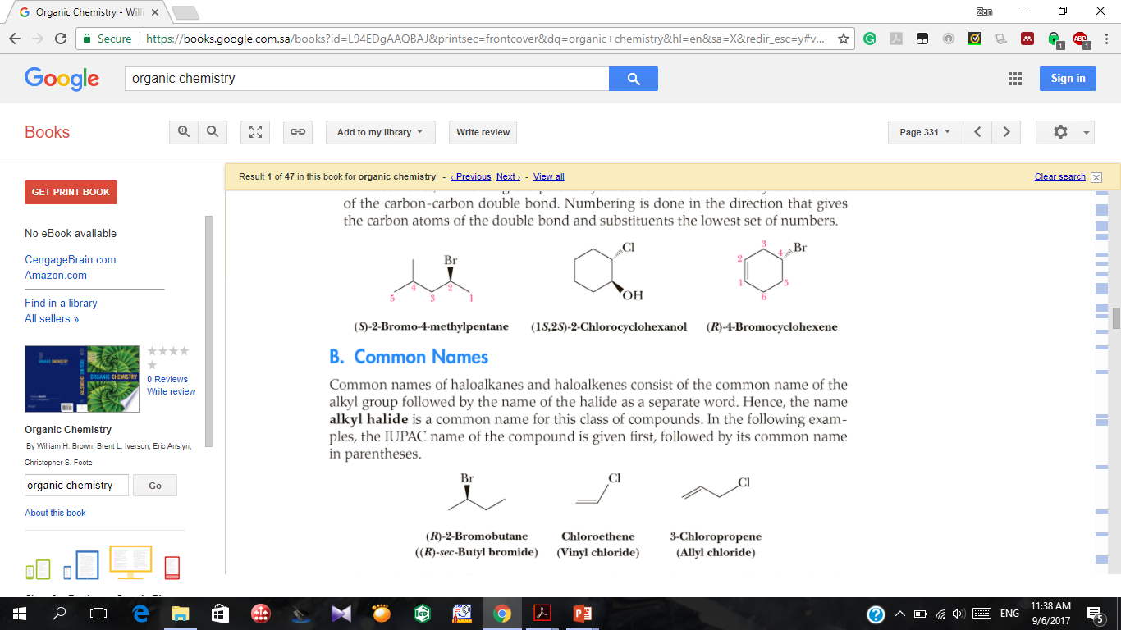
IUPAC:
Chloromethyl benzene
(Benzyl Chloride)
Common:
Chlorobenzene p-Bromo toluene
Systematic name Common name
Note:
substituted alkane
CH3 Br bromomethane
CH3 CH2 Cl chloroethane
alkyl group attached to halogen plus halide
CH3 Br methyl bromide
CH3 CH2 Cl ethyl chloride

Slide 11
Types of Dihalides
A geminal dihalide (Latin, geminus, “twin”) has the two halogen atoms bonded to the same carbon atom.
A vicinal dihalide (Latin, vicinus, “neighboring”) has the two halogens bonded to adjacent carbon atoms.

Slide 12
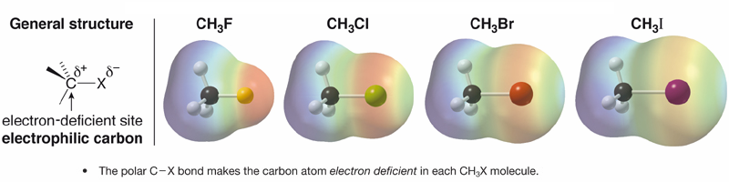
Physical Properties
Polarity
Fluorine, chlorine, and bromine are all more electronegative than carbon ; as a result, C-X bonds with these atoms are polarized with a partial negative charge on halogen and a partial positive charge on carbon.

Slide 13
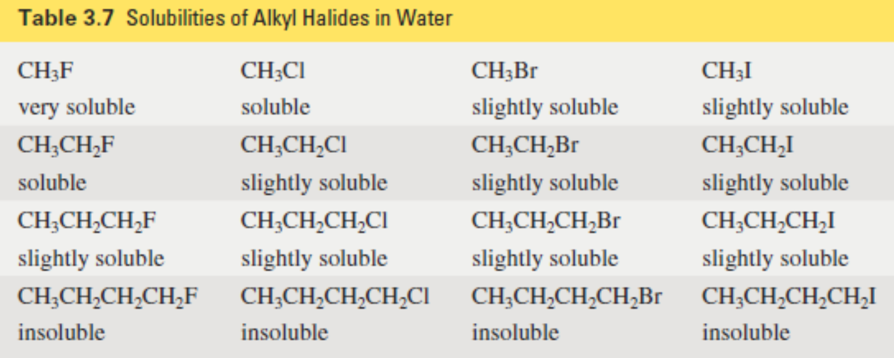
Physical Properties
Solubility
Alkyl halides have some polar character, but only alkyl fluorides have an atom that can form a hydrogen bond with water. The other alkyl halides are less soluble in water
In General, all organic halides are insoluble in water and soluble in common organic solvents.

Slide 14
Physical Properties
The boiling point
The boiling points of alkyl halides increase with increasing molecular weight because of the increase in van der Waals forces.
Alkyl halides have higher melting point than the corresponding alkanes, alkenes, and alkynes because:
    1. Polarity
    2. Molecular weight
      (In series of halides BP. F <Cl <Br <I)
    CH₃CH₂CH₂F CH₃CH₂CH₂Br CH₃CH₂CH₂I
    bp= 47⁰C bp= 71⁰C bp= 102⁰C
    Ethane (bp -89°C) & bromomethane (bp 4°C)
    butyl bromide, bp 100°C & tert-butyl bromide, bp 72°C.

Slide 15
Preparation Of Halocompounds
1- Direct halogenation of hydrocarbons
  Halogenation of alkanes
  Halogenation of alkenes
  Halogenation of alkynes
  Halogenation of aromatic ring and alkyl benzenes
2- Conversion of alcohols: alkyl halides

Slide 16
Preparation Of Halocompounds
1- Direct halogenation of hydrocarbons
Halogenation of alkanes:

Slide 17

B. Halogenation of alkenes:

Slide 18
Note:

Slide 19
C. Halogenation of alkynes :

Slide 20
D. Halogenation of aromatic ring and alkyl benzenes:

Slide 21

2-Conversion of alcohols: alkyl halides (Nucleophilic Substitution)
Concentrated halogen acid; HX - Phosphorus halides; PX₃ or PX₅ or Thionyl chloride ;SOCl$2$

Slide 22
Reactions of Organic Halides
Nucleophilic Substitution Reactions
Elimination Reactions
Formation of Grignard reagent and its reactions
Reduction of alkyl halides
Reduction by Zinc metal and acids or by metal hydrides
Reduction by sodium metal (coupling reaction)
Reduction using lithium dialkyl cuprate

Slide 23
Reactions of Organic Halides
1- Nucleophilic Substitution Reactions

Slide 24
Reactions of Organic Halides

Slide 26
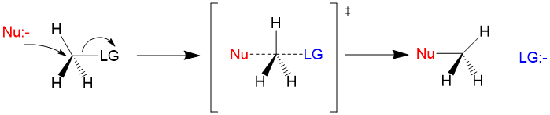
Nucleophilic Substitution Mechanism
The SN2 mechanism:
is a one –step process in which the bond to the leaving group begins to break as the bond to nucleophile begins to form

Slide 27
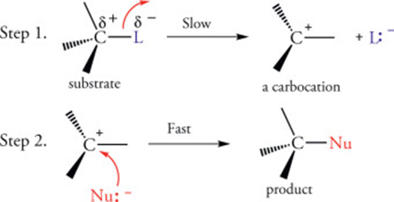
Nucleophilic Substitution Mechanism
The SN1 mechanism:
Is a two process: the bond between the carbon and leaving group breaks first and then the resulting carbocation combines with nucleophile

Slide 28
2- Elimination Reactions
Reactions of Organic Halides
Alkyl halides can lose HX molecule to give an alkene.
If the haloalkane is unsymmetrical (e.g. 2-bromobutane or 2-bromopentane) a mixture of isomeric alkene products is obtained.

Slide 29
Reactions of Organic Halides
E2
Elimination Reactions mechanism

Slide 30
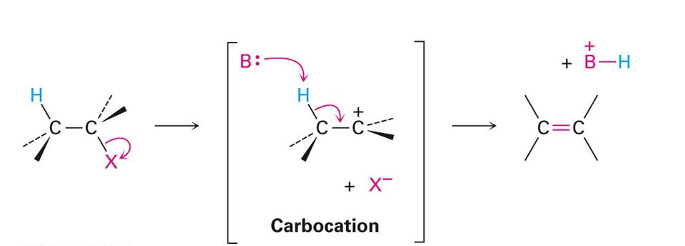
Reactions of Organic Halides
E2
Elimination Reactions mechanism
E1

Slide 31
Reactions of Organic Halides
3- Formation of Grignard reagent and its reactions:
Reactions of Grignard reagent

Slide 32
Reactions of Organic Halides
4- Reduction of alkyl halides:
Reduction by Zinc metal and acids or by metal hydrides
Reduction by sodium metal (coupling reaction)
Reduction using lithium dialkyl cuprate

Slide 33
Questions

