Slide 1
Chapter 1
Physics and Measurement

Slide 2
Plan and Learning Outcome
In this chapter we will learn
What is Physics and its objective?
Physical quantities and its type.
Measurements and its need.
Units and dimension.

Slide 3
Objective of Physics (الهدف من الفيزياء)
Physics describe the law of Nature
To find the limited number (العدد المحدود) of fundamental (أساسي)laws that govern natural phenomena
To use these laws to develop (تطوير) theories that can predict the results of future experiments
Express the laws in the language of mathematics

Slide 5
Theory and Experiments
Should be complement (تكملة) to each other
When a discrepancy (تناقض, فرق ) occurs (يحدث), theory may be modified(تعديل)
Theory may apply to limited conditions (شروط محدودة)
Example: Newtonian Mechanics is confined to objects traveling slowing with respect to the speed of light
Try to develop a more general theory

Slide 6
Quantities Used
In mechanics, three basic quantities (كميات الأساسية)are used
Length
Mass
Time
Fundamental or basic quantities is independent of each other
Will also use derived quantities (الكميات المشتقة)
These are other quantities which can be expressed in terms of fundamental quantities

Slide 7
Derived quantities
(الكميات المشتقة)
For example : Area= square of length
Speed= distance/time

Slide 8
comparison مقارنة
quantitative كمي
Standard معيار

Slide 9
Standards of Quantities
Standardized systems
agreed upon by some authority, usually a governmental body
SI – Systéme International
agreed to in 1960 by an international committee
SI system used in this text

Slide 10
Length
Units
SI – meter, m
Defined in terms of a meter – the distance traveled by light in a vacuum during a given time

Slide 11
Mass
Units
SI – kilogram, kg
Defined in terms of a kilogram, based on a specific cylinder kept at the International Bureau of Standards
See Table 1.2 for masses of various objects

Slide 12
Standard Kilogram

Slide 13
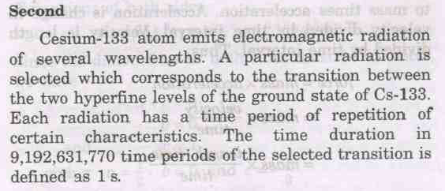
Time
Units
seconds, s
Defined in terms of the oscillation (ذبذبة) of radiation from a cesium atom

Slide 14
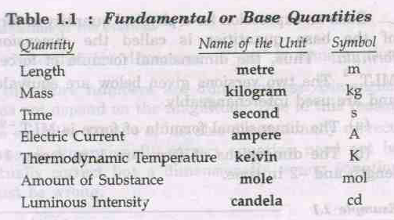
البادئات
The magnitude of Physical quantities vary over wide range. For example:
Separation between two protons in the nucleus =
The mass of electron =
The mass of our galaxy =
The CGPM recommended standard prefix for certain powers of 10

Slide 15
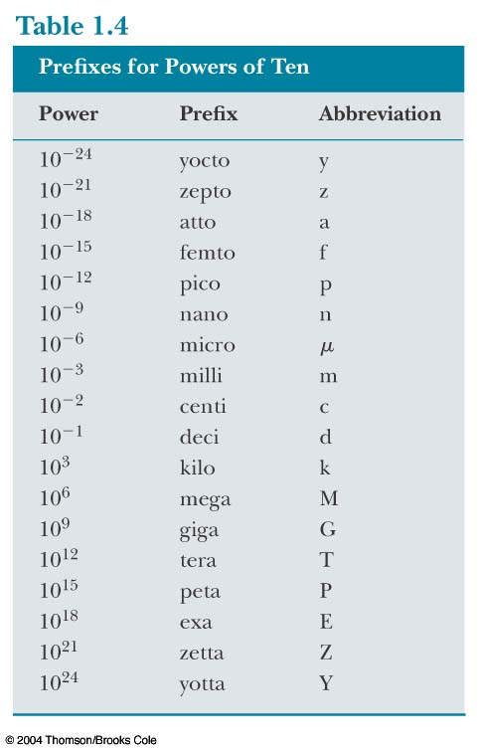
Prefixes, cont.
The prefixes can be used with any base units
They are multipliers of the base unit
Examples:
1 mm = 10⁻³ m
1 mg = 10⁻³ g

Slide 16
Dimension
What is Dimension (البعد)?
All the physical quantities (الكميات الفيزيائية) can be expressed as the product of power of the base (Fundamental) quantities.
For example:
Velocity = Displacement/Time
= length/ time
= L/T = LT⁻¹
Acceleration= velocity/time = LT⁻¹ /T
= LT⁻²
.

Slide 17
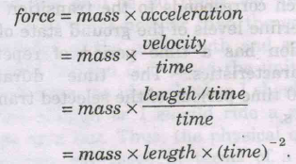
= MLT⁻²

Slide 18
Dimension
The exponent of the base quantities that enters into the expression is called the dimension of the quantity in that base.
Thus dimension of Force are 1 in mass, 1 in length and -2 in time.
For convenience base quantities are written as one letter symbol.
Mass – M, length- L and time – T
Dimension of force is [M¹ L¹ T⁻²]

Slide 19
Dimension
Problem

Slide 20
Uses of Dimension
What is equation?
Several terms separated by symbols of equality, plus or minus sign.
The dimension of all terms in the equation must be identical

Slide 21
Uses of Dimension

Slide 22
Uses of Dimension

Slide 23
Test questions
Q. 3. Suppose that two quantities A and B have different dimension. Determine which of the following airthematic operation could be physically meaningful,
(a) A+B (b) A/B (c) B-A (d) AB

Slide 24
Test questions
Q. 1.
Q. 2

Slide 25
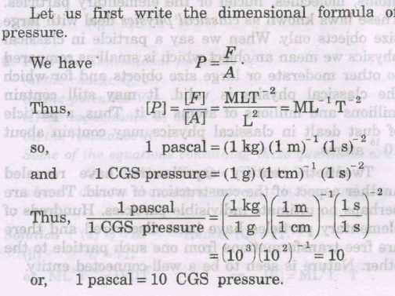
Uses of Dimension

Slide 26
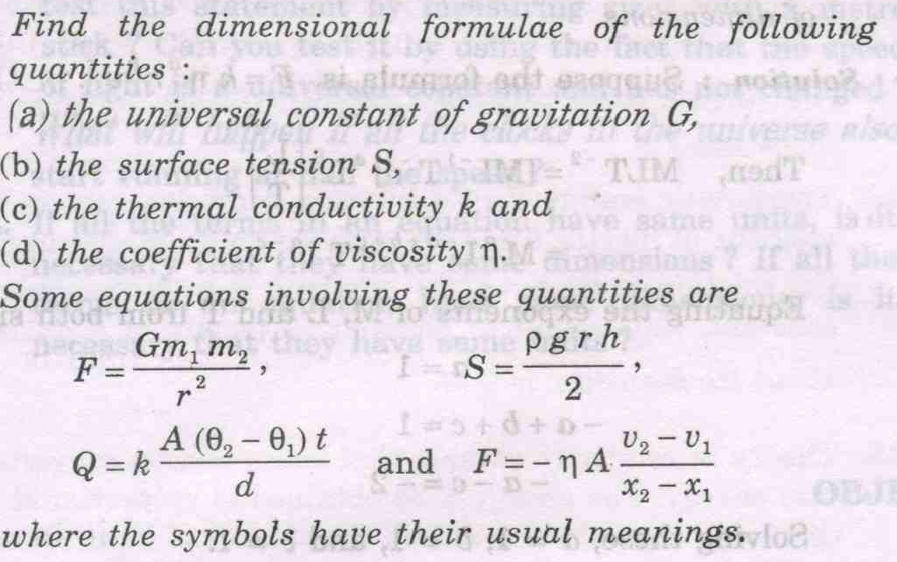
Problems
Dimension formula

Slide 27
Problems
Conversion
Q.
Q.

Slide 28
Simple pendulum
Suppose an acc^{n} of a particle
a = k r^{n}v^{m}
Write the simple form of equation

Slide 29
The position of a particle moving under uniform acceleration is some function of time
and the acceleration. Suppose we write this position s = ka^{m}t^{n}, where k is a dimensionless constant.
Show by dimensional analysis that this expression is satisfied if m = 1 and n = 2. Can this analysis give the value of k?
Which of the following equations are dimensionally correct?
(a) v_{f} = v_{i} + ax
(b) y = (2 m)cos(kx), where k = 2 m^{–1}.

