Slide 1
Chapter 1
Case Studies

Slide 2
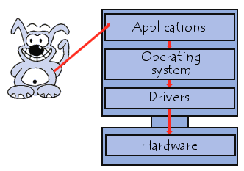
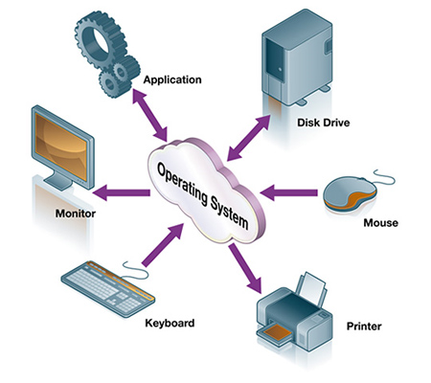
operating system (OS)
OS is a system software that manages computer hardware and software resources and provides common services for computer programs.

Slide 4
The Classification of Operating systems
Multi-user: Allows two or more users to run programs at the same time. Some operating systems permit hundreds or even thousands of concurrent users.
Multiprocessing: Supports running a program on more than one CPU.
Multitasking : Allows more than one program to run concurrently.
Multithreading : Allows different parts of a single program to run concurrently.
Real time: Responds to input instantly.

Slide 5
DOS
DOS (Disk Operating System) gained a reputation by supporting operating systems developed by IBM and Windows.
DOS was prominent in the industry up until support was terminated for Windows ME.
Though it's not as sophisticated as modern systems, DOS offers many advantages to the user.
This system is very stable and rarely endures crashes.
It can display content on an arcade monitor without the aid of special hardware and the use of batch files offer a high degree of customization.
While the system is still used, DOS has become more difficult to manage as support is limited.

Slide 6
UNIX
UNIX is an operating system which was first developed in the 1960s, and has been under constant development ever since.
By operating system, we mean the suite of programs which make the computer work. It is a stable, multi-user, multi-tasking system for servers, desktops and laptops.
UNIX systems also have a graphical user interface (GUI) similar to Microsoft Windows which provides an easy to use environment.
However, knowledge of UNIX is required for operations which aren't covered by a graphical program, or for when there is no windows interface available.

Slide 7
UNIX
There are many different versions of UNIX, although they share common similarities.
The most popular varieties of UNIX are Sun Solaris, GNU/Linux, and MacOS X.

Slide 8
Linux
The Linux operating system is developed on a kernel based on Unix.
It is known as one of the most secure platforms, yet Linux is often viewed as more complex.
Linux is the result of an open-source project, allowing users and developers to access the source code for free.
Because it requires less hardware, Linux is capable of providing exceptional performance even on a smaller hard disk.

Slide 9
Linux
Large communities of users exist for this system, constantly contributing to the code and making improvements.
The server-based concept of Linux has resulted in fewer home users and a lack of multimedia support for the system.

Slide 10
Mac OS X
Mac OS X is Apple's trademark operating system software for their line of Macintosh computers.
The system was based in part on Unix and mimics it's format with the administrative controls.
Mac OS X software requires a low level of maintenance with fewer occurrences of computers worms, viruses and spyware.
The Apple operating system does have some disadvantages, primarily in regard to software and hardware compatibility.

Slide 11
Windows
The Microsoft Windows operating system is the most popular choice and currently has a stronghold over the market.
This platform has made significant advancements from version 1.0 all the way to the new Vista system.
The Windows system is highly compatible, feature-rich and has a much larger selection of software applications.
Unlike the Linux kernel, Windows is proprietary software and tends to be more expensive than others.
Despite widespread usage, Windows has been heavily associated with the term "insecure" as a number of security vulnerabilities have made it the most targeted system.

Slide 12
Windows
Frequently exploited by hackers and malicious code writers, it is recommended that any Windows operating system with internet access be protected by some form of security software.
Although the XP version is still popular among users, support for this system will conclude in 2009 as more emphasis will be placed on developing the Vista series.

Slide 13
References:
http://www.spamlaws.com/operating-system-comparison.html
http://www.ee.surrey.ac.uk/Teaching/Unix/unixintro.html
http://www.webopedia.com/TERM/O/operating_system.html

