Slide 1
Chapter 5
Electric Logic Sensors and Actuators

Slide 2
Logic Sensors and Actuators
Electric sensors and actuators can be classified as continuous or logic.
Logic sensors have 2 states: 0/1, TRUE/FALSE, ON/OFF.
Logic actuators are used with a PLC to activate or deactivate the logic switching elements, that will drive the mechanical system.
Examples of using logic sensors:
Mechanical limit switch used to detect an approaching object.
Optical sensor or detector used to detect an object that is breaking the beam of light.
Capacitive detector used to detect the existence of dielectric objects.
Inductive detector switch used to detect the existence of a ferrous metal object.
A thermostat switch (such as those used in refrigeration and air conditioning) opens or closes a contact when a certain temperature is reached.

Slide 3
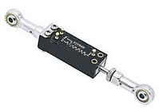
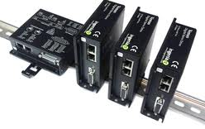
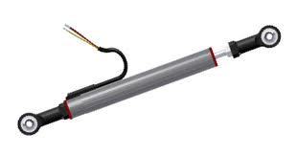
Continuous Sensors and Actuators
Continuous sensors generate a continuous signal (voltage or current) that is proportional to the actual physical variable.
For example, a linear potentiometer will generate analog output signal proportional to linear displacements.
Continuous actuators are used to activate or deactivate to drive the mechanical system proportional to the value of the control signal.
For example, the analog output signal from PLC can be used to activate a linear amplifier that will control the speed of a DC motor.
Linear Analog DC servo drives
Linear potentiometer

Slide 4
Nearby or Proximity Logic Detectors
There are two ways to detect the existence of an object:
Physical contact: direct mechanical contact using a physical force contact
No physical contact: using proximity technique

Slide 5
Contact switches
Internally, contact switches consist of electric contacts driven by mechanical lever and spring.
Applying a small force on this mechanical liver actuates the contact. Removing the force causes the return of the contact to its original position.
Contact switches are available with either normally closed NC or normally opened NO contacts. Micro limit switches can be found with small equipment, while heavy-duty limit switches (more expensive) can be found with large equipment.
Contact switches can be used as motion limit switches or as push button switches and used as user-machine interface switches, e.g. start/stop push button switches.

Slide 6
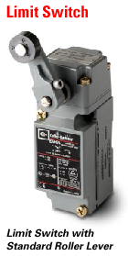
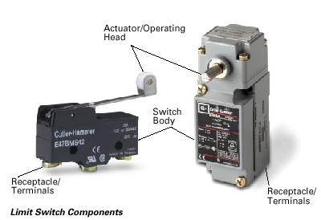
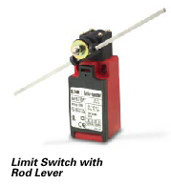
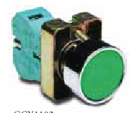
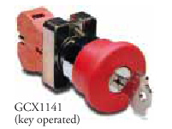
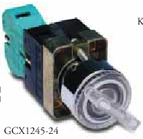
5.2 Nearby or Proximity Logic Detectors
Fig 5.1 Examples of contact switches used as limit switches.
Fig 5.2 Examples of contact switches used as push-button, key type and selector switches used as machine-user interface buttons.

Slide 7
Configurations of contact switches
Contact switches are of two types:
single-pole single-throw (SPST) contacts.
single-pole double-throw (SPDT) contacts, also called “change over” or “transfer” contacts.

Slide 8
Drawbacks of contact switches
It has been estimated that 90% of machine automation failures are from limit switches.
In many automation applications, the limit switches represent the weakest link of the control system.
This is because these sensors are located in the places where action is. These switches are usually located in hot areas, moisture, corrosive atmosphere …etc.

Slide 9
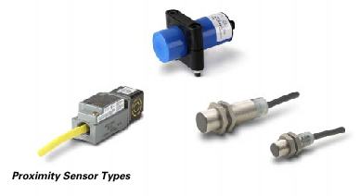
Capacitive proximity switches
http://www.youtube.com/watch?v=SsvjxnN8ZUk
Not limited to metallic targets (non ferrous, also called dielectric materials): liquid, water, oil, powder, wood, plastic, etc.
Can detect objects inside sealed containers
Change in capacitance causes the circuit to actuate a solid state switch
Maximum sensing distances range from 5 to 40mm
Switching accuracy affected by humidity and temperature
Low responses to detect high speed moving objects compared to inductive sensors

Slide 10
Inductive proximity switches
http://www.youtube.com/watch?v=dZKesqSYtZA&list=PL3D1192AC1FFB36DF&index=5
An inductive sensor is an electronic proximity sensor, which detects metallic objects without touching them.
The sensor consists of an induction loop. Electric current generates a magnetic field, which collapses generating a current that falls asymptotically toward zero from its initial level when the input electricity ceases.
This change can be detected by sensing circuitry, which can signal to some other device whenever metal is detected
Common applications of inductive sensors include
Metal detectors
Traffic lights
Car washes
Applications where dirt is prevalent.
Elements of a simple inductive sensor. 1. Field sensor 2. Oscillator 3. Demodulator 4. Flip-flop 5. Output

Slide 11
Photoelectric switches
Photoelectric sensors consist of a source emitting a light beam and a light-sensing detector receiving the beam.
The object to be sensed interrupts or reflects the beam, thereby making its presence known without physical contact between sensors and object.
3 possible modes of operation
Through-beam
Reflection from target
Retro-reflection

Slide 12
Through-beam photoelectric sensor
The emitter and detector are mounted in separate housings which are aligned carefully so as to face each other exactly.
As the target to be detected approaches, it breaks the beam.
In this type of operation the sensor can work for lengths up to 100m, provided the beam is concentrated and the air is clean.
An interesting variation of the through-beam principle can be used as smoke detector (such as in domestic fire alarm).

Slide 13
Reflection from target
The emitter and detector are built into a single housing, which reduces wiring and mounting cost.
When the target reaches the proper location, it reflects the beam back into the detector.
This mode is only suitable for fairly small distances, where the air must be reasonably clean of contamination.
The method can be used for detecting the liquid level.

Slide 14
Retroreflection
A special reflector (typically a formed plastic surface with small embedded spheres or pyramids) reflects the light beam back into the detector, regardless of the angle of incidence, unless the target interrupts it.
The emitter and detector are mounted on the same housing.
This method can be used to sense a distance up to 10 m in the absence of atmospheric contaminations.

Slide 15
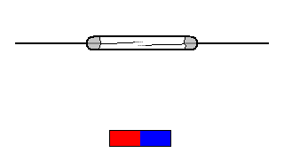
Reed switches
The reed switch is an electrical switch operated by an applied magnetic field.
It consists of a pair of contacts on ferrous metal reeds in a hermetically sealed glass envelope.
The contacts may be normally open, closing when a magnetic field is present, or normally closed and opening when a magnetic field is applied.
The switch may be actuated by a coil, making a reed relay or by bringing a magnet near to the switch. Once the magnet is pulled away from the switch, the reed switch will go back to its original position.
An example of a reed switch's application is to detect the opening of a door, when used as a proximity switch for a burglar alarm.

Slide 16
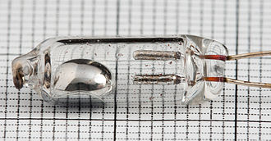
Mercury switches
A mercury switch (also known as a mercury tilt switch) is a switch which opens and closes an electrical circuit through a small amount of liquid mercury.
Mercury switches have one or more sets of electrical contacts in a sealed glass envelope which contains a bead of mercury.
The envelope may also contain air, an inert gas, or a vacuum.
Gravity is constantly pulling the drop of mercury to the lowest point in the envelope. When the switch is tilted in the appropriate direction, the mercury touches a set of contacts, thus completing the electrical circuit through those contacts.
Tilting the switch the opposite direction causes the mercury to move away from that set of contacts, thus breaking that circuit.

Slide 17
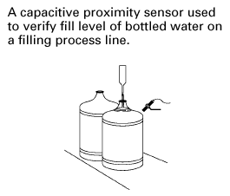
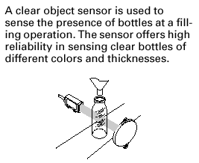
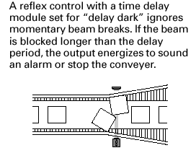
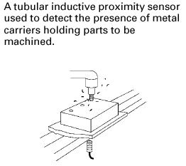
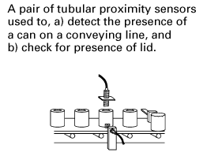
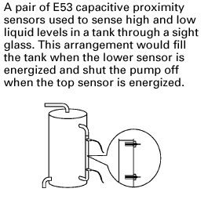
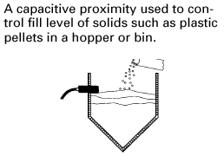
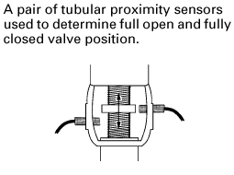
5.3 Applications Nearby or Proximity Logic Detectors
(a)
(b)
(c)
(d)
(e)
(f)
a) Capacitive type.
b) Retro-reflection optical.
c) Retro-reflection optical.
d) Inductive type.
e) Inductive or capacitive
f) Capacitive.
g) Retro-reflection or thru-beam.
h) Capacitive.
i) Inductive.
j) Capacitive or thru-beam.
k) Thru-beam
(h)
(i)
l) Thru-beam optical type.
m) Thru-beam type.
n) Inductive (steel cans) or reflection from target optical type.

Slide 18
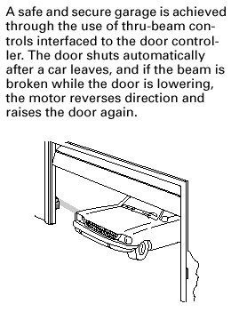
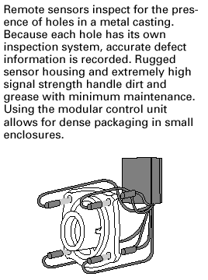
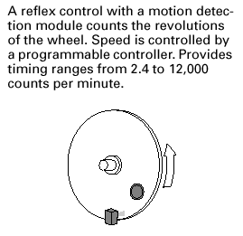
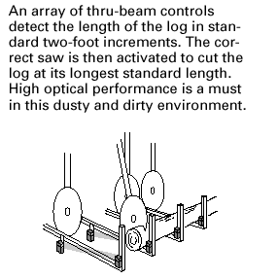
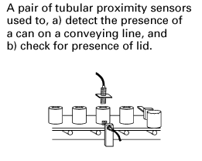
5.3 Applications of Nearby or Proximity Logic Detectors
(h)
(i)
(g)
(l)
(k)
(j)
(m & n)
g) Retro-reflection or thru-beam.
h) Capacitive.
i) Inductive.
j) Capacitive or thru-beam.
k) Thru-beam
l) Thru-beam optical type.
m) Thru-beam type.
n) Inductive (steel cans) or reflection from target optical type.

Slide 19
Actuators
An actuator is a type of motor for moving or controlling a mechanism or system.
An actuator is the mechanism by which a control system acts upon an environment.
It is operated by a source of energy, and converts that energy into motion.
Typical energy: Electric current, Hydraulic fluid pressure, Pneumatic pressure
Logic actuators
Solenoids
Relay switches
Electromechanical relays
Reed relays
Solid state relays

Slide 20
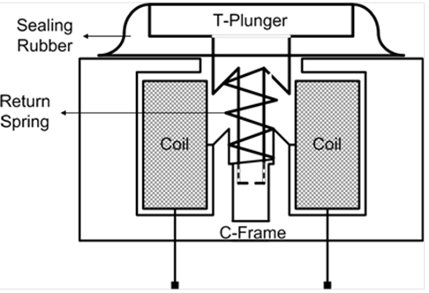
Solenoids
The majority of the solenoids generate force only in one direction and they are used as on-off actuators
Solenoids are simple and cheap linear actuators
Widely used in the construction of contactors, circuit breakers, and solenoid valves.
The operation of solenoids is based on conversion of electrical energy into mechanical energy, and therefore solenoids are being considered as electromechanical actuators.

Slide 21
Solenoid features
Type of displacement: linear or angular
Actuation type: push or pull
Stroke: range of displacement in mm (linear) or degrees (angular)
Force or torque
Duty cycle f:
Life time: standard life is 50,000 to 100,000 operations
Environment conditions: sensitivity to temperature and humidity
Performance curve: Force = F(Stroke)

Slide 22
Performance curve of a solenoid

Slide 23
Example: sizing a solenoid
Consider a linear solenoid with the following specifications:
ON time: 20 sec.
OFF time: 150 sec.
Working stroke : 5 mm
Pull force : 10 N
Determine duty cycle and select one of the following solenoids according to their performance curves

Slide 24
Duty cycle:
Working stroke : 5 mm
Pull force : 10 N
Solenoid-C will not provide the required linear displacement (maximum displacement 3.81 mm).
Both solenoids A and B provide the required displacement at duty cycle 11%
However, solenoid A provides much greater force (52N) then required (10N).
Solenoid B provides the required force and displacement at the calculated duty cycle.

Slide 25
Relay switches
A relay is an electrically operated switch
Relays are used as :
current or voltage amplifiers (i.e. power relays)
electric isolation between the control signal (i.e. coil) and the output load (i.e. contact).
logic switching elements to control a high power circuit by a low-power signal (i.e. control relay)
multi-contact relay, where one input signal is used to control many different loads (possible with different voltages for each load)
There are three basic relay types:
Electromechanical
Reed
Solid-state

Slide 26
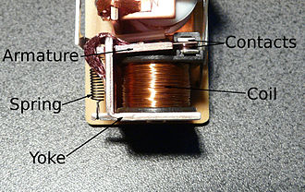
Electromechanical relays (EMR)
When an electric current is passed through the coil it generates a magnetic field that activates the armature
The consequent movement of the movable contact(s) either makes or breaks (depending upon construction) a connection with a fixed contact.
When the current to the coil is switched off, the armature is returned by a force to its relaxed position. Usually this force is provided by a spring, but gravity is also used commonly in industrial motor starters.
Most relays are manufactured to operate quickly.
In a low-voltage application this reduces noise; in a high voltage or current application it reduces arcing.

Slide 27
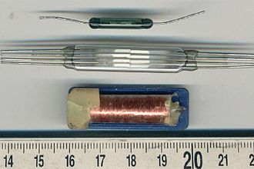
Reed relays
A reed relay is a reed switch enclosed in a solenoid.
The reed switch contacts are made of magnetic material that makes them move under the influence of the field of the enclosing solenoid.
Reed relays can switch faster than larger relays and require very little power from the control circuit.
However, they have relatively low switching current and voltage ratings.
Though rare, the reeds can become magnetized over time, which makes them stick 'on' even when no current is present

Slide 28
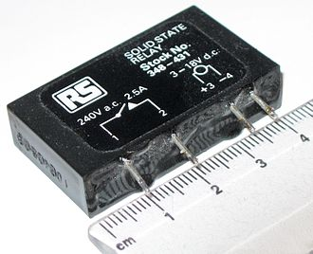
Solid state relays (SSR)
A solid state relay (SSR) is a solid state electronic component that provides a similar function to an electromechanical relay but does not have any moving components, increasing long-term reliability.

Slide 29
SSR features
Advantages | Drawbacks
SSR switch is much faster than EMR and has quite operation. | Their initial cost is greater that EMR
The life of SSR is nearly infinite compared to EMR life. | They can switch only one circuit, hence, muti-SSR required to switch multi-loads
SSR can be switched using low power electronic devices (gates) | They are not good as positive shutoff devices, since they have a leakage current
Resistance for shocks and vibration compared to EMR | SSR usually fail in the on state, which is quite dangerous.
 | The application of SSR is not forward like EMR; for example, two types of SSR are used for DC and AC load.
 | SSR are not suitable for very high temperature operation.

Slide 30
Problems
5-1) Complete the following statements:
Sensors can detect the ………..or ………. Of objects. (ans: presence,absence)
The three main sensor categories are: ………….., …………., ………. (ans: contact switches, proximity sensors, photoelectric sensors).
The sensor type that can only detect metallic objects is the ……… sensor (ans: inductive type)
The sensor type that uses a broken beam of light to detect objects is commonly referred as a ……….. sensor. (ans: photoelectric type).
Inductive proximity sensors work best with …….. metals. (ans: Ferrous)
The transparency of the container has no effects on the sensing of …….. sensors. (ans: Capacitive)
The initials designating a transistor output that sinks current from the load are ……… (ans: NPN)
The initials designating a transistor output that sources current to the load are ………. (ans: PNP)
5-2) State the main difference between the electromechanical and solid-state relays, what are the advantages and Drawbacks of both devices?
5-3) What are the differences between Load-Power Sensors and Line-Powered Sensors?
5-4) State the main difference between NPN and PNP sensor output signals, sketch the two output circuits?

