Slide 1
Chapter 4
Fundamentals of Computer Logic

Slide 2
Computer logics
First introduced in 1854 by English mathematician George Boole in his book An Investigation of the Laws of Thought.
In the 1930s, Claude Shannon applied the rules of Boole's algebra to analyze and design circuits by algebraic means in terms of logic gates.
Boolean algebra has been fundamental in the development of computer science and digital logic.

Slide 3
Logic gate: AND

Slide 4
Logic gate: OR

Slide 5
Logic gate: NOT
Truth table for NOT logic gate
A | NOT (Ā)
1 | 0
0 | 1

Slide 6
Logic gate: NAND

Slide 7
Logic gate: NOR

Slide 8
Logic gate: EOR

Slide 9
Basic theorms

Slide 10
Duality theorem

Slide 11
4.6 Implementation of Boolean equations using RLL and Electronic solid state logic gates

Slide 12
4.6 Implementation of Boolean equations using RLL and Electronic solid state logic gates

Slide 13
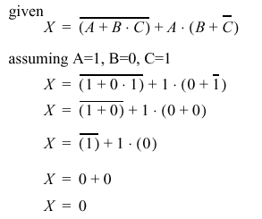
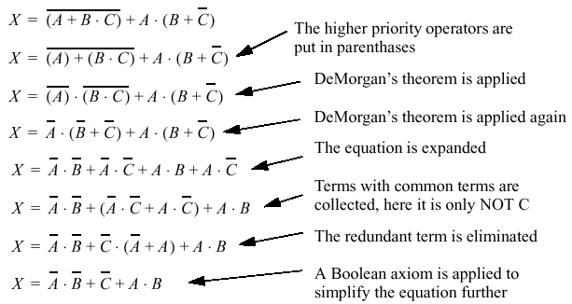
4.6 Implementation of Boolean equations using RLL and Electronic solid state logic gates
Example: Determine X
Example: Simplify X

Slide 14
4.6 Implementation of Boolean equations using RLL and Electronic solid state logic gates

Slide 15
4.6 Implementation of Boolean equations using RLL and Electronic solid state logic gates

Slide 16
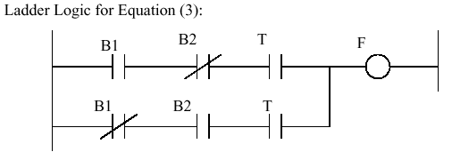
4.6 Implementation of Boolean equations using RLL and Electronic solid state logic gates

Slide 17
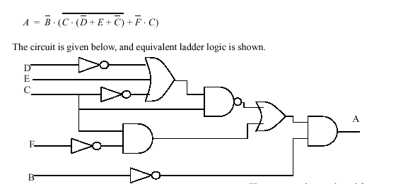
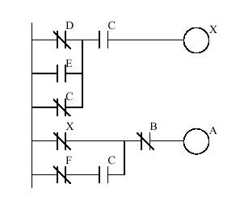
4.6 Implementation of Boolean equations using RLL and Electronic solid state logic gates
Example 6: given the following Boolean equation , sketch logic network and RLL

Slide 18
4.6 Logic network design
For a given logic control sequence or truth table, It is possible to produce the Boolean Algebra expression using the following steps:
Construct a truth table for the requested input/output
For each TRUE statement associated to an output, form the logic product (AND) of the inputs.
Form the logic Sum (OR) of the logic products obtained in step 2.

Slide 19
4.6 Logic network design

Slide 20
4.6 Combination and Sequential Networks

Slide 21
4.6 Combination and Sequential Networks
Input |  | Output
S | R | Q_{n+1} | Q_{n+1}
0 | 0 | Q_{n} | Q_{n}
0 | 1 | 0 | 1
1 | 0 | 1 | 0
1 | 1 | Not define | Not define

Slide 24
CK
FF0
FF1
FF2
FF3
1111
15
1110
14
1101
13
1100
12
1011
11
1010
10
1001
9
1000
8
0111
7
0110
6
0101
5
….

Slide 25
Problems

Slide 26
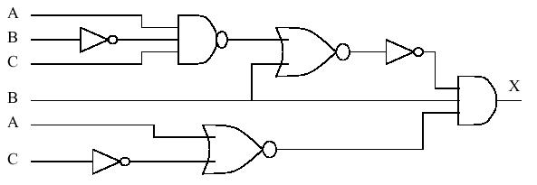
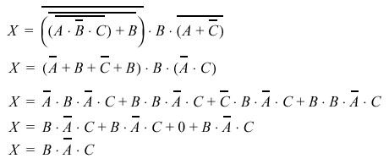
B A C
X

