Slide 1
Cryptography and Network Security Chapter 14
Fifth Edition
by William Stallings
Lecture slides by Lawrie Brown
Notes:
Lecture slides by Lawrie Brown for “Cryptography and Network Security”, 4/e, by William Stallings, Chapter 14 – “Authentication Applications”.

Slide 2
Key Distribution and Management
Symmetric key cryptography: fast implementations, good for encrypting large amounts of data; requires shared secret key
Asymmetric (public) key cryptography: inefficient for large data, good for authentication; no need to share a secret
How to share symmetric keys?
How to distribute public keys?

Slide 3
Symmetric Key Distribution using Symmetric Encryption
Objective: two entities share same secret key
Principle: change keys frequently
How to exchange a secret key?
A physically delivers key to B
Third party, C, can physically deliver key to A and B
If A and B already have a key, can securely transmit new key to each other, encrypted with old key
If A and B have secure connection with third party C, C can securely send keys to A and B

Slide 4
Symmetric Key Distribution using Symmetric Encryption
Option 1 and 2: manual delivery; feasible if number of entities is small (link encryption)
Option 3: requires initial distribution of key; discovery of initial key releases all subsequent keys.
Option 4: requires initial distribution of key with C; practical for large-scale systems (end-to-end encryption)
Notes:
The strength of any cryptographic system thus depends on the key distribution technique. For two parties A and B, key distribution can be achieved in a number of ways:
Physical delivery (1 & 2) is simplest - but only applicable when there is personal contact between recipient and key issuer. This is fine for link encryption where devices & keys occur in pairs, but does not scale as number of parties who wish to communicate grows. 3 is mostly based on 1 or 2 occurring first.
A third party, whom all parties trust, can be used as a trusted intermediary to mediate the establishment of secure communications between them (4). Must trust intermediary not to abuse the knowledge of all session keys. As number of parties grow, some variant of 4 is only practical solution to the huge growth in number of keys potentially needed.

Slide 5
Link Encryption vs End-to-End Encryption
Link Encryption
Encrypt data over individual links in network
Each link end-point shares a secret key
Decrypt/Encrypt at each device in path
Requires all links/devices to support encryption
End-to-End Encryption
Encrypt data at network end-points (e.g. hosts or applications)
Each pair of hosts/applications share a secret key
Does not rely on intermediate network devices

Slide 6
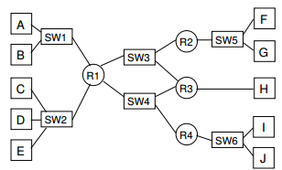
How Many Keys Need To Be Exchanged?
Link-level encryption?
End-to-end encryption between hosts?
End-to-end encryption between applications?

Slide 7
Key Hierarchy
Key Distribution Centre (KDC) is trusted third party
typically have a hierarchy of keys
Data sent between end-systems encrypted with temporary session key
Session keys obtained from KDC over network; encrypted with master key
Master keys can be distributed using manual delivery
Notes:
The use of a key distribution center is based on the use of a hierarchy of keys. At a minimum, two levels of keys are used: a session key, used for the duration of a logical connection; and a master key shared by the key distribution center and an end system or user and used to encrypt the session key.

Slide 8
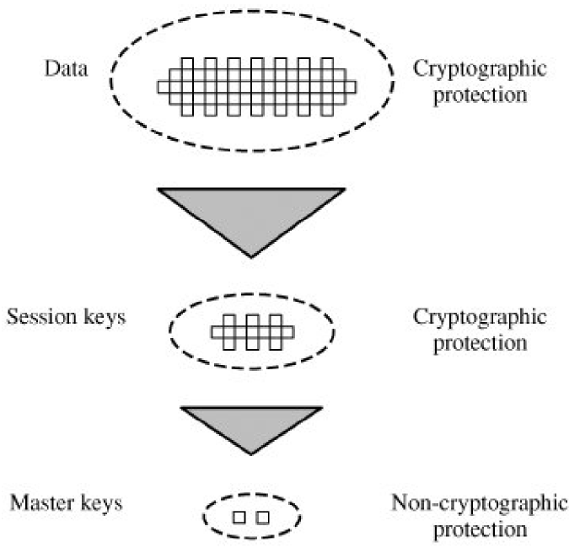
The Use of a Key Hierarchy

Slide 9
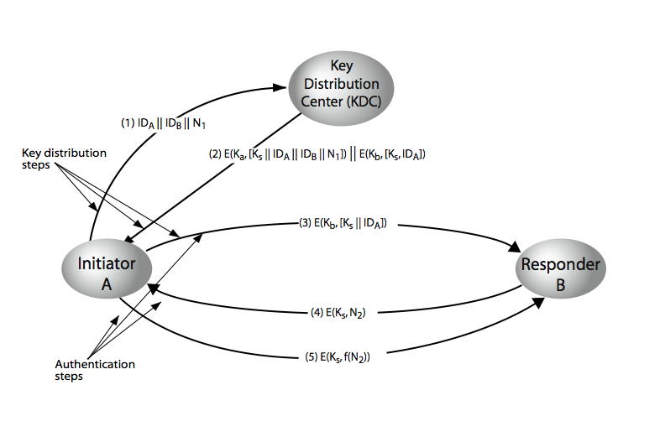
Key Distribution Scenario
Notes:
The key distribution concept can be deployed in a number of ways. A typical scenario is illustrated in Stallings Figure 7.9 above, which has a “Key Distribution Center” (KDC) which shares a unique key with each party (user). See text section 7.3 for details of the steps shown in this distribution process.

Slide 10
KDC Scenario Notation
End-systems: A and B, identified by ID_{A} and ID_{B}
Master keys: K_{a}, K_{b}
Session key (between A and B): K_{s}
Nonce values: N₁, N₂
E.g. timestamp, counter, random value
Must be different for each request
Must be difficult for attacker to guess

Slide 11
Key Distribution Issues
Hierarchical Key Control
Use multiple KDCs in a hierarchy
E.g. KDC for each LAN (or building); central KDC to exchange keys between hosts in different LANs
Reduces effort in key distribution; limits damage if local KDC is compromised
Session Key Lifetime
Shorter lifetime is more secure; but increases overhead of exchanges
Connection-oriented protocols (e.g. TCP): new session
key for each connection
Connection-less protocols (e.g. UDP/IP): change after fixed period or certain number of packets sent
Notes:
Briefly note here some of the major issues associated with the use of Key Distribution Centers (KDC’s).
For very large networks, a hierarchy of KDCs can be established. For communication among entities within the same local domain, the local KDC is responsible for key distribution. If two entities in different domains desire a shared key, then the corresponding local KDCs can communicate through a (hierarchy of) global KDC(s)
To balance security & effort, a new session key should be used for each new connection-oriented session. For a connectionless protocol, a new session key is used for a certain fixed period only or for a certain number of transactions.
An automated key distribution approach provides the flexibility and dynamic characteristics needed to allow a number of terminal users to access a number of hosts and for the hosts to exchange data with each other, provided they trust the system to act on their behalf.
The use of a key distribution center imposes the requirement that the KDC be trusted and be protected from subversion. This requirement can be avoided if key distribution is fully decentralized.
In addition to separating master keys from session keys, may wish to define different types of session keys on the basis of use.
These issues are discussed in more detail in the text Stallings section 7.3.

Slide 12
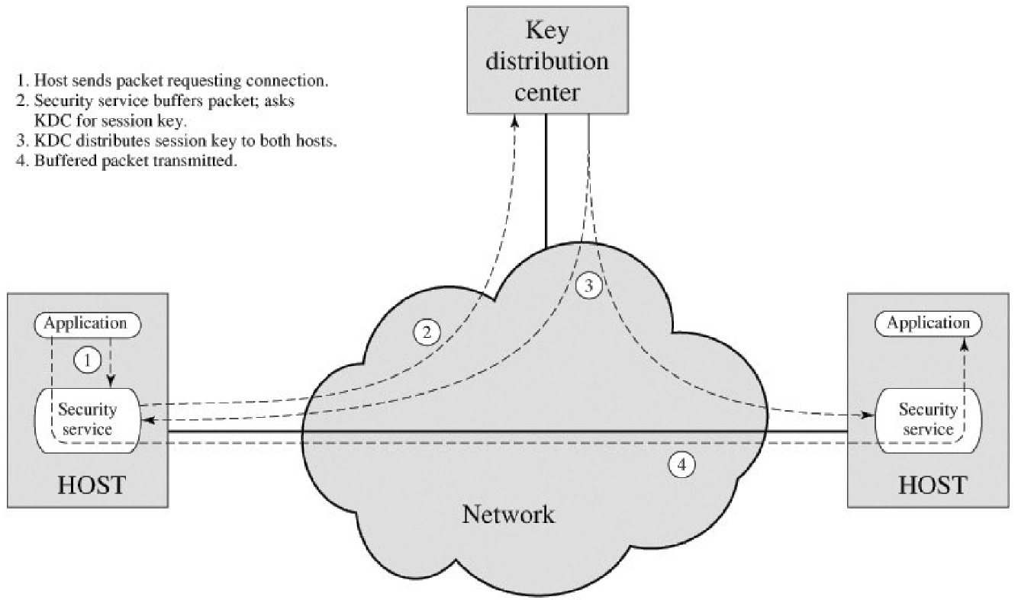

Slide 13
Decentralized Key Distribution
Alternative that doesn't rely on KDC
I Each end-system must manually exchange n – 1 master keys (K_{m}) with others

Slide 14
Symmetric Key Distribution using Asymmetric Encryption
Asymmetric encryption generally too slow for encrypting large amount of data
Common application of asymmetric encryption is exchanging secret keys
Three examples:
1. Simple Secret Key Distribution
2. Secret Key Distribution with Confidentiality and Authentication
3. Hybrid Scheme: Public-Key Distribution of KDC Master Keys

Slide 15
Simple Secret Key Distribution
Simple: no keys prior to or after communication
Provides confidentiality for session key
Subject to man-in-the-middle attack
Only useful if attacker cannot modify/insert messages

Slide 16
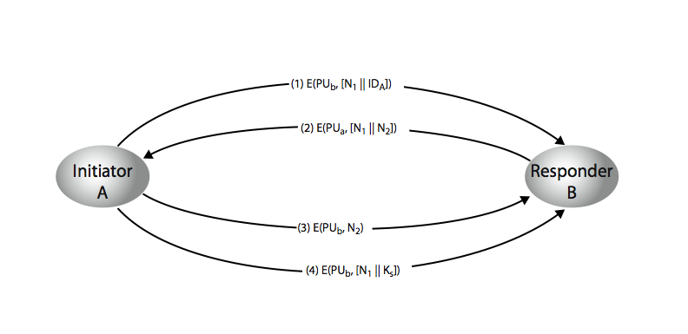
Public-Key Distribution of Secret Keys
Provides both confidentiality and authentication in exchange of secret key
Notes:
Stallings Figure 14.8 “Public-Key Distribution of Secret Keys” illustrates such an exchange. See text for details of steps in protocol. Note that these steps correspond to final 3 of Figure 14.11, hence can get both secret key exchange and authentication in a single protocol.

Slide 17
Hybrid Scheme: Public-Key Distribution of KDC Master Keys
Use public-key distribution of secret keys when exchanging master keys between end-systems and KDC
Efficient method of delivering master keys (rather than manual delivery)
Useful for large networks, widely distributed set of users with single KDC

Slide 18
Distribution of Public Keys
By design, public keys are made public
Issue: how to ensure public key of A actually belongs to A (and not someone pretending to be A)
Four approaches for distributing public keys
Public announcement
Publicly available directory
Public-key authority
Public-key certificates
Notes:
Several techniques have been proposed for the distribution of public keys, which can mostly be grouped into the categories shown.

Slide 19
Uncontrolled Public-Key Distribution
Make public key available in open forum: newspaper,email signature, website, conference, . . .
Problem: anyone can announce a key pretending to be another user

Slide 20
Public Announcement
users distribute public keys to recipients or broadcast to community at large
eg. append PGP keys to email messages or post to news groups or email list
major weakness is forgery
anyone can create a key claiming to be someone else and broadcast it
until forgery is discovered can masquerade as claimed user
Notes:
The point of public-key encryption is that the public key is public, hence any participant can send his or her public key to any other participant, or broadcast the key to the community at large. Its major weakness is forgery, anyone can create a key claiming to be someone else and broadcast it, and until the forgery is discovered they can masquerade as the claimed user.

Slide 21
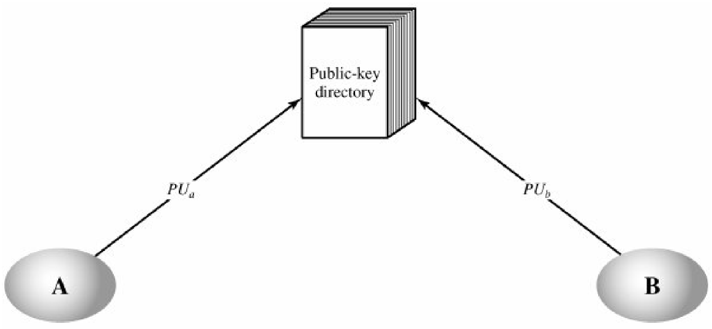
Public-Key Publication
All users publish keys in central directory
Users must provide identification when publishing key
Users can access directory electronically
Weakness: directory must be secure

Slide 22
Publicly Available Directory
can obtain greater security by registering keys with a public directory
directory must be trusted with properties:
contains {name,public-key} entries
participants register securely with directory
participants can replace key at any time
directory is periodically published
directory can be accessed electronically
still vulnerable to tampering or forgery
Notes:
A greater degree of security can be achieved by maintaining a publicly available dynamic directory of public keys. Maintenance and distribution of the public directory would have to be the responsibility of some trusted entity or organization. This scheme is clearly more secure than individual public announcements but still has vulnerabilities to tampering or forgery.

Slide 23
Public-Key Authority
Improve security by tightening control over distribution of keys from directory
Has properties of directory
Assume each user has already security published publickey at authority; each user knows authorities public key
Does require real-time access to directory when keys are needed
Notes:
Stronger security for public-key distribution can be achieved by providing tighter control over the distribution of public keys from the directory. It requires users to know the public key for the directory, and that they interact with directory in real-time to obtain any desired public key securely. Note that a total of seven messages are required, as shown next.

Slide 24
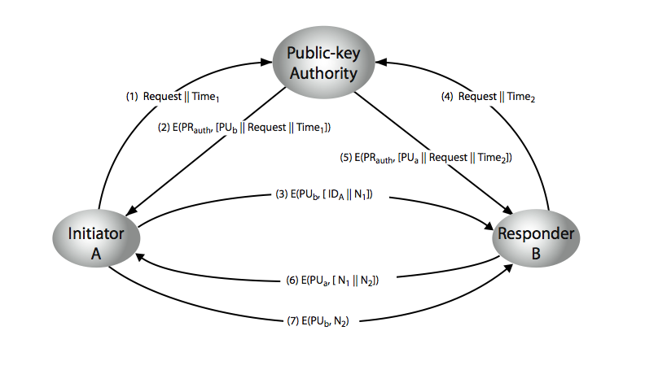
Public-Key Authority
First 5 messages are for key exchange; last 2 are authentication of users
Although 7 messages, public keys obtained from authority can be cached
Problem: authority can be bottleneck
Alternative: public-key certificates
Notes:
Stallings Figure 14.11 “Public-Key Authority” illustrates a typical protocol interaction. See text for details of steps in protocol.

Slide 25
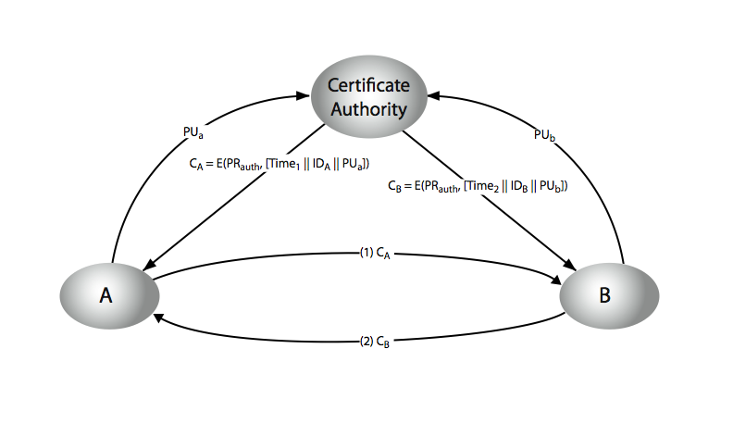
Public-Key Certificates
Assume public keys sent to CA can be authenticated by CA; each user has certificate of CA
Notes:
Stallings Figure 10.4 “Public-Key Certificates” illustrates such a scheme. See text for details of steps in protocol.

Slide 26
Public-Key Certificates
certificates allow key exchange without real-time access to public-key authority
a certificate binds identity to public key
usually with other info such as period of validity, rights of use etc
with all contents signed by a trusted Public-Key or Certificate Authority (CA)
can be verified by anyone who knows the public-key authorities public-key
Notes:
An further improvement is to use certificates, which can be used to exchange keys without contacting a public-key authority, in a way that is as reliable as if the keys were obtained directly from a public-key authority. A certificate binds an identity to public key, with all contents signed by a trusted Public-Key or Certificate Authority (CA). This can be verified by anyone who knows the public-key authorities public-key.
One scheme has become universally accepted for formatting public-key certificates: the X.509 standard. X.509 certificates are used in most network security applications, including IP security, secure sockets layer (SSL), secure electronic transactions (SET), and S/MIME. Will discuss it in much more detail later.

Slide 27
Public Key Certificates
A certificate is the ID and public-key of a user signed by CA
CA = E(PR_{auth}; [T|| ID_{A} || PU_{a}])
Timestamp T validates currency of certificate (expiration date)
Common format for certificates is X.509 standard (by ITU)
S/MIME (secure email)
IP security (network layer security)
SSL/TLS (transport layer security)
SET (e-commerce)

Slide 28
X.509 Certificates
issued by a Certification Authority (CA), containing:
version (1, 2, or 3)
serial number (unique within CA) identifying certificate
signature algorithm identifier
issuer X.500 name (CA)
period of validity (from - to dates)
subject X.500 name (name of owner)
subject public-key info (algorithm, parameters, key)
issuer unique identifier (v2+)
subject unique identifier (v2+)
extension fields (v3)
signature (of hash of all fields in certificate)
notation CA<<A>> denotes certificate for A signed by CA
Notes:
The X.509 certificate is the heart of the standard. There are 3 versions, with successively more info in the certificate - must be v2 if either unique identifier field exists, must be v3 if any extensions are used. These user certificates are assumed to be created by some trusted certification authority (CA) and placed in the directory by the CA or by the user. The directory server itself is not responsible for the creation of public keys or for the certification function; it merely provides an easily accessible location for users to obtain certificates. The certificate includes the elements shown.
The standard uses the notation for a certificate of: CA<<A>> where the CA signs the certificate for user A with its private key.

Slide 29
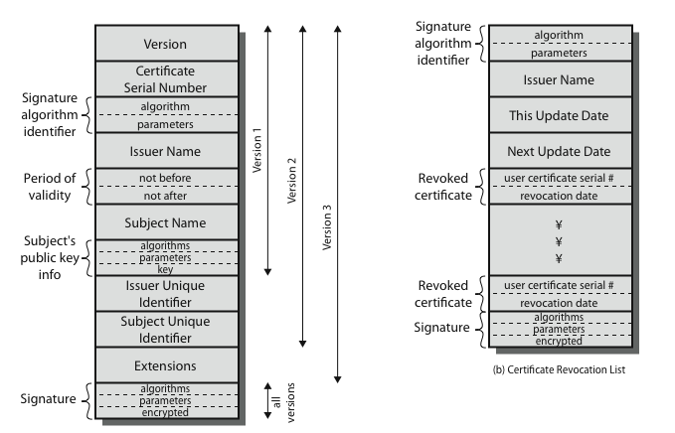
X.509 Certificates
Notes:
Stallings Figure 14.4 shows the format of an X.509 certificate and CRL.

Slide 30
Obtaining a Certificate
any user with access to CA can get any certificate from it
only the CA can modify a certificate
because cannot be forged, certificates can be placed in a public directory
Notes:
User certificates generated by a CA have the characteristics that any user with access to the public key of the CA can verify the user public key that was certified, and no party other than the certification authority can modify the certificate without this being detected. Because certificates are unforgeable, they can be placed in a directory without the need for the directory to make special efforts to protect them.

