Slide 1
Biostatistics for the Biological and Health Sciences
Chapter 2
Exploring Data with Tables and Graphs
Copyright © 2018, 2014, 2012 Pearson Education, Inc. All Rights Reserved

Slide 2
Exploring Data with Tables and Graphs
2-1 Frequency Distributions for Organizing and Summarizing Data
2-2 Histograms
2-3 Graphs that Enlighten and Graphs that Deceive
2-4 Scatterplots, Correlation, and Regression

Slide 3
Key Concept
When working with large data sets, a frequency distribution (or frequency table) is often helpful in organizing and summarizing data. A frequency distribution helps us to understand the nature of the distribution of a data set.

Slide 4
Frequency Distribution
Frequency Distribution (or Frequency Table)
  Shows how data are partitioned among several categories (or classes) by listing the categories along with the number (frequency) of data values in each of them.

Slide 5
Definitions (1 of 2)
Lower class limits
  The smallest numbers that can belong to each of the different classes
Upper class limits
  The largest numbers that can belong to each of the different classes
Class boundaries
  The numbers used to separate the classes, but without the gaps created by class limits

Slide 6
Definitions (2 of 2)
Class midpoints
  The values in the middle of the classes Each class midpoint can be found by adding the lower class limit to the upper class limit and dividing the sum by 2.
Class width
  The difference between two consecutive lower class limits in a frequency distribution

Slide 7
Procedure for Constructing a Frequency Distribution (1 of 2)
Select the number of classes, usually between 5 and 20.
Calculate the class width.
Round this result to get a convenient number. (It’s usually best to round up.)

Slide 8
Procedure for Constructing a Frequency Distribution (2 of 2)
Choose the value for the first lower class limit by using either the minimum value or a convenient value below the minimum.
Using the first lower class limit and class width, list the other lower class limits.
List the lower class limits in a vertical column and then determine and enter the upper class limits.
Take each individual data value and put a tally mark in the appropriate class. Add the tally marks to get the frequency.

Slide 9
Example: McDonald’s Lunch Service Times (1 of 5)
Using the McDonald’s lunch service times in the first table, follow the procedure shown on the next slide to construct the frequency distribution shown in the second table. Use five classes.
Drive-through Service Times (seconds) for McDonald’s Lunches
107 | 139 | 197 | 209 | 281 | 254 | 163 | 150 | 127 | 308 | 206 | 187 | 169 | 83 | 127 | 133 | 140
143 | 130 | 144 | 91 | 113 | 153 | 255 | 252 | 200 | 117 | 167 | 148 | 184 | 123 | 153 | 155 | 154
100 | 117 | 101 | 138 | 186 | 196 | 146 | 90 | 144 | 119 | 135 | 151 | 197 | 171 | 190 | 169 | Blank
Time (Seconds) | Frequency
75-124 | 11
125-174 | 24
175-224 | 10
225-274 | 3
275-324 | 2
McDonald’s Lunch Drive-Through Service Times

Slide 10
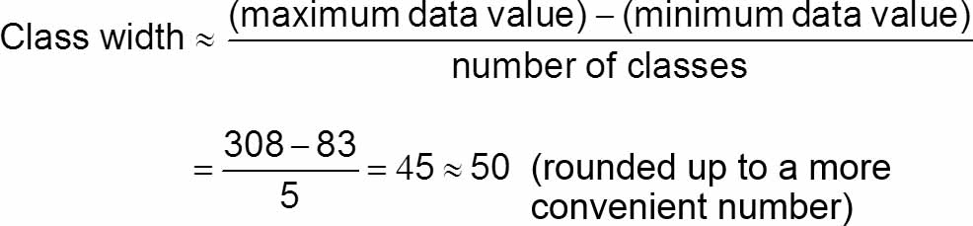
Example: McDonald’s Lunch Service Times (2 of 5)
Step 1: Select 5 as the number of desired classes.
Step 2: Calculate the class width as shown below. Note that we round 45 up to 50,which is a more convenient number.

Slide 11
Example: McDonald’s Lunch Service Times (3 of 5)
Step 3: The minimum data value is 83, which is not a very convenient starting point, so go to a value below 83 and select the more convenient value of 75 as the first lower class limit.
Step 4: Add the class width of 50 to the starting value of 75 to get the second lower class limit of 125. Continue to add the class width of 50 until we have five lower class limits. The lower class limits are therefore 75, 125, 175, 225, and 275.

Slide 12
Example: McDonald’s Lunch Service Times (4 of 5)
Step 5: List the lower class limits vertically, as shown below. From this list, we identify the corresponding upper class limits as 124, 174, 224, 274, and 324.
75-
125-
175-
225-
275-

Slide 13
Example: McDonald’s Lunch Service Times (5 of 5)
Step 6: Enter a tally mark for each data value in the appropriate class. Then add the tally marks to find the frequencies shown in the table.
Time (Seconds) | Frequency
75-124 | 11
125-174 | 24
175-224 | 10
225-274 | 3
275-324 | 2

Slide 14
Relative Frequency Distribution (1 of 2)
Relative Frequency Distribution or Percentage
Frequency Distribution
  Each class frequency is replaced by a relative frequency (or proportion) or a percentage.

Slide 15
Relative Frequency Distribution (2 of 2)
Relative Frequency Distribution or Percentage
Frequency Distribution
  Each class frequency is replaced by a relative frequency (or proportion) or a percentage.
The sum of the percentages in a relative frequency distribution must be very close to 100% (with a little wiggle room for rounding errors).

Slide 16
Cumulative Frequency Distribution
Cumulative Frequency Distribution
  The frequency for each class is the sum of the frequencies for that class and all previous classes.
Cumulative Frequency Distribution of McDonald’s Lunch Service Times
Time (Seconds) | Cumulative Frequency
Less than 125 | 11
Less than 175 | 35
Less than 225 | 45
Less than 275 | 48
Less than 325 | 50

Slide 17
Critical Thinking: Using Frequency Distributions to Understand Data
In statistics we are often interested in determining whether the data have a normal distribution.
The frequencies start low, then increase to one or two high frequencies, and then decrease to a low frequency.
The distribution is approximately symmetric. Frequencies preceding the maximum frequency should be roughly a mirror image of those that follow the maximum frequency.

Slide 18
Gaps
The presence of gaps can show that the data are from two or more different populations.
However, the converse is not true, because data from different populations do not necessarily result in gaps.

Slide 19
Example: Exploring Data: What Does a Gap Tell Us? (1 of 2)
The table shown is a frequency distribution of the weights (grams) of randomly selected pennies.
Weight (grams) of Penny | Frequency
2.40-2.49 | 18
2.50-2.59 | 19
2.60-2.69 | 0
2.70-2.79 | 0
2.80-2.89 | 0
2.90-2.99 | 2
3.00-3.09 | 25
3.10-3.19 | 8

Slide 20
Example: Exploring Data: What Does a Gap Tell Us? (2 of 2)
Examination of the frequencies reveals a large gap between the lightest pennies and the heaviest pennies.
This suggests that we have two different populations:
  Pennies made before 1983 are 95% copper and 5% zinc.
  Pennies made after 1983 are 2.5% copper and 97.5% zinc.

Slide 21
Comparisons
Combining two or more relative frequency distributions in one table makes comparisons of data much easier.

Slide 22
Example: Comparing McDonald’s and Dunkin’ Donuts (1 of 2)
The table shows the relative frequency distributions for the drive-through lunch service times (seconds) for McDonald’s and Dunkin’ Donuts.
Time (seconds) | McDonald’s | Dunkin’ Donuts
25-74 | Blank | 22%
75-124 | 22% | 44%
125-174 | 48% | 28%
175-224 | 20% | 6%
225-274 | 6% | Blank
275-324 | 4% | Blank

Slide 23
Example: Comparing McDonald’s and Dunkin’ Donuts (2 of 2)
Time (seconds) | McDonald’s | Dunkin’ Donuts
25-74 | Blank | 22%
75-124 | 22% | 44%
125-174 | 48% | 28%
175-224 | 20% | 6%
225-274 | 6% | Blank
275-324 | 4% | Blank
Because of the dramatic differences in their menus, we might expect the service times to be very different.
By comparing the relative frequencies, we see that there are major differences. The Dunkin’ Donuts service times appear to be lower than those at McDonald’s.

Slide 24
Exploring Data with Tables and Graphs
2-1 Frequency Distributions for Organizing and Summarizing Data
2-2 Histograms
2-3 Graphs that Enlighten and Graphs that Deceive
2-4 Scatterplots, Correlation, and Regression

Slide 25
Key Concept
While a frequency distribution is a useful tool for summarizing data and investigating the distribution of data, an even better tool is a histogram, which is a graph that is easier to interpret than a table of numbers.

Slide 26
Histogram
Histogram
  A graph consisting of bars of equal width drawn adjacent to each other (unless there are gaps in the data)
  The horizontal scale represents classes of quantitative data values, and the vertical scale represents frequencies. The heights of the bars correspond to frequency values.

Slide 27
Important Uses of a Histogram
Visually displays the shape of the distribution of the data
Shows the location of the center of the data
Shows the spread of the data
Identifies outliers

Slide 28
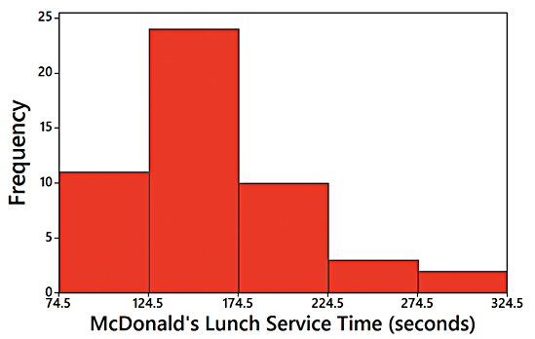
Relative Frequency Histogram
Relative Frequency Histogram
  It has the same shape and horizontal scale as a histogram, but the vertical scale is marked with relative frequencies instead of actual frequencies.
Time (seconds) | Frequency
75-124 | 11
125-174 | 24
175-224 | 10
225-274 | 3
275-324 | 2

Slide 29
Critical Thinking Interpreting Histograms
Explore the data by analyzing the histogram to see what can be learned about “CVDOT”:
the Center of the data,
the Variation,
the shape of the Distribution,
whether there are any Outliers,
and Time.

Slide 30
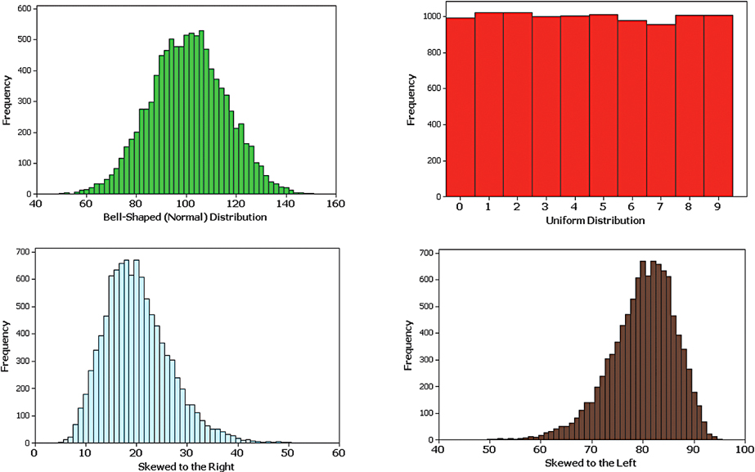
Common Distribution Shapes

Slide 31
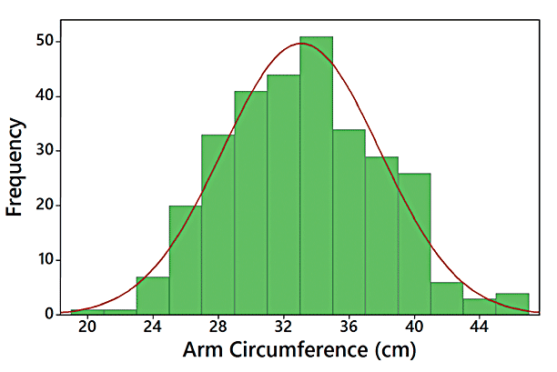
Normal Distribution
Because this histogram is roughly bell-shaped, we say that the data have a normal distribution.

Slide 32
Skewness (1 of 3)
Skewness
  A distribution of data is skewed if it is not symmetric and extends more to one side than to the other.

Slide 33
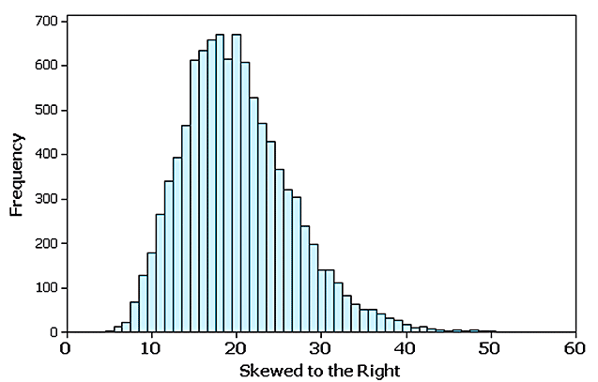
Skewness (2 of 3)
Data skewed to the right (positively skewed) have a longer right tail.

Slide 34
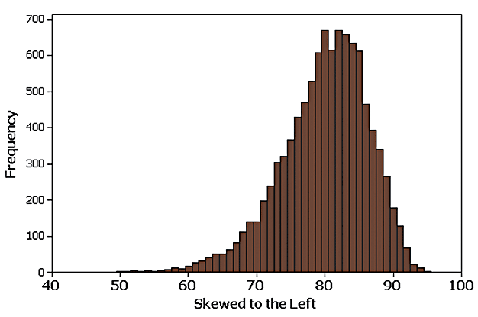
Skewness (3 of 3)
Data skewed to the left (negative skewed) have a longer left tail.

Slide 35
Assessing Normality with Normal Quantile Plots (1 of 5)
Criteria for Assessing Normality with a Normal Quantile Plot
Normal Distribution: The pattern of the points in the normal quantile plot is reasonably close to a straight line, and the points do not show some systematic pattern that is not a straight-line pattern.

Slide 36
Assessing Normality with Normal Quantile Plots (2 of 5)
Criteria for Assessing Normality with a Normal Quantile Plot
Not a Normal Distribution: The population distribution is not normal if the normal quantile plot has either or both of these two conditions:
  The points do not lie reasonably close to a straight-line pattern.
  The points show some systematic pattern that is not a straight-line pattern.

Slide 37
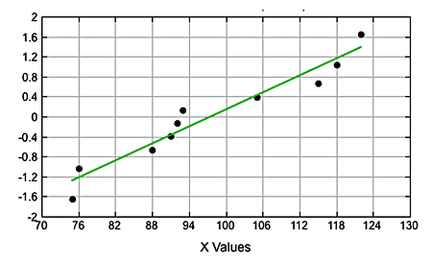
Assessing Normality with Normal Quantile Plots (3 of 5)
Normal Distribution: The points are reasonably close to a straight-line pattern, and there is no other systematic pattern that is not a straight-line pattern.

Slide 38
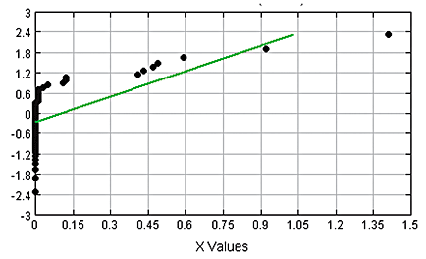
Assessing Normality with Normal Quantile Plots (4 of 5)
Not a Normal Distribution: The points do not lie reasonably close to a straight line.

Slide 39
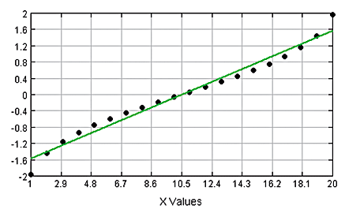
Assessing Normality with Normal Quantile Plots (5 of 5)
Not a Normal Distribution: The points show a systematic pattern that is not a straight-line pattern.

Slide 40
Exploring Data with Tables and Graphs
2-1 Frequency Distributions for Organizing and Summarizing Data
2-2 Histograms
2-3 Graphs that Enlighten and Graphs that Deceive
2-4 Scatterplots, Correlation, and Regression

Slide 41
Key Concept
Introduce other common graphs that foster understanding of data.
Discuss some graphs that are deceptive because they create impressions about data that are somehow misleading or wrong.
Technology now provides us with powerful tools for generating a wide variety of graphs.

Slide 42
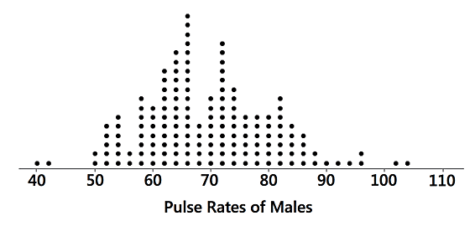
Graphs that Enlighten: Dotplots (1 of 2)
Dotplots
  A graph of quantitative data in which each data value is plotted as a point (or dot) above a horizontal scale of values. Dots representing equal values are stacked.

Slide 43
Graphs that Enlighten: Dotplots (2 of 2)
Dotplots
  Features of a Dotplot
    Displays the shape of distribution of data.
    It is usually possible to recreate the original list of data values.

Slide 44
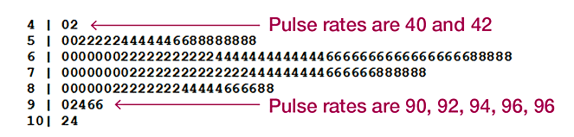
Stemplots (1 of 2)
Stemplots (or stem-and-leaf plot)
  Represents quantitative data by separating each value into two parts: the stem (such as the leftmost digit) and the leaf (such as the rightmost digit).

Slide 45
Stemplots (2 of 2)
Stemplots (or stem-and-leaf plot)
  Features of a Stemplot
    Shows the shape of the distribution of the data.
    Retains the original data values.
    The sample data are sorted (arranged in order).

Slide 46
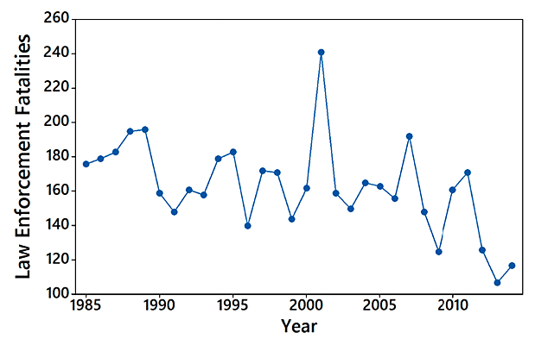
Time-Series Graph (1 of 2)
Time-Series Graph
  A graph of time-series data, which are quantitative data that have been collected at different points in time, such as monthly or yearly

Slide 47
Time-Series Graph (2 of 2)
Time-Series Graph
  Feature of a Time-Series Graph
    Reveals information about trends over time.

Slide 48
Bar Graph (1 of 2)
Bar Graphs
  A graph of bars of equal width to show frequencies of categories of categorical (or qualitative) data. The bars may or may not be separated by small gaps.

Slide 49
Bar Graph (2 of 2)
Bar Graphs
  Feature of a Bar Graph
    Shows the relative distribution of categorical data so that it is easier to compare the different categories.

Slide 50
Pareto Chart (1 of 3)
Pareto Charts
  A Pareto chart is a bar graph for categorical data, with the added stipulation that the bars are arranged in descending order according to frequencies, so the bars decrease in height from left to right.

Slide 51
Pareto Chart (2 of 3)
Pareto Charts
  Features of a Pareto Chart
    Shows the relative distribution of categorical data so that it is easier to compare the different categories.
    Draws attention to the more important categories.

Slide 52
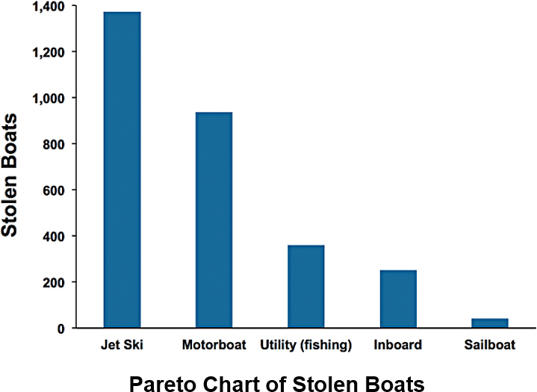
Pareto Chart (3 of 3)

Slide 53
Pie Chart (1 of 3)
Pie Charts
  A very common graph that depicts categorical data as slices of a circle, in which the size of each slice is proportional to the frequency count for the category

Slide 54
Pie Chart (2 of 3)
Pie Charts
  Feature of a Pie Chart
    Shows the distribution of categorical data in a commonly used format.

Slide 55
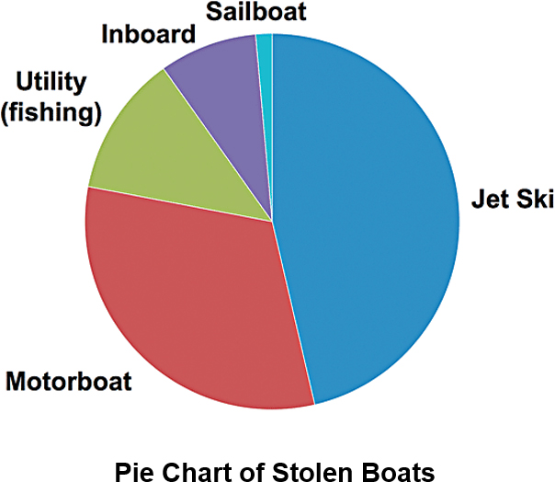
Pie Chart (3 of 3)

Slide 56
Frequency Polygon (1 of 3)
Frequency Polygon
  A graph using line segments connected to points located directly above class midpoint values
  A frequency polygon is very similar to a histogram, but a frequency polygon uses line segments instead of bars.

Slide 57
Frequency Polygon (2 of 3)
Frequency Polygon
  A variation of the basic frequency polygon is the relative frequency polygon, which uses relative frequencies (proportions or percentages) for the vertical scale.

Slide 58
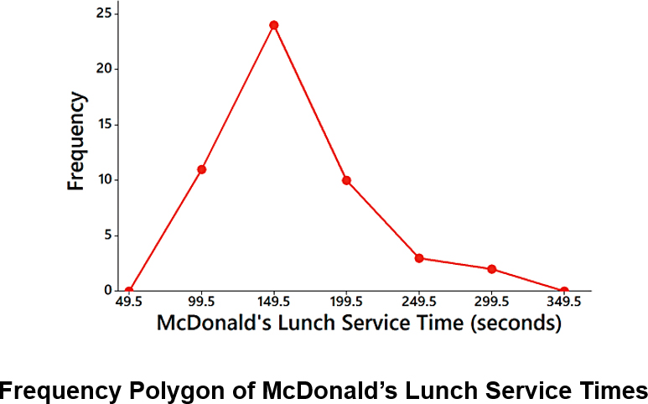
Frequency Polygon (3 of 3)

Slide 59
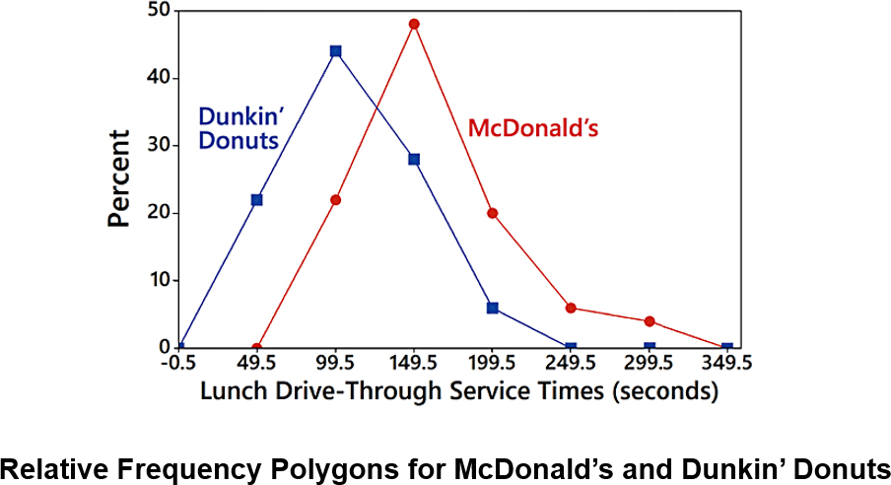
Relative Frequency Polygon

Slide 60
Graphs That Deceive (1 of 4)
Nonzero Vertical Axis
  A common deceptive graph involves using a vertical scale that starts at some value greater than zero to exaggerate differences between groups.

Slide 61
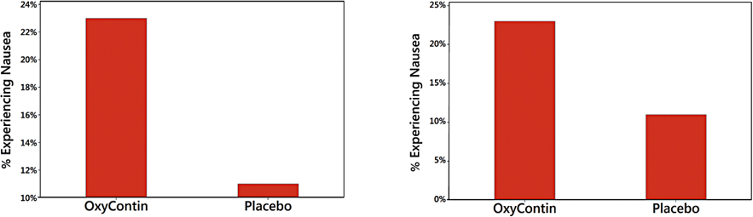
Graphs That Deceive (2 of 4)
Nonzero Vertical Axis
Always examine a graph carefully to see whether a vertical axis begins at some point other than zero so that differences are exaggerated.

Slide 62
Graphs That Deceive (3 of 4)
Pictographs
  Drawings of objects, called pictographs, are often misleading. Data that are one-dimensional in nature (such as budget amounts) are often depicted with two-dimensional objects (such as dollar bills) or three-dimensional objects (such as stacks of coins, homes, or barrels).

Slide 63
Graphs That Deceive (4 of 4)
Pictographs
  By using pictographs, artists can create false impressions that grossly distort differences by using these simple principles of basic geometry:
    When you double each side of a square, its area doesn’t merely double; it increases by a factor of four.
    When you double each side of a cube, its volume doesn’t merely double; it increases by a factor of eight.

Slide 64
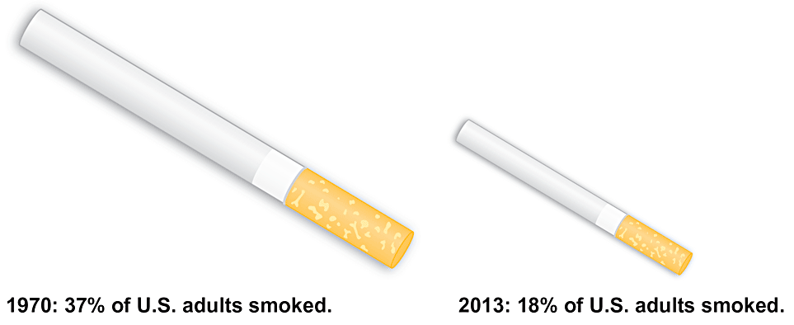
Pictographs

Slide 65
Concluding Thoughts (1 of 2)
In addition to the graphs we have discussed in this section, there are many other useful graphs - some of which have not yet been created. The world needs more people who can create original graphs that enlighten us about the nature of data.

Slide 66
Concluding Thoughts (2 of 2)
In The Visual Display of Quantitative Information, Edward Tufte offers these principles:
For small data sets of 20 values or fewer, use a table instead of a graph.
A graph of data should make us focus on the true nature of the data, not on other elements, such as eye-catching but distracting design features.
Do not distort data; construct a graph to reveal the true nature of the data.
Almost all of the ink in a graph should be used for the data, not for other design elements.

Slide 67
Exploring Data with Tables and Graphs
2-1 Frequency Distributions for Organizing and Summarizing Data
2-2 Histograms
2-3 Graphs that Enlighten and Graphs that Deceive
2-4 Scatterplots, Correlation, and Regression

Slide 68
Key Concept
Introduce the analysis of paired sample data.
Discuss correlation and the role of a graph called a scatterplot, and provide an introduction to the use of the linear correlation coefficient.
Provide a very brief discussion of linear regression, which involves the equation and graph of the straight line that best fits the sample paired data.

Slide 69
Scatterplot and Correlation (1 of 2)
Correlation
  A correlation exists between two variables when the values of one variable are somehow associated with the values of the other variable.
Linear Correlation
  A linear correlation exists between two variables when there is a correlation and the plotted points of paired data result in a pattern that can be approximated by a straight line.

Slide 70
Scatterplot and Correlation (2 of 2)
Scatterplot (or Scatter Diagram)
  A scatterplot (or scatter diagram) is a plot of paired (x, y) quantitative data with a horizontal x-axis and a vertical y-axis. The horizontal axis is used for the first variable (x), and the vertical axis is used for the second variable (y).

Slide 71
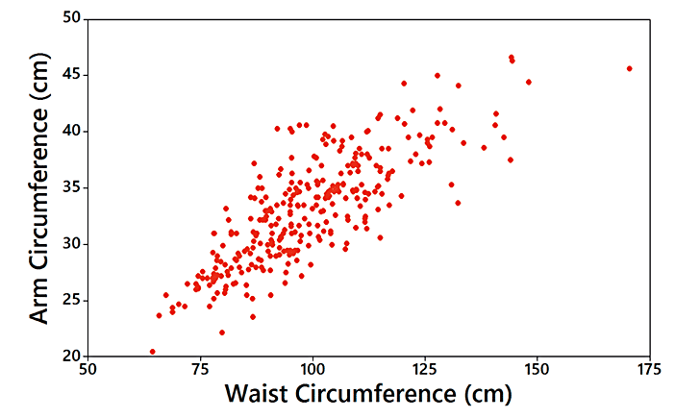
Example: Waist and Arm Correlation (1 of 2)
Correlation: The distinct pattern of the plotted points suggests that there is a correlation between waist circumferences and arm circumferences.

Slide 72
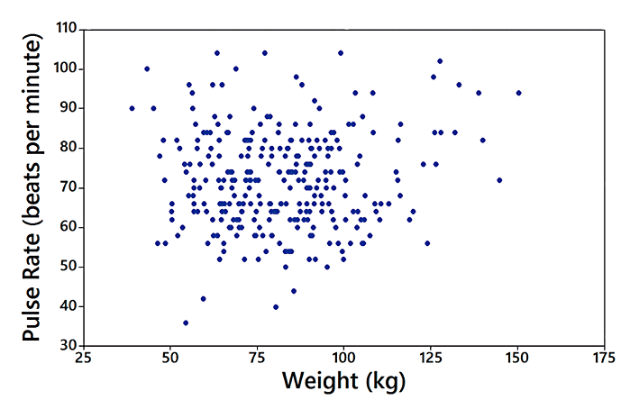
Example: Waist and Arm Correlation (2 of 2)
No Correlation: The plotted points do not show a distinct pattern, so it appears that there is no correlation between weights and pulse rates.

Slide 73
Linear Correlation Coefficient r
Linear Correlation Coefficient r
  The linear correlation coefficient is denoted by r, and it measures the strength of the linear association between two variables.

Slide 74
Using r for Determining Correlation
The computed value of the linear correlation coefficient, r, is always between −1 and 1.
If r is close to −1 or close to 1, there appears to be a correlation.
If r is close to 0, there does not appear to be a linear correlation.

Slide 75
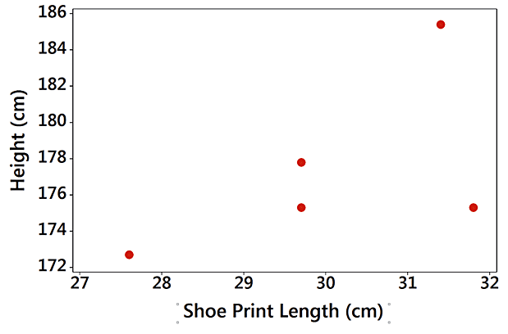
Example: Correlation between Shoe Print Lengths and Heights? (1 of 2)
Shoe Print Length (cm) | 29.7 | 29.7 | 31.4 | 31.8 | 27.6
Height (cm) | 175.3 | 177.8 | 185.4 | 175.3 | 172.7

Slide 76
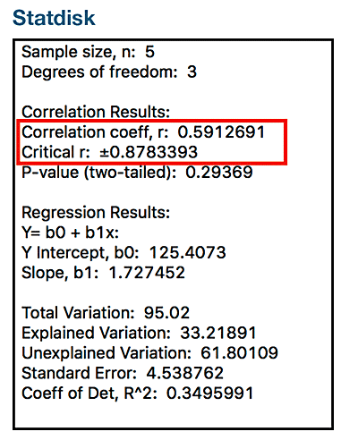
Example: Correlation between Shoe Print Lengths and Heights? (2 of 2)
It isn’t very clear whether there is a linear correlation.

Slide 77
P-Value
P-Value
  If there really is no linear correlation between two variables, the P-value is the probability of getting paired sample data with a linear correlation coefficient r that is at least as extreme as the one obtained from the paired sample data.

Slide 78
Interpreting a P-Value from the Previous Example
The P-value of 0.294 is high. It shows there is a high chance of getting a linear correlation coefficient of r = 0.591 (or more extreme) by chance when there is no linear correlation between the two variables.

Slide 79
Interpreting a P-Value from the Example Where n = 5
Because the likelihood of getting r = 0.591 or a more extreme value is so high (29.4% chance), we conclude there is not sufficient evidence to conclude there is a linear correlation between shoe print lengths and heights.

Slide 80
Interpreting a P-Value
Only a small P-value, such as 0.05 or less (or a 5% chance or less), suggests that the sample results are not likely to occur by chance when there is no linear correlation, so a small P-value supports a conclusion that there is a linear correlation between the two variables.

Slide 81
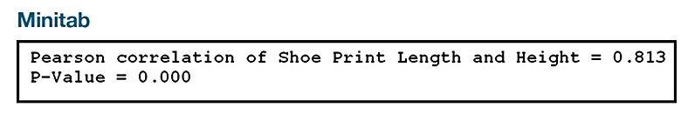
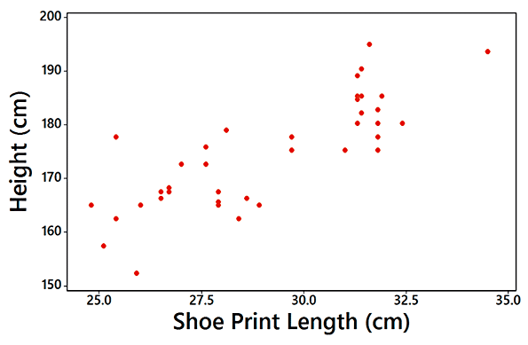
Example: Correlation between Shoe Print Lengths and Heights (n = 40)

Slide 82
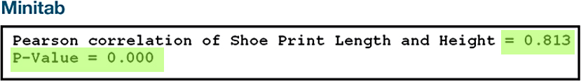
Example: Correlation between Shoe Print Lengths and Heights
The scatterplot shows a distinct pattern. The value of the linear correlation coefficient is r = 0.813, and the P-value is 0.000. Because the P-value of 0.000 is small, we have sufficient evidence to conclude there is a linear correlation between shoe print lengths and heights.

Slide 83

Regression
Regression
  Given a collection of paired sample data, the regression line (or line of best fit, or least-squares line) is the straight line that “best” fits the scatterplot of the data.

Slide 84
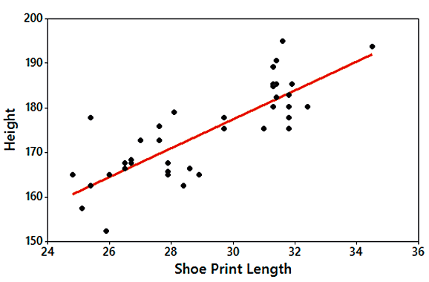
Example: Regression Line (1 of 2)

Slide 85
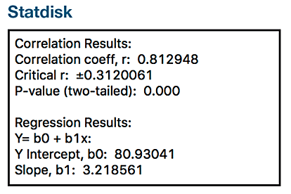
Example: Regression Line (2 of 2)
The general form of the regression equation has a y-intercept of b₀ = 80.9 and slope b₁ = 3.22.
Using variable names, the equation is:
Height = 80.9 + 3.22 (Shoe Print Length)

