Slide 1
Chapter 2: The Linux System Part 5

Slide 2
Chapter 2: The Linux System
Linux History
Design Principles
Kernel Modules
Process Management
Scheduling
Memory Management
File Systems
Input and Output
Interprocess Communication
Network Structure
Security

Slide 3
File Systems

Slide 4
File Systems
File systems: Systems that controls how the computer stores files on disk and how it retrieves them.
Linux retains UNIX’s standard file-system model.
In UNIX, a file does not have to be an object stored on disk or fetched over a network from a remote file server.
Rather, UNIX files can be anything capable of handling the input or output of a stream of data.
Device drivers can appear as files, and interprocesscommunication channels or network connections also look like files to the user.

Slide 5
The Linux Ext2fs File System
The standard on-disk file system used by Linux is called second extended file system (ext2fs).
Ext2fs uses a mechanism for locating data blocks belonging to a specific file.
Ext2fs does not use fragments; it performs its allocations in smaller units
The default block size on ext2fs is 1Kb, although 2Kb and 4Kb blocks are also supported
Ext2fs uses allocation policies designed to place logically adjacent blocks of a file into physically adjacent blocks on disk, so that it can submit an I/O request for several disk blocks as a single operation

Slide 6
The Linux Ext2fs File System
The ext2fs allocation policy comes in two parts.
An ext2fs file system is partitioned into multiple block groups. ext2fs uses the concept of cylinder groups, where each group corresponds to a single cylinder of a physical disk.
However, modern disk-drive technology packs sectors onto the disk at different densities, and thus with different cylinder sizes, depending on how far the disk head is from the center of the disk. Therefore, fixed-sized cylinder groups do not necessarily correspond to the disk’s geometry

Slide 7
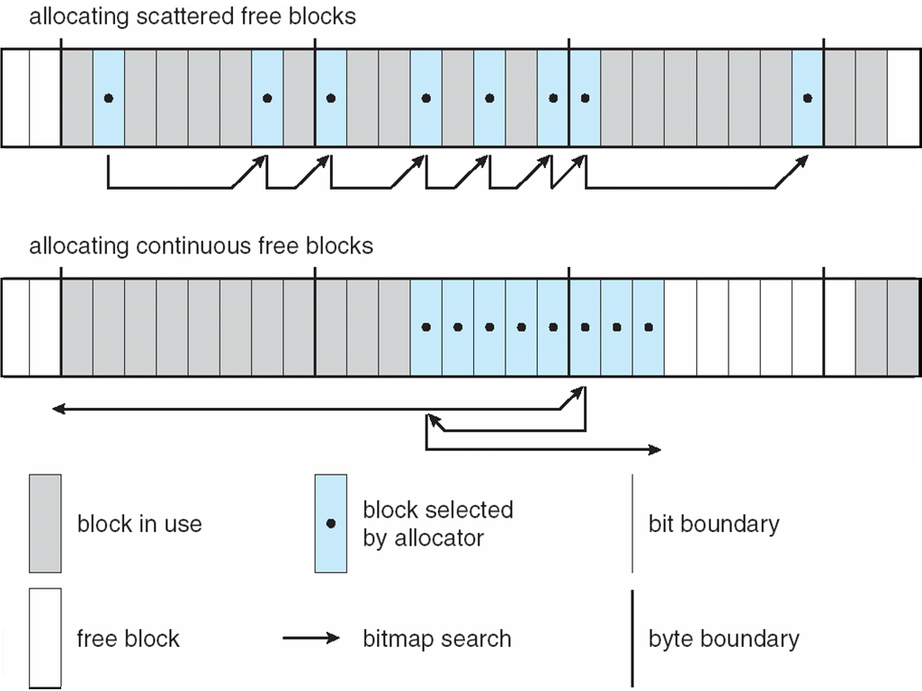
Ext2fs Block-Allocation Policies

Slide 8
Input and Output

Slide 9
Input and Output
Linux splits all devices into three classes:
Block devices
Character devices
Network devices

Slide 10
Input and Output
Block device:
is one with which the driver communicates by sending fixed-sized blocks of data.
may be accessed randomly.
Example: hard disk and floppy disk, CD-ROMs, flash memory and USB cameras .

Slide 11
Input and Output
Character device:
is one with which the driver communicates by sending or receiving single characters (Bytes).
only accessed serially.
Example: serial port, parallel port , mice , keyboards and sound cards.

Slide 12
Input and Output
Network device:
Are dealt with differently from block and character devices.
Users cannot directly transfer data to network devices; instead, they must communicate indirectly by opening a connection to the kernel’s networking subsystem.

Slide 13
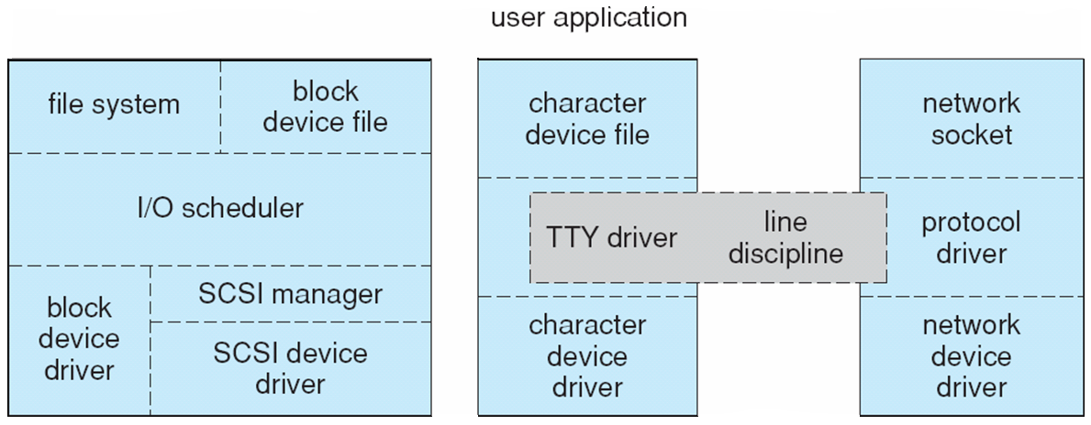
Device-Driver Block Structure

Slide 14
Interprocess Communication

Slide 15
Interprocess Communication
The standard Linux mechanism for informing a process that an event has occurred is the signal.
Signals can be sent from any process to any other process.
There is a limited number of signals, and they cannot carry information: Only the fact that a signal occurred is available to a process.
Whenever a process wants to wait for some event to complete, it places itself on a wait queue associated with that event.
The Linux kernel does not use signals to communicate with processes with are running in kernel mode, rather, communication within the kernel is accomplished via scheduling states and wait.queue structures.

Slide 16
Passing Data Between Processes
The pipe mechanism allows a child process to inherit a communication channel to its parent, data written to one end of the pipe can be read a the other.
Shared memory offers an extremely fast way of communicating; any data written by one process to a shared memory region can be read immediately by any other process that has mapped that region into its address space.
To obtain synchronization, however, shared memory must be used in conjunction with another Interprocess-communication mechanism.

Slide 17
Network Structure

Slide 18
Network Structure
Networking is a key area of functionality for Linux.
It supports the standard Internet protocols for UNIX to UNIX communications
It also implements protocols native to nonUNIX operating systems, in particular, protocols used on PC networks, such as Appletalk and IPX
Internally, networking in the Linux kernel is implemented by three layers of software:
The socket interface
Protocol drivers
Network device drivers

Slide 19
Network Structure (Cont.)
The socket interface
Receives all network requests and send them to protocol driver.
Protocol drivers
Create new packet
Rewrite packet
Reassembly or fragment packet
Remove packet
Decide which socket or device will send the packet
Network device drivers
Forward packet to suitable host

Slide 20
Network Structure (Cont.)
The most important set of protocols in the Linux networking system is the internet protocol suite
It implements routing between different hosts anywhere on the network

Slide 21
Security

Slide 22
Security
The security concerns can be classified in two groups:
Authentication: Making sure that nobody can access the system without first proving that she has entry rights
Access control: Providing a mechanism for checking whether a user has the right to access a certain object and preventing access to objects as required.
The pluggable authentication modules (PAM) system is available under Linux.
PAM is based on a shared library that can be used by any system component that needs to authenticate users.
Access control under UNIX systems, including Linux, is performed through the use of unique numeric identifiers (uid and gid).

