Slide 1
Classes and Objects

Slide 2
Basic Terminology
A class defines a kind of objects:
specifies the kinds of attributes (data) an object of the class can have.
provides methods specifying the actions an object of the class can take.
An object is an instance of the class.
Person is a class
Sara and Ahmed are objects of the Person class.

Slide 3
What does a class have?
Members of a class:
Attributes (instance variables, data)
For each instance of the class (object), values of attributes can vary, hence instance variables
Methods
Person class
Attributes: name, address, phone number
Methods: change address, change phone number
Sara object
Name is Sara, address is …
Ahmed object
Name is Ahmed, address is …

Slide 4
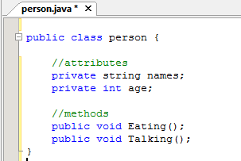
Definition of Class Person

Slide 5
Information Hiding
Information hiding
protect data inside an object
do not allow direct access

Slide 6
public and private
private
Attribute (variable)
only the same class can access/change
Method
only the same class can invoke
public
Attribute (variable)
any class can directly access/change
Method
any class can invoke

Slide 7
private or public ?
Attributes (variables)
should be private, why?
Methods
usually public, why?
sometimes private
Default is public in Java
Convention is to explicitly state public or private

Slide 8
Class Files and Separate Compilation
One class definition per file
File name and class name are the same
File extension is .java
After compilation
byte code is stored in a file with extension .class
Execution
.class is run in the JVM
Multiple .class files in the same directory
No need to import them

Slide 9
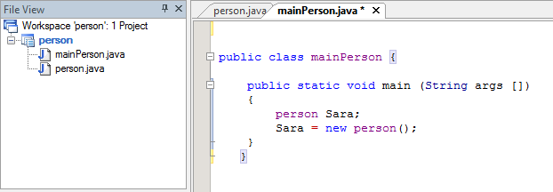
Object

Slide 10
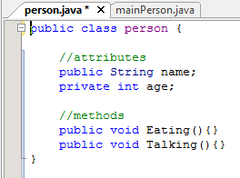
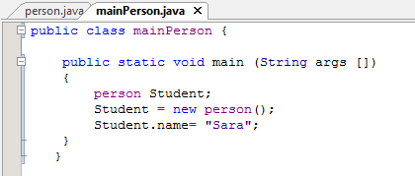
Dot operator with public members

Slide 11
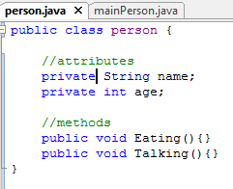
Dot operator with private members

Slide 12
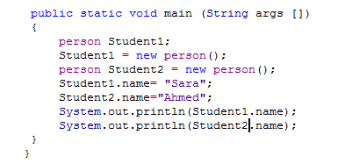
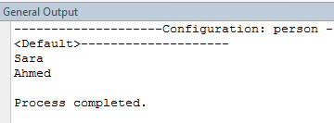
different objects

Slide 13
Methods

Slide 14
Method Definitions
Methods belong to a class
Defined inside the class
Heading
Return type (e.g. int, float, void)
Name (e.g. nextInt, println)
Parameters (e.g. println(…) )
More…
Body
enclosed in braces {}.
Declarations and/or statements.

Slide 15
The Method main
A program
a class that has a method named main.
Execution begins in the main method

Slide 16
------------ Person.java ------ defining Person ---------------------
public class Person
{
private String name;
private String iceCream;
public void setName(String newName)
{
name = newName; // this. is optional
}
public void setIceCream(String newIceCream) { … }
public void print()
{
System.out.println(name + “ likes “ + iceCream); //
}
}
------------ PersonTest.java ----- using Person ------------------
public class PersonTest
{
public static void main(String[] args)
{
Person joe = new Person();
joe.setName(“Joseph”);
joe.setIceCream(“Rocky Road”);
Person mary = new Person();
mary.setName(“Mary”);
mary.setIceCream(“Chocolate Fudge”);
mary.print();
}
}

Slide 17
Two Types of Methods
Return a value
next = keyboard.nextInt();
keyboard is the calling object.
Don’t return a value, called void method
System.out.println(“Enter data:”);
System.out is the calling object

Slide 18
void Method Definitions
example
public void WriteName()
{
//body
System.out.println(“Name: “ + name);
}

Slide 19
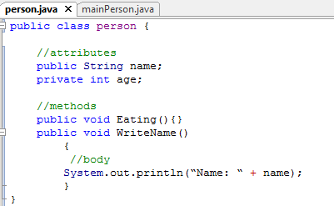
person example

Slide 20
Defining Methods That Return a Value
example
public String getName(){
// body
return name;
}

Slide 21
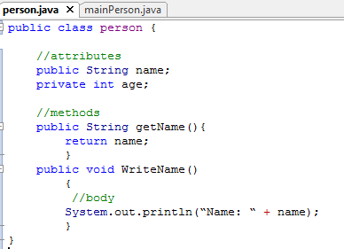
person example

Slide 22
Defining Methods That Return a Value
must contain return statement
return Expression;
Expression must have a type that matches the return type

Slide 23
public Method Definitions
syntax for a void method
public void methodName(parameters)
{
<statement(s)>
}
syntax for methods that return a value
public returnType methodName(parameters)
{
<statement(s), including a
return statement>
}

Slide 24
Passing Values to a Method: Parameters
Input values for methods (within the program, not from user)
passed values or parameters
More flexibility for methods
parameters
Part of method definition
After the method name, within parentheses
type
name
arguments
Calling a method with an object within the parentheses
matching data type
in the same order

Slide 25
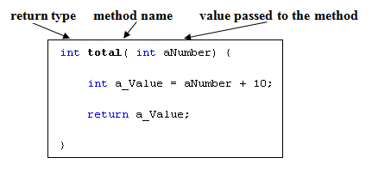

Slide 26
Parameter Passing Example
//Definition of method to double an integer
public int doubleValue(int numberIn)
{
return 2 * numberIn;
}
//Invocation of the method... somewhere in main...
...
int next = 5;
int result= someObj.doubleValue(next));
What is the parameter in the method definition?
numberIn
What is the argument in the method invocation call?
next

Slide 27
Type Matching/Constraint
The type of each argument should match the corresponding formal parameter.
If appropriate, Java automatically performs type casting:
Define: float square(float num)
Call: int x=5; square(x);
byte --> short --> int --> long --> float --> double

Slide 28
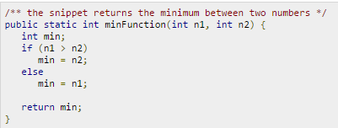
Example
Method calling
int result = sum)9,6);

Slide 29
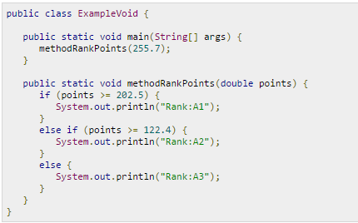
Example

Slide 30
Example

