Slide 1
CEN444
Computer Networks
Chapter 1
Dr. Majed Alresaini

Slide 2
Introduction
18th century: great mechanical systems, Industrial Revolution.
The 19th century: steam engine.
The 20th century: information gathering, processing, and distribution.
Worldwide telephone networks.
Radio and television
The birth and unprecedented growth of the computer industry
The launching of communication satellites.
The Internet.

Slide 3
Definition
computer networks: collection of autonomous computers interconnected by a single technology.
Connections: copper wire, fiber optics, microwaves, infrared, satellites, etc...
Networks come in many sizes, shapes and forms.
Networks are usually connected together to make larger networks.
Internet is the most well-known example of a network of networks.

Slide 4
Computer Networks vs. distributed systems
distributed system: collection of independent computers appears to its users as a single coherent system.
A well-known example of a distributed system is the
World Wide Web (WWW).
WWW runs on top of the Internet and presents a model in which everything looks like a document (Web page).
A distributed system is a software system built on top of a network.
The software gives distributed systems high degree of cohesiveness and transparency.

Slide 5
Computer Networks vs. distributed systems
The distinction between a network and a distributed system lies with the software (especially the operating system), rather than with the hardware.
Nevertheless, there is considerable overlap between the two subjects.

Slide 6
Business Applications
resource sharing: example, share a common printer.
Most important sharing information.
VPNs (Virtual Private Networks): may be used to join the individual networks at different sites into one extended network.
  Example: a user happens to be 15,000 km away from his data should not prevent him from using the data as though they were local.
  an attempt to end the ‘‘tyranny of geography.’’

Slide 7
Business Applications
Example: a company has databases. Employees need to access them remotely.
  the data are stored on powerful computers called servers
    housed and maintained by a system administrator.
  the employees have simpler machines, called clients, on their desks, with which they access remote data.
  The client and server machines are connected by a network

Slide 8
client-server model

Slide 9
client-server model
The most popular example of client-server model is that of a Web application.
Under most conditions, one server can handle a large number (hundreds or thousands) of clients simultaneously.

Slide 10
Business Applications
A computer network can provide a powerful communication medium among employees.
email (electronic mail ).
IP telephony. Voice over IP (VoIP).
Desktop sharing.
e-commerce (electronic commerce).

Slide 11
Home Applications
‘‘There is no reason for any individual to have a computer in his home.’’, Ken Olsen, 1977, president of the Digital Equipment Corporation.
Digital was number two after IBM.
Digital no longer exists.
Computer use at home:
  word processing and games
  Internet access.
  Entertainment: music, photos, and videos.

Slide 12
Home Applications
Internet provides connectivity to remote computers.
Metcalfe’s law: the value of a network is proportional to the square of the number of users because this is roughly the number of different connections that may be made.
Surfing the World Wide Web for information or just for fun.
Information includes arts, business, cooking, government, health, history, hobbies, recreation, science, sports, travel, etc…
Newspapers can be personalized, e.g. you want everything about corrupt politicians, big fires, and epidemics, but no football.

Slide 13
Home Applications
Online digital library: ACM (www.acm.org) and the IEEE Computer Society (www.computer.org).
Information is mostly accessed using the client-server model.
peer-to-peer communication: everyone can communicate with one or more other; there is no fixed division into clients and servers.

Slide 14
peer-to-peer communication
No central database of content.
Each user maintains his own database locally.
List of other nearby people who are members of the system.
Example: BitTorrent, 2003.
Share music and videos.
Napster was shut down after biggest copyright infringement case, 2000.
Email is peer-to-peer.

Slide 15
peer-to-peer communication
Some teenagers are addicted to instant messaging.
Twitter, Internet radio, YouTube, Facebook, wiki, Wikipedia.
wiki is a collaborative Web site that the members of a community edit.
electronic commerce.
electronic flea markets (e-flea?): online auctions of second-hand goods.
online auctions are peer-to-peer as consumers can act as both buyers and sellers.

Slide 16
Forms of e-commerce

Slide 17
Home Applications
IPTV (IP TeleVision).
Online game playing.
ubiquitous computing: smart homes.
power-line networks.
shower may record water usage.
RFID (Radio Frequency IDentification): passive no battery chips, size of stamps can be affixed to books, passports, pets, credit cards, etc…
This lets RFID readers locate and communicate with the items over a distance of up to several meters
Originally, RFID was commercialized to replace barcodes.
Barcodes are free and RFID tags cost a few cents.

Slide 18
Mobile Users
Mobile computers: fastest-growing segments of the computer industry.
Read and send email, tweet, watch movies, play games, or surf the Web.
At home, office, anywhere on land, sea or in the air.
Connectivity to the Internet enables many of these mobile uses using wireless networks.
Cellular networks, Wireless hotspots.

Slide 19
Mobile Users
Wireless networks are of great value to fleets of trucks, taxis, delivery vehicles, etc…
Wireless networks are also important to the military.
Wireless vs. Mobile:

Slide 20
Mobile Users
Mobile phones: Text messaging (or texting), 3G and 4G cellular networks, GPS (Global Positioning System),
m-commerce (mobile-commerce): authorize payments for food in vending machines, movie tickets, and other small items instead of cash and credit cards.
NFC (Near Field Communication): can act as an RFID smartcard and interact with a nearby reader for payment.

Slide 21
Sensor networks
Nodes that gather information they sense.
Can be part of cars or phones, etc.. Or may be small separate devices.
Example: car gather data: location, speed, vibration, and fuel efficiency and upload this information to a database.
Those data can help find potholes, plan trips around congested roads, and tell you if you are a ‘‘gas guzzler’’.
Example: tracking the migration of individual zebras by placing a small sensor on each animal.

Slide 22
Sensor networks
Wireless parking meters can accept credit or debit card payments with instant verification over the wireless link.
Report when in use over the wireless network.
Drivers can find an available spot more easily.
When a meter expires, it check for a car (by bouncing a signal off it).
Report the expiration to parking enforcement.
Estimate: city governments in the U.S. could collect an additional $10 billion this way.

Slide 23
Wearable computers
Smart watches with radios now you can buy them.
Pacemakers and insulin pumps.
Can be controlled over a wireless network.
This lets doctors test and reconfigure them more easily.
Dangerous: could lead to some nasty problems if the devices are insecure can be hacked.

Slide 24
Social Issues
Computer networks, like the printing press 500 years ago.
allow ordinary citizens to distribute and view content.
Social networks, message boards, content sharing sites, etc...
politics, religion, or sensitive topics may be deeply offensive to some people.
high-resolution color photographs and video clips.
In the past, people have sued network operators.

Slide 25
Social Issues
Snooping on the traffic.
Employee rights versus employer rights.
Government versus citizen’s rights.
People’s privacy.
Cookies: can leak credit card numbers, social security numbers, etc…
Google show advertisements based on your emails through Gmail.
Medical advice you get from the Internet. From who?
Electronic junk mail (spam).

Slide 26
Social Issues
Viruses, botnet, phishing, etc…
Laws in different countries.

Slide 27
NETWORK HARDWARE
broadcast links and point-to-point links.
wireless network is an example of a broadcast link.
Packets: short messages.
Unicasting: one sender and one receiver.
Broadcasting: to all, multicasting: to more than one.

Slide 28
Networks Classification

Slide 29
PANs (Personal Area Networks)

Slide 30
LAN (Local Area Network)

Slide 31
MAN (Metropolitan Area Network)

Slide 32
WAN (Wide Area Network)

Slide 33
NETWORK SOFTWARE

Slide 34
Protocol Hierarchies

Slide 35
Virtual Communication

Slide 36
Design Issues for the Layers
Error detection, error correction.
Routing, what if node in a path down?
Addressing or naming.
Scalable.
Statistical multiplexing.
Flow control.
Congestion.
Real time.
Quality of service
Confidentiality, integrity, authentication.

Slide 37
Connection-Oriented vs. Connectionless
Connection-oriented: first establishes a connection, uses the connection, and then releases the connection.
circuit is a connection with associated resources such as a fixed bandwidth. Example: telephone network.
Connectionless: Each message (packet) carries the full destination address.
store-and-forward switching vs. cut-through switching.
connectionless service is called datagram service.

Slide 38
Types of service.

Slide 39
Service Primitives

Slide 40
client-server interaction

Slide 41
Services vs. Protocols
A service relates to an interface between two layers.
A protocol is a set of rules governing the format and meaning of the packets, or messages that are exchanged by the peer entities within a layer.

Slide 42
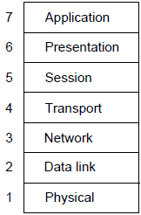
ISO OSI (Open Systems Interconnection)
A principled, international standard, seven layer model to connect different systems
– Provides functions needed by users
– Converts different representations
– Manages task dialogs
– Provides end-to-end delivery
– Sends packets over multiple links
– Sends frames of information
– Sends bits as signals

Slide 43
ISO OSI (Open Systems Interconnection)

Slide 44
The TCP/IP Reference Model

Slide 45
The TCP/IP Reference Model

Slide 46
OSI vs. TCP/IP
OSI:
    Very influential model with clear concepts
    Models, protocols and adoption all bogged down by politics and complexity
TCP/IP:
    Very successful protocols that worked well and thrived
    Weak model derived after the fact from protocols

Slide 47
The Model Used in This Course

Slide 48
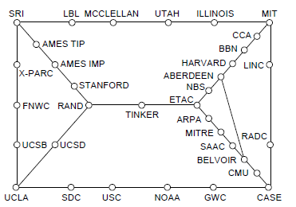
Internet (1)
Before the Internet was the ARPANET, a decentralized, packet-switched network based on Baran’s ideas.
Nodes are IMPs, or early routers, linked to hosts
56 kbps links
ARPANET topology in Sept 1972.
Notes:
Decentralized or fully distributed is a contrast to the hierarchical telephone network that came beforehand. Unlike the telephone network, blowing up a single important node will not break the network or large portions of it.

Slide 49
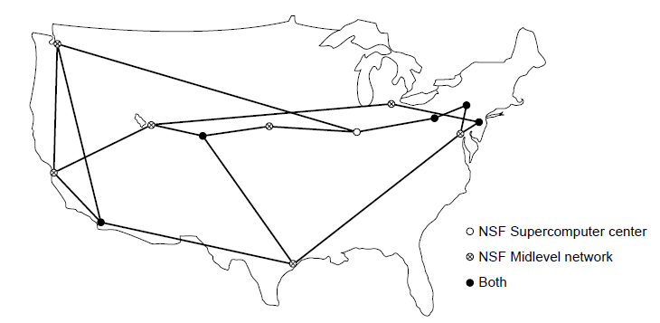
Internet (2)
The early Internet used NSFNET (1985-1995) as its backbone; universities connected to get on the Internet
T1 links (1.5 Mbps)
NSFNET topology in 1988
Notes:
NSFNET was an academic research network growing out of CSNET that was created so that universities without DoD contracts could participate. It was initially connected to the ARPANET by gateways, and later took over the central role as the “backbone of the Internet”, i.e., the network through which packets passed on their way between parties connected to different parts of the Internet.

Slide 50
Internet (3)
The modern Internet is more complex:
  ISP networks serve as the Internet backbone
  ISPs connect or peer to exchange traffic at IXPs
  Within each network routers switch packets
  Between networks, traffic exchange is set by business agreements
  Customers connect at the edge by many means
    Cable, DSL, Fiber-to-the-Home, 3G/4G wireless, dialup
  Data centers concentrate many servers (“the cloud”)
  Most traffic is content from data centers (esp. video)
  The architecture continues to evolve
Notes:
ISP = Internet Service Provicer, IXP = Internet eXchange Point

Slide 51
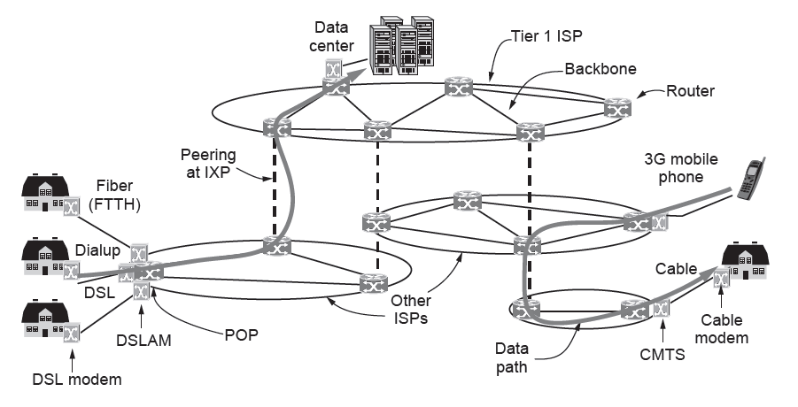
Internet (4)
Architecture of the Internet

Slide 52
Network Standardization
  Standards define what is needed for interoperability
  Some of the many standards bodies:
Body | Area | Examples
ITU | Telecommunications | G.992, ADSL H.264, MPEG4
IEEE | Communications | 802.3, Ethernet 802.11, WiFi
IETF | Internet | RFC 2616, HTTP/1.1 RFC 1034/1035, DNS
W3C | Web | HTML5 standard CSS standard

Slide 53
METRIC UNITS

