Slide 1
Server side

Slide 2
The World Wide Web
The World Wide Web (WWW) is a system of interlinked hypertext documents accessed via the Internet.
With a web browser, one can view web pages that may contain text, images, videos, and other multimedia and navigate between them by using hyperlinks.

Slide 3
  The World Wide Web (WWW) was developed by Tim Berners-Lee and other research scientists at CERN, the European center for nuclear research, in the late 1980s and early 1990s.
  WWW is a client-server model and uses TCP connections to transfer information or web pages from server to client.
  WWW uses a Hypertext model. Hypertext allows interactive accesses to a collection of documents.
  Documents can hold
    Text (hypertext), Graphics, Sound, Animations, Video
  Documents are linked together
    Non-distributed – all documents stored locally (e.g on CD-Rom).
    Distributed – documents stored at remote servers on the Internet.

Slide 4
WWW – Document Representation
  Each WWW document is called a page.
  Initial page for individual or organization is called a home page.
  Page can contain many different types of information; page must specify:
    Content – The actual information
    Type of content – The type of information, e.g. text, pictures etc
    Links to other documents
  Rather than having a fixed representation for every browser, pages are formatted with a mark up language.
  This allows browser to format page to fit display.
  Standard is called HyperText Markup Language (HTML).

Slide 5
WWW – Client Server Model
  The browser is the client, WWW (or web) server is the server.
  Browser:
    The browser makes TCP connection to the web server.
    The browser sends request for the particular web page that it wishes to display.
    The browser reads the contents of the web page from the TCP connection and displays it in the browsers window.
    The browser closes the TCP connection used to transfer the web page.
  Each separate item in a web page (e.g., pictures, audio) require a separate TCP connection.
  HyperText Transport Protocol (HTTP) specifies commands that the client (browser) issues to the server (web server) and the responses that the server sends back to the client.

Slide 6
Web Server Basics
Web browsers communicate with web servers using the HyperText Transfer Protocol (HTTP). When you click a link on a web page, submit a form, or run a search, the browser sends an HTTP Request to the server.
This request includes:
A URL identifying the target server and resource (e.g. an HTML file, a particular data point on the server, or a tool to run).
A method that defines the required action .
Additional information can be encoded with the request.
Web servers wait for client request messages, process them when they arrive, and reply to the web browser with an HTTP Response message.

Slide 11
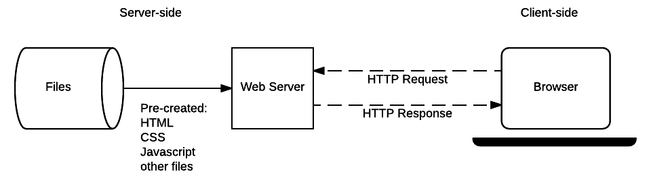
Static sites
static site is one that returns the same hard-coded content from the server whenever a particular resource is requested.
Static sites are excellent when you have a small number of pages and you want to send the same content to every user.

Slide 12
Dynamic sites
A dynamic website is one where some of the response content is generated dynamically, only when needed.
dynamic site can return different data for a URL based on information provided by the user or stored preferences.
Most of the code to support a dynamic website must run on the server. Creating this code is known as "server-side programming”.

Slide 13
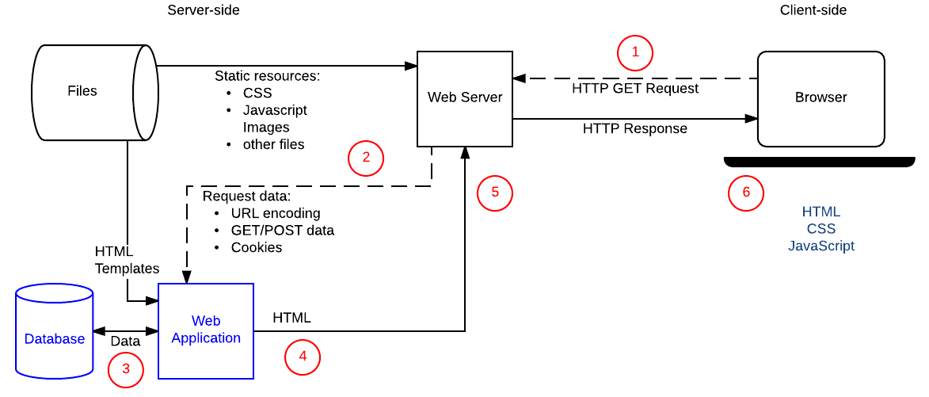

Slide 20
Are server-side and client-side programming the same?
They have different purposes and concerns.
They generally don't use the same programming languages (the exception being JavaScript, which can be used on the server- and client-side).
They run inside different operating system environments

Slide 21
client-side code
Code running in the browser is known as client-side code and is primarily concerned with improving the appearance and behavior of a rendered web page.
Client-side code is written using HTML, CSS, and JavaScript — it is run inside a web browser

Slide 22
Server-side code
Server-side code can be written in any number of programming languages — examples of popular server-side web languages include PHP, Python, Ruby, C#, and JavaScript (NodeJS).
The server-side code has full access to the server operating system .
Developers typically write their code using web frameworks(are collections of functions, objects, rules and other code constructs designed to solve common problems, speed up development, and simplify the different types of tasks faced in a particular domain)

Slide 25
What can you do on the server-side?
Server-side programming is very useful because it allows us to efficiently deliver information tailored for individual users.
Companies like Amazon use server-side programming to construct search results for products, Banks use server-side programming to store account information and allow only authorized users to view and make transactions.

Slide 26
benefits of server-side programming
Efficient storage and delivery of information (when products are sold either online or in a shop, the shop might update its database of inventory).
Customized user experience (many sites store credit cards so that details don't have to be entered again) .
Controlled access to content (social-networking sites which allow users to determine who can see the content they post to the site, and whose content appears in their feed )

Slide 27
Store session/state information (site to know that a user has previously logged in and display links to their emails or order history)
Notifications and communication (Facebook and Twitter send emails and SMS messages to notify you of new communications).
Data analysis ( Amazon and Google both advertise products based on previous searches )

