Slide 1
Chapter 4
Gases

Slide 2
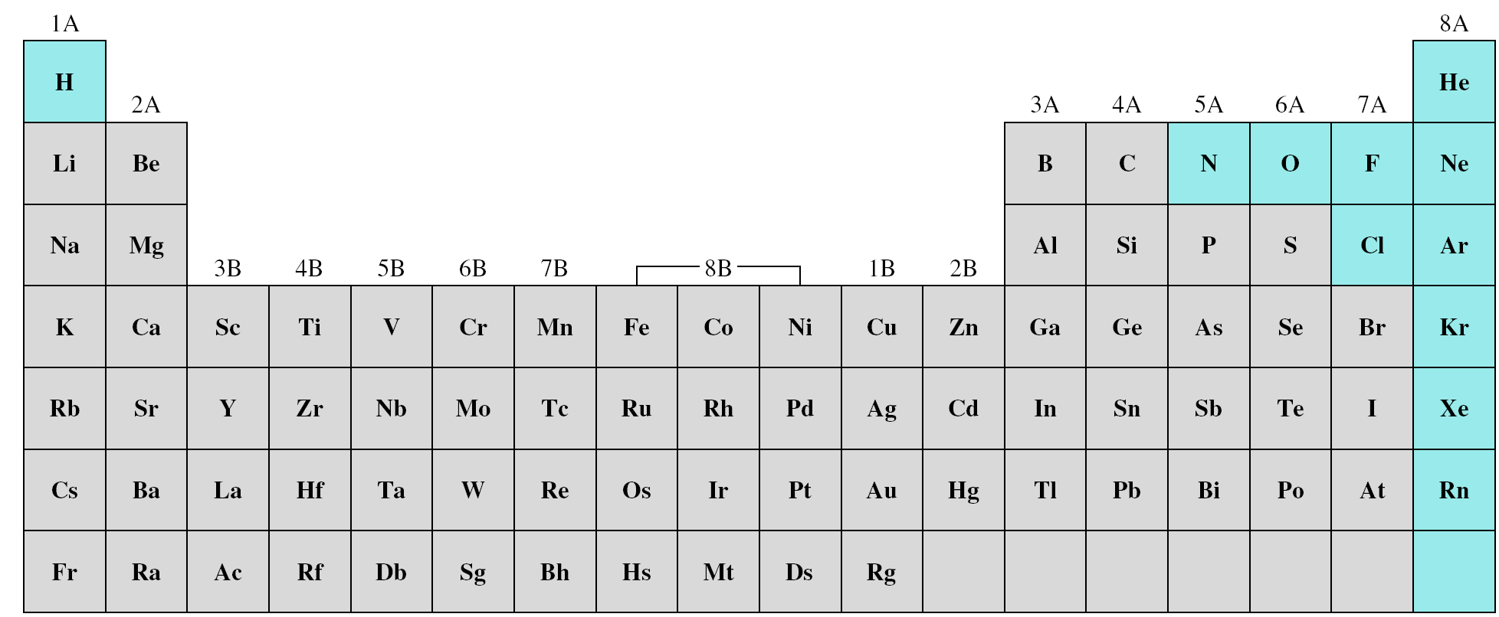
Substances That Exist as Gases
Elements that exist as gases at 25⁰C and 1 atmosphere
Ionic compounds do not exist as gases at 25°C and 1 atm.
because electrostatic forces between cations and anions.
Molecular compounds is more varied.
Gases; CO, CO₂, HCl, NH₃, and CH₄ (methane).
The majority are liquids or solids at room temperature.

Slide 3
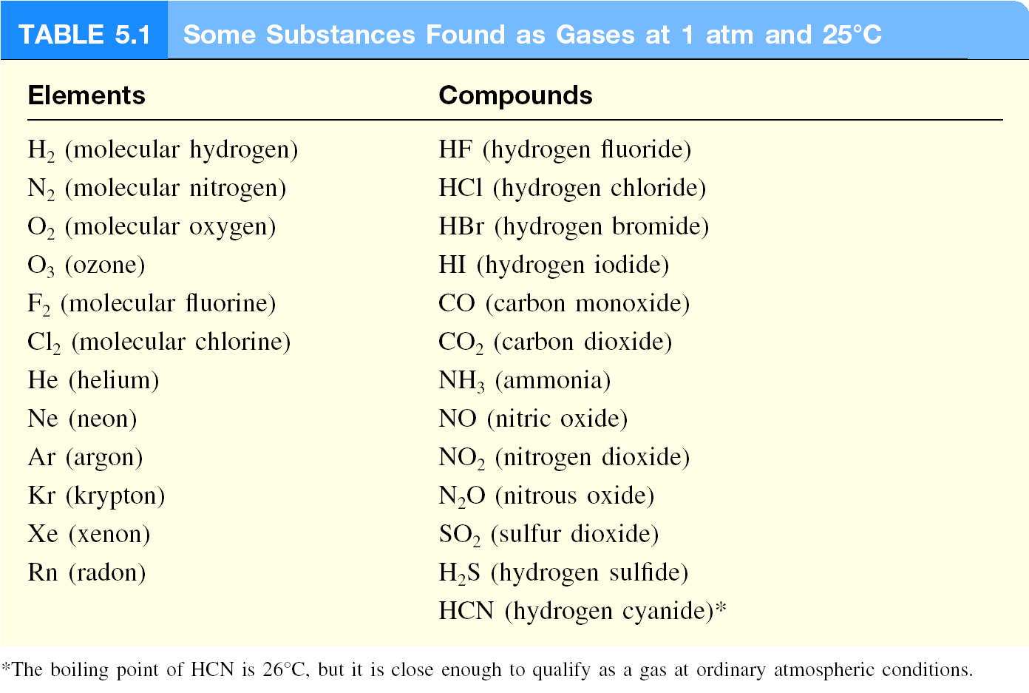
Substances That Exist as Gases

Slide 4
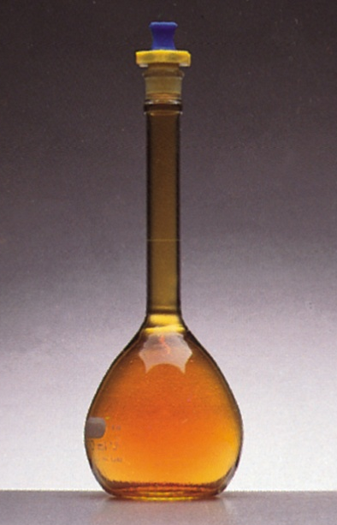
Substances That Exist as Gases
Physical Characteristics of Gases
Gases assume the volume and shape of their containers.
Gases are the most compressible state of matter.
Gases will mix evenly and completely when confined to the same container.
Gases have much lower densities than liquids and solids.
NO₂ gas

Slide 5
Pressure of a Gas
SI Units of Pressure
Velocity is the change in distance with elapsed time.
distance moved
velocity =
m/s or cm/s
elapsed time
Acceleration is the change in velocity with time.
change in velocity
acceleration =
m/s² (or cm/s² )
elapsed time
force = mass x acceleration
SI unit of force is the newton (N),
where 1 N = 1 kg m/s²

Slide 6
Pressure of a Gas
SI Units of Pressure
Pressure as force applied per unit area:
Force
Pressure =
Area
Units of Pressure
1 pascal (Pa) = 1 N/m²
1 atm = 760 mmHg = 760 torr
1 atm = 101,325 Pa

Slide 7
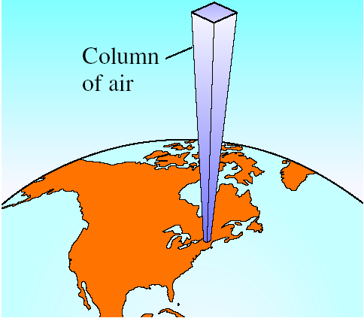
Pressure of a Gas
Atmospheric Pressure
10 miles
0.2 atm
4 miles
0.5 atm
Sea level
1 atm

Slide 8
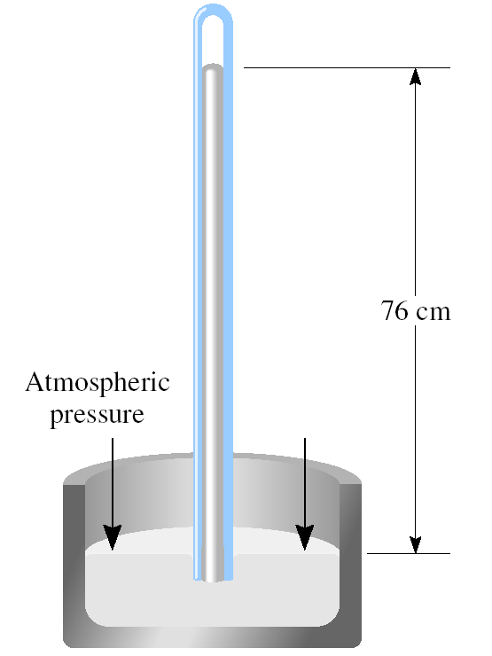
Pressure of a Gas
Atmospheric Pressure
How is atmospheric pressure measured?
The barometer is probably the most familiar instrument for measuring atmospheric pressure.
Standard atmospheric pressure (1 atm) is equal to the pressure that supports a column of mercury exactly 760 mm (or 76 cm) high at 0°C at sea level.

Slide 9
Pressure of a Gas
Atmospheric Pressure

Slide 10
Pressure of a Gas
Atmospheric Pressure

Slide 11
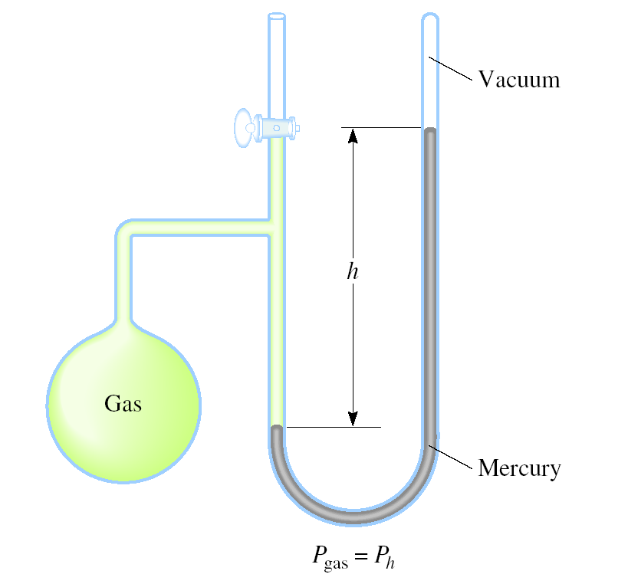
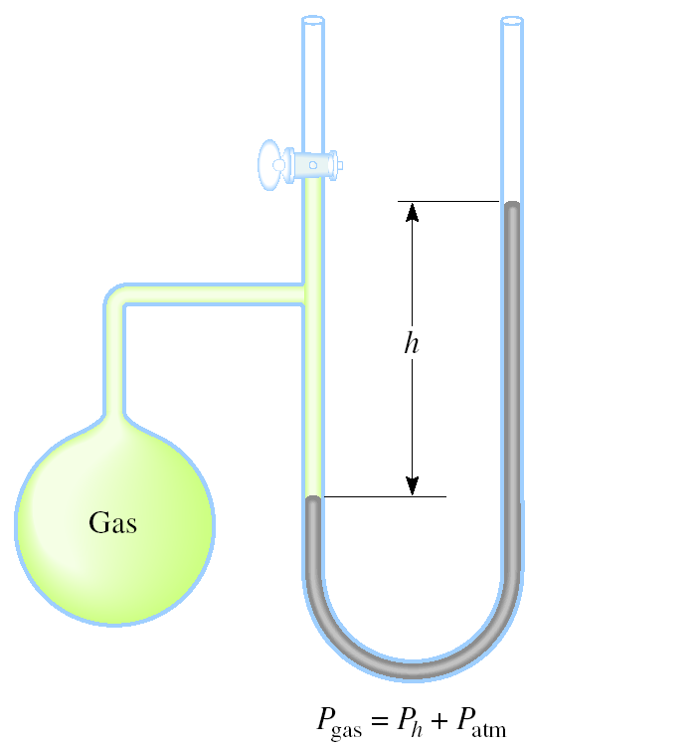
Pressure of a Gas
A manometer is a device used to measure the pressure of gases other than the atmosphere.
closed-tube
open-tube

Slide 12
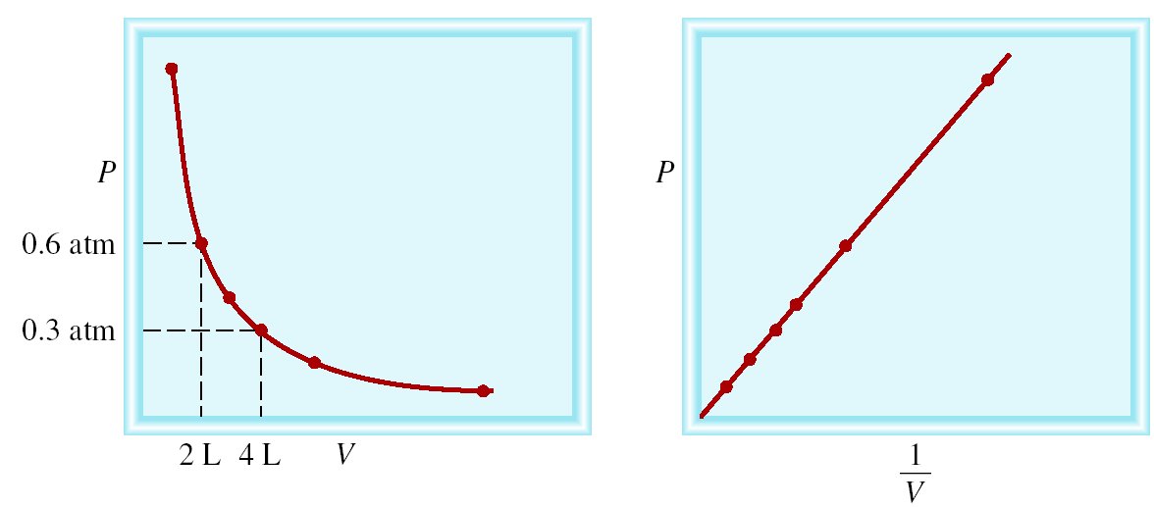
The Gas Laws
The Pressure-Volume Relationship: Boyle’s Law
Boyle’s law, states that the pressure of a fixed amount of gas at a constant temperature is inversely proportional to the volume of the gas.
P α 1/V
P x V = constant
Constant temperature
Constant amount of gas
P₁ x V₁ = P₂ x V₂

Slide 13
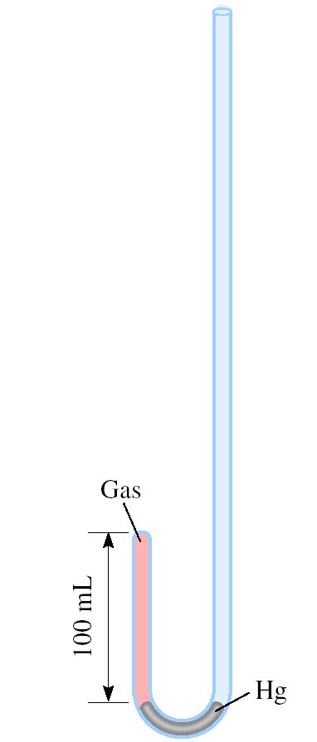
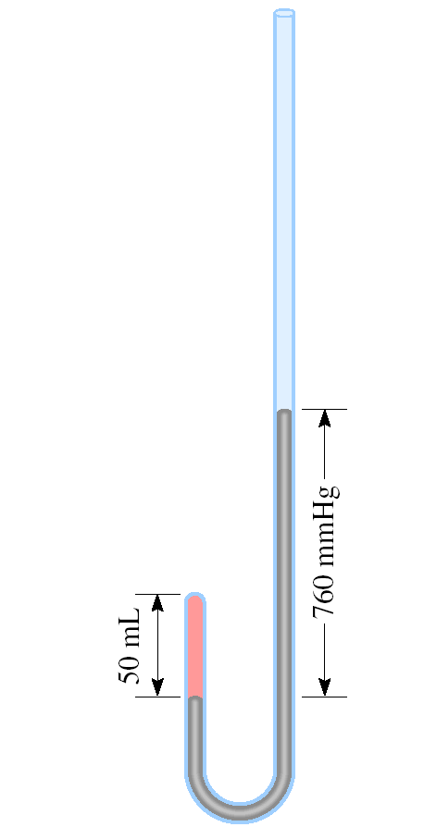
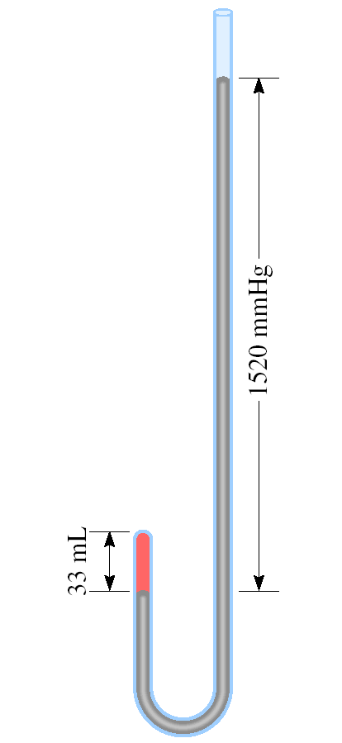
The Gas Laws
Apparatus for Studying the Relationship Between
Pressure and Volume of a Gas
As P (h) increases
V decreases

Slide 14
The Gas Laws
A sample of chlorine gas occupies a volume of 946 mL at a pressure of 726 mmHg. What is the pressure of the gas (in mmHg) if the volume is reduced at constant temperature to 154 mL?
P x V = constant
P₁ x V₁ = P₂ x V₂
P₁ = 726 mmHg
P₂ = ?
V₁ = 946 mL
V₂ = 154 mL
P₁ x V₁
726 mmHg x 946 mL
P₂ =
=
= 4460 mmHg
V₂
154 mL

Slide 15
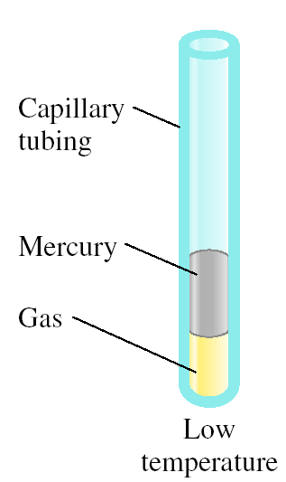
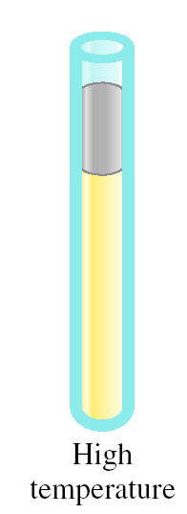
The Gas Laws
The Temperature-Volume Relationship: Charles’s and Gay-Lussac’s Law
Variation in Gas Volume with Temperature at Constant Pressure
As T increases
V increases

Slide 16
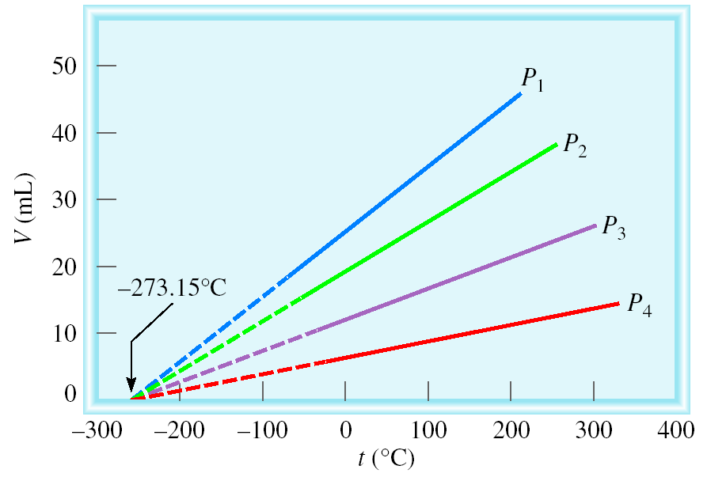
The Gas Laws
The Temperature-Volume Relationship: Charles’s and Gay-Lussac’s Law
Charles’s law, states that the volume of a fixed amount of gas maintained at constant pressure is directly proportional to the absolute temperature of the gas.
Variation of Gas Volume with Temperature at Constant Pressure
V α T
V = constant x T
Temperature must be in Kelvin
V₁/T₁ = V₂ /T₂
T (K) = t (⁰C) + 273.15

Slide 17
The Gas Laws
A sample of carbon monoxide gas occupies 3.20 L at 125 ⁰C. At what temperature will the gas occupy a volume of 1.54 L if the pressure remains constant?
V₁ /T₁ = V₂ /T₂
V₁ = 3.20 L
V₂ = 1.54 L
T₁ = 398.15 K
T₂ = ?
T₁ = 125 (⁰C) + 273.15 (K) = 398.15 K
V₂ x T₁
1.54 L x 398.15 K
T₂ =
=
= 192 K
V₁
3.20 L

Slide 18
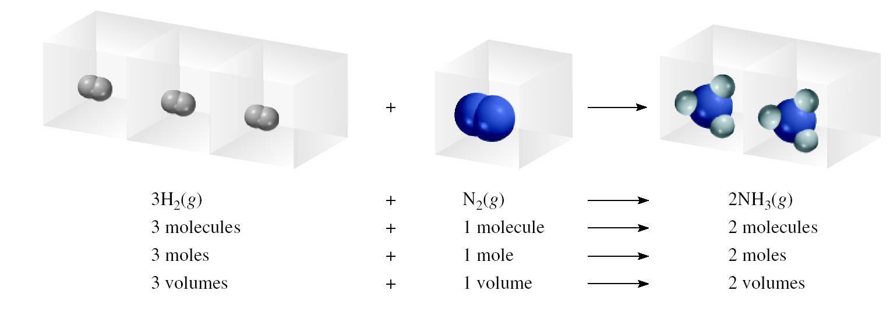
The Gas Laws
The Volume-Amount Relationship: Avogadro’s Law
Avogadro’s law, states that at constant pressure and temperature, the volume of a gas is directly proportional to the number of moles of the gas present.
V α number of moles (n)
Constant temperature
Constant pressure
V = constant x n
V₁ / n₁ = V₂ / n₂

Slide 19
The Gas Laws
The Volume-Amount Relationship: Avogadro’s Law
Ammonia burns in oxygen to form nitric oxide (NO) and water vapor. How many volumes of NO are obtained from one volume of ammonia at the same temperature and pressure?
4NH₃ + 5O₂ 4NO + 6H₂O
1 mole NH₃ 1 mole NO
At constant T and P
1 volume NH₃ 1 volume NO

Slide 20
The Ideal Gas Equation
1
Boyle’s law: P α (at constant n and T)
V
Charles’ law: V α T (at constant n and P)
Avogadro’s law: V α n (at constant P and T)
nT
V α
P
nT
nT
V = constant x = R
R is the gas constant
P
P
PV = nRT

Slide 21
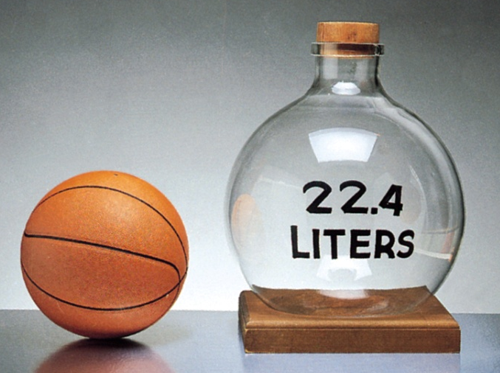
The Ideal Gas Equation
The conditions 0 ⁰C (273.15 K) and 1 atm are called standard temperature and pressure (STP).
Experiments show that at STP, 1 mole of an ideal gas occupies 22.414 L.
PV = nRT
PV
(1 atm)(22.414L)
R =
=
nT
(1 mol)(273.15 K)
R = 0.082057 L • atm / (mol • K)
An ideal gas is a hypothetical gas whose pressure-volume-temperature behavior can be completely accounted for by the ideal gas equation.

Slide 22
The Ideal Gas Equation
What is the volume (in liters) occupied by 49.8 g of HCl at STP?
T = 0 ⁰C = 273.15 K
P = 1 atm
PV = nRT
1 mol HCl
nRT
n = 49.8 g x
= 1.37 mol
V =
36.45 g HCl
P
L•atm
1.37 mol x 0.0821 x 273.15 K
mol•K
V =
1 atm
V = 30.7 L

Slide 23
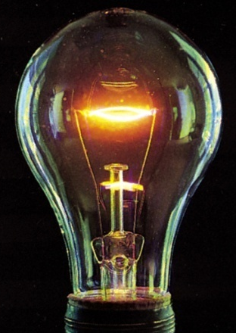
The Ideal Gas Equation
Argon is an inert gas used in lightbulbs to retard the vaporization of the filament. A certain lightbulb containing argon at 1.20 atm and 18 ⁰C is heated to 85 ⁰C at constant volume. What is the final pressure of argon in the lightbulb (in atm)?
PV = nRT
n, V and R are constant
nR
P
=
= constant
P₁ = 1.20 atm
P₂ = ?
V
T
T₁ = 291 K
T₂ = 358 K
P₁
P₂
=
T₁
T₂
T₂
358 K
P₂ = P₁ x
= 1.20 atm x
= 1.48 atm
T₁
291 K

Slide 24
The Ideal Gas Equation

Slide 25
The Ideal Gas Equation

Slide 26
The Ideal Gas Equation
Density (d) Calculations
n
PM
=
V
RT
The number of moles of the gas, n , is
m
n
=
M
m is the mass of the gas in g
M is the molar mass of the gas
m
m
PM
P
d =
=
=
V
M V
RT
RT
Molar Mass (M ) of a Gaseous Substance
dRT
M =
d is the density of the gas in g/L
P

Slide 27
The Ideal Gas Equation
A 2.10-L vessel contains 4.65 g of a gas at 1.00 atm and 27.0 ⁰C. What is the molar mass of the gas?
dRT
m
4.65 g
g
M =
d =
=
= 2.21
P
V
2.10 L
L
g
L•atm
2.21
x 0.0821 x 300.15 K
L
mol•K
M =
1 atm
M =
54.5 g/mol

Slide 28
The Ideal Gas Equation

Slide 29
The Ideal Gas Equation

Slide 30
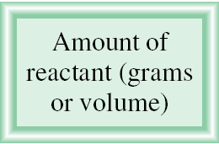
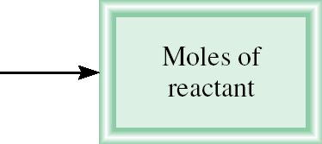
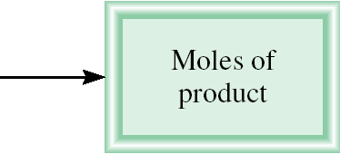
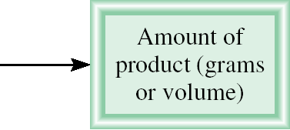
Gas Stoichiometry
The relationships between amounts (moles, n) and volume ( V )
What is the volume of CO₂ produced at 37 ⁰C and 1.00 atm when 5.60 g of glucose are used up in the reaction:
C₆H₁₂O₆ (s) + 6O₂ (g) 6CO₂ (g) + 6H₂O (l)
g C₆H₁₂O₆ mol C₆H₁₂O₆ mol CO₂ V CO₂
1 mol C₆H₁₂O₆
6 mol CO₂
5.60 g C₆H₁₂O₆
x
x
= 0.187 mol CO₂
180 g C₆H₁₂O₆
1 mol C₆H₁₂O₆
L•atm
0.187 mol x 0.0821 x 310.15 K
nRT
mol•K
V =
=
= 4.76 L
P
1.00 atm

Slide 31
Dalton's law of Partial Pressures
Dalton’s law of partial pressures, states that the total pressure of a mixture of gases is just the sum of the pressures that each gas would exert if it were present alone.
V and T are constant

Slide 32
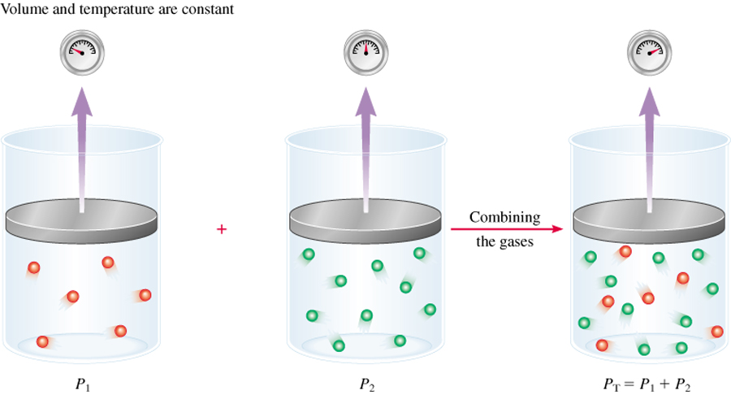
Dalton's law of Partial Pressures
Consider a case in which two gases, A and B, are in a container of volume V.
n_{A}RT
P_{A} =
n_{A} is the number of moles of A
V
n_{B}RT
P_{B} =
n_{B} is the number of moles of B
V
n_{A}
n_{B}
P_{T} = P_{A} + P_{B}
X_{A} =
X_{B} =
n_{A} + n_{B}
n_{A} + n_{B}
P_{A} = X_{A} P_{T}
P_{B} = X_{B} P_{T}
P_{i} = X_{i} P_{T}
n_{i}
mole fraction (X_{i} ) =
n_{T}

Slide 33
Dalton's law of Partial Pressures
A sample of natural gas contains 8.24 moles of CH₄, 0.421 moles of C₂H₆, and 0.116 moles of C₃H₈. If the total pressure of the gases is 1.37 atm, what is the partial pressure of propane (C₃H₈)?
P_{i} = X_{i} P_{T}
P_{T} = 1.37 atm
0.116
X_{propane} =
= 0.0132
8.24 + 0.421 + 0.116
P_{propane} = 0.0132 x 1.37 atm
= 0.0181 atm

Slide 34
Dalton's law of Partial Pressures

Slide 35
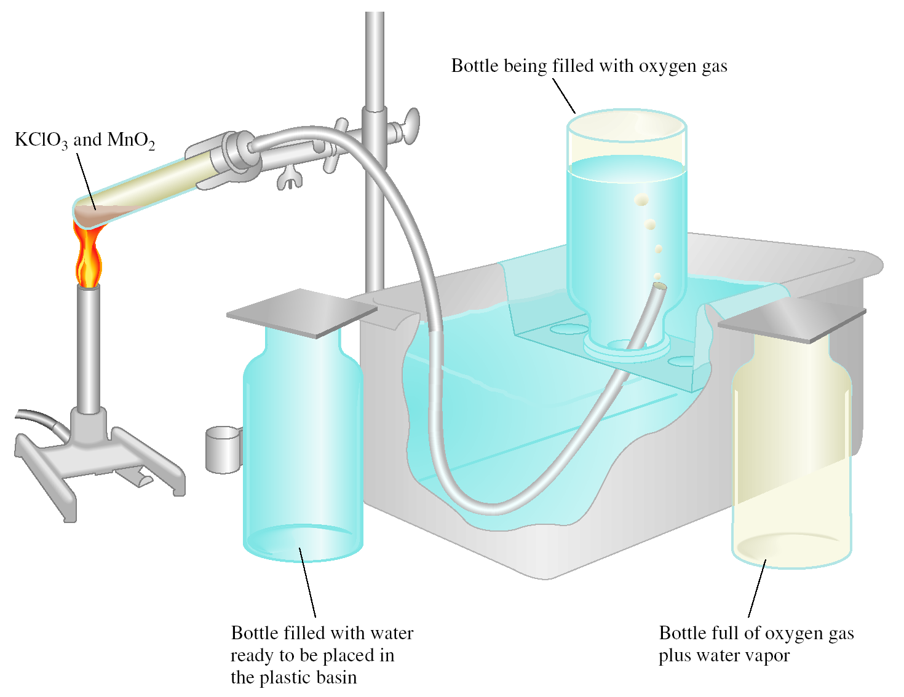
Dalton's law of Partial Pressures
Collecting a Gas over Water
2KClO₃ (s) 2KCl (s) + 3O₂ (g)

Slide 36
Dalton's law of Partial Pressures
Gas does not react with water and that it is not appreciably soluble in it.
Oxygen gas is ok, but not for gases such as NH₃.
The oxygen gas collected in this way is not pure, however, because water vapor is also present in the bottle.
The total gas pressure is equal to the sum of the pressures exerted by the oxygen gas and the water vapor:
P_{T} = P_{O} + P_{H O}
2
2

Slide 37
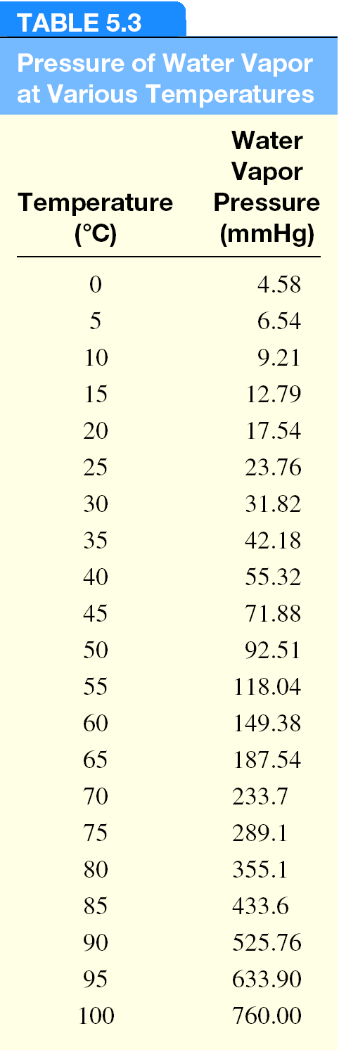
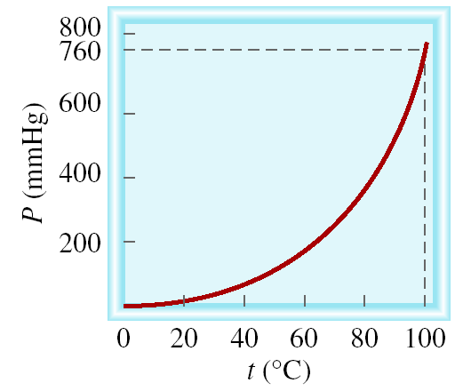
Dalton's law of Partial Pressures
Vapor of Water and Temperature

Slide 38
Dalton's law of Partial Pressures

