Slide 1
Chapter 9
Selecting the Sample
1
Copyright © 2014 Pearson Education, Inc.

Slide 2
Learning Objectives
To become familiar with sample design terminology
To understand the differences between probability and nonprobability sampling methods
To learn how to take four types of probability samples: simple random samples, systematic samples, cluster samples, and stratified samples
To learn how to take four types of nonprobability samples: convenience samples, purposive samples, referral samples, and quota samples
To acquire the skills to administer different types of samples, including online samples
To be able to develop a sample plan

Slide 3
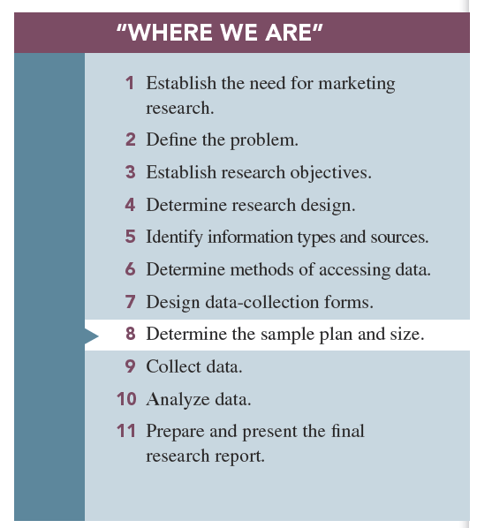

Slide 4
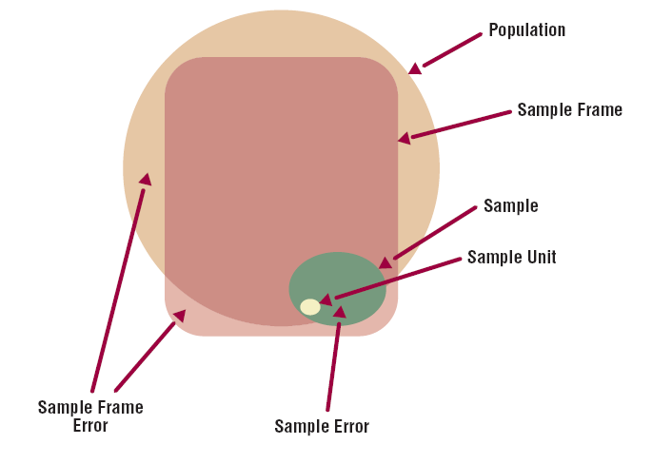
Basic Concepts in samples and Sampling
Population: the entire group under study as defined by research objectives

Slide 5
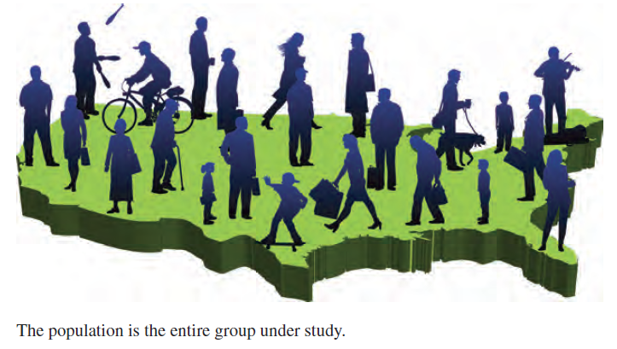
Population

Slide 6
Census
A census is an accounting of the complete population.
A Census requires information from everyone in the population.

Slide 7
Sample and sample unit
Sample: a subset of the population that should represent the entire group
Sample unit: the basic level of investigation

Slide 8
Sample frame and sample frame error
A sample frame: a master list of the entire population
Sampling frame error: the degree to which the sample frame fails to account for all of the population
Sampling error: any error in a survey that occurs because a sample is used

Slide 10
Reasons for Taking a Sample
Why a sample is almost always more desirable than a census? Taking a sample is less expensive than taking a census.
1-Practical considerations such as cost and population size
2-Inability of researcher to analyze huge amounts of data generated by census

Slide 11
Probability versus Nonprobability sampling
All sample designs fall into one of two categories;
1-Probability samples: ones in which members of the population have a known chance (probability) of being selected into the sample
2-Nonprobability samples: instances in which the chances (probability) of selecting members from the population into the sample are unknown

Slide 12
First: Probability Sampling Methods
Thee are four methods;
1-Simple random sampling
2-Systematic sampling
3-Cluster sampling
4-Stratified sampling

Slide 13
1-Simple random sampling: the probability of being selected into the sample is “known” and equal for all members of the population.
This probability is expressed by the following formula;
Probability of selection= Sample size/ Population size

Slide 14
The random device method involves using an apparatus of some sort to ensure that every member of the population has the same chance of being selected into the sample.
- The “random device” is a form of simple random sampling.

Slide 15
The random numbers method involves small populations that are easily accommodated by the physical aspects of the device.
Go to p.245 and read the steps

Slide 16
Simple random sampling used in practice; there are two practical application in which simple random sample designs are employed quite successfully;
Random digit dialing; is used in telephone survey to overcome the problems of unlisted and new telephone number.
- It may result in large number of calls to non existing telephone numbers.
B) Plus-one dialing; a convenient variation of random digit dialing.
-Plus-one dialing procedure, in which numbers are selected from a telephone directory and a digit.

Slide 17
2-Systematic sampling: way to select a random sample from a directory or list that is much more efficient than simple random sampling.
To use systematic sampling , it is necessary to obtain a hard-copy listing of the population.
The most common listing is a directory of some sort.
The researcher decide on a Skip interval which is calculated by dividing the number of names on the list by the sample size(go to p.244)

Slide 18
The efficiency in systematic sampling is gained by two features;
1- Skip interval aspect .
2- The need to use random number only at the beginning.
Disadvantage of systematic sampling;
-The sample frame will not include certain population members, and these members have no chance of being selected into the sample because of this fact.

Slide 19
3-Cluster sampling: method in which the population is divided into subgroups, called “clusters,” each of which could represent the entire population.
-Area sampling as a form of cluster sampling;
Area sampling is a form of cluster sampling; the geographic area is divided into clusters.

Slide 20
One-step area sample: the researcher may believe the various geographic areas (clusters) to be sufficiently identical to allow concentrating his or her attention on just one area and then generalizing the results to the full population.
Two-step area sample: the researcher selects a random sample of areas, and then he or she decides on a probability method to sample individuals within the chosen areas.

Slide 21
Disadvantage: the cluster specification error occurs when the clusters are not homogeneous.

Slide 22
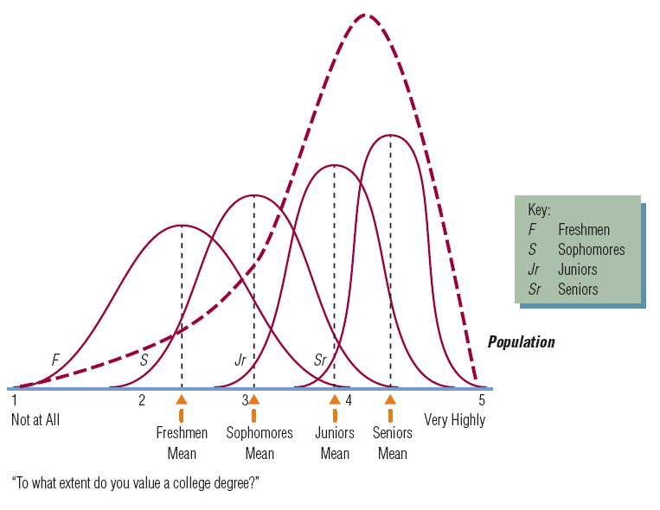
4-Stratified sampling: separates the population into different subgroups and then samples all of these subgroups.

Slide 23
Second; Nonprobability Sampling
With nonprobability sampling methods selection is not based on fairness, equity, or equal chance.
Types of nonprobability sampling ;
1-Convenience sampling
2-Purposive sampling
3-Referral sampling
4-Quota sampling

Slide 24
1-Convenience samples: samples drawn at the convenience of the interviewer.
Accordingly, the most convenience areas to researcher in terms of reduced time and effort turn out to be high-traffic areas, such as malls.
Convenience samples may misrepresent the population.
2-Purposive samples: requires a judgment or an “educated guess” as to who should represent the population.
-Focus group used it.

Slide 25
3-Referral samples: require respondents to provide the names of prospective respondents.
-Such as the sample begin when the researcher compiles the names of prospective respondents that is smaller than the total sample desires for the study, after each respondent is interviewed he or she is queried about the names of other possible respondents.( Rainbow company)

Slide 26
4-Quota samples: specified percentages of the total sample for various types of individuals to be interviewed.
-For example;
A researcher may desire the sample to be 50% males and 50% females.

Slide 27
Online Sampling Techniques
Three types of samples are used with online survey;
1-Online panels: large numbers of individuals who have agreed to participate in online surveys
2-River samples: created via the use of banners, pop-ups, or other online devices that invite website visitors to take part in the survey
3-E-mail list samples: purchased or otherwise procured from someone or some company that has compiled email addresses of opt-in members of the population of interest

Slide 28
Developing a sample plan
Which the researcher goes through to draw and ultimately arrive at final sample;(Steps in sample plane)
1- Define the population.
2-Obtain a sample frame.
3-Decide on the sample method.
4- Decide on the sample size.
5- Draw the sample.
6-Validate the sample; inspect some relevant characteristics of the sample to judge how well it matches the known distribution of these characteristics in the population.

