Slide 1
SQL
Chapter 8 & 9

Slide 2
Chapter - Objectives
Purpose and importance of SQL.
DDL:
Data types supported by SQL standard and Identifiers.
How to use CREATE and ALTER TABLE statements.
DML:
How to update database using INSERT, UPDATE, and DELETE.
How to retrieve data from database using SELECT.

Slide 3
Objectives of SQL
Ideally, database language should allow user to:
Create the database and relation structures;
Perform insertion, modification, deletion of data from relations;
Perform simple and complex queries.
SQL is a transform-oriented language with 2 major components:
A DDL for defining database structure.
A DML for retrieving and updating data.
Pearson Education © 2009

Slide 4
Writing SQL Commands
Most components of an SQL statement are case insensitive, except for literal character data.
Use extended form of BNF notation:
- Upper-case letters represent reserved words.
- Lower-case letters represent user-defined words.
- | indicates a choice among alternatives.
- Curly braces { } indicate a required element.
- Square brackets [ ] indicate an optional element.
- … indicates optional repetition (0 or more).
Pearson Education © 2009

Slide 5
Literals
Literals are constants used in SQL statements.
All non-numeric literals must be enclosed in single quotes. e.g. ‘London’
All numeric literals must not be enclosed in quotes e.g. 650.00
Pearson Education © 2009

Slide 6
1. Data Definition DDL
Pearson Education © 2009

Slide 7
Data Definition
SQL DDL allows database objects such as schemas, domains, tables, views, and indexes to be created and destroyed.
Main SQL DDL statements are:
CREATE SCHEMA DROP SCHEMA
CREATE DOMAIN DROP DOMAIN
CREATE/ALTER TABLE DROP TABLE
CREATE VIEW DROP VIEW
Many DBMSs also provide:
CREATE INDEX DROP INDEX

Slide 8
Identifiers
May contain A-Z, a-z, 0-9, _
No longer than 128 characters
Start with letter
Cannot contain spaces

Slide 9
Data Definition
Relations and other database objects exist in an environment.
Each environment contains one or more catalogs, and each catalog consists of set of schemas.
Schema is named collection of related database objects.
Objects in a schema can be tables, views, domains, assertions, collations, translations, and character sets. All have same owner.

Slide 10
1.1 CREATE SCHEMA
- Syntax:
CREATE SCHEMA[Name|AUTHORIZATION CreatorId ]
DROP SCHEMA Name [RESTRICT | CASCADE ]
With RESTRICT (default), schema must be empty or operation fails.
With CASCADE, operation cascades to drop all objects associated with schema in order defined above. If any of these operations fail, DROP SCHEMA fails.

Slide 11
1.2. CREATE TABLE
- Syntax:
CREATE TABLE TableName
{(colName dataType [NOT NULL] [UNIQUE]
[DEFAULT defaultOption]
[CHECK searchCondition] [,...]}
[PRIMARY KEY (listOfColumns),]
{[UNIQUE (listOfColumns),] […,]}
{[FOREIGN KEY (listOfFKColumns)
REFERENCES ParentTableName [(listOfCKColumns)],
[ON UPDATE referentialAction]
[ON DELETE referentialAction ]] [,…]}
{[CHECK (searchCondition)] [,…] })

Slide 12
1.2. CREATE TABLE
Creates a table with one or more columns of the specified dataType.
With NOT NULL, system rejects any attempt to insert a null in the column.
Can specify a DEFAULT value for the column.
Primary keys should always be specified as NOT NULL.
FOREIGN KEY clause specifies FK along with the referential action.

Slide 13
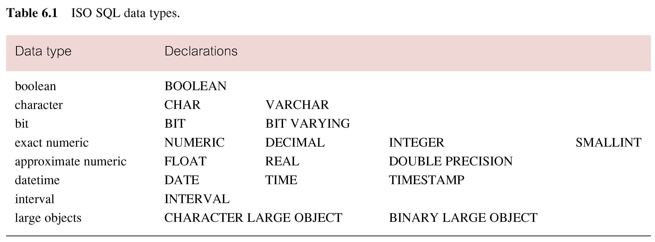
ISO SQL Data Types
Pearson Education © 2009

Slide 14
Example 7.1 - CREATE TABLE
PropertyForRent(propertyNo , rooms , rent , ownerNo , staffNo , branchNo )
CREATE TABLE PropertyForRent (
propertyNo VARCHAR(5) NOT NULL,
Rooms SMALLINT NOT NULL DEFAULT 4 CHECK(VALUE BETWEEN 1 AND 15),
Rent DECIMAL(6,2) NOT NULL DEFAULT 600,
ownerNo VARCHAR(5) NOT NULL,
staffNo VARCHAR(5) ,
branchNo VARCHAR(4) NOT NULL,
PRIMARY KEY (propertyNo),
FOREIGN KEY (staffNo) REFERENCES Staff );

Slide 15
1.3. ALTER TABLE
Alter table statement is used with existing table to :
Add a new table constraint .
Drop a table constraint.
Add a new column to a table.
Drop a column from a table.
Set a default for a column.
Drop a default for a column.

Slide 16
1.3. ALTER TABLE
- Syntax
ALTER TABLE tablename
[ADD [COLUMN] ColumnName dataType [NOT NULL] [UNIQUE]
[DEFAULT defaultOption] [CHECK (search condition)] ]
[DROP[COLUMN] ColumnName [RESTRICT | CASCADE]]
[ADD [CONSTRAINT [Constraint Name]] TableConstraint Definition]
[DROP CONSTRAINT ConstraintName [RESTRICT | CASCADE]]
[ALTER ColumnName SET DEFAULT DefaultOption]
[ALTER ColumnName DROP DEFAULT]

Slide 17
1.3. ALTER TABLE
Add new column to Client table.
ALTER TABLE Client
ADD prefNoRooms PRooms;
Remove the city attribute from the client table.
ALTER TABLE Client
Drop City;

Slide 18
1.4. DROP TABLE
- Syntax:
DROP TABLE TableName [RESTRICT | CASCADE]
- Example:
DROP TABLE PropertyForRent;
Removes named table and all rows within it.
With RESTRICT, if any other objects depend for their existence on continued existence of this table, SQL does not allow request.
With CASCADE, SQL drops all dependent objects (and objects dependent on these objects).

Slide 19
2. Data Manipulation DML
Chapter #6 in the textbook
Pearson Education © 2009

Slide 20
2.1. INSERT
INSERT INTO TableName [ (columnList) ]
VALUES (dataValueList)
columnList is optional; if omitted, SQL assumes a list of all columns in their original CREATE TABLE order.
Any columns omitted must have been declared as NULL when table was created, unless DEFAULT was specified when creating column.
Pearson Education © 2009

Slide 21
2.1. INSERT
dataValueList must match columnList as follows:
number of items in each list must be same;
must be direct correspondence in position of items in two lists;
data type of each item in dataValueList must be compatible with data type of corresponding column.
Pearson Education © 2009

Slide 22
Example 6.35 INSERT … VALUES
STAFF(sno, fname, lname, position, sex, DOB, salary, bno)
Insert a new row into Staff table supplying data for all columns.
INSERT INTO Staff
VALUES (‘SG16’, ‘Alan’, ‘Brown’, ‘Assistant’, ‘M’, Date‘1957-05-25’, 8300, ‘B003’);
Pearson Education © 2009

Slide 23
Example 6.36 INSERT using Defaults
STAFF(sno, fname, lname, position, sex, DOB, salary, bno)
Insert a new row into Staff table supplying data for all mandatory columns.
INSERT INTO Staff (staffNo, fName, lName,
position, salary, branchNo)
VALUES (‘SG44’, ‘Anne’, ‘Jones’,
‘Assistant’, 8100, ‘B003’);
Or
INSERT INTO Staff
VALUES (‘SG44’, ‘Anne’, ‘Jones’, ‘Assistant’, NULL,
NULL, 8100, ‘B003’);
Pearson Education © 2009

Slide 24
2.2. UPDATE
UPDATE TableName
SET columnName1 = dataValue1
[, columnName2 = dataValue2...]
[WHERE searchCondition]
TableName can be name of a base table or an updatable view.
SET clause specifies names of one or more columns that are to be updated.
Pearson Education © 2009

Slide 25
2.2. UPDATE
WHERE clause is optional:
if omitted, named columns are updated for all rows in table;
if specified, only those rows that satisfy searchCondition are updated.
New dataValue(s) must be compatible with data type for corresponding column.
Pearson Education © 2009

Slide 26
Example 6.38/39 UPDATE All Rows
Give all staff a 3% pay increase.
UPDATE Staff
SET salary = salary*1.03;
Give all Managers a 5% pay increase.
UPDATE Staff
SET salary = salary*1.05
WHERE position = ‘Manager’;
Pearson Education © 2009

Slide 27
Example 6.40 UPDATE Multiple Columns
Promote David Ford (staffNo=‘SG14’) to Manager and change his salary to £18,000.
UPDATE Staff
SET position = ‘Manager’, salary = 18000
WHERE staffNo = ‘SG14’;
Pearson Education © 2009

Slide 28
2.3. DELETE
DELETE FROM TableName
[WHERE searchCondition]
TableName can be name of a base table or an updatable view.
searchCondition is optional; if omitted, all rows are deleted from table. This does not delete table.
If search_condition is specified, only those rows that satisfy condition are deleted.
Pearson Education © 2009

Slide 29
Example 6.41/42 DELETE Specific Rows
Delete all viewings that relate to property PG4.
DELETE FROM Viewing
WHERE propertyNo = ‘PG4’;
Delete all records from the Viewing table.
DELETE FROM Viewing;
Pearson Education © 2009

Slide 30
2.4. SELECT
SELECT [DISTINCT | ALL]
{* | [columnExpression [AS newName]] [,...] }
FROM TableName [alias] [, ...]
[WHERE condition]
[GROUP BY columnList] [HAVING condition]
[ORDER BY columnList]
FROM Specifies table(s) to be used.
WHERE Filters rows.
GROUP BY Forms groups of rows with same column value.
HAVING Filters groups subject to some condition.
SELECT Specifies which columns are to appear in output.
ORDER BY Specifies the order of the output.
Order of the clauses cannot be changed.
Only SELECT and FROM are mandatory
Pearson Education © 2009

Slide 31
Example 6.1 All Columns, All Rows
List full details of all staff.
SELECT staffNo, fName, lName, address,
position, sex, DOB, salary, branchNo
FROM Staff;
Can use * as an abbreviation for ‘all columns’:
SELECT *
FROM Staff;
Pearson Education © 2009

Slide 32
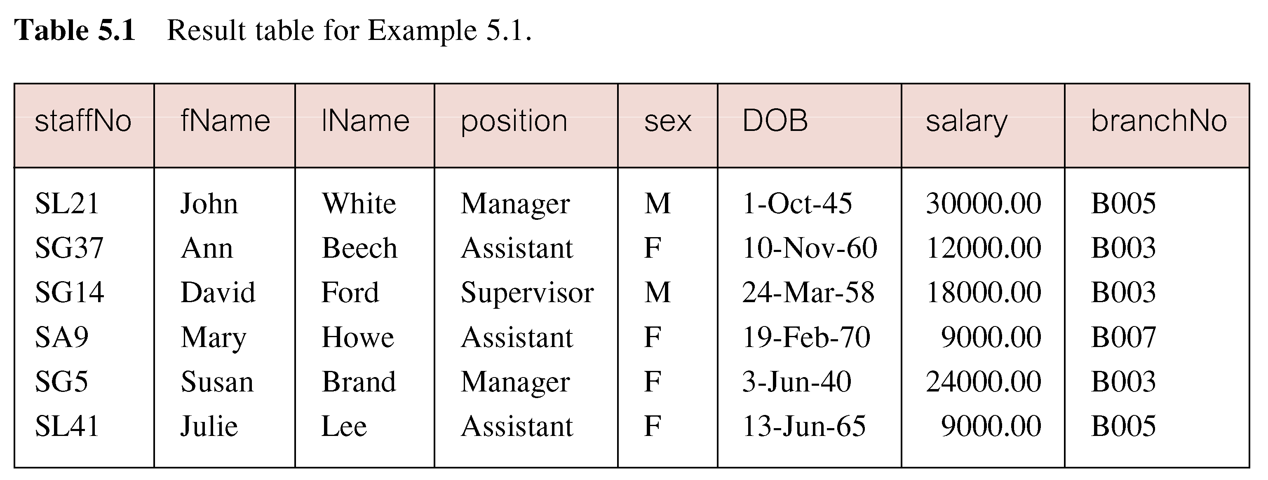
Example 6.1 All Columns, All Rows
Pearson Education © 2009

Slide 33
Example 6.2 Specific Columns, All Rows
Produce a list of salaries for all staff, showing only staff number, first and last names, and salary.
SELECT staffNo, fName, lName, salary
FROM Staff;
Pearson Education © 2009

Slide 34
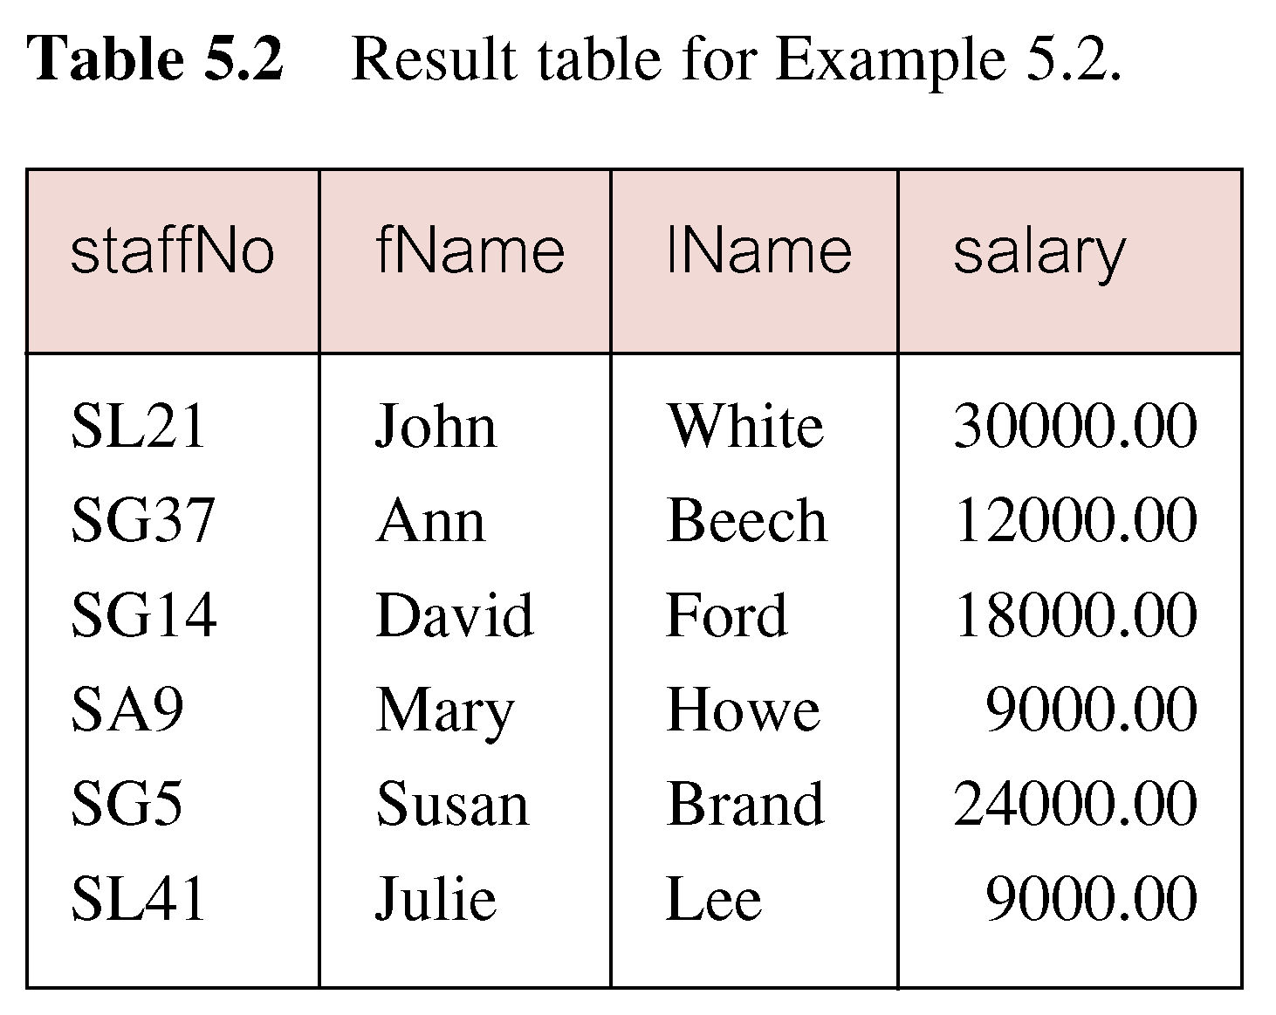
Example 6.2 Specific Columns, All Rows
Pearson Education © 2009

Slide 35
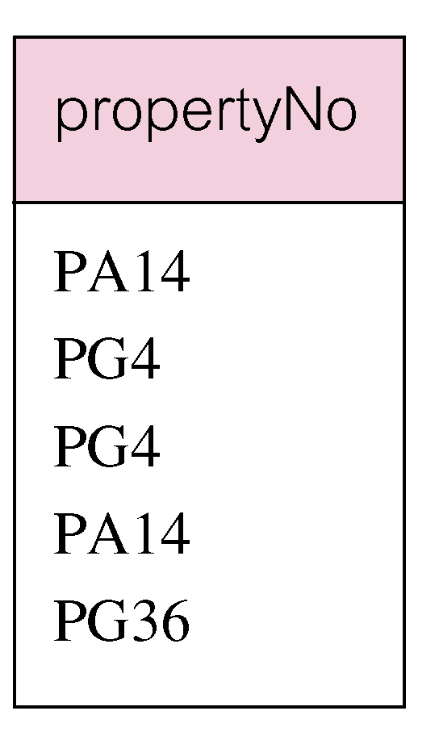
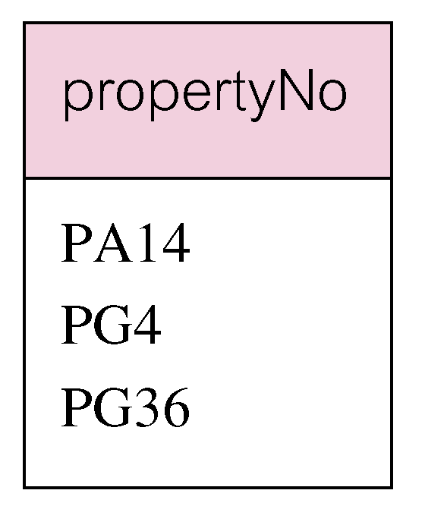
Example 6.3 Use of DISTINCT
Use DISTINCT to eliminate duplicates:
SELECT DISTINCT propertyNo
FROM Viewing;
Pearson Education © 2009

Slide 36
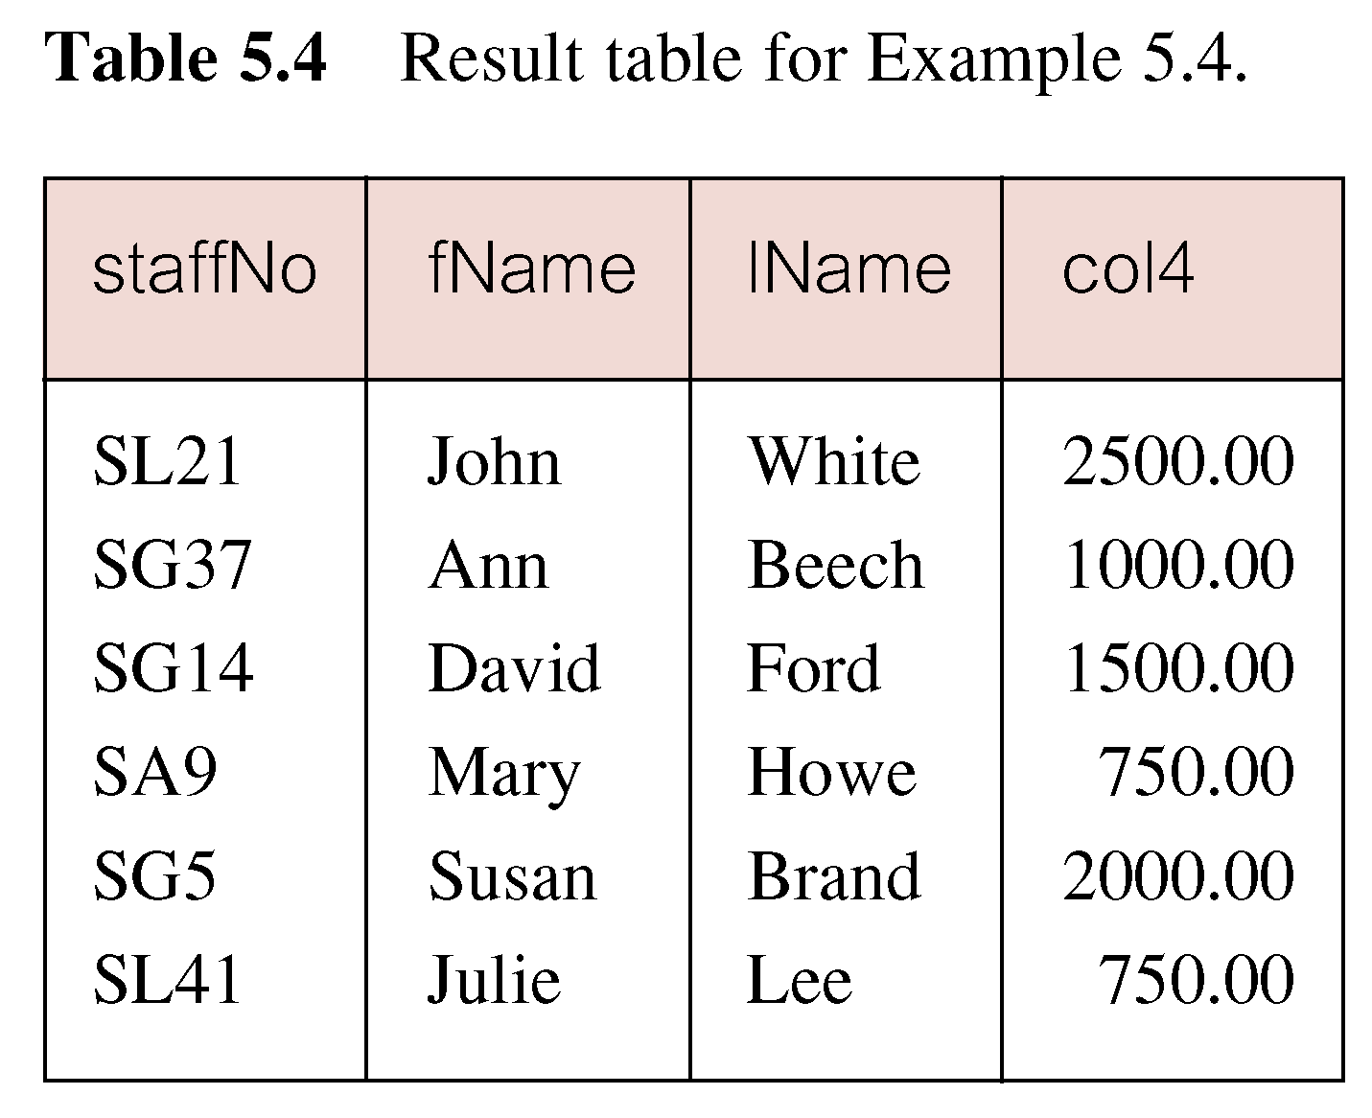
Example 6.4 Calculated Fields
Produce list of monthly salaries for all staff, showing staff number, first/last name, and salary.
SELECT staffNo, fName, lName, salary/12
FROM Staff;
Pearson Education © 2009

Slide 37
Example 6.4 Calculated Fields
To name column, use AS clause:
SELECT staffNo, fName, lName, salary/12
AS monthlySalary
FROM Staff;
The SQL expression in the SELECT list can specify a derived or calculated field.
Columns referenced in the arithmetic expression must have a numeric type.
SQL expression can involve + , - , * , / , ( , ).
Pearson Education © 2009

Slide 38
Row Selection (WHERE clause)
WHERE clause consists of five basic search conditions:
Comparison: Compare the value of one expression to the value of another expression (= , <, >, <=, >=, < >).
Range: Test whether the value of an expression falls within a specified range of values (BETWEEN/ NOT BETWEEN).
Set membership: Test whether the value of an expression equals one of a set of values (IN/ NOT IN).
Pattern match: Test whether a string matches a specified pattern (LIKE/ NOT LIKE).
NULL: Test whether a column has null value (IS NULL/ IS NOT NULL).

Slide 39
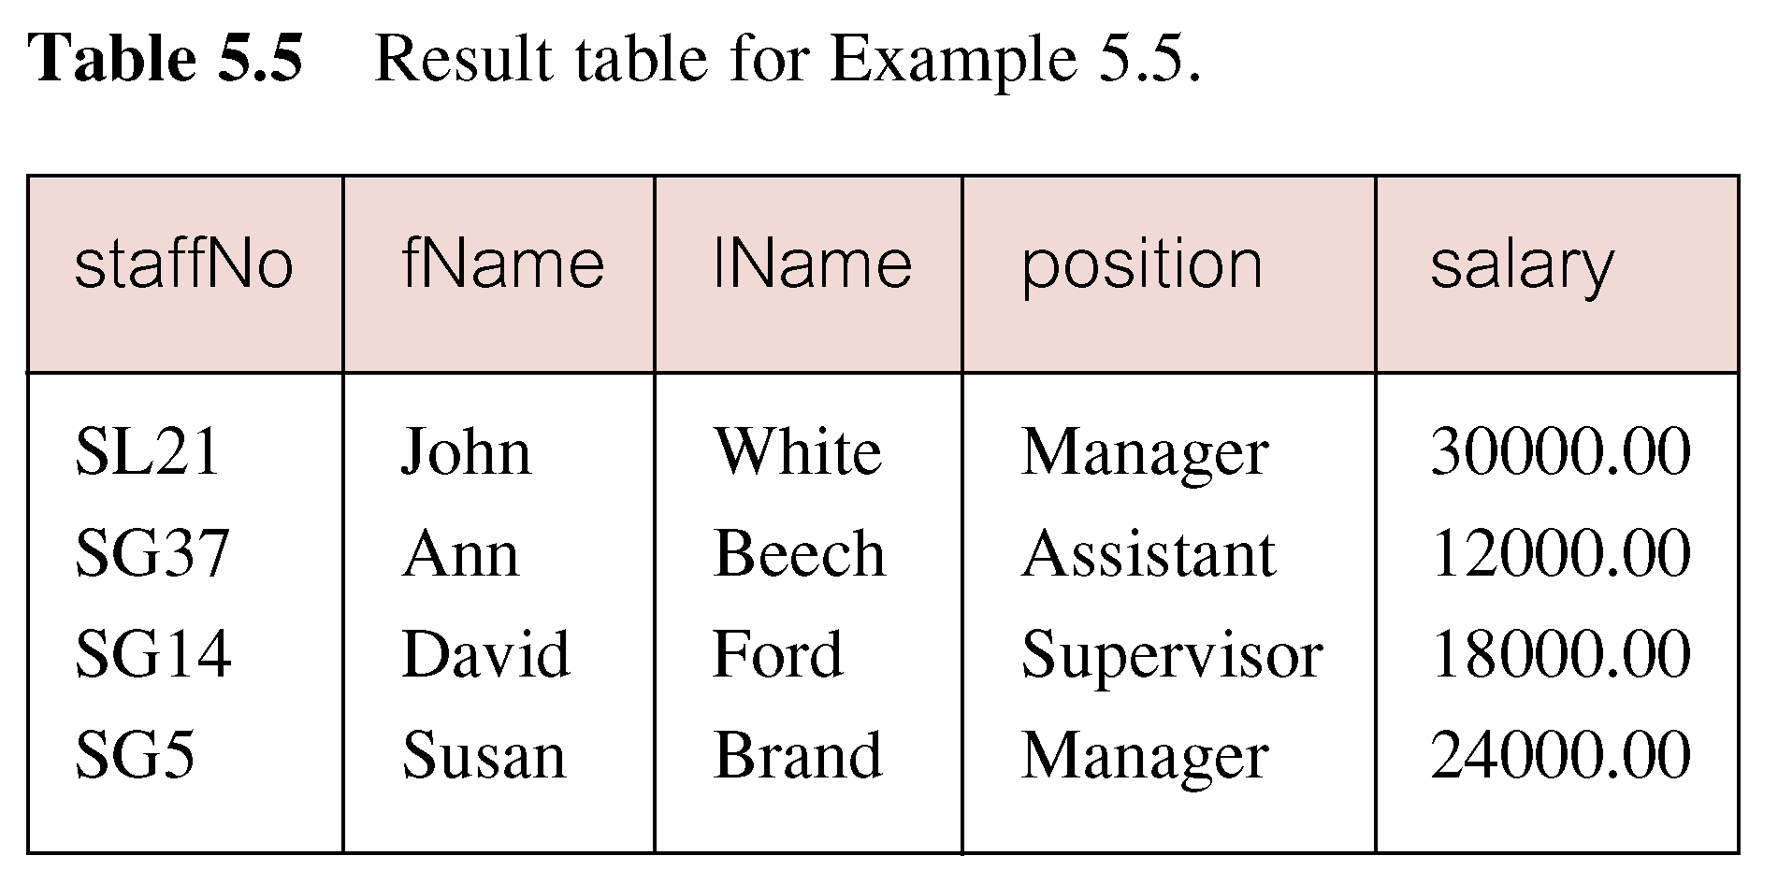
Example 6.5 Comparison Search Condition
Compound comparison operators: AND, OR, NOT, ( )
Order of evaluation: (1)Expression is evaluated left to right (2)Between brackets (3)NOT (4)AND (5)OR
List all staff with a salary greater than 10,000.
SELECT staffNo, fName, lName, position, salary
FROM Staff
WHERE salary > 10000;
Pearson Education © 2009

Slide 40
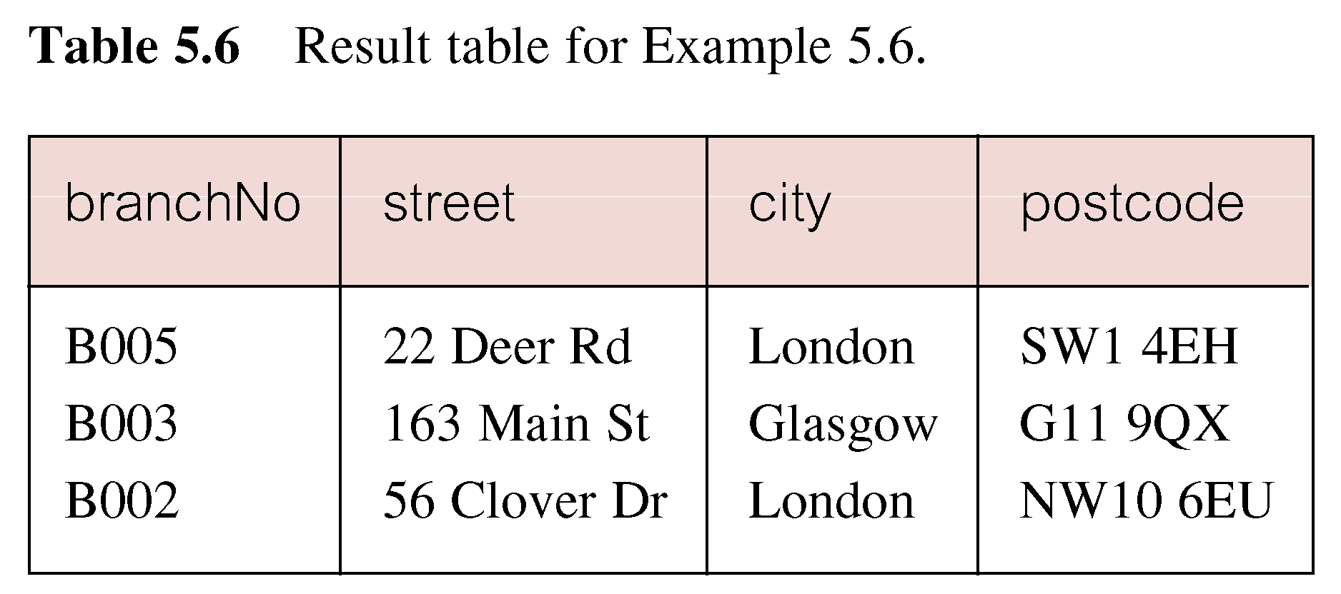
Example 6.6 Compound Comparison Search Condition
List addresses of all branch offices in London or Glasgow.
Branch (branchNo, street , city, postcode)
SELECT *
FROM Branch
WHERE city = ‘London’ OR city = ‘Glasgow’;
Pearson Education © 2009

Slide 41
Example 6.7 Range Search Condition
List all staff with a salary between 20,000 and 30,000.
SELECT staffNo, fName, lName, position, salary
FROM Staff
WHERE salary BETWEEN 20000 AND 30000;
BETWEEN test includes the endpoints of range.
Pearson Education © 2009

Slide 42
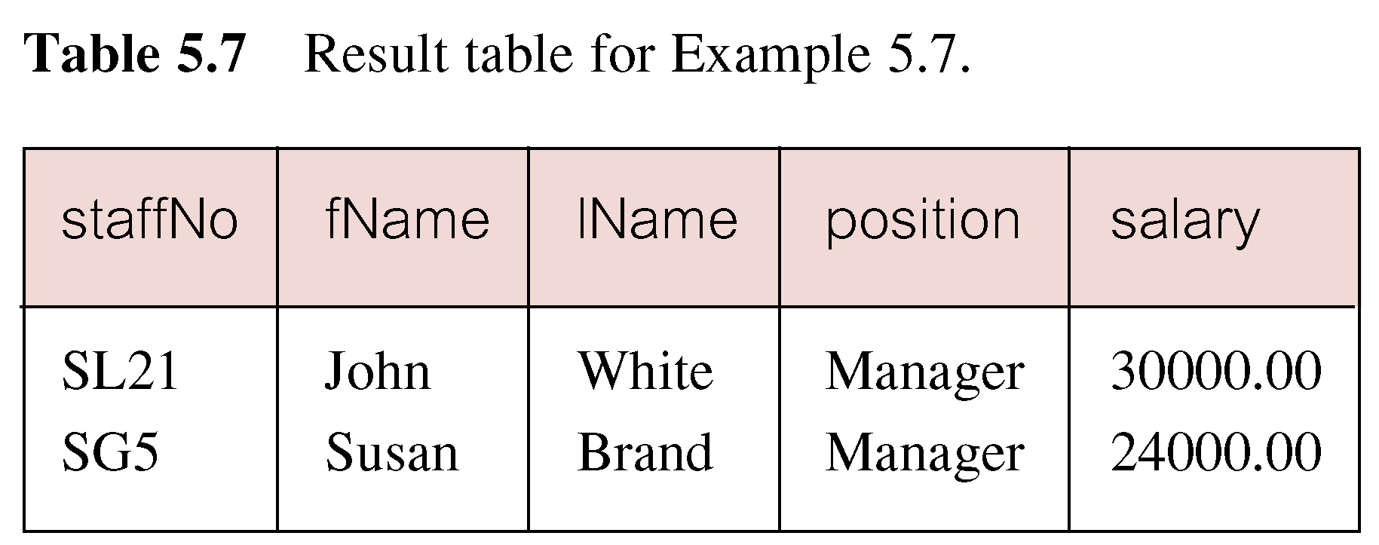
Example 6.7 Range Search Condition
Pearson Education © 2009

Slide 43
Example 6.7 Range Search Condition
Also a negated version NOT BETWEEN.
BETWEEN does not add much to SQL’s expressive power. Could also write:
SELECT staffNo, fName, lName, position, salary
FROM Staff
WHERE salary>=20000 AND salary <= 30000;
Useful, though, for a range of values.
Pearson Education © 2009

Slide 44
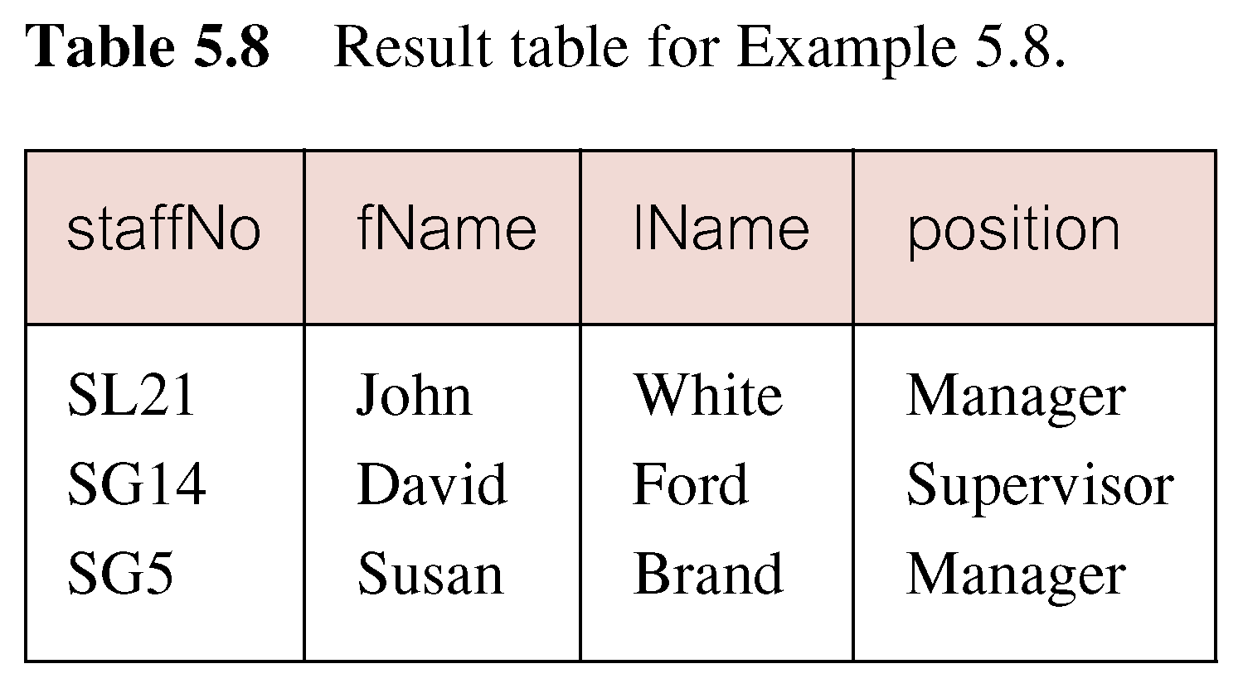
Example 6.8 Set Membership
List all managers and supervisors.
SELECT staffNo, fName, lName, position
FROM Staff
WHERE position IN (‘Manager’, ‘Supervisor’);
Pearson Education © 2009

Slide 45
Example 6.8 Set Membership
There is a negated version (NOT IN).
IN does not add much to SQL’s expressive power. Could have expressed this as:
SELECT staffNo, fName, lName, position
FROM Staff
WHERE position=‘Manager’ OR
position=‘Supervisor’;
IN is more efficient when set contains many values.
Pearson Education © 2009

Slide 46
Example 6.9 Pattern Matching
Find all owners with the string ‘Glasgow’ in their address.
SELECT ownerNo, fName, lName, address, telNo
FROM PrivateOwner
WHERE address LIKE ‘%Glasgow%’;
Pearson Education © 2009

Slide 47
Example 6.9 Pattern Matching
SQL has two special pattern matching symbols:
%: sequence of zero or more characters
_ (underscore): any single character.
LIKE ‘%Glasgow%’ means a sequence of characters of any length containing ‘Glasgow’.
Pearson Education © 2009

Slide 48
Example 6.10 NULL Search Condition
List details of all viewings on property PG4 where a comment has not been supplied.
Viewing (PropertyNo, RenterNo, DateViewed, Comments)
There are 2 viewings for property PG4, one with and one without a comment.
Have to test for null explicitly using special keyword IS NULL:
SELECT clientNo, viewDate
FROM Viewing
WHERE propertyNo = ‘PG4’ AND
comment IS NULL;
Pearson Education © 2009

Slide 49
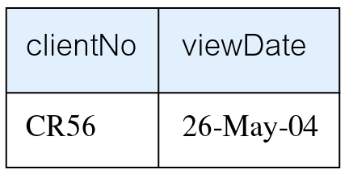
Example 6.10 NULL Search Condition
Negated version (IS NOT NULL) can test for non-null values.
Pearson Education © 2009

Slide 50
Example 6.11 Single Column Ordering
Order by: allow the retrieved records to be ordered in ascending (ASC) or descending order (DESC) on any column or combination of columns.
List salaries for all staff, arranged in descending order of salary.
SELECT staffNo, fName, lName, salary
FROM Staff
ORDER BY salary DESC;
Pearson Education © 2009

Slide 51
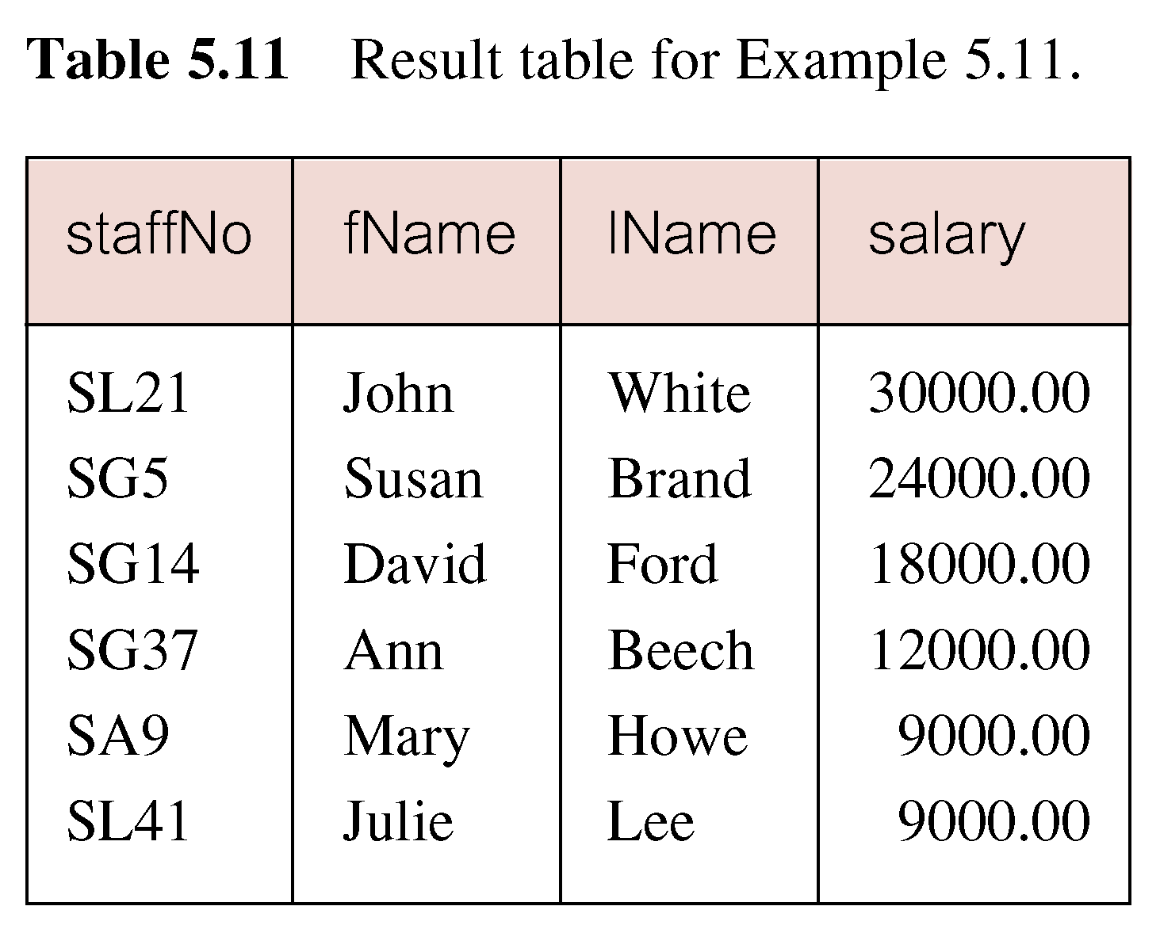
Example 6.11 Single Column Ordering
Pearson Education © 2009

