Slide 1
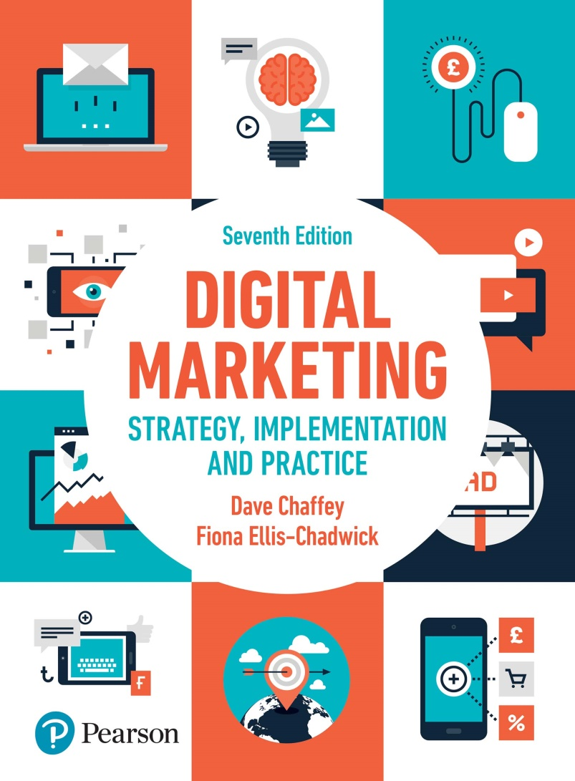
DIGITAL MARKETING STRATEGY, IMPLEMENTATION AND PRACTICE Seventh Edition
Part 3
Digital marketing: implementation and practice
Chapter 8
Campaign planning for digital media

Slide 2
Chapter 8 Campaign planning for digital media
Main topics
The characteristics of digital media
Goal setting
Campaign insight
Segmentation and targeting
Offer, message development and creative
Budgeting
Integrations
Case study: Facebook – a Titan of the digital age

Slide 3
The characteristics of digital media
From push to pull
Interactive dialogues
From one-to many to one-to -some and one-to-one
From one-to many to many-to-many communications
From lean back to lean forward
Medium changes, advertising standards
Increase in communications
Integration
Timing of campaign
Notes:
Figure 8.7 Alternative response mechanisms for a business-to-business landing page example

Slide 4
Figure 8.1 The differences between one-to-many and one-to-one communication using the Internet [organisation (O) communicating a message (M) to customers (C)]

Slide 5
Figure 8.2 The communication model of Schramm (1955) applied to the internet

Slide 6
Step1: Goal setting
Terminology for measuring digital campaigns
Notes:
Figure 8.3 Measures used for setting campaign objectives or assessing campaign success, increasing in sophistication from bottom to top

Slide 7
Figure 8.4 An example of the effectiveness measures for an online ad campaign

Slide 8
Figure 8.5 Conversion marketing approach to objective setting for web communications

Slide 9
Campaign response mechanism
Online response mechanism
Notes:
Figure 8.6 Range of response mechanisms from online media

Slide 10
Step 2 Campaign insight
Customer insight for digital marketing campaigns
Site audience
Online buying behaviour
Customer media consumption
Customer search behaviour
Competitor campaign activity
Competitor performance

Slide 11
Step 3 Segmentation and targeting
Targeting variable | Examples of online targeting attributes
1 Relationship with company | New contacts (prospects who haven’t purchased), ‘nursery’ (new customers), existing customers, lapsed customers
2 Demographic segmentation | B2C: age, gender, social group, geographic location B2B: company size, industry served, individual members of decision-making unit
3 Psychographic of attitudinal segmentation | Attitudes to risk and value when buying, e.g. early adopter, brand loyal or price conscious
4 Value | Assessment of current or historical value and future value
5 Lifecycle stage | Position in lifecycle, related to value and behaviour, i.e. time since initial registration, number of products purchased, categories purchased in
6 Behaviour | Search term entered into search engine; interaction with content in websites or emails; responsiveness to different types of offers (promotion or product type); responsiveness to campaigns in different channels (channel preference); purchase history in product categories including recency, frequency and monetary value (Chapter 6)
Notes:
Table 8.2 A range of targeting and segmentation approaches for a digital campaign

Slide 12
Step 4 Offer message development and creative
Content marketing
Source : SmartInsights.com (with permission)
Notes:
Figure 8.8 The Content Distribution Matrix

Slide 13
Activity
Review a company’s use of different types of content support marketing
Source: SmartInsights.com (with permission)
Notes:
Figure 8.9 The Content Marketing Matrix

Slide 14
Set 5 Budgeting and selecting the digital media mix
Level of investment
Selecting the right mix of digital media
Level of investment in digital assets

Slide 15
Figure 8.10 Options for the online vs offline communications mix: (a) online>offline, (b) similar online and offline, (c) offline>online

Slide 16
Figure 8.11 Recommendations of the mix of investment in digital media for direct and brand response campaigns
Source: Zenith Media (www.zenithmedia.com)

Slide 17
Figure 8.12 Examples of different referrers contributing to a sale for a car rental company

Slide 18
Figure 8.13 Example of different referrers contributing to a social media campaign

Slide 19
Figure 8.14 Examples of the referring mix for an airline
Source: Lee (2010)

Slide 20
Levels of investments in digital assets
Source : www.smartinsights.com/conversion-model-spreadsheets
Notes:
Figure 8.16 Spreadsheet template for digital campaign budgeting

Slide 21
Step 6 Integration into overall media schedule or plan
Key activities:
Branding and messaging
Varying the offer
Frequency and interval of communications
Sequencing of communications
Optimising timing

Slide 22
Figure 8.17 Integration of different communication tools through time

Slide 23
Case study Facebook – a Titan of the digital age
Questions:
As an investor in a social network such as Facebook, which financial and customer-related metrics would you use to assess and benchmark the current business success and future growth?
Complete a situation analysis for Facebook focusing in an assessment of the main business risks that could damage the future growth potential of the social network
Imaging you are Facebook’s marketing director. Suggest a marketing strategy for the next 18 months based on your answers to question 2.

