Slide 1
Stock Valuation
Ch8

Slide 2
Features of Common and Proffered Stocks
First: Common Stock
Definition: Equity with no priority in dividend or in bankruptcy.
Stockholder rights:
1. Voting right:
Shareholders control the corporation through the right to elect directors.
Shareholders elect board of directors who in turn hire managers to run the company.
Directors are elected each year at an annual meeting.
The general idea of voting is: “one share, one vote”, the golden rule (as much stocks you have, as much as you have a power in electing the board)
The mechanism for electing directors is either:
A. Straight Voting
B. Cumulative Voting

Slide 3
1. VOTING RIGHT (Straight voting)
Straight Voting:
Example: If you have 500 shares and the number of board of directors to be elected is 4 members, then you will make 4 meetings to elect. Each one of these meetings you cannot vote with more than 500 votes for yourself or for someone else.
A procedure in which a shareholder may cast all votes for each member of the board of directors.
directors are electing one at a time.
You guarantee a seat if you own 50% + 1 Share of stock.

Slide 4
1. VOTING RIGHT (cumulative voting)
Cumulative voting:
A procedure in which a shareholder may cast all votes for one member of the board of directors
In cumulative voting, shareholders just make one meeting to elect the board of directors. And its calculated as:
The cumulative voting permits minority participation.
Calculated as: the number of shares * the number of directors elected (N).
1/ (N+1) % of the stocks + 1 share of stock, will guarantee you a seat in the board.

Slide 5
Voting Right
Straight voting prevent minority shareholders from having a chance in electing themselves and that’s why its preferred in some countries.
However, When cumulative voting is mandatory in some states or countries, one way to minimize its impact is through Staggering.
A staggered election means that only a fraction of directors are to be elected in a particular time.
Example : at a specific time, only two members of the board are to be elected, which means it will take a shareholders 1/(2+1)= 33.3% to guarantee a seat in the board. This process result in:
Making it more difficult for minority to elect directors because there are fewer directors to be elected.

Slide 6
Example
Stock in JRJ corporation sells for $20 per share and features cumulative voting. There are $10,000 shares outstanding. If three directors are up for elections, how much does it cost to ensure yourself a seat on the board?
The question here is how many shares of stock it will take to get a seat.
To guarantee a seat in the board: 1/ 3+1 = ¼ % of stocks + one stock.
The answer is 2,501 shares will guarantee you a seat in the board.
So the cost will be 2,501 *$20 = $50,020.
Why is that? Because there is no way that the remaining (7,499) votes can be divided among three people to give all of them more than 2,501 votes.

Slide 7
Voting Right
Proxy voting the grant of authority by a shareholder to someone else to vote his or her shares.
Classes of Stock each class has unequal voting right. Ex. Google: google has two classes of common stock. Class A shares and class B shares.
Class A shares are held by the public and each share has one vote. Class B shares are held by company’s insiders, and each class B shares has 10 votes.
( the purpose of classes of stock is to control the firm)

Slide 8
Common stockholders rights
Other shareholders rights (other than voting):
The right to share dividends paid.
The right to share assets remaining after liabilities have been paid in liquidation.
The right to vote in making big decisions.
The preemptive right: the company that wants to sell stocks, it must offer it first to the existing shareholders before offering it to general public to protect their proportionate ownership in the corporation.

Slide 9
Dividends
Dividends
Payments by a corporation to shareholders, made in either cash or stock.
Characteristics of dividends:
Unless the board declares the dividend, it is not a liability of corporation.
The payment of the dividends is not a business expense so it is not deductible for corporate tax purposes.
Dividends received by shareholders are taxable.

Slide 10
Proffered stock : Stocks with dividends priority over common stock, normally with a fixed dividend rate, sometimes without voting rights. (has a stated value: usually $100)
It differs from common stock because it has preference over common stock in the payment of dividends and in the distribution of corporation assets in the event of liquidation.
Cumulative and noncumulative dividends:
Dividends payable on proffered stock are either cumulative or noncumulative.
If they are cumulative, they will be carried forward as an arrearage.
Holders of proffered stock are often granted voting and other rights if proffered dividend have not been paid for sometime.

Slide 11
Common Stock Valuation
Example: you are considering buying a share of stock today. You plan to sell the stock in one year. You somehow know that the stock will be worth $70 at that time. You predict that the stock will also pay a $10 per share dividend at the end of the year. If you require a 25 percent return on your investment, what is the most you would pay for the stock? In other words, what is the present value of the $10 dividend along with the $70 ending value at 25 percent?
If you buy the stock today and sell it at the end of the year, you will have a total of $80 in cash. At 25 percent:
Present value=($10+70)/1.25=$64
P0=(D1+P1)/(1+R)
Where P0 is the price of the stock today and P1 is the price of the stock in one year and R is the required return

Slide 12
The price today of a share of stock P0 is the present value of all of its future dividends
P0=[D1/(1+R)]+[D2/(1+R)²]+[D3/(1+R)³]+[D3/(1+R)³]+[D4/(1+R)⁴……
The three cases we consider are the following:
(1) The dividend has a zero growth rate,
(2) the dividend grows at a constant rate, and
(3) the dividend grows at a constant rate after
some length of time.

Slide 13
Some Special Cases
1. zero growth
D1=D2=D3=D4 = CONSTANT
Because the dividend is always the same, the stock can be viewed as ordinary perpetuity with a cash flow equal to D every period.
The value of the stock in this case: P0= D/R, where R is the required return.
Example: Suppose a company has a policy of paying a $10 per share dividend every year. If the policy is to be continued indefinitely, what is the value of the stock if the required return is 20%?
The stock is worth $10/0.20 = $50 per share.

Slide 14
Some Special Cases
2. Constant Growth
Suppose we know that the dividend for some company always grows at a steady rate (g) if we let (D0) be the dividend just paid, then the next dividend with be
D1= D0 (1+g)
As a rule :
or Dt = D1 * (1+g) ^{t-1}
as we have seen before with cash flows that grows at a constant rate forever is called a growing perpetuity.
Dt = D0 *(1+g) ^{t}

Slide 15
Constant Growth
Example:
The Hedless Corporation has just paid a dividend of $4 per share. The dividend of this company grows at a steady rate of 8% per year. Based on this information, what will the dividend be in five years?
Here we have a $3 current amount that grows at 8% per year for five years. The future amount is:
$3 * (1.08) ⁵ = $4.41.
The dividend will increase by $1.41 over the coming five years.

Slide 16
As long as the growth rate g is less than the discount rate r, the the present value of future cash flow or the value of the stock will be:
Po = Do * (1+g) / R-g = D1/R-g
And we call that the dividend growth model
Pt = Dt * (1+g) / R-g = Dt+1/R-g
Example: Suppose Do= $2.30, R is 13% and g is 5% then the price:
Po = Do * (1+g)/(r-g)
= $2.30 * 1.05/ (0.13-0.05)
= $30.19

Slide 17
Within the same example, suppose we are interested in the price of the stock in five years p5?
To find it, we need to find the dividend in year 5 D5:
D5 = $2.30 * (1.05) ⁵ = $2.935
Then from the dividend growth model we get the price of the stock in five years:
P5= D5 * (1+g)/R-g = $2.935 * 1.05/ 0.13-0.05 = $38.53

Slide 18
Example : The next dividend for the Gordon Growth Company will be $4 per share. Investors require a 16 percent return on such companies. The dividend increases by 6% every year. Based on the dividend growth model, what is the value of the stock today? What is the value of the stock in four years?
The tricky part here is that we are given D1 not Do so we wont multiply $4 by (1+g). The price per share is:
Po = D1/(R-g)
= $4/ (0.26-0.06)
= $ 40

Slide 19
Continue the Example
The value of the stock in four years?
We need to find D4
D4 = D1 (1+g) ³ = $4 *(1.06) ³ = $4.764
The price in four years using the dividend growth model:
P4= D4 * (1+g) /r-g
= $4.764 *1.06 (0.16- 0.06)
= $50.50
Or by finding the future value of po
P4 = p0 *(1+r) ^{t} = 50 * (1.06) ⁴ = $50.50

Slide 20
Non Constant Growth
Example: company that is currently not paying dividends, you predict that , in five years, the company will pay a dividend for the first time. The dividend will be $0.50 per share. You then expect that the dividend will grow at a rate of 10% per year indefinitely. The required return on companies such as this one is 20%. What is the price of the stock today?
We first need to know what will be the value of the stock when the company starts to pay dividend then find the present value of that to get the value of the stock today.
The company starts paying dividend at D5
So we can find P4= D4 (1+g)/R-g
= D5 /r-g
= $0.5/ (0.20-0.10)
= $5

Slide 21
so the stock will worth $5 in four years.
Then p0 or the value today = $5/1.20 ⁴ = $2.41.
What if the dividend is not zero in the first few years???

Slide 22
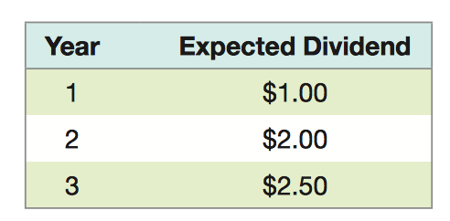
Example: suppose you have come up with the following dividend forecasts for the next three years:
After the third year, the dividend will grow at a constant rate of 5 percent per year. The required return is 10 percent. What is the value of the stock today?
for this problem, constant growth starts at time 3. This means we can use our constant growth model to determine the stock price at time 3, P3. By far the most common mistake in this situation is to incorrectly identify the start of the constant growth phase and, as a result, calculate the future stock price at the wrong time.

Slide 23
To calculate this present value, we first have to compute the present value of the stock price three years, then have to add in the present value of the
dividends that will be paid between now and then. So, the price in three years is:
P3= 􏰀D3 􏰃(1+􏰁g)􏰑/(R-􏰂g) 􏰀= $2.50 􏰃( 1.05􏰑)/(.10 =􏰂 .05)= 􏰀 $52.50

Slide 24
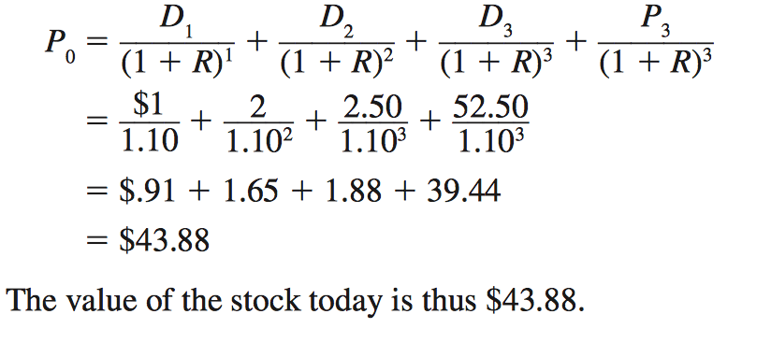
We can now calculate the total value of the stock as the present value of the first three dividends plus the present value of the price at time 3, P3:

Slide 25
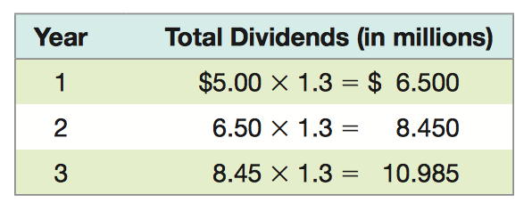
Example
Chain Reaction, Inc., has been growing at a phenomenal rate of 30 percent per year because of its rapid expansion and explosive sales. You believe this growth rate will last for three more years and will then drop to 10 percent per year. If the growth rate then remains at 10 percent indefinitely, what is the total value of the stock? Total dividends just paid were $5 million, and the required return is 20 percent.
To value the equity in this company, we first need to calculate the total dividends over the supernormal growth period:

Slide 26
The price at time 3 can be calculated as:
P3= 􏰀D3 􏰃(1􏰁+g)􏰑/(R-􏰂g)
where g is the long-run growth rate. So, we have:
P3 􏰀 $10.985 * 􏰃 1.10􏰑/(.20 -􏰂.10)= 􏰀 $120.835

Slide 27
Two stage growth
the idea is that the dividend will grow at a rate of g1 for t years and then grow at a rate of g2 thereafter forever.
Or for any price:

Slide 28
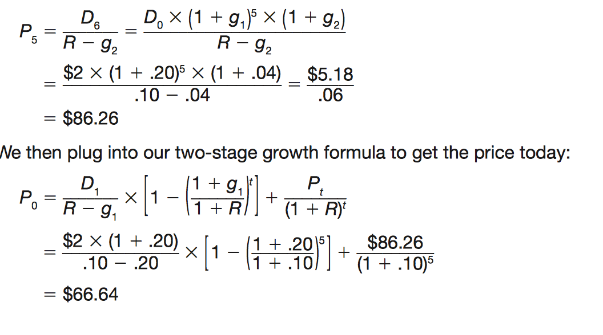
Example
The Highfield Company’s dividend is expected to grow at 20 percent for the next five years. After that, the growth is expected to be 4 percent forever. If the required return is 10 per- cent, what’s the value of the stock?
The dividend just paid was $2. the stock price five years from now, P5:

Slide 29
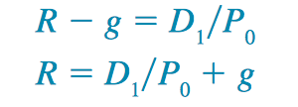
COMPONENTS OF THE REQUIRED RETURN
Earlier, we calculated P0 as:
P0= 􏰀 D1􏰑/(R 􏰂 g) If we rearrange this to solve for R, we get:
This tells us that the total return, R, has two components.
The first of these, D1􏰑P0, is called the dividend yield.
The second part is also the rate at which the stock price grows or we call it capital gains yield

Slide 30
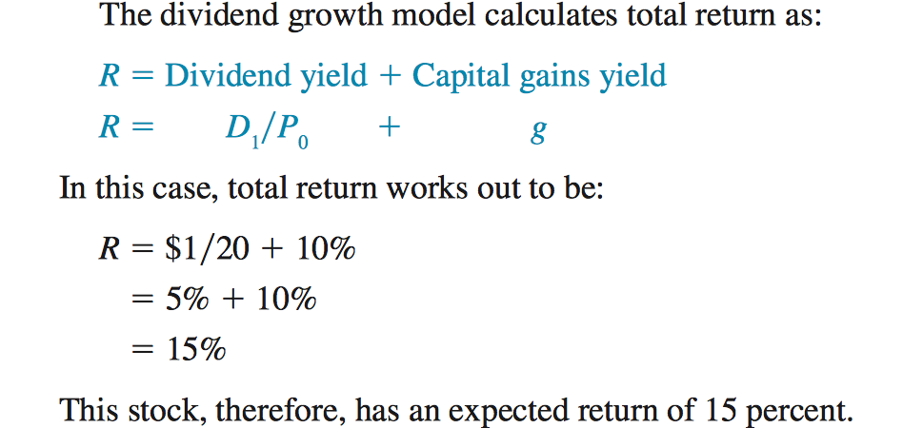
Example
suppose we observe a stock selling for $20 per share. The next dividend will be $1 per share. You think that the dividend will grow by 10 percent per year more or less indefinitely. What return does this stock offer if this is correct?

Slide 31
Review
. Which one of following is the rate at which a stock's price is expected to appreciate? A. current yield B. total return C. dividend yield D. capital gains yield E. coupon rate
. Which one of the following is an underlying assumption of the dividend growth model? A. A stock has the same value to every investor. B. A stock's value is equal to the discounted present value of the future cash flows which it generates. C. A stock's value changes in direct relation to the required return. D. Stocks that pay the same annual dividend have equal market values. E. The dividend growth rate is inversely related to a stock's market price.

Slide 32
Review
Sessler Manufacturers made two announcements concerning its common stock today. First, the company announced that the next annual dividend will be $1.75 a share. Secondly, all dividends after that will decrease by 1.5 percent annually. What is the maximum amount you should pay to purchase a share of this stock today if you require a 14 percent rate of return? A. $11.29 B. $12.64 C. $13.27 D. $14.00 E. $14.21

