Slide 1
Chapter 7
Digital Filter Design
FIR Filter Design.
Frequency Sampling Design Method
Fourier Transform Design Method
2. IIR Filter Design.
Bilinear Transformation Method
Pole Zero Placement Method
60 –Hz Hum Eliminator
3. Application
ECG Pulse

Slide 2
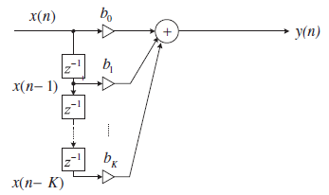
FIR Filter Design
Definition:
A finite impulse response (FIR) filter is specified by
The transfer function of the FIR filter:
$b_{i}$ filter coefficients, K+1 filter length
The difference equation
The realization of the FIR filter

Slide 3
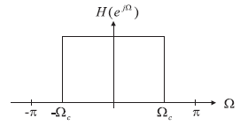
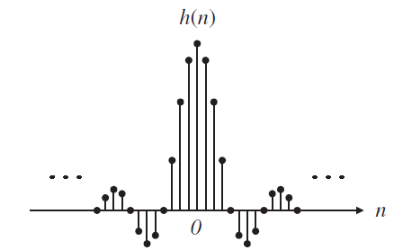
Fourier Transform Design Method
Frequency response of ideal LPF:
$$Inverse fourier Transform$$
Impulse response of ideal LPF:
The desired impulse response $h(n)$ of ideal LPF is infinite and symmetrical about $n=0$.
After truncating 2M+1 major components using the coefficient symmetry:
Symmetric
To obtain causal FIR filter, h(n) is delayed by M samples.
Where,

Slide 4
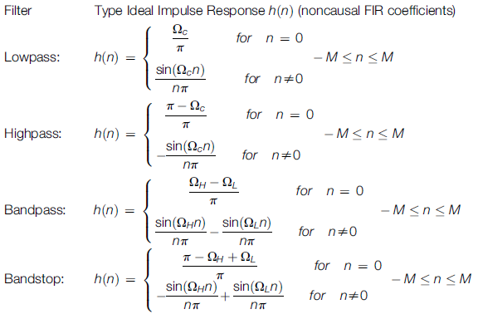
Ideal Impulse Responses for Standard FIR Filters

Slide 5
FIR Low Pass Filter Design
Example
Design a 3-tap FIR LPF with cut-off frequency of 800 Hz and a sampling rate of 8,000 Hz using the Fourier transform method.
Determine the transfer function and difference equation of the designed FIR system.
Compute and plot the magnitude frequency response for$Ω=0,\frac{π}{4},\frac{π}{2} , \frac{3π}{4} and π$ radians.
Solution
Normalized cut-off frequency
3-tap filter
$$2M+1=3$$
$$M=1$$
$$h\left(n\right) for n from −M to M$$
$$n=−1, 0, 1,$$
filter coefficients
From previous slide table
and
compute coefficients
and
Using symmetry
Delaying h(n) by
M = 1 sample

Slide 6
Example - Contd.
b. The transfer function: Causal FIR filter coefficients
inverse z-transform
c. The magnitude frequency response and phase response
Substituting
in $H(z)$
Factoring term
Using Euler formula
Magnitude and phase frequency
response

Slide 7
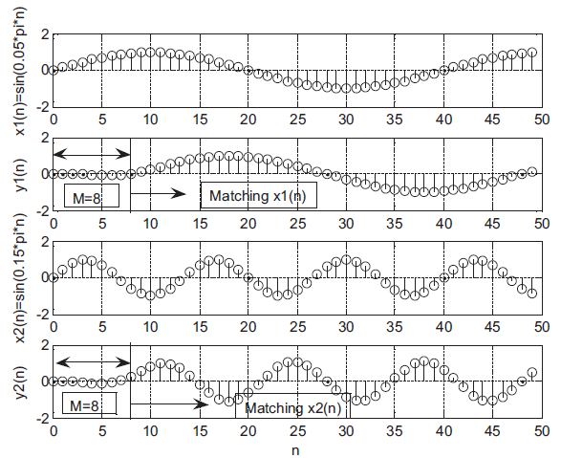
Linear Phase
If filter has linear phase property (the FIR coefficients are symmetric about the middle coefficient, and the FIR filter order is an odd number), the output will simply be a delayed version of input.
M=8 samples delay
Let, 17-tap FIR filter with linear phase property (M=8).
M=8 samples delay

Slide 8
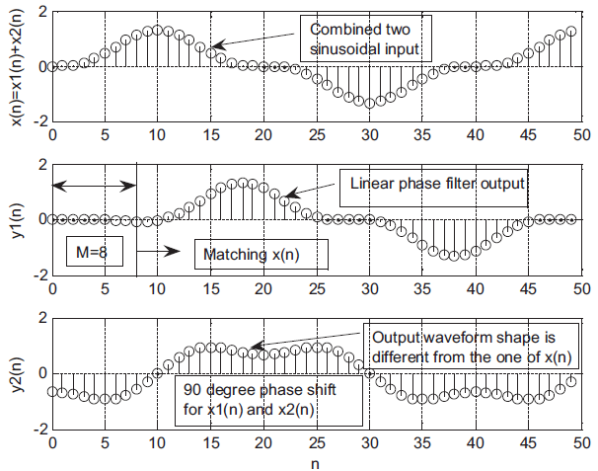
Nonlinear Phase
Input:
Linear phase filter output:
90 degree Non-linear phase filter output:
Input:
Linear phase filter output:
90 degrees phase delay filter output:
Distorted!

Slide 9
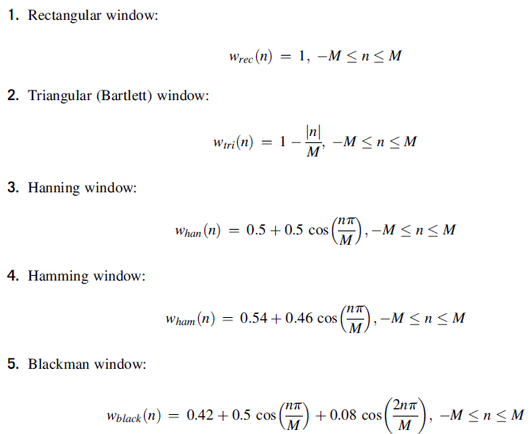
FIR Filtering With Window Method
window functions are used to remedy the undesirable Gibbs oscillations.
The window function, which is symmetrical and can gradually weight the designed FIR coefficients down to zeros at both ends for the range$−M≤n≤M$.
Applying the window sequence $w\left(n\right)$ to the filter coefficients gives

Slide 10
Example: Window Method
Problem:
Design a 5-tap FIR band reject (band-stop) filter with a lower cut-off frequency of 2,000 Hz, an upper cut-off frequency of 2,400 Hz, and a sampling rate of 8,000 Hz using the Hamming window method. Determine the transfer function.
Solution:
normalized cut-off frequencies
$$M=2$$
5-tap FIR
2M +‏ 1 = 5 then M=2
$$Symmetry$$

Slide 11
Example: Window Method –contd
Hamming
window
function
$$Symmetry$$
Windowed
impulse
response
By delaying $h_{w}(n)$by M = 2 samples,
The transfer function

Slide 12
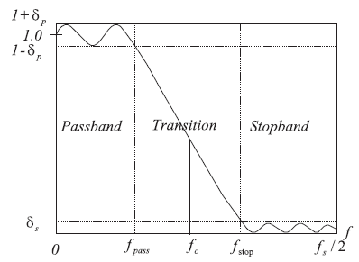
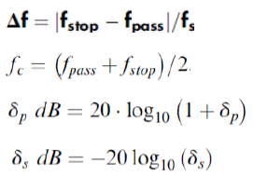
FIR Filter Length Estimation
Given the required stop-band attenuation and pass-band ripple specifications the appropriate window can be selected.

Slide 13
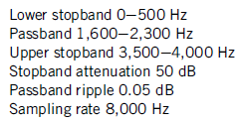
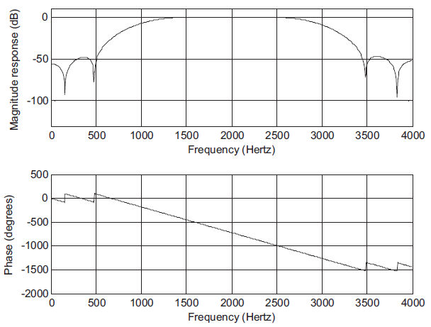
Example: FIR Filter Length Estimation
Problem:
Design a BPF with
Use Hamming window
Solution:
Choose nearest higher odd N = 25
Using Matlab for the design
Filter type BPF
Window type Hamming

Slide 14
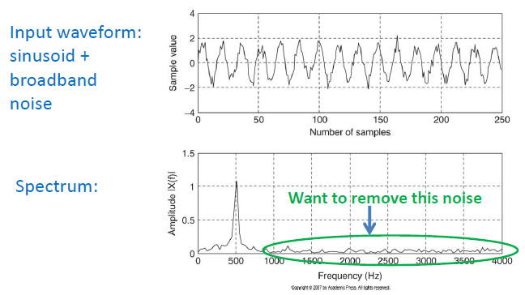
Application: Noise Reduction
We can design a digital filter to remove frequency components (noise) other than the desired frequency range.

Slide 15
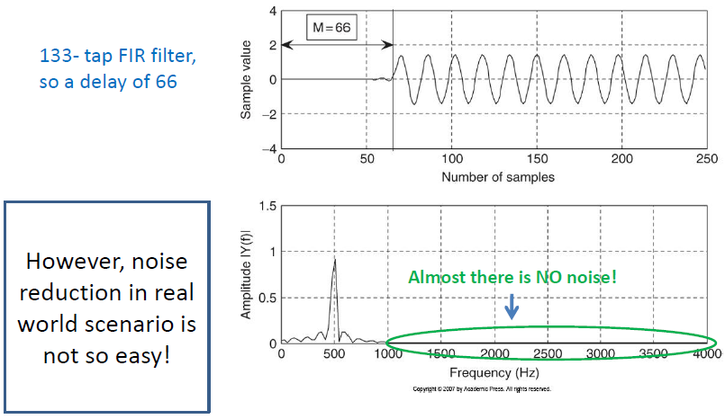
Application: Noise Reduction –contd.

Slide 16
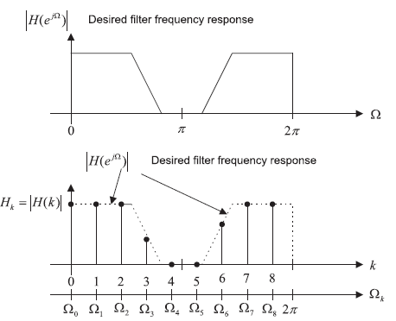
Frequency Sampling Design Method
Simple to design
The key feature of frequency sampling is that the filter coefficients can be calculated based on the specified magnitudes of the desired filter frequency response uniformly in the frequency domain.
$H_{k}$ are obtained from sampled desired frequency response at equally spaced instants in frequency domain
Filter length = 2M+1
Magnitude response in the range $[0, π]$
Calculate FIR filter coefficients:
Use the symmetry:

Slide 17
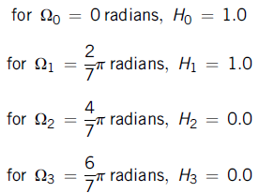
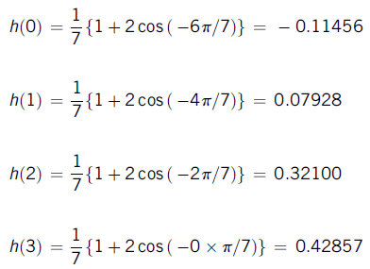
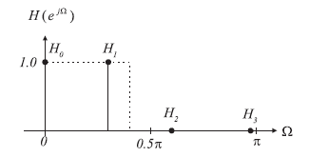
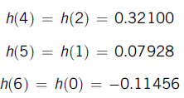
Example: Frequency Sampling Design Method
Problem:
Design a linear phase low-pass FIR filter with 7 taps and a cut-off frequency of $Ω_{c}=0.3π$radians using the frequency sampling method.
Solution:
Sampled
frequencies
$$N=2M+1=7 ⟶ M=3,$$
H_{k} at the specified frequencies
By
Symmetry

Slide 18
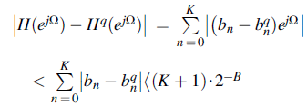
Coefficient Quantization Effect
Obtaining filter coefficients with infinite precision is impossible.
Filter coefficients are usually truncated or rounded off for the application.
FIR filter transfer function with infinite precision coefficients:
FIR filter transfer function with quantized precision
Error of the magnitude frequency response
K=tap
B=Number of Bits
K=tap
Example
25-Tap FIR filter, 8 bit code (sign + 7 bits for fraction
Error is bounded by (less than)
$$\left(K+1\right)2^{−B}=\frac{K+1}{2^{B}}=\frac{25}{2^{7}}=0.0977$$
Let infinite precision coeff. = 0.00759455135346
$$\left.0.00759455135346×2^{7}=0.9721≅1 (rounded up to the integer\right)$$
Quantized coeff. = $1/{2^{7}}$= 0.0078125

Slide 19
IIR Filter Design
Definition:
Infinite impulse response (IIR) filter is described using :
IIR filter output depends also on the past outputs
IIR filter
difference equation
IIR filter
transfer function

Slide 20
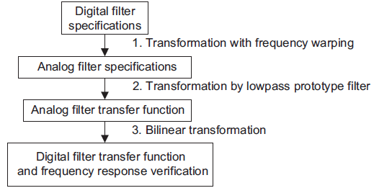
IIR Filter Design: Bilinear Transformation Method
Steps of the design procedure

Slide 21
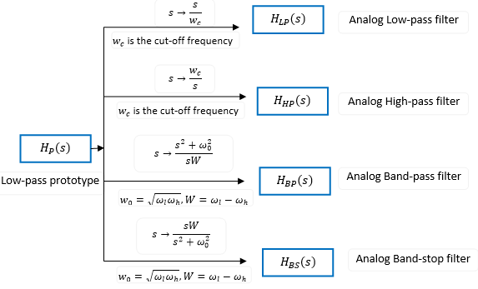
Bilinear Transformation Method
Prototype Transformation
Frequency Warping
For LPF and HPF:
From analog LPF to desired analog filter
For BPF and BRF:
Obtained digital filter Transfer Function:

Slide 22
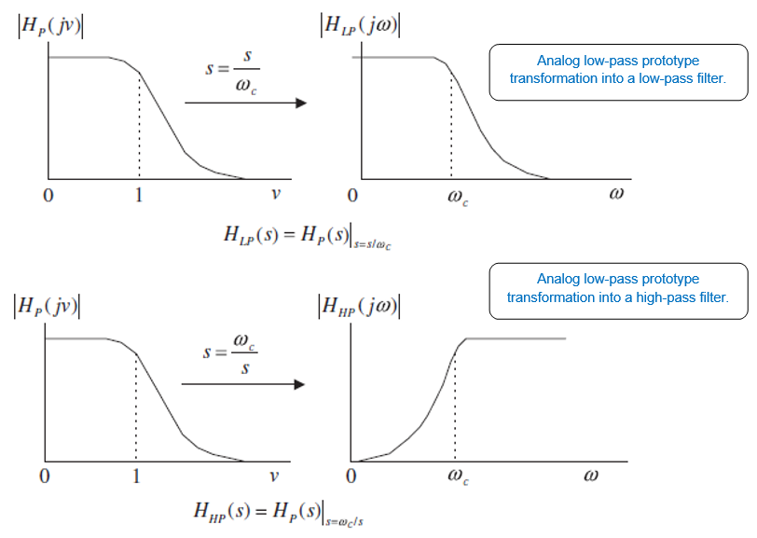
Bilinear Transformation Method

Slide 23
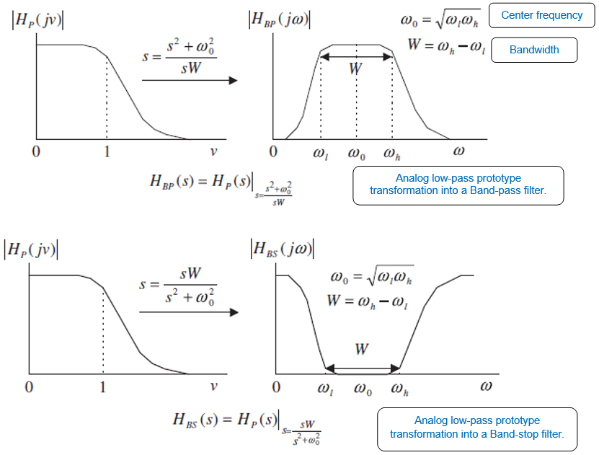
Bilinear Transformation Method

Slide 24
Example 1: Bilinear Transformation Method
Design a first-order high-pass digital Chebyshev filter with a cut-off frequency of 3 kHz and 1 dB ripple on the pass-band using a sampling frequency of 8,000 Hz.
Problem:
Solution:
Digital frequency (rad/s):
Pre-warped analog frequency :
First-order LP Chebyshev filter prototype:
Applying transformation LPF to HPF:
Dividing by 1.9625
Applying BLT:

Slide 25
Example 2: Bilinear Transformation Method
Design a second-order digital band-pass Butterworth filter with the following specifications:
Problem:
Solution:
Digital frequencies:
pre-warped analog frequency:
A first-order LPF prototype will produce second-order BPF prototype.

Slide 26
Example 2: Bilinear Transformation Method contd.
prototype transformation (LPF to BPF):
1st order LPF prototype:
Applying transformation LPF to BPF:
Applying BLT:

Slide 27
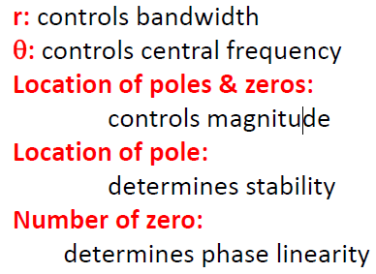
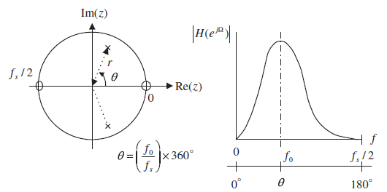
Pole Zero Placement Method
Second-Order BPF Design
Poles are complex conjugate with magnitude r and the angle $θ$
Zeros are placed at z=1 corresponding to DC (zero frequency), and z= -1, corresponding to the folding frequency
Pole-zero placement for a second-order narrow BPF.
scale to have unit pass-band BPF gain

Slide 28
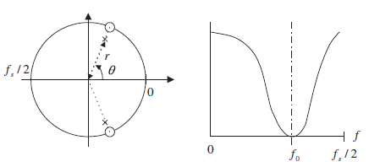
Pole Zero Placement Method
Poles amplitude Determines the 3 dB bandwidth
Second-Order BSF (Notch) Design
The zeros are placed on the unit circle with the same angles with respect to poles.
Poles angle Determines the center frequency
scale factor to adjust the BRF so it has a unit pass-band gain
Example
Sampling rate = 8,000 Hz
Design a second-order notch filter with
3 dB bandwidth: BW = 100 Hz
Narrow stop-band centered at f₀ = 1,500 Hz

Slide 29
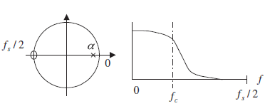
Pole Zero Placement Method
First-Order LPF Design
When Cut-off frequency $f_{c}<{f_{s}}/4$
When Cut-off frequency $f_{c}>{f_{s}}/4$
Pole placed on the real axis
Pole placed on the real axis
The zero is placed at ($z=−1)$
Transfer function
unit pass-band gain scale factor
Example
transfer function of first-order LPF is required to satisfy:
unit gain scale factor:
transfer function:
Since cut-off frequency = 100 Hz < $\frac{f_{s}}{4}=2000Hz,$ pole at:

Slide 30
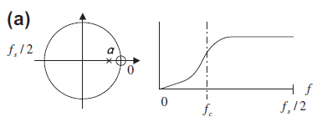
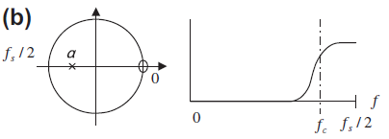
Pole Zero Placement Method
First-Order HPF Design
When Cut-off frequency $f_{c}<{f_{s}}/4$
When Cut-off frequency $f_{c}>{f_{s}}/4$
Pole placed on the real axis
Pole placed on the real axis
The zero is placed at ($z=+1)$
Transfer function
unit pass-band gain scale factor
Example
transfer function of first-order HPF is required to satisfy:
unit gain scale factor:
transfer function:
Since cut-off frequency = 3800 Hz > $\frac{f_{s}}{4}=2000Hz,$ pole at

Slide 31
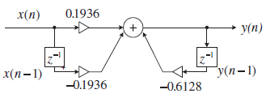
IIR Filter realization
Example:
Realize the first-order digital high-pass Butterworth filter using a direct-form I realization.
Solution:
Filter coefficients:
DSP equation:
Implementation:

Slide 32
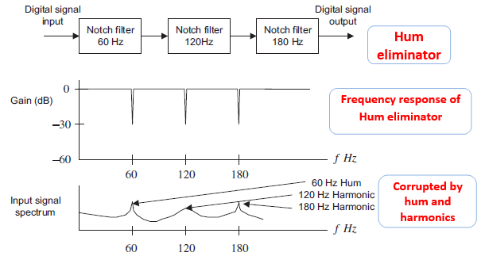
Application1: 60 –Hz Hum Eliminator
Hum noise: created by poor power supply or electromagnetic interference and characterized by a frequency of 60 Hz and its harmonics.
Eliminate the 60-Hz hum frequency with its second and third harmonics in most practical applications.
We can do this by cascading 3 notch filters having frequencies of 60 Hz, 120 Hz, and 180 Hz, respectively.

Slide 33
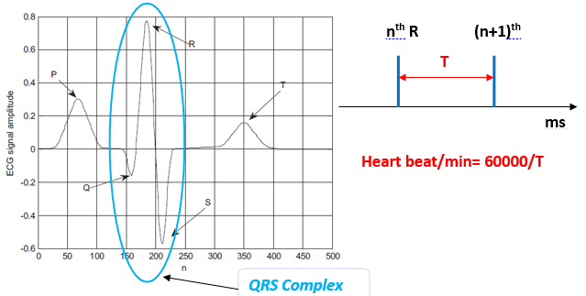
Application2: ECG Pulse
The ECG signal is produced by the electrical activity of the human heart, it is characterized by five peaks and valleys P, Q, R, S, and T.
The properties of the QRS complex, (rate of occurrence and times, heights, and widths, provide information to cardiologists concerning various pathological conditions of the heart.
ECG + Hum $⟶$makes difficult to analyze.

Slide 34
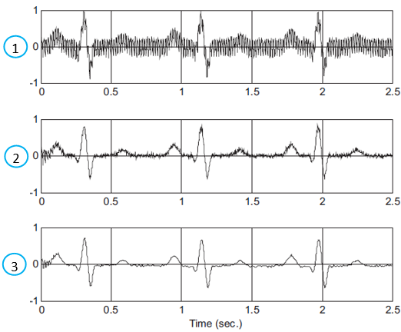
Heart Beat Detection Using ECG Pulse
Initial corrupted ECG data (with 60-Hz interference and its 120 and 180 Hz harmonics, and muscle noise).
The 60-Hz interference and its harmonics of 120 and 180 Hz have been removed
Result after the band-pass filter
Original ECG signal occupies the frequency range from 0.01 Hz to 250 Hz (used for diagnostic-quality ECG).

Slide 35
Example: EGC Signal pre-processing
Problem:
Design the ECG signal pre-processing system for heart beat rate detection
Solution:
60-Hz eliminator design (notch frequency of 60Hz)

Slide 36
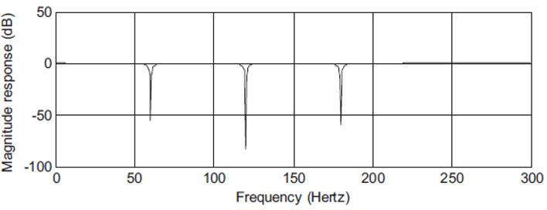
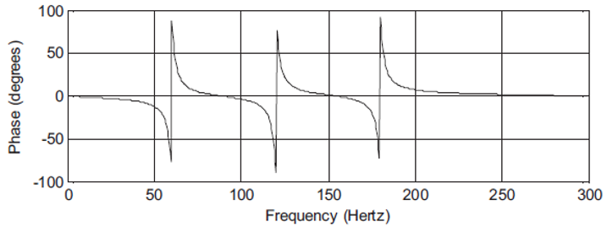
Example: EGC Signal pre-processing -contd
transfer functions and the difference equations
Frequency responses of three cascaded notch filters.

Slide 37
Example: EGC Signal pre-processing -contd
The second-stage design using the BLT

