Slide 1
Chapter 7
Evaluating Survey Data Collection Methods
1
Copyright © 2014 Pearson Education, Inc.

Slide 2
Learning Objectives
To learn the four basic alternative modes for gathering survey data
To understand the advantages and disadvantages of each of the various data collection modes
To comprehend the factors researchers consider when choosing a particular survey method
To become knowledgeable about the details of different types of survey data collection methods, such as personal interviews, telephone interviews, and computer-administered interviews, including online surveys

Slide 3
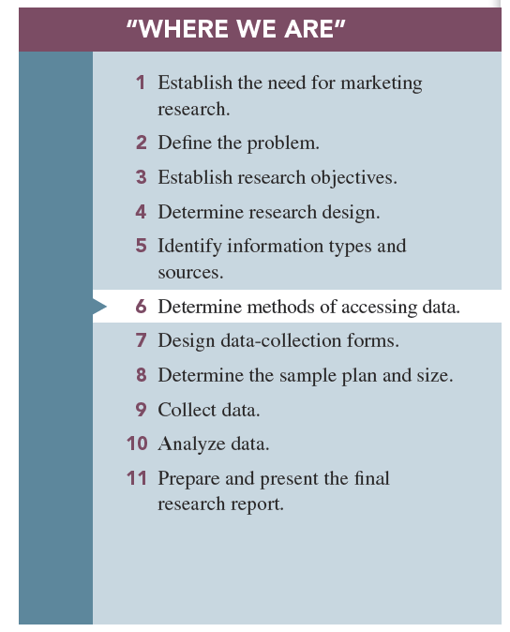

Slide 4
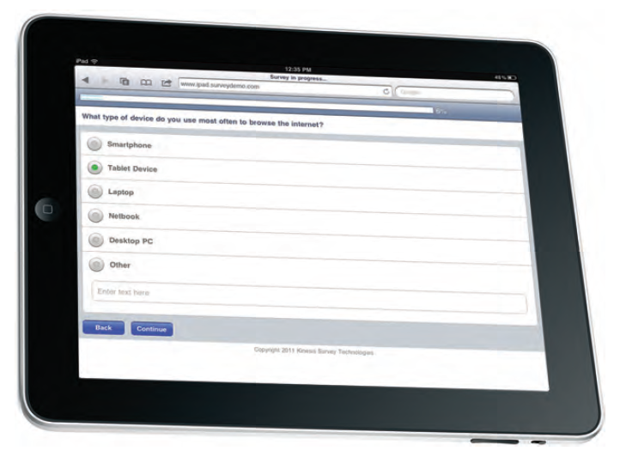
Contemporary Survey

Slide 5
Surveys
A survey involves interviews with a large number of respondents using a predesigned questionnaire.
Four basic survey methods:
1-Person-administered surveys
2-Computer-assisted surveys
3-Self-administered surveys
4-Mixed-mode (hybrid) surveys

Slide 6
Advantages of Surveys
1-Standardization
2-Ease of administration
3-Ability to tap the “unseen”
4-Suitability to tabulation and statistical analysis
5-Sensitivity to subgroup differences

Slide 7
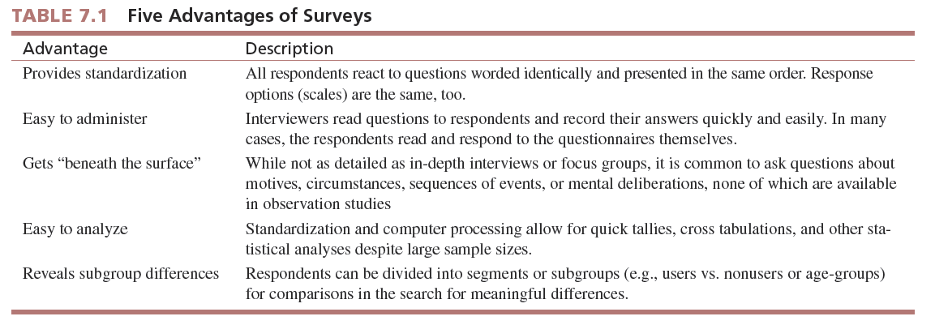

Slide 8
Data Collection Modes
1-Person administered Surveys: an interviewer reads questions, either face-to-face or over the telephone, to the respondent and records his or her answers.
Advantages:
Feedback
Rapport
Quality control
Adaptability

Slide 9
Disadvantages:
a)Humans make errors
b)Slow speed
c)High cost
d)Interview evaluation: apprehensive they are answering the question “correctly.” Feel they are being “evaluated.” Especially a problem with sensitive topics such as hygiene, finances, political opinions, etc.

Slide 10
2- Computer-Assisted Surveys; the interviewer basically verbalizes the question while relying to some degree on computer technology to facilitate the interview work.
•Advantages:
Speed
Relatively error-free interviews
Use of pictures, videos, and graphic
Quick capture of data

Slide 11
Disadvantages:
-Technical skills nay be required
-Setup costs can be high

Slide 12
3-Self-administered: the respondent completes the survey on his or her own.
-Traditional “paper and pencil” survey
Advantages:
Reduced cost
Respondents control pace at which they answer
No interview-evaluation apprehension
Disadvantages:
Respondent controls the survey—does not send in on time or does not send in.
Lack of monitoring—no one to explain or encourage respondents.
High questionnaire requirements—it must be perfect.

Slide 13
4-Computer administered surveys: a computer plays an integral role in posing the questions and recording respondents answers.
Advantages:
Breadth of user-friendly features
Relatively inexpensive
Reduction of interview evaluation concern in respondents
Disadvantages:
Requires computer-literate and Internet-connected respondents

Slide 14
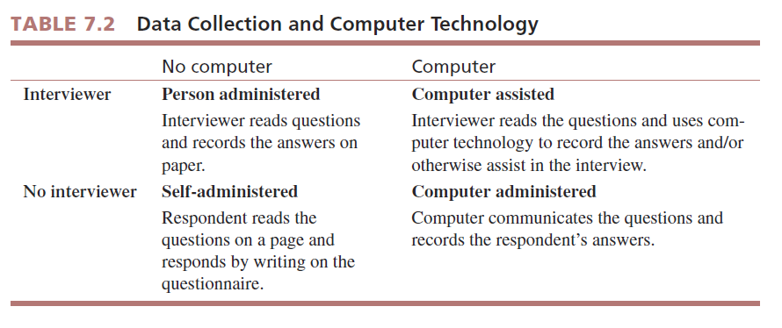

Slide 15
5-Mixed-mode surveys use multiple data collection methods.
It has become increasingly popular to use mixed-mode surveys in recent years.
Advantages:
Multiple advantages to achieve data collection goal
Example: May use online surveys to quickly reach portion of population with Internet access and may use telephone calling to reach those without Internet access.

Slide 16
Disadvantages:
Mode affects response?
Additional complexity

Slide 17
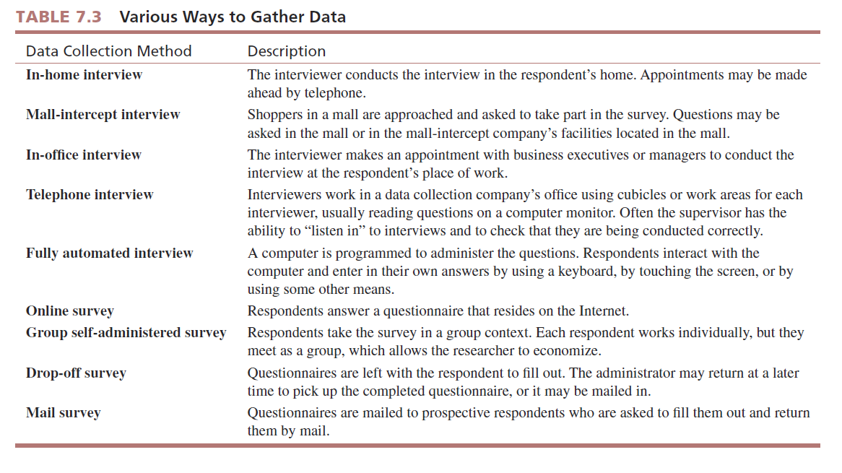
PERSON-ADMINISTERED/COMPUTER-
ASSISTED SURVEY
COMPUTER-
ADMINISTERED SURVEYS
SELF-
ADMINISTERED
SURVEY

Slide 18
Descriptions of Data Collection Methods
First; Person-Administered Interviews;
1- in-home survey is conducted by an interviewer in the home of the respondent.
In-home interviews are used when the survey requires respondents to see, read, touch, use, or interact with product prototype and when the researcher believes the security and comfort of respondents homes are important in affecting the quality of the data collected.

Slide 19
Key advantages:
-Conducted in the privacy of the home, which facilitates interviewer–respondent rapport

Slide 20
2-Mall-Intercept Surveys
The mall-intercept survey is one in which the respondent is encountered and questioned while he or she is visiting a shopping mall.
Key advantages:
Mall-intercept interviews are conducted in large shopping malls, and they are less expensive per interview than are in-home interviews
Key disadvantages:
Only mall patrons are interviewed.
Respondents may feel uncomfortable answering the questions in the mall.

Slide 21
3-In-Office Surveys
In-office surveys take place in person while the respondent is in his or her office or perhaps in a company lounge area.
Key advantage:
Useful for interviewing busy executives
Key disadvantages:
Relatively high cost per interview
Gaining access is sometimes difficult

Slide 22
4- Telephone Surveys;
Central Location Telephone Surveying
Involves a field data collection company installing several telephone lines at one location from which interviewers make calls.
Key advantages:
Fast turnaround
Good quality control
Reasonable cost

Slide 23
Key disadvantage;
1-The respondent cannot be shown anything or physically interact with the research object.
2-The telephone interview does not permit the interviewer to make the various judgments and evaluations that can be made by the in-person interviewer.
3-Marketing researchers are more limited in the quantity and type of information they can obtain.
4- The growing threat to its existence as a result of increased noncooperation by the public.

Slide 24
CATI;
The most advanced telephone interview companies have computerized the central location telephone interviewing process with systems called computer-assisted telephone interviews (CATI).
With CATI, the interviewer reads the questions on a computer screen and enters respondents answers directly in to the computer program.

Slide 25
Key advantages:
-With CATI, the interviewer is the voice of the computers.
-Most CATI systems are programmed to reject wrong answers.

Slide 26
Second : Computer- Administerd interviews
1-Fully Automated Survey
Some companies have developed fully automated surveys in which the survey is administered by a computer but not online.
In the research industry, this approach is known as completely automated telephone survey (CATS).

Slide 27
Key advantages:
Respondent responds at his or her own pace
Computer data file results
2-Online Interviews;
•The Internet-based questionnaire in which the respondent answers questions online has become the industry standard for surveys.

Slide 28
Key advantages:
Ease of creating and posting
Fast turnaround
Computer data file
Results
Key disadvantage:
Marketing researchers were quick to realize that online surveys presented design challenges and opportunities related to fostering cooperation in potential respondents.

Slide 29
Thirdly : Self-Administered Survey
1- group self-administered survey entails administering a questionnaire to respondents in groups rather than individually for convenience and to gain economies of scale.
Key advantages:
Cost of interviewer eliminated
Economical for assembled groups of respondents
Key disadvantage:
Must find groups and secure permission to conduct the survey

Slide 30
2- drop-off survey is sometimes called “drop and collect,” in which the survey representative approaches a prospective respondent, introduces the general purpose of the survey to the prospect, and leaves it with the respondent to fill out on his or her own.
Key advantages:
Cost of interviewer eliminated
Appropriate for local market surveys
Key disadvantage:
Generally not appropriate for large-scale national survey

Slide 31
3- mail survey is one in which the questions are mailed to prospective respondents who are asked to fill them out and return them to the researcher by mail.
Key disadvantage:
Nonresponse, which refers to questionnaires that are not returned
Self-selection bias, which means that those who do respond are probably different from those who do not fill out the questionnaire and return it

Slide 32
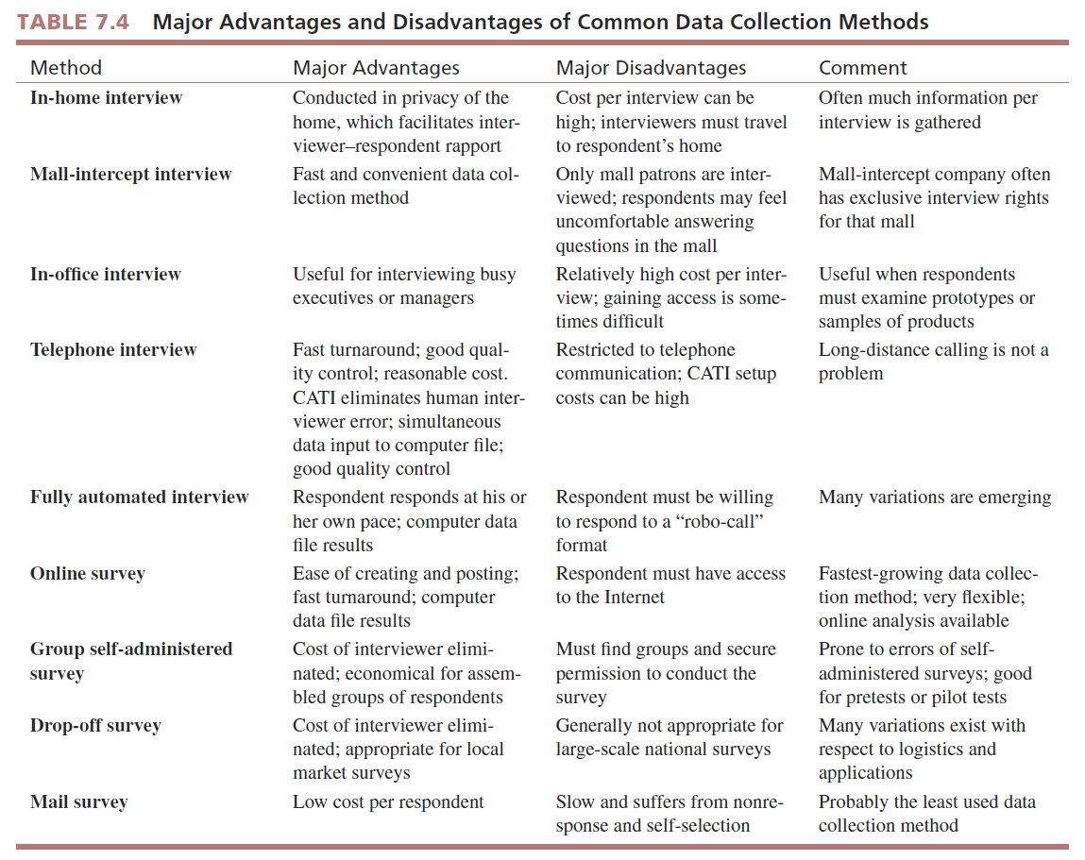

Slide 33
Choice of Survey Method
In selecting a data collection mode, the researcher balances quality cost , time, and other consideration.
How much time is there for data collection?
-Sometimes data must be collected quickly. -There are many reasons for tight.
How much money is there for data collection?
-We should know the budget of the compny.

Slide 34
What type of respondents interaction required?
If respondents need to see, handle, or experience something, the data collection mode must accommodate these requirements.
What is the incidence rate?
-The incidence rate , the percentage of the population that possesses some characteristic necessary to be included in the survey, affects the decision about data collection mode.

Slide 35
Are there cultural and/or infrastructure considerations?
-Cultural norms and/or limitations of communications systems may limit the data collection mode choice.

