Slide 1
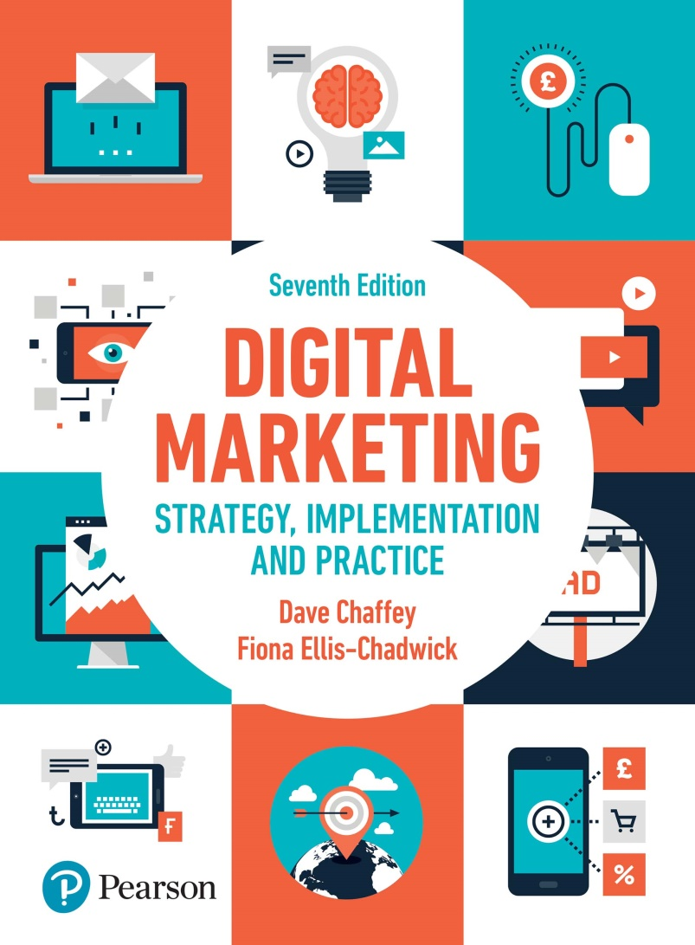
DIGITAL MARKETING STRATEGY, IMPLEMENTATION AND PRACTICE Seventh Edition
Part 3
Digital marketing: implementation and practice
Chapter 7
Delivering the digital customer experience

Slide 2
Chapter 7 Delivering the digital customer experience
Main topics:
Planning web sites
Initiating digital experience project
Defining site or app requirements
Designing the user experience
Managing and testing the concept
Online retail merchandising
Site promotion and traffic building
The impact of service quality on e-loyalty

Slide 3
Delivering the digital customer experience
Notes:
Figure 7.2 The online customer experience pyramid – success factors

Slide 4
Planning web sites, app design and redesign projects
Main development tasks:
Pre-development
Discovery, analysis, design
Content creation, coding development and testing
Publishing or launching the site or improvement
Pre-launch promotion or communications
Ongoing promotion
Ongoing development

Slide 5
Figure 7.3 Summary of the process of website development

Slide 6
Figure 7.4 Interactive approach to improving site effectiveness
Source: Sullivan (2011)

Slide 7
Who should be involved in a digital experience project?
Site sponsor
Site owner
Project manager
Site designer
Content developer
Webmaster
Digital experience analyst
Stakeholder

Slide 8
Figure 7.5 Example of a website ‘Design and Build’ project timeline

Slide 9
Initiation of a digital project
Domain name selection and registration
Uniform resource locators
Selecting a hosting provider
Web site performance optimisation
Notes:
Figure 7.6 Metrobank desktop and mobile experiences

Slide 10
Figure 7.7 Web Page performance test service results ( www.webpagetest.org )

Slide 11
Defining site or app requirements
The discovery or analysis phase involves using marketing research techniques to find out the needs of the business and audience.
Key considerations:
Business requirements
Usability requirements
Web accessibility requirements
Personalisation requirements
Localisation and cultural customisation
Reviewing competitor web sites
Designing the information architecture
Blueprints, wire frames and landing pages
Notes:
Figure 7.8 Optimax website ( www.optimax.com )

Slide 12
Figure 7.10 Personalisation pyramid web site
Source: Monetate, with permission.

Slide 13
Figure 7.11 The continuum of translation types
Source: Chaffey (2017)

Slide 14
Figure 7.12 Site structure diagram (blueprint) showing layout and relationships between pages

Slide 15
Figure 7.13 Example wireframe for a children’s toy site

Slide 16
Designing the user experience
Key topics:
Evaluating designs
Elements of site design
Mobile design requirements and techniques
Notes:
Figure 7.14 Responsive design showing updated layout for different content blocks

Slide 17
Managing and testing content
Criteria for selecting a content management system
Testing the experience

Slide 18
Online retail merchandising
Common approaches:
Expanding navigation through synonyms
Applying faceted navigation
Featuring the best-selling products
Use of bundling
Use of customer ratings
Notes:
Figure 7.15 Faceted navigation at Euroffice.com

Slide 19
The impact of service quality on e-loyalty
Tangibles
Reliability and responsiveness
Assurance
Multichannel communication preferences
Empathy

Slide 20
Figure 7.16 Variation between product complexity, customer value and type of online experiences used to deliver service

Slide 21
Table 7.5 Online elements of service quality
Tangibles | Reliability | Responsiveness | Assurance and empathy
Ease of use | Availability | Download speed | Contact with call centre
Content quality | Reliability | Email response | Personalisation
Price | Email replies | Call-back | Privacy
 |  | Fulfilment | Security

Slide 22
Case study 7 Refining the online customer experiences at i-to-i.com
Questions
Select one country that i-to-i operates in closest to the area where you live. Define a persona based on their age and product needs and then identify the main customer journeys and content requirements for this persona. Which routes through the site would this user follow?
Review the range of engagement techniques on the i-to-i web site to engage the audience to generate leads
Identify key area for improvement of i-to-i based on your use of the site.

