Slide 1
Chapter 6
Digital Filters

Slide 2
Digital Filtering: Realization
Definition:
A digital filter is a DSP system, where $x\left(n\right)and y(n)$ are the DSP system’s input and output, respectively.
The Digital filter difference equation:
Where$a_{i }and b_{i }$ represent the coefficients of the system.
Matlab Implementation:
3-tap (2ndorder) IIR filter

Slide 3
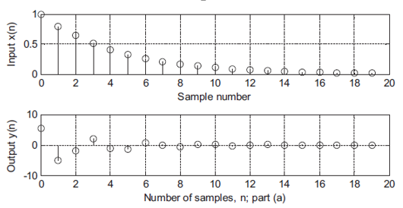
Example
Given the DSP system
with initial conditions
and the input
Compute the system response $y(n)$ for 20 samples using MATLAB.
Solution:

Slide 4
Transfer Function
If $x\left(n\right) and y\left(n\right)$ are the input and the output of the Digital filter (DSP) respectively, and $X\left(z\right) and Y\left(z\right)$ are their Z-transforms,
Differential Equation:
Z-Transform
Z-Transform:
Transfer Function:

Slide 5
Example: Transfer Function
Given a DSP:
Find the its transfer function H(z).
Z-transform on both sides of the difference equation
Z-Transform:
Rearrange:
factoring Y(z) on the left side and X(z) on the right side
Transfer Function:
Given H(z) :
Find the difference equation of the system
Rearrange:
Dividing the numerator and denominator by $z^{2}$
Differential Equation:
Applying the inverse z-transform and using the shift property

Slide 6
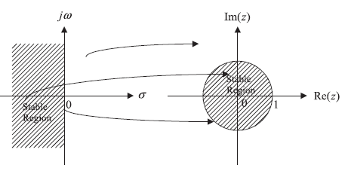
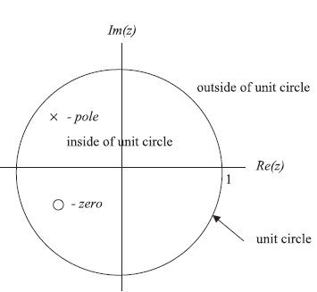
Pole –Zero from Transfer Function
A digital transfer function can be written in the pole-zero form.
The z-plane pole-zero plot is used to investigate characteristics and the stability of the digital system.
Relationship of the sampled system in the Laplace domain and its digital system in the z-transform domain
mapping:
The z-plane is divided into two parts by a unit circle.
Each pole is marked on z-plane using the cross symbol x, while each zero is plotted using the small circle symbol o.

Slide 7
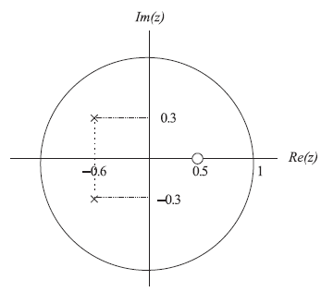
Example: Pole-zero plot
Given the digital transfer function:
Plot poles and zeros
multiplying the numerator and denominator by $z^{2}$
$$zero1=0.5$$
$$= \frac{(z−zero1)}{(z−pole1)(z−pole2)}$$
$$pole1=−0.6+j0.3$$
$$pole2=−0.6−j0.3$$
The system is stable.
The zeros do not affect system stability.

Slide 8
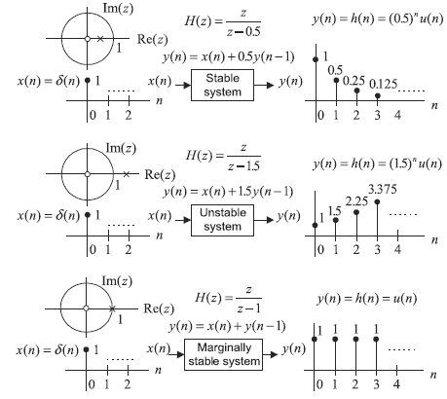
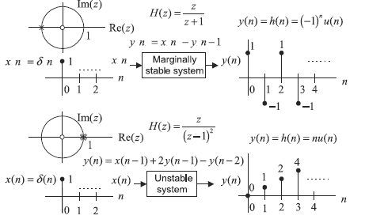
System Stability (Depends on poles’ location)
If the outmost poles of the DSP TF H(z) are inside the unit circle on the z-plane pole-zero plot, then the system is stable.
If the outmost poles are first-order poles of the DSP TF H(z) and on the unit circle on the z-plane pole-zero plot, then the system is marginally stable.

Slide 9
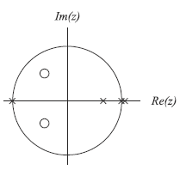
Example: System Stability
Sketch the z-plane pole-zero plot and determine the stability for the system:
Since the outermost pole is multiple order (2nd order) at z = 1 and is on the unit circle, the system is unstable.

Slide 10
Digital Filter: Frequency Response
From the Laplace transfer function, we can achieve the analog filter frequency response $H(jω)$ by substituting $s=jω$ into the transfer function H(s).
Similarly, in a DSP system, we substitute ${\left.z= e^{sT}\right|}_{s=jω}=e^{jωT}$ into the Z-transfer function of the system’s transfer function H(z) to acquire the digital frequency response
Putting
Magnitude frequency
response
Phase response
normalized digital
frequency

Slide 11
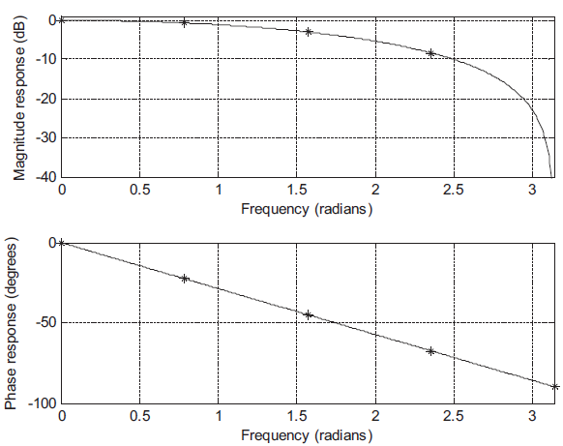
Frequency Response Example
Problem
Given the digital system with a sampling rate of 8,000 Hz, determine the frequency response.
Solution
z-transform : (on both sides on the difference equation )
Frequency response:
transfer function
$$z=e^{jΩ}$$
Magnitude frequency response
Phase frequency response
It is observed that when the frequency increases, the magnitude response decreases. The DSP system acts like a digital low-pass filter, and its phase response is linear.

Slide 12
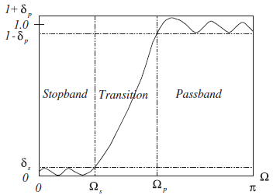
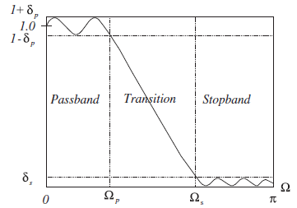
Digital Filter: Frequency Response –contd.
BASIC TYPES OF FILTERING
Pass-band Ripple (frequency fluctuation) parameter
Stop-band Ripple (frequency fluctuation) parameter
High-pass filter (HPF)
Pass-band cut-off frequency
Stop-band cut-off frequency
Low-pass filter (LPF)
Matlab: Frequency Response:

Slide 13
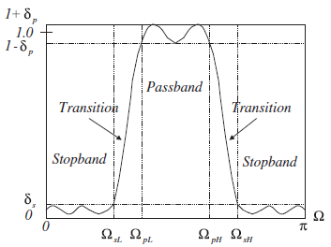
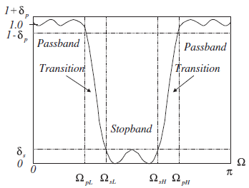
Digital Filter: Frequency Response –contd.
BASIC TYPES OF FILTERING
Higher stop-band
Cut-off frequency
Lower stop-band cut-off frequency
Lower Pass-band cut-off frequency
Higher pass-band
Cut-off frequency
Band-stop filter (BSF)
Band-pass filter (BPF)

