Slide 1
Chapter 6
Qualitative Research Techniques
Copyright © 2014 Pearson Education, Inc.

Slide 2
Learning Objectives
To understand basic difference between quantitative and qualitative research techniques
To learn the pros and cons of using observation as a means of gathering data
To discover what focus groups are and how they are conducted and analyzed

Slide 3
To become acquainted with online focus groups and their advantages
To become familiar with other qualitative methods used by marketing researchers

Slide 4
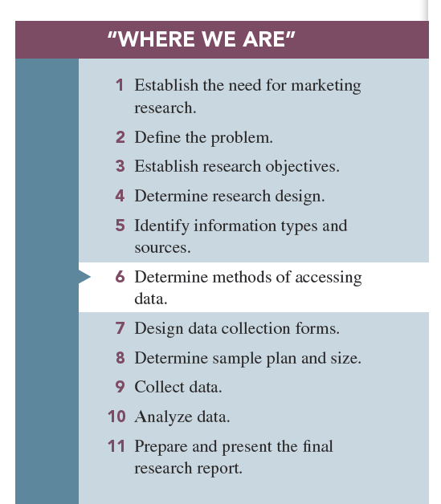

Slide 5
THE DIFFERENCES BETWEEN QUANTITATIVE AND QUALITATIVE RESEARCH TECHNIQUES
-The means of data collection during the research process can be classified into two broads categories:
1-Quantitative research: is defined as research involving the administration of a set of structured questions with predetermined response options to large number of respondents.

Slide 6
2-Qualitative research: research involving collecting, analyzing, and interpreting data by observing what people do and say.
-Qualitative research techniques afford rich insight into consumer behavior.
-Although there are proponents of both types of research, many marketing researchers have adopted Pluralistic research combination of both quantitative and qualitative research methods in order to gain the advantages of both

Slide 7
Observation Techniques
Observation methods: techniques in which the researcher relies on his or her powers of observation rather than communicating with a person in order to obtain information.
Types of observation:
1-Direct versus indirect
2-Overt versus covert
3-Structured versus unstructured
4-In situ versus invented

Slide 8
1-Direct versus Indirect;
-Direct observation: observing behavior as it occurs
-Indirect observation: observing the effects or results of the behavior rather than the behavior itself.
•Two types of indirect observations include:
a)Archives: secondary sources, such as historical records, that can be applied to the present problem
b)Physical traces: tangible evidence of some past event

Slide 9
2-Covert versus overt;
-Covert observation: subject is unaware that he or she is being observed, such as mystery shopping.
-Overt observation: respondent is aware that he or she is being observed, such as Arbitron’s PPM, which monitors the media to which a consumer is exposed.

Slide 10
3- Structured versus unstructured
-Structured—researcher identifies beforehand which behaviors are to be observed and recorded (often there is a checklist).
-Unstructured—all behavior is observed, and the observer determines what is to be recorded.

Slide 11
4- In situ versus invented;
-In situ observation: the researcher observes the behavior exactly as it happens.
-Invented observation: the researcher creates the situation.

Slide 12
Appropriate conditions for use of observation
•Certain conditions must be met before a researcher can successfully use observation as a marketing research tool; the event must occur during a relatively short time interval, and the observed behavior must occur in a public setting.
•Short time interval—event must begin and end in a reasonably short time. You cannot “observe” a process of purchasing that lasts months.
Example; shopping trip in a super market.

Slide 13
•Public behavior—cannot observe private behaviors.
-Public behavior refers to behavior that occurs in a setting he researcher can readily observe such as shopping in a grocery store or with childern in a department store.
•Faulty recall conditions—behaviors are so “automatic” that consumer cannot recall them.
Example; people cannot recall accurately how many times they looked at their wristwatch while waiting in a long line to buy a ticket to a best-selling movie.

Slide 14
Advantages of observational data
1-Insight into actual, not reported, behaviors
2-No chance for recall error
3-Better accuracy
4-Less cost
Limitations of observational data
1-Small number of subjects
2-Subjective interpretations
3-Inability to pry beneath the behavior observed
4-Motivations, attitudes, and other internal conditions are unobserved

Slide 15
Focus Groups
Focus groups are small groups of people brought together and guided by a moderator through an unstructured, spontaneous discussion for the purpose of gaining information relevant to the research problem.
Focus groups represent a useful technique for gathering information from a limited sample of respondent.

Slide 16
Information from Focus group can be used to generate ideas, to learn the respondents ,
” vocabulary” when relating to certain type of product, or to gain some insights into basic needs and attitudes.

Slide 17
How Focus Group Work
Types of Focus Groups;
1-Traditional: Select 6 to 12 persons and meet in a dedicated room with one-way mirror for client viewing, for about two hours.
2-Contemporary: Online and the client can observe the online activity from remote locations; may have 25 or even 50 respondents; allow client interaction; may take place in nontraditional locations.
-Focus group participant are guided by Moderator.

Slide 18
Moderator: responsible for creating the correct atmosphere in the group and guiding discussion.
Focus group company principals are sometime referred to as Qualitative research consultants (QRC).
The QRC prepares a Focus group report: summarizes the information provided by the focus group participants relative to the research questions

Slide 19
Two factors are crucial when analyzing the data:
1-Some sense must be made by translating the statements of participants into categories or themes and then reporting the degree of consensus apparent in the focus group.
2-The demographic and buyer behavior characteristic of focus group participants should be judged against the target market profile to assess to what degree the group represent the target market.

Slide 20
Online focus group: a form of contemporary focus groups, one in which the respondents and/or clients communicate and/or observe by use of the Internet.
Advantages:
1-No physical setup is necessary.
2-Transcripts are captured on file in real time.
3-Participants can be in widely separated geographical areas.
4-Participants are comfortable in their home or office environments.
5-The moderator can exchange private messages with individual participants.

Slide 21
Disadvantages of online focus group:
1-Observation of participants’ body language is not possible.
2-Participants cannot physically inspect products or taste food items.
3-Participants can lose interest or become distracted.

Slide 22
•Advantages of Focus Groups:
1-Generate fresh ideas
2-Allow clients to observe their participants
3-May be directed at understanding a wide variety of issues
4-Allow fairly easy access to special respondent groups
• Disadvantages of Focus Groups;
1-Representativeness of participants
2-Dependence on the moderator
3-Interpretation sometimes difficult

Slide 23
When Should Focus Groups Be Used?
Focus groups should be used when the research objective is to describe rather than predict.
They work well for the following situation;
1- A company wants to know “how to speak to its market”.
2- What language and terms do its customer use?
3-What are some new ideas for an ad campaign?

Slide 24
4- Will a new service we are developing have appeal to customer and how can we improve it?
5- How can we better package our product?
- In all these cases, focus group can describe the terms customers use; their reaction and ideas for ads, product, or package features are appealing, and suggestions for improving the company’s delivery of benfits.

Slide 25
When Should Focus Groups Not Be Used?
Focus groups should not be used when the research questions require a prediction or when a major decision affecting the company’s livelihood rests on the research results.

Slide 26
Some Objectives of Focus Groups
1-To generate ideas
2-To understand consumer vocabulary
3-To reveal consumer goods, motives, perceptions, and attitudes about products or services
4-To understand findings from quantitative studies

Slide 27
Operational Aspects of Traditional Focus Groups
1-How many people should be in a focus group? The optimal size of a focus group is 6 to 12 people.
2-Who should be in the focus group? Focus group members should be homegeneous.
3-How should focus group participants be recruited and selected? Selection of focus group members is determined by the purpose of the focus group.

Slide 28
4-Where should a focus group meet? Focus group facilities should be comfortable allow interaction, and not have distractions.
5-When should the moderator become involved in the research project? Moderators should not be hired at the last minute to run focus groups.
6-How are focus group results reported and used? Focus groups report some of the subtle and obscure features of the relationship among consumers and products, advertising, an sales efforts.
7-What other benefits do focus groups offer? The focus group approach is firmly entrenched in the marketing research world as a mainstay technique.

Slide 29
Other Qualitative Techniques
1-In-depth interview (IDI) is a set of probing questions posed one-on-one to a subject by a trained interviewer so as to gain an idea of what the subject thinks about something or why he or she behaves a certain way.
When IDI are conducted using the telephone they are called “tele-depth interviewS or TDIS.
When visuals are added by the web, they called web-TDIS.
Laddering is a technique used in depth interviews in an attempts to discover how product attributes are associated with consumer values.

Slide 30
2-Protocol analysis involves placing a person in a decision-making situation and asking him or her to verbalize everything he or she considers when making a decision.
3-Projective techniques involve situations in which participants are placed in (projected into) simulated activities in the hopes that they will divulge things about themselves that they might not reveal under direct questioning

Slide 31
Five Common Projective Techniques are used by Marketing:
1-Word association test: involves reading words to a respondent who then answers with the first word that comes to his or her mind.
2-Sentence completion: respondents are given incomplete sentences and asked to complete them in their own words

Slide 32
3- Picture test; a picture is provided to participants who are instructed to describe their reactions by writing a short story about the picture.
4-Cartoon or Balloon test; with a balloon test, a line drawing with an empty ‘balloon’ above the head of the actors is provided to subjects who are instructed to write in balloon what the actor is saying or thinking.
5-Role-playing Activity; with role playing participants are asked to pretend they are a “third person” such as a friend or neighbor, and to describe how they would act in a certain situation or to a specific statement.

Slide 33
3- Ethnographic research: is a term borrowed from anthropology to descriptive a detailed, descriptive study of a group and its behavior , characteristics, culture, and so on.
Example Observing the “before and after” someone takes a medication and how it makes or does not make a difference in his or her life.

Slide 34
4- Physiological Measurement: involves monitoring a respondents involuntary responses to marketing stimuli via the use of equipment that monitors body processes.
-Two physiological measures:
1- the pupilometer : is device that attaches to a person’s head and determines interest and attention by measuring the amount of dilation in the pupil of the eye.
- It actually pupil when views different pictures.

Slide 35
-Eye tracking is a technique for measuring where the eyes are looking , it is especially useful in analyzing how consumers process advertisements.
2- The galvanometer; is a device that determines excitement levels by measuring electrical activity in respondents skin.
-Physiological measures are under special circumstances, such as testing sexually oriented stimuli about which many people are embarrassed or may not tell the truth, and they require special skills to be administered correctly.

Slide 36
Two disadvantages of using this techniques:
1- The techniques are unnatural, and subjects may become nervous and emit false reading.
2- Even though we know that the respondent reacted to the stimulus, we do not know if the response was positive or negative.

