Slide 1
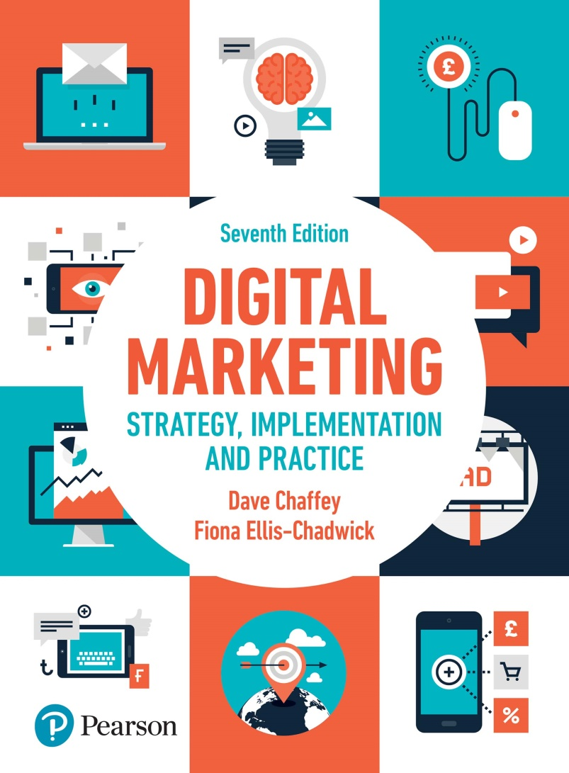
DIGITAL MARKETING STRATEGY, IMPLEMENTATION AND PRACTICE Seventh Edition
Part 2
Digital marketing strategy development
Chapter 5
Digital media and the marketing mix

Slide 2
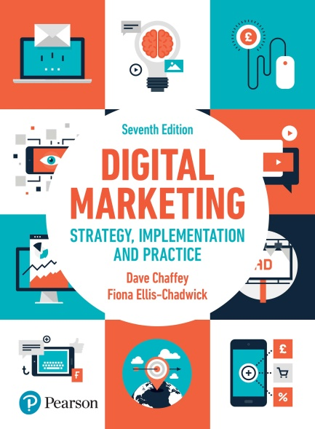
Chapter 5 Digital media and the marketing mix
Main topics:
Product
Price
Place
Promotion
People, process and physical evidence
Case study: Spotify streaming develops new revenue models

Slide 3
What is the marketing mix?
Notes:
Figure 5.1 The seven elements of the marketing mix

Slide 4
Product
Implications for digital technology for the product element of the mix
Options for varying the core product
Options for offering digital products
Options for changing the extended product
Conducting online research
Speed of new product development
Speed of new product diffusion

Slide 5
The long tail concept
Notes:
Figure 5.2 Zip’s law, showing decrease in popularity of items within an ordered sequence

Slide 6
Branding in a digital environment
Success factors for brand sites
Brand identity
Brand names for online brands

Slide 7
Price
Increased price transparency
Downward pressure on price
Innovative pricing approaches
Alternative pricing structure or policies
Notes:
Figure 5.3 mySupermarket aggregator (www.mysupermarket.co.uk)

Slide 8
Price elasticity of demand
Notes:
Figure 5.4 Price elasticity of demand for relatively elastic product

Slide 9
Price elasticity of demand for a relatively inelastic product
Notes:
Figure 5.5 Price elasticity of demand for a relatively inelastic product

Slide 10
Figure 5.6 Alternative pricing mechanisms

Slide 11
Place
Place of purchase
New channel structures
Channel conflicts
Virtual organisations

Slide 12
Promotion
Communications Tool | Online implementation
Advertising Selling Sales promotion Public relations Sponsorship Direct mail Exhibitions Merchandising Packaging Word of mouth | Interactive display ads, pay-per-click search advertising, targeted ads in social networks Virtual sales staff, site merchandising, assisted selling (including livechat) and affiliate marketing Incentives such as coupons, rewards, online loyalty schemes Online PR and influencer outreach, blogs, e-newsletters, newsletters, social networks, links and viral campaigns Sponsoring an online event, site or service Opt-in email using e-newsletters and focused ‘solus’ emails Webinars, virtual exhibitions and white-paper distribution Promotional ad-serving on retail sites, personalised recommendations and email alerts Virtual tours, real packaging displayed online Social, viral, affiliate marketing, email a friend, links
Notes:
Table 5.2 The main elements of the promotional mix

Slide 13
People Process and Physical evidence
People:
Customer define support query
Receipt of email and acknowledgement
Routing of emails
Compose response
Follow-up

Slide 14
Process:
Customer preferred channel
Company -preferred channel
Delivering customer services and assisted sales through Livechat

Slide 15
Physical evidence refers to:
A customer’s experience of the company through the web site and other digital media.

Slide 16
Case study: Spotify streaming develops new revenue models
Question:
Assess how Spotify compete with traditional and online music providers by reviewing the approaches it uses for different elements of the marketing mix
Source: https://www.recode.net/2018/2/28/17064460/spotify-ipo-charts-music-streaming-daniel-ek
Notes:
Figure 5.9 Changes in retail revenue in the US music industry

