Slide 1
Knowledge Representation & Reasoning (Part 1)
Propositional Logic
University of Berkeley, USA
http://www.aima.cs.berkeley.edu

Slide 2
Knowledge Representation & Reasoning
Introduction
How can we formalize our knowledge about the world so that:
  We can reason about it?
  We can do sound inference?
  We can prove things?
  We can plan actions?
  We can understand and explain things?

Slide 3
Knowledge Representation & Reasoning
Introduction
Objectives of knowledge representation and reasoning are:
  form representations of the world.
  use a process of inference to derive new representations about the world.
  use these new representations to deduce what to do.

Slide 4
Knowledge Representation & Reasoning
Introduction
Some definitions:
Knowledge base: set of sentences. Each sentence is expressed in a language called a knowledge representation language.
Sentence: a sentence represents some assertion about the world.
Inference: Process of deriving new sentences from old ones.

Slide 5
Knowledge Representation & Reasoning
Introduction
Declarative vs procedural approach:
  Declarative approach is an approach to system building that consists in expressing the knowledge of the environment in the form of sentences using a representation language.
  Procedural approach encodes desired behaviors directly as a program code.

Slide 6
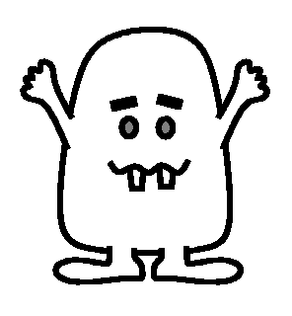
Knoweldge Representation & Reasoning
THE WUMPUS
Example: Wumpus world

Slide 7

Knoweldge Representation & Reasoning
Environment
Squares adjacent to wumpus are smelly.
Squares adjacent to pit are breezy.
Glitter if and only if gold is in the same square.
Shooting kills the wumpus if you are facing it.
Shooting uses up the only arrow.
Grabbing picks up the gold if in the same square.
Releasing drops the gold in the same square.
Goals: Get gold back to the start without entering it or wumpus square.
Percepts: Breeze, Glitter, Smell.
Actions: Left turn, Right turn, Forward, Grab, Release, Shoot.

Slide 8
Knoweldge Representation & Reasoning
The Wumpus world
Is the world deterministic?
  Yes: outcomes are exactly specified.
Is the world fully accessible?
  No: only local perception of square you are in.
Is the world static?
  Yes: Wumpus and Pits do not move.
Is the world discrete?
  Yes.

Slide 9
Knoweldge Representation & Reasoning
Exploring Wumpus World
A

Slide 10
Knoweldge Representation & Reasoning
Exploring Wumpus World
ok
Ok because:
Haven’t fallen into a pit.
Haven’t been eaten by a Wumpus.
A

Slide 11
Knoweldge Representation & Reasoning
Exploring Wumpus World
OK
OK | OK
OK since
  no Stench,
  no Breeze,
neighbors are safe (OK).
A

Slide 12
Knoweldge Representation & Reasoning
Exploring Wumpus World
OK stench
OK | OK
We move and smell a stench.
A

Slide 13
Knoweldge Representation & Reasoning
Exploring Wumpus World
W?
OK stench | W?
OK | OK
We can infer the following.
Note: square (1,1) remains OK.
A

Slide 14
Knoweldge Representation & Reasoning
Exploring Wumpus World
W?
OK stench | W?
OK | OK breeze
Move and feel a breeze
What can we conclude?
A

Slide 15
Knoweldge Representation & Reasoning
Exploring Wumpus World
W?
OK stench | P? W?
OK | OK breeze | P?
But, can the 2,2 square really have either a Wumpus or a pit?
NO!
A
And what about the other P? and W? squares

Slide 16
Knoweldge Representation & Reasoning
Exploring Wumpus World
W
OK stench | P? W?
OK | OK breeze | P
A

Slide 17
Knoweldge Representation & Reasoning
Exploring Wumpus World
W | OK
OK stench | OK | OK
OK | OK breeze | P
A

Slide 18
Knoweldge Representation & Reasoning
Exploring Wumpus World
W
OK Breeze | OK
OK | OK Stench | P
…
And the exploration continues onward until the gold is found.
…
A
A

Slide 19
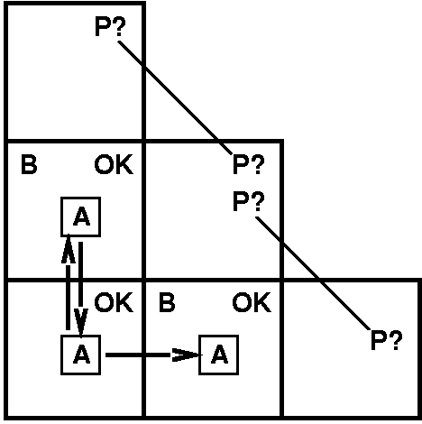
Knoweldge Representation & Reasoning
A tight spot
Breeze in (1,2) and (2,1)
  → no safe actions.
Assuming pits uniformly distributed, (2,2) is most likely to have a pit.

Slide 20
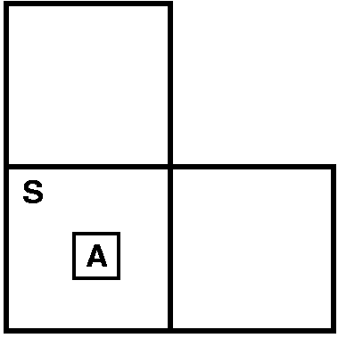
Knoweldge Representation & Reasoning
Another tight spot
Smell in (1,1)
  → cannot move.
Can use a strategy of coercion:
  shoot straight ahead;
  wumpus was there
      → dead → safe.
  wumpus wasn't there → safe.
W?
W?

Slide 21
Knoweldge Representation & Reasoning
Fundamental property of logical reasoning:
In each case where the agent draws a conclusion from the available information, that conclusion is guaranteed to be correct if the available information is correct.

Slide 22
Knoweldge Representation & Reasoning
Fundamental concepts of logical representation
Logics are formal languages for representing information such that conclusions can be drawn.
Each sentence is defined by a syntax and a semantic.
Syntax defines the sentences in the language. It specifies well formed sentences.
Semantics define the ``meaning'' of sentences;
  i.e., in logic it defines the truth of a sentence in a possible world.
For example, the language of arithmetic
  x + 2 ≥ y is a sentence.
  x + y > is not a sentence.
  x + 2 ≥ y is true iff the number x+2 is no less than the number y.
  x + 2 ≥ y is true in a world where x = 7, y =1.
  x + 2 ≥ y is false in a world where x = 0, y= 6.

Slide 23
Knoweldge Representation & Reasoning
Fundamental concepts of logical representation
Model: This word is used instead of “possible world” for sake of precision.
m is a model of a sentence α means α is true in model m
Definition: A model is a mathematical abstraction that simply fixes the truth or falsehood of every relevant sentence.
Example: x number of men and y number of women sitting at a table playing bridge.
x+ y = 4 is a sentence which is true when the total number is four.
Model : possible assignment of numbers to the variables x and y. Each assignment fixes the truth of any sentence whose variables are x and y.

Slide 24
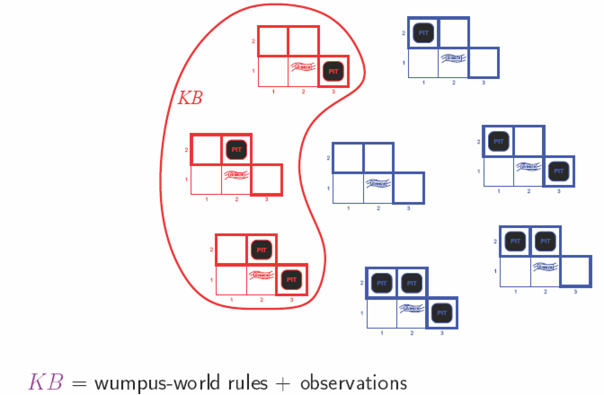
Knoweldge Representation & Reasoning
Potential models of the Wumpus world
A model is an instance of the world. A model of a set of sentences is an instance of the world where these sentences are true.

Slide 25
Knoweldge Representation & Reasoning
Entailment: Logical reasoning requires the relation of logical entailment between sentences. ⇒ « a sentence follows logically from another sentence ».
Mathematical notation: α╞ β (α entails the sentenceβ)
Formal definition: α╞ β if and only if in every model in which α is true, β is also true. (truth of β is contained in the truth of α).
Fundamental concepts of logical representation

Slide 26
Entailment
Fundamental concepts of logical representation
Entail
Sentences
α
Sentences
KB
Logical
Representation
Semantics
Semantics
Follows
World
Facts
Facts
Logical reasoning should ensure that the new configurations represent aspects of the world that actually follow from the aspects that the old configurations represent.

Slide 27
Knoweldge Representation & Reasoning
Model cheking: Enumerates all possible models to check that α is true in all models in which KB is true.
Mathematical notation: KB α
The notation says: α is derived from KB by i or i derives α from KB. I is an inference algorithm.
Fundamental concepts of logical representation
i

Slide 28
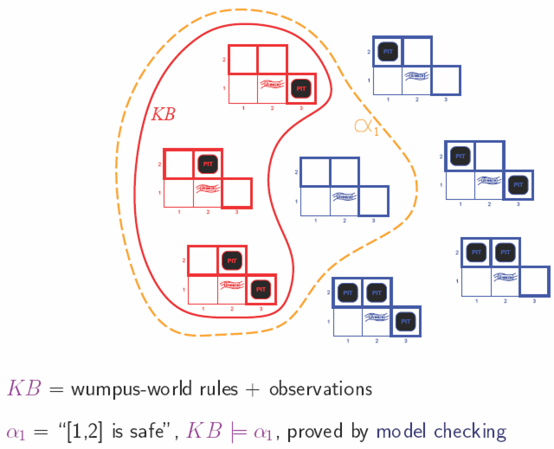
Knoweldge Representation & Reasoning
Fundamental concepts of logical representation
Entailment

Slide 29
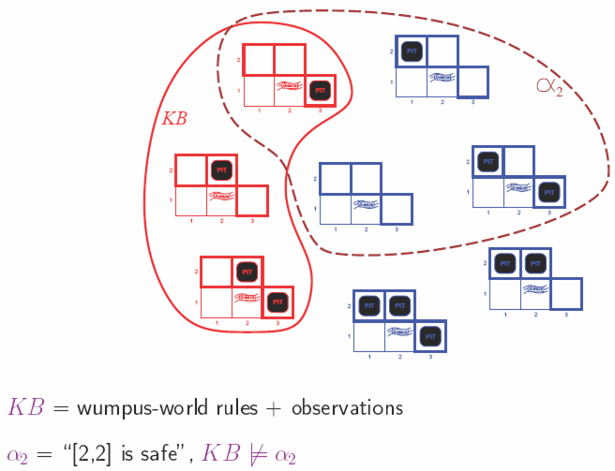
Knoweldge Representation & Reasoning
Fundamental concepts of logical representation
Entailment again

Slide 30
Knoweldge Representation & Reasoning
Fundamental concepts of logical representation
An inference procedure can do two things:
  Given KB, generate new sentence α purported to be entailed by KB.
  Given KB and α, report whether or not α is entailed by KB.
Sound or truth preserving: inference algorithm that derives only entailed sentences.
Completeness: an inference algorithm is complete, if it can derive any sentence that is entailed.

Slide 31
Knoweldge Representation & Reasoning
Explaining more Soundness and completeness
Soundness: if the system proves that something is true, then it really is true. The system doesn’t derive contradictions
Completeness: if something is really true, it can be proven using the system. The system can be used to derive all the true mathematical statements one by one

Slide 32
Knoweldge Representation & Reasoning
Propositional Logic
Propositional logic is the simplest logic.
  Syntax
  Semantic
  Entailment

Slide 33
Knoweldge Representation & Reasoning
Propositional Logic
Syntax: It defines the allowable sentences.
Atomic sentence:
- single proposition symbol.
- uppercase names for symbols must have some mnemonic value: example W_{1,3} to say the wumpus is in [1,3].
True and False: proposition symbols with fixed meaning.
Complex sentences: they are constructed from simpler sentences using logical connectives.

Slide 34
Knoweldge Representation & Reasoning
Propositional Logic
Logical connectives:
    ¬(NOT) negation.
    ∧(AND) conjunction, operands are conjuncts.
    ∨ (OR), operands are disjuncts.
    ⇒ implication (or conditional) A ⇒ B, A is the premise or antecedent and B is the conclusion or consequent. It is also known as rule or if-then statement.
    ⬆ if and only if (biconditional).

Slide 35
Knoweldge Representation & Reasoning
Propositional Logic
Logical constants TRUE and FALSE are sentences.
Proposition symbols P1, P2 etc. are sentences.
Symbols P1 and negated symbols ¬ P1 are called literals.
If S is a sentence, ¬ S is a sentence (NOT).
If S1 and S2 is a sentence, S1 ∧ S2 is a sentence (AND).
If S1 and S2 is a sentence, S1 ∨ S2 is a sentence (OR).
If S1 and S2 is a sentence, S1 ⇒ S2 is a sentence (Implies).
If S1 and S2 is a sentence, S1 ⇔ S2 is a sentence (Equivalent).

Slide 36
Knoweldge Representation & Reasoning
Propositional Logic
A BNF(Backus-Naur Form) grammar of sentences in propositional Logic is defined by the following rules.
Sentence → AtomicSentence │ComplexSentence
AtomicSentence → True │ False │ Symbol
Symbol → P │ Q │ R …
ComplexSentence → ¬ Sentence
│(Sentence ∧ Sentence)
│(Sentence ∨ Sentence)
│(Sentence ⇒ Sentence)
│(Sentence ⇔ Sentence)

Slide 37
Knoweldge Representation & Reasoning
Propositional Logic
Order of precedence
From highest to lowest:
    parenthesis ( Sentence )
      NOT ¬
      AND ∧
      OR ∨
      Implies ⇒
      Equivalent ⇔
    Special cases: A ∨ B ∨ C no parentheses are needed
    What about A ⇒ B ⇒ C???

Slide 38
Knoweldge Representation & Reasoning
Propositional Logic
Semantic: It defines the rules for determining the truth of a sentence with respect to a particular model.
The question: How to compute the truth value of ny sentence given a model?

Slide 39
Knoweldge Representation & Reasoning
Most sentences are sometimes true.
P ∧ Q
Some sentences are always true (valid).
¬ P ∨ P
Some sentences are never true (unsatisfiable).
¬ P ∧ P
Model of
P ∧ Q

Slide 40
Knoweldge Representation & Reasoning
Implication: P ⇒ Q
“If P is True, then Q is true; otherwise I’m making no claims about the truth of Q.” (Or: P ⇒ Q is equivalent to ¬Ρ∨Q)
Under this definition, the following statement is true
Pigs_fly ⇒ Everyone_gets_an_A
Since “Pigs_Fly” is false, the statement is true irrespective of the truth of “Everyone_gets_an_A”. [Or is it? Correct inference only when “Pigs_Fly” is known to be false.]

Slide 41
Knoweldge Representation & Reasoning
Propositional Inference: Enumeration Method
Let α=Α ∨ Β and
KB =(Α ∨ C) ∧(B ∨ ¬C)
Is it the case that KB α ?
Check all possible models -- α must be true whenever KB is true.
A | B | C | KB (Α ∨ C) ∧ (B ∨ ¬C) | α Α ∨ Β
False | False | False | False | False
False | False | True | False | False
False | True | False | False | True
False | True | True | True | True
True | False | False | True | True
True | False | True | False | True
True | True | False | True | True
True | True | True | True | True

Slide 42
Knoweldge Representation & Reasoning
A | B | C | KB (Α ∨ C) ∧ (B ∨ ¬C) | α Α ∨ Β
False | False | False | False | False
False | False | True | False | False
False | True | False | False | True
False | True | True | True | True
True | False | False | True | True
True | False | True | False | True
True | True | False | True | True
True | True | True | True | True

Slide 43
Knoweldge Representation & Reasoning
A | B | C | KB (Α ∨ C) ∧ (B ∨ ¬C) | α Α ∨ Β
False | False | False | False | False
False | False | True | False | False
False | True | False | False | True
False | True | True | True | True
True | False | False | True | True
True | False | True | False | True
True | True | False | True | True
True | True | True | True | True
KB ╞ α

Slide 44
Knoweldge Representation & Reasoning
Propositional Logic: Proof methods
Model checking
Truth table enumeration (sound and complete for propositional logic).
For n symbols, the time complexity is O(2^{n}).
Need a smarter way to do inference
Application of inference rules
Legitimate (sound) generation of new sentences from old.
Proof = a sequence of inference rule applications.
Can use inference rules as operators in a standard search algorithm.

Slide 45
Knoweldge Representation & Reasoning
Validity and Satisfiability
A sentence is valid (a tautology) if it is true in all models
e.g., True, A ∨ ¬A, A ⇒ A, (A ∧ (A ⇒ B)) ⇒ B
Validity is connected to inference via the Deduction Theorem:
KB ╞ α if and only if (KB ∧ α) is valid
A sentence is satisfiable if it is true in some model
e.g., A ∨ B
A sentence is unsatisfiable if it is false in all models
e.g., A ∧ ¬A
Satisfiability is connected to inference via the following:
KB ╞ α if and only if (KB ∧ ¬α) is unsatisfiable
(there is no model for which KB=true and α is false)

Slide 46
Knoweldge Representation & Reasoning
Propositional Logic: Inference rules
An inference rule is sound if the conclusion is true in all cases where the premises are true.
    α Premise
    _____
    β Conclusion

Slide 47
Knoweldge Representation & Reasoning
Propositional Logic: An inference rule: Modus Ponens
From an implication and the premise of the implication, you can infer the conclusion.
    α ⇒ β, α Premise
    ___________
    β Conclusion
Example:
“raining implies soggy courts”, “raining”
Infer: “soggy courts”

Slide 48
Knoweldge Representation & Reasoning
Propositional Logic: An inference rule: Modus Tollens
From an implication and the premise of the implication, you can infer the conclusion.
    α ⇒ β, ¬ β Premise
    ___________
    ¬ α Conclusion
Example:
“raining implies soggy courts”, “courts not soggy”
Infer: “not raining”

Slide 49
Knoweldge Representation & Reasoning
Propositional Logic: An inference rule: AND elimination
From a conjunction, you can infer any of the conjuncts.
    α1∧ α2∧ … αn Premise
    _______________
    αi Conclusion
Question: show that Modus Ponens and And Elimination are sound?

Slide 50
Knoweldge Representation & Reasoning
Propositional Logic: other inference rules
And-Introduction
    α₁, α₂, …, α_{n} Premise
    _______________
    α₁∧ α₂∧ … α_{n} Conclusion
Double Negation
    ¬¬α Premise
    _______
    α Conclusion
Rules of equivalence can be used as inference rules. (Tutorial).

Slide 51
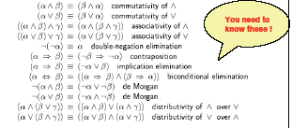
Knoweldge Representation & Reasoning
Propositional Logic: Equivalence rules
Two sentences are logically equivalent iff they are true in the same models: α ≡ ß iff α╞ β and β╞ α.

Slide 52
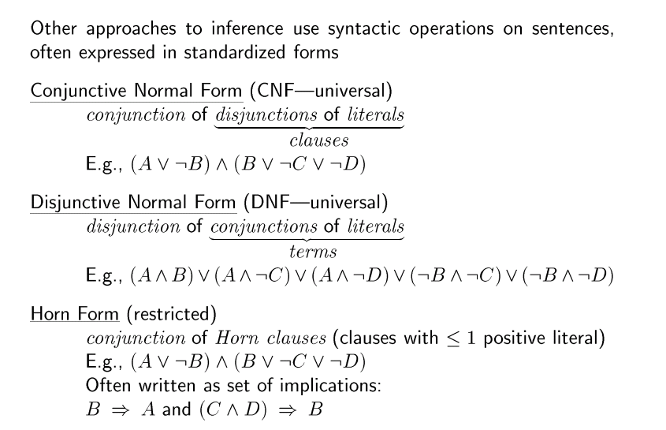
Knoweldge Representation & Reasoning

Slide 53
Knoweldge Representation & Reasoning
Inference in Wumpus World
Let S_{i,j} be true if there is a stench in cell i,j
Let B_{i,j} be true if there is a breeze in cell i,j
Let W_{i,j} be true if there is a Wumpus in cell i,j
Given:
1. ¬B1,1
2. B1,1 ⇔ (P1,2 ∨ P2,1)
Let’s make some inferences:
1. (B1,1 ⇒ (P1,2 ∨ P2,1)) ∧ ((P1,2 ∨ P2,1) ⇒ B1,1 )
(By definition of the biconditional)
2. (P1,2 ∨ P2,1) ⇒ B1,1 (And-elimination)
3. ¬B1,1 ⇒ ¬(P1,2 ∨ P2,1) (equivalence with contrapositive)
4. ¬(P1,2 ∨ P2,1) (modus ponens)
5. ¬P1,2 ∧ ¬P2,1 (DeMorgan’s rule)
6. ¬P1,2 (And Elimination)

Slide 54
Knoweldge Representation & Reasoning
Inference in Wumpus World
Initial KB
Some inferences:
Apply Modus Ponens to R₁
  Add to KB
  ¬W_{1,1} ∧ ¬W_{2,1} ∧ ¬W_{1,2}
Apply to this AND-Elimination
  Add to KB
  ¬W_{1,1}
  ¬W_{2,1}
  ¬W_{1,2}
Percept Sentences
¬S_{1,1} ¬B_{1,1}
S_{2,1} ¬ B_{2,1}
¬S_{1,2} B_{1,2}
…
Environment Knowledge
R₁: ¬S_{1,1}⇒ ¬W_{1,1}∧ ¬W_{2,1}∧ ¬W_{1,2}
R₂: S_{2,1}⇒ W_{1,1} ∨ W_{2,1} ∨ W_{2,2} ∨ W_{3,1}
R₃: ¬B_{1,1} ⇒ ¬P_{1,1}∧ ¬P_{2,1}∧ ¬P_{1,2}
R₅: B_{1,2} ⇒ P_{1,1}∨ P_{1,2} ∨ P_{2,2} ∨ P_{1,3}
...

Slide 55
Knoweldge Representation & Reasoning
Recall that when we were at (2,1) we could not decide on a safe move, so we backtracked, and explored (1,2), which yielded ¬B_{1,2}.
¬B_{1,2} ⇔ ¬P_{1,1} ∧ ¬P_{1,3} ∧ ¬P_{2,2} this yields to
¬P_{1,1} ∧ ¬P_{1,3} ∧ ¬P_{2,2} and consequently
¬P_{1,1} , ¬P_{1,3} , ¬P_{2,2}
• Now we can consider the implications of B_{2,1}.

Slide 56
Knoweldge Representation & Reasoning
B_{2,1} ⇔ (P_{1,1} ∨ P_{2,2} ∨ P_{3,1})
B_{2,1} ⇒ (P_{1,1} ∨ P_{2,2} ∨ P_{3,1}) (biconditional Elimination)
P_{1,1} ∨ P_{2,2} ∨ P_{3,1} (modus ponens)
P_{1,1} ∨ P_{3,1} (resolution rule because no pit in (2,2))
P_{3,1} (resolution rule because no pit in (1,1))
The resolution rule: if there is a pit in (1,1) or (3,1), and it’s not in (1,1), then it’s in (3,1).
P_{1,1} ∨ P_{3,1}, ¬P_{1,1}
P_{3,1}

Slide 57
Knoweldge Representation & Reasoning
Resolution
Unit Resolution inference rule:
l₁ ∨ … ∨ l_{k}, m
l₁ ∨ … ∨ l_{i-1} ∨ l_{i+1} ∨ … ∨ l_{k}
where l_{i} and m are complementary literals.

Slide 58
Knoweldge Representation & Reasoning
Resolution
Full resolution inference rule:
l₁ ∨ … ∨ l_{k}, m₁ ∨ … ∨ m_{n}
l₁∨ … ∨l_{i-1}∨l_{i+1} ∨…∨l_{k}∨m₁∨…∨m_{j-1}∨m_{j+1}∨...∨ m_{n}
where l_{i} and m are complementary literals.

Slide 59
Knoweldge Representation & Reasoning
Resolution
For simplicity let’s consider clauses of length two:
l₁ ∨ l₂, ¬l₂ ∨ l₃
l₁ ∨ l₃
To derive the soundness of resolution consider the values l₂ can take:
• If l₂ is True, then since we know that ¬l₂ ∨ l₃ holds, it
must be the case that l3 is True.
• If l₂ is False, then since we know that l₁ ∨ l₂ holds, it
must be the case that l₁ is True.

Slide 60
Knoweldge Representation & Reasoning
Resolution
1. Properties of the resolution rule:
  • Sound
  • Complete (yields to a complete inference algorithm).
2. The resolution rule forms the basis for a family of complete inference algorithms.
3. Resolution rule is used to either confirm or refute a sentence but it cannot be used to enumerate true sentences.

Slide 61
Knoweldge Representation & Reasoning
Resolution
4. Resolution can be applied only to disjunctions of literals. How can it lead to a complete inference procedure for all propositional logic?
5. Turns out any knowledge base can be expressed as a conjunction of disjunctions (conjunctive normal form, CNF).
E.g., (A ∨ ¬B) ∧ (B ∨ ¬C ∨ ¬D)

Slide 62
Knoweldge Representation & Reasoning
Resolution: Inference procedure
6. Inference procedures based on resolution work by using the principle of proof by contadiction:
To show that KB ╞ α we show that (KB ∧ ¬α) is unsatisfiable
The process: 1. convert KB ∧ ¬α to CNF
2. resolution rule is applied to the resulting clauses.

Slide 63
Knoweldge Representation & Reasoning
Resolution: Inference procedure
Function PL-RESOLUTION(KB,α) returns true or false
Clauses ← the set of clauses in the CNF representation of (KB∧¬α) ;
New ←{};
Loop Do
For each (C_{i} C_{j} ) in clauses do
resolvents ← PL-RESOLVE (C_{i} C_{j} );
If resolvents contains the empty clause then return true;
New ← new ∪ resolvents
If new ⊆ clauses then return false
Clauses ← clauses ∪ new

Slide 64
Knoweldge Representation & Reasoning
Resolution: Inference procedure
Function PL-RESOLVE (C_{i} C_{j} ) applies the resolution rule to (C_{i} C_{j} ).
The process continues until one of two things happens:
  There are no new clauses that can be added , in which case KB does not entail α, or
  Two clauses resolve to yield the empty clause, in which case KB entails α.

Slide 65

Knoweldge Representation & Reasoning
Resolution: Inference procedure:
Example of proof by contradiction
KB = (B_{1,1} ⇔ (P_{1,2} ∨ P_{2,1})) ∧ ¬ B_{1,1}
α = ¬P_{1,2}
Question: convert (KB ∧ ¬α) to CNF

Slide 66
Knoweldge Representation & Reasoning
Inference for Horn clauses
Horn Form (special form of CNF): disjunction of literals of which at most one is positive.
KB = conjunction of Horn clauses
Horn clause = propositional symbol; or
(conjunction of symbols) ⇒ symbol
Modus Ponens is a natural way to make inference in Horn KBs

Slide 67
Knoweldge Representation & Reasoning
Inference for Horn clauses
α1, … ,αn, α1 ∧ … ∧ αn ⇒ β
β
Successive application of modus ponens leads to algorithms that are sound and complete, and run in linear time

Slide 68
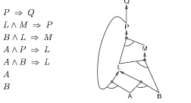
Knoweldge Representation & Reasoning
Inference for Horn clauses: Forward chaining
• Idea: fire any rule whose premises are satisfied in the KB and add its conclusion to the KB, until query is found.
Forward chaining is sound and complete
for horn knowledge bases

Slide 69
Knoweldge Representation & Reasoning
Inference for Horn clauses: backward chaining
• Idea: work backwards from the query q:
check if q is known already, or prove by backward chaining all premises of some rule concluding q.
Avoid loops:
check if new subgoal is already on the goal stack
Avoid repeated work: check if new subgoal has already been proved true, or has already failed

Slide 70
Summary
Logical agents apply inference to a knowledge base to derive new information and make decisions.
Basic concepts of logic:
  Syntax: formal structure of sentences.
  Semantics: truth of sentences wrt models.
  Entailment: necessary truth of one sentence given another.
  Inference: deriving sentences from other sentences.
  Soundess: derivations produce only entailed sentences.
  Completeness: derivations can produce all entailed sentences.
Truth table method is sound and complete for propositional logic but Cumbersome in most cases.
Application of inference rules is another alternative to perform entailment.

