Slide 1
Constraint Satisfaction Problems
University of Berkeley, USA
http://www.aima.cs.berkeley.edu

Slide 2
Constraint Satisfaction Problems (CSPs)
Standard search problem:
state is a "black box“ – any data structure that supports successor function, heuristic function, and goal test
CSP:
state is defined by variables X_{i} with values from domain D_{i}
goal test is a set of constraints specifying allowable combinations of values for subsets of variables

Slide 3
Constraint satisfaction problem
A CSP is defined by
a set of variables
a domain of values for each variable
a set of constraints between variables
A solution is
an assignment of a value to each variable that satisfies the constraints

Slide 4
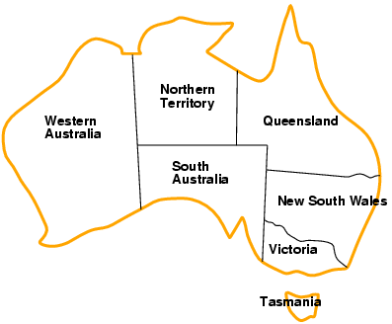
Example: Map-Coloring
Variables WA, NT, Q, NSW, V, SA, T
Domains D_{i} = {red,green,blue}
Constraints: adjacent regions must have different colors
e.g., WA ≠ NT

Slide 5
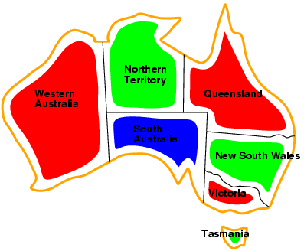
Example: Map-Coloring
Solutions are complete and consistent assignments, e.g., WA = red, NT = green, Q = red, NSW = green, V = red, SA = blue, T = green
A state may be incomplete e.g., just WA=red

Slide 6
Constraint graph
Binary CSP: each constraint relates two variables
Constraint graph: nodes are variables, arcs are constraints
NT
Q
WA
NSW
SA
V
T

Slide 7
Varieties of CSPs
Discrete variables
finite domains:
n variables, domain size d → O(d^{n}) complete assignments
e.g., Boolean CSPs, incl. Boolean satisfiability (NP-complete)
infinite domains:
integers, strings, etc.
e.g., job scheduling, variables are start/end days for each job
need a constraint language, e.g., StartJob₁ + 5 ≤ StartJob₃
Continuous variables
e.g., start/end times for Hubble Space Telescope observations
linear constraints solvable in polynomial time by linear programming

Slide 8
Varieties of constraints
Unary constraints involve a single variable,
e.g., SA ≠ green
Binary constraints involve pairs of variables,
e.g., SA ≠ WA
Higher-order constraints involve 3 or more variables,
e.g., cryptarithmetic column constraints

Slide 9
Constraint Satisfaction problem
Backtracking Search

Slide 10
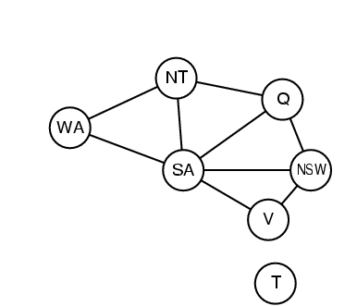
Standard search formulation
Let’s try the standard search formulation.
We need:
Initial state: none of the variables has a value (color)
Successor state: one of the variables without a value will get some value.
Goal: all variables have a value and none of the constraints is violated.
NxD
N layers
WA
WA
WA
NT
T
[NxD]x[(N-1)xD]
WA
NT
WA
NT
WA
NT
NT
WA
Equal!
N! x D^{N}
There are N! x D^{N} nodes in the tree but only D^{N} distinct states??

Slide 11
Backtracking search
Every solution appears at depth n with n variables → use depth-first search
Depth-first search for CSPs with single-variable assignments is called backtracking search
Backtracking search is the basic uninformed algorithm for CSPs
Can solve n-queens for n ≈ 25

Slide 12
Backtracking (Depth-First) search
Special property of CSPs: They are commutative:
This means: the order in which we assign variables
does not matter.
Better search tree: First order variables, then assign them values one-by-one.
NT
WA
=
WA
NT
D
WA
WA
WA
WA
NT
D²
WA
NT
WA
NT
D^{N}

Slide 13
Backtracking search

Slide 14
Backtracking example

Slide 15
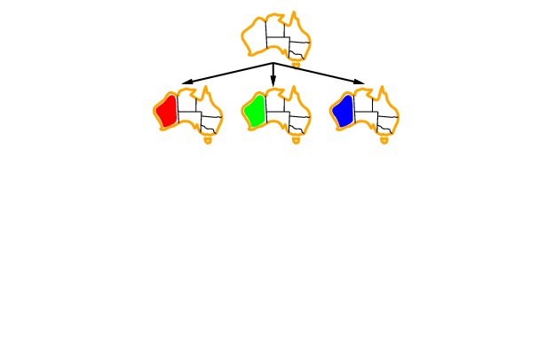
Backtracking example

Slide 16
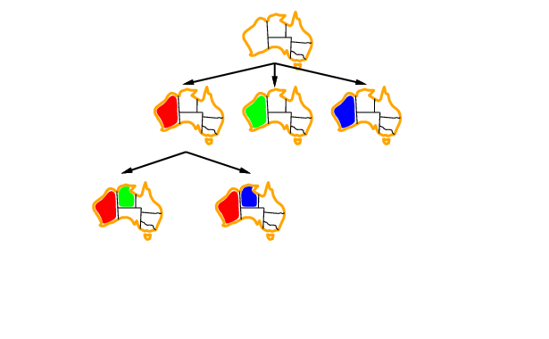
Backtracking example

Slide 17
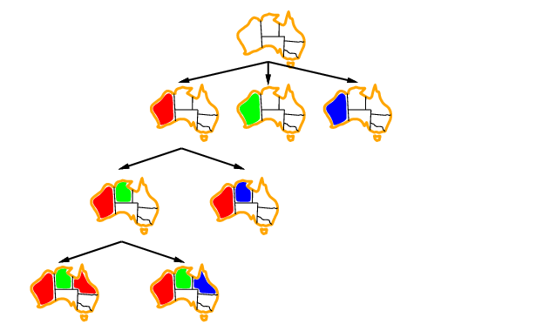
Backtracking example

Slide 18
Depth First Search (DFS)
Application:
Given the following state space (tree search), give the sequence of visited nodes when using DFS (assume that the nodeO is the goal state):
A
B
C
D
E
F
G
H
I
J
K
L
M
N
O

Slide 19
Depth First Search
A,
A
B
C
D
E

Slide 20
Depth First Search
A,B,
A
B
C
D
E
F
G

Slide 21
Depth First Search
A,B,F,
A
B
C
D
E
F
G

Slide 22
Depth First Search
A,B,F,
G,
A
B
C
D
E
F
G
K
L

Slide 23
Depth First Search
A,B,F,
G,K,
A
B
C
D
E
F
G
K
L

Slide 24
Depth First Search
A,B,F,
G,K,
L,
A
B
C
D
E
F
G
K
L
O

Slide 25
Depth First Search
A,B,F,
G,K,
L, O: Goal State
A
B
C
D
E
F
G
K
L
O

Slide 26
Depth First Search
The returned solution is the sequence of operators in the path: A, B, G, L, O : assignments when using CSP !!!
A
B
C
D
E
F
G
K
L
O

Slide 27
Backtracking
Example 1

Slide 28
Example of a csp
A
B
E
C
D
H
F
G
3 colour me!

Slide 29
Example of a csp
{blue, green, red}
{blue, green, red}
A
B
{blue, green, red}
E
C
{blue, green, red}
D
{blue, green, red}
H
{blue, green, red}
F
G
{blue, green, red}
{blue, green, red}
3 colour me!

Slide 30
Example of a csp
A
B
E
C
D
H
F
G
1 = red
2 = blue
3 = green

Slide 31
Example of a csp
A
B
E
C
D
H
F
G
1 = red
2 = blue
3 = green

Slide 32
Example of a csp
A
B
E
C
D
H
F
G
1 = red
2 = blue
3 = green

Slide 33
Example of a csp
A
B
E
C
D
H
F
G
1 = red
2 = blue
3 = green

Slide 34
Example of a csp
A
B
E
C
D
H
F
G
1 = red
2 = blue
3 = green

Slide 35
Example of a csp
A
B
E
C
D
H
F
G
1 = red
2 = blue
3 = green

Slide 36
Example of a csp
A
B
E
C
D
H
F
G
1 = red
2 = blue
3 = green

Slide 37
Example of a csp
A
B
E
C
D
H
F
G
1 = red
2 = blue
3 = green

Slide 38
Example of a csp
A
B
E
C
D
H
F
G
1 = red
2 = blue
3 = green

Slide 39
Example of a csp
A
B
E
C
D
H
F
G
1 = red
2 = blue
3 = green

Slide 40
Example of a csp
A
B
E
C
D
H
F
G
1 = red
2 = blue
3 = green

Slide 41
Example of a csp
A
B
E
C
D
H
F
G
1 = red
2 = blue
3 = green

Slide 42
Example of a csp
A
B
E
C
D
H
F
G
1 = red
2 = blue
3 = green

Slide 43
Example of a csp
A
B
E
C
D
H
F
G
1 = red
2 = blue
3 = green

Slide 44
Example of a csp
A
B
E
C
D
H
F
G
1 = red
2 = blue
3 = green

Slide 45
Example of a csp
A
B
E
C
D
H
F
G
1 = red
2 = blue
3 = green

Slide 46
Example of a csp
A
B
E
C
D
H
F
G
1 = red
2 = blue
3 = green

Slide 47
Example of a csp
A
B
E
C
D
H
F
G
1 = red
2 = blue
3 = green

Slide 48
Example of a csp
A
B
E
C
D
H
F
G
1 = red
2 = blue
3 = green

Slide 49
Example of a csp
A
B
E
C
D
H
F
G
1 = red
2 = blue
3 = green

Slide 50
Example of a csp
A
B
E
C
D
H
F
G
1 = red
2 = blue
3 = green

Slide 51
Example of a csp
A
B
E
C
D
H
F
G
1 = red
2 = blue
3 = green

Slide 52
Example of a csp
A
B
E
C
D
H
F
G
1 = red
2 = blue
3 = green

Slide 53
Example of a csp
A
B
E
C
D
H
Solution !!!!
F
G
1 = red
2 = blue
3 = green

Slide 54
Backpropagation
Example 2

Slide 55
Backpropagation
[R,B,G]
[R,B,G]
[R]
[R,B,G]
[R,B,G]

Slide 56
Backpropagation
[R,B,G]
[R,B,G]
[R]
[R,B,G]
[R,B,G]

Slide 57
Backpropagation
[R,B,G]
[R,B,G]
[R]
[R,B,G]
[R,B,G]

Slide 58
Backpropagation
[R,B,G]
[R,B,G]
[R]
[R,B,G]
[R,B,G]

Slide 59
Backpropagation
[R,B,G]
[R,B,G]
[R]
[R,B,G]
[R,B,G]

Slide 60
Backpropagation
[R,B,G]
[R,B,G]
[R]
[R,B,G]
[R,B,G]
Dead End → Backtrack

Slide 61
Backpropagation
[R,B,G]
[R,B,G]
[R]
[R,B,G]
[R,B,G]

Slide 62
Backpropagation
[R,B,G]
[R,B,G]
[R]
[R,B,G]
[R,B,G]

Slide 63
Backpropagation
[R,B,G]
[R,B,G]
[R]
[R,B,G]
[R,B,G]
Solution !!!

Slide 64
Improving backtracking efficiency

Slide 65
Improving backtracking efficiency
General-purpose methods can give huge gains in speed:
Which variable should be assigned next?
In what order should its values be tried?
Can we detect inevitable failure early?

Slide 66
Most constrained variable Minimum Remaining Values (MRV)
Most constrained variable:
choose the variable with the fewest legal values
Called minimum remaining values (MRV) heuristic
Picks a variable which will cause failure as soon as possible, allowing the tree to be pruned.

Slide 67
Backpropagation MRV minimum remaining values
choose the variable with the fewest legal values

Slide 68
Backpropagation - MRV
[R,B,G]
[R,B,G]
[R]
[R,B,G]
[R,B,G]

Slide 69
Backpropagation - MRV
[R,B,G]
[R,B,G]
[R]
[R,B,G]
[R,B,G]

Slide 70
Backpropagation - MRV
[R,B,G]
[R,B,G]
[R]
[R,B,G]
[R,B,G]

Slide 71
Backpropagation - MRV
[R,B,G]
[R,B,G]
[R]
[R,B,G]
[R,B,G]

Slide 72
Backpropagation - MRV
[R,B,G]
[R,B,G]
[R]
[R,B,G]
[R,B,G]

Slide 73
Backpropagation - MRV
[R,B,G]
[R,B,G]
[R]
[R,B,G]
[R,B,G]
Solution !!!

Slide 74
Most constraining variable MCV
Tie-breaker among most constrained variables
Most constraining variable:
choose the variable with the most constraints on remaining variables (most edges in graph)

Slide 75
Backpropagation MCV Most Constraining variable
choose the variable with the most constraints on remaining variables

Slide 76
Backpropagation - MCV
[R,B,G]
[R,B,G]
4 arcs
2 arcs
2 arcs
[R]
3 arcs
3 arcs
[R,B,G]
[R,B,G]

Slide 77
Backpropagation - MCV
[R,B,G]
[R,B,G]
4 arcs
2 arcs
2 arcs
[R]
3 arcs
3 arcs
[R,B,G]
[R,B,G]

Slide 78
Backpropagation - MCV
[R,B,G]
[R,B,G]
4 arcs
2 arcs
2 arcs
[R]
3 arcs
3 arcs
[R,B,G]
[R,B,G]

Slide 79
Backpropagation - MCV
[R,B,G]
[R,B,G]
4 arcs
2 arcs
2 arcs
[R]
3 arcs
3 arcs
[R,B,G]
[R,B,G]

Slide 80
Backpropagation - MCV
[R,B,G]
[R,B,G]
4 arcs
2 arcs
2 arcs
[R]
Dead End
3 arcs
3 arcs
[R,B,G]
[R,B,G]

Slide 81
Backpropagation - MCV
[R,B,G]
[R,B,G]
4 arcs
2 arcs
2 arcs
[R]
3 arcs
3 arcs
[R,B,G]
[R,B,G]

Slide 82
Backpropagation - MCV
[R,B,G]
[R,B,G]
4 arcs
2 arcs
2 arcs
[R]
3 arcs
3 arcs
[R,B,G]
[R,B,G]

Slide 83
Backpropagation - MCV
[R,B,G]
[R,B,G]
4 arcs
2 arcs
2 arcs
[R]
3 arcs
3 arcs
[R,B,G]
[R,B,G]

Slide 84
Backpropagation - MCV
[R,B,G]
[R,B,G]
4 arcs
2 arcs
2 arcs
[R]
Dead End
3 arcs
3 arcs
[R,B,G]
[R,B,G]

Slide 85
Backpropagation - MCV
[R,B,G]
[R,B,G]
4 arcs
2 arcs
2 arcs
[R]
3 arcs
3 arcs
[R,B,G]
[R,B,G]

Slide 86
Backpropagation - MCV
[R,B,G]
[R,B,G]
4 arcs
2 arcs
2 arcs
[R]
3 arcs
3 arcs
[R,B,G]
[R,B,G]

Slide 87
Backpropagation - MCV
[R,B,G]
[R,B,G]
4 arcs
2 arcs
2 arcs
[R]
3 arcs
3 arcs
[R,B,G]
[R,B,G]

Slide 88
Backpropagation - MCV
[R,B,G]
[R,B,G]
4 arcs
2 arcs
2 arcs
[R]
3 arcs
3 arcs
[R,B,G]
[R,B,G]

Slide 89
Backpropagation - MCV
[R,B,G]
[R,B,G]
4 arcs
2 arcs
2 arcs
[R]
3 arcs
3 arcs
[R,B,G]
[R,B,G]
Solution !!!

Slide 90
Least constraining value LCV
Given a variable, choose the least constraining value:
the one that rules out (eliminate) the fewest values in the remaining variables
Combining these heuristics makes 1000 queens feasible

Slide 91
Backpropagation LCV Least Constraining Value
choose the value which eliminates the fewest number of values in the remaining variables

Slide 92
Backpropagation - LCV
[R,B,G]
[R,B,G]
4 arcs
2 arcs
2 arcs
[R]
3 arcs
3 arcs
[R,B,G]
[R,B,G]

Slide 93
Backpropagation - LCV
[R,B,G]
[R,B,G]
4 arcs
2 arcs
2 arcs
[R]
3 arcs
3 arcs
[R,B,G]
[R,B,G]

Slide 94
Backpropagation - LCV
[R,B,G]
[R,B,G]
4 arcs
2 arcs
2 arcs
[R]
3 arcs
3 arcs
[R,B,G]
[R,B,G]

Slide 95
Backpropagation - LCV
[R,B,G]
[R,B,G]
4 arcs
2 arcs
2 arcs
[R]
3 arcs
3 arcs
[R,B,G]
[R,B,G]

Slide 96
Backpropagation - LCV
[R,B,G]
[R,B,G]
4 arcs
2 arcs
2 arcs
[R]
3 arcs
3 arcs
[R,B,G]
[R,B,G]

Slide 97
Backpropagation - LCV
[R,B,G]
[R,B,G]
4 arcs
2 arcs
2 arcs
[R]
3 arcs
3 arcs
[R,B,G]
[R,B,G]
Dead End

Slide 98
Backpropagation - LCV
[R,B,G]
[R,B,G]
4 arcs
2 arcs
2 arcs
[R]
3 arcs
3 arcs
[R,B,G]
[R,B,G]

Slide 99
Backpropagation - LCV
[R,B,G]
[R,B,G]
4 arcs
2 arcs
2 arcs
[R]
3 arcs
3 arcs
[R,B,G]
[R,B,G]

Slide 100
Backpropagation - LCV
[R,B,G]
[R,B,G]
4 arcs
2 arcs
2 arcs
[R]
3 arcs
3 arcs
[R,B,G]
[R,B,G]

Slide 101
Backpropagation - LCV
[R,B,G]
[R,B,G]
4 arcs
2 arcs
2 arcs
[R]
3 arcs
3 arcs
Solution !!!
[R,B,G]
[R,B,G]

Slide 102
Constraint Satisfaction problem
Forward Checking

Slide 103
Forward Checking
Assigns variable X, say
Looks at each unassigned variable, Y say, connected to X and delete from Y’s domain any value inconsistent with X’s assignment
Eliminates branching on certain variables by propagating information
If forward checking detects a dead end, algorithm will backtrack immediately.

Slide 104
Forward checking
Idea:
Keep track of remaining legal values for unassigned variables
Terminate search when any variable has no legal values

Slide 105
Forward checking
Idea:
Keep track of remaining legal values for unassigned variables
Terminate search when any variable has no legal values

Slide 106
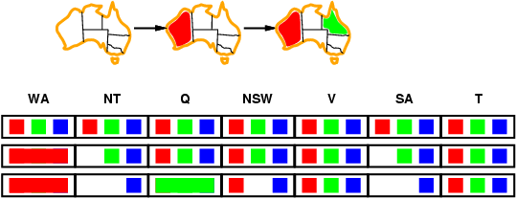
Forward checking
Idea:
Keep track of remaining legal values for unassigned variables
Terminate search when any variable has no legal values

Slide 107
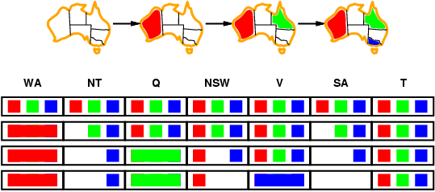
Forward checking
Idea:
Keep track of remaining legal values for unassigned variables
Terminate search when any variable has no legal values
Dead End

Slide 108
Forward Checking
Examples

Slide 109
Example: 4-Queens Problem
X1
{1,2,3,4}
X2
{1,2,3,4}
1
2
3
4
1
2
3
4
X3
{1,2,3,4}
X4
{1,2,3,4}
[4-Queens slides copied from B.J. Dorr CMSC 421 course on AI]

Slide 110
Example: 4-Queens Problem
X1
{1,2,3,4}
X2
{1,2,3,4}
1
2
3
4
1
2
3
4
X3
{1,2,3,4}
X4
{1,2,3,4}

Slide 111
Example: 4-Queens Problem
X1
{1,2,3,4}
X2
{ , ,3,4}
1
2
3
4
1
2
3
4
X3
{ ,2, ,4}
X4
{ ,2,3, }

Slide 112
Example: 4-Queens Problem
X1
{1,2,3,4}
X2
{ , ,3,4}
1
2
3
4
1
2
3
4
X3
{ ,2, ,4}
X4
{ ,2,3, }

Slide 113
Example: 4-Queens Problem
X1
{1,2,3,4}
X2
{ , ,3,4}
1
2
3
4
1
2
3
4
X3
{ , , , }
X4
{ ,2, , }
Dead End → Backtrack

Slide 114
Example: 4-Queens Problem
X1
{1,2,3,4}
X2
{ , , ,4}
1
2
3
4
1
2
3
4
X3
{ , 2 , , }
X4
{ , ,3, }

Slide 115
Example: 4-Queens Problem
X1
{1,2,3,4}
X2
{ , , ,4}
1
2
3
4
1
2
3
4
X3
{ , 2 , , }
X4
{ , , , }
Dead End → Backtrack

Slide 116
Example: 4-Queens Problem
X1
{ ,2,3,4}
X2
{1,2,3,4}
1
2
3
4
1
2
3
4
X3
{1,2,3,4}
X4
{1,2,3,4}

Slide 117
Example: 4-Queens Problem
X1
{ ,2,3,4}
X2
{ , , ,4}
1
2
3
4
1
2
3
4
X3
{1, ,3, }
X4
{1, ,3,4}

Slide 118
Example: 4-Queens Problem
X1
{ ,2,3,4}
X2
{ , , ,4}
1
2
3
4
1
2
3
4
X3
{1, ,3, }
X4
{1, ,3,4}

Slide 119
Example: 4-Queens Problem
X1
{ ,2,3,4}
X2
{ , , ,4}
1
2
3
4
1
2
3
4
X3
{1, , , }
X4
{1, ,3, }

Slide 120
Example: 4-Queens Problem
X1
{ ,2,3,4}
X2
{ , , ,4}
1
2
3
4
1
2
3
4
X3
{1, , , }
X4
{1, ,3, }

Slide 121
Example: 4-Queens Problem
X1
{ ,2,3,4}
X2
{ , , ,4}
1
2
3
4
1
2
3
4
X3
{1, , , }
X4
{ , ,3, }

Slide 122
Example: 4-Queens Problem
X1
{ ,2,3,4}
X2
{ , , ,4}
1
2
3
4
1
2
3
4
X3
{1, , , }
X4
{ , ,3, }
Solution !!!!

Slide 123
Forward Checking
[R,B,G]
[R,B,G]
[R]
[R,B,G]
[R,B,G]

Slide 124
Forward Checking
[ ,B,G]
[R,B,G]
[R]
[ ,B,G]
[R,B,G]

Slide 125
Forward Checking
[ ,B,G]
[R,B,G]
[R]
[ ,B,G]
[R,B,G]

Slide 126
Forward Checking
[ ,B,G]
[R, ,G]
[R]
[ , ,G]
[R, ,G]

Slide 127
Forward Checking
[ ,B,G]
[R, ,G]
[R]
[ , ,G]
[R, ,G]

Slide 128
Forward Checking
[ ,B,G]
[R, ,G]
[R]
[ , ,G]
[ , ,G]

Slide 129
Forward Checking
[ ,B,G]
[R, ,G]
[R]
[ , ,G]
[ , ,G]

Slide 130
Forward Checking
[ ,B,G]
[R, ,G]
[R]
[ , , ]
[ , ,G]

Slide 131
Forward Checking
[ ,B,G]
[R, ,G]
[R]
[ , , ]
[ , ,G]
Dead End

Slide 132
Forward Checking
[ ,B,G]
[R, ,G]
[R]
[ , ,G]
[R, ,G]

Slide 133
Forward Checking
[ ,B,G]
[R, ,G]
[R]
[ , ,G]
[R, , ]

Slide 134
Forward Checking
[ ,B,G]
[R, ,G]
[R]
[ , ,G]
[R, , ]

Slide 135
Forward Checking
[ ,B,G]
[R, ,G]
[R]
[ , ,G]
[R, , ]
Solution !!!

Slide 136
Constraint Satisfaction problem
Constraint Propagation
Arc Consistency

Slide 137
Constraint propagation
Forward checking propagates information from assigned to unassigned variables, but doesn't provide early detection for all failures:
NT and SA cannot both be blue!
Constraint propagation repeatedly enforces constraints locally

Slide 138
Arc consistency
More complex than forward checking, but backtracks sooner so may be faster
Make each arc consistent
Constraints treated as directed arcs
X →Y is consistent iff
for every value of X there is some allowed value for Y
Note:
If the arc from A to B is consistent, the (reverse) arc from B to A is not necessarily consistent!
Arc consistency does not detect every possible inconsistency!!

Slide 139
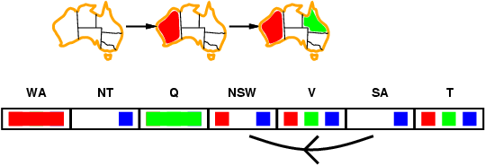
Arc consistency
Simplest form of propagation makes each arc consistent
X →Y is consistent iff
for every value x of X there is some allowed y

Slide 140
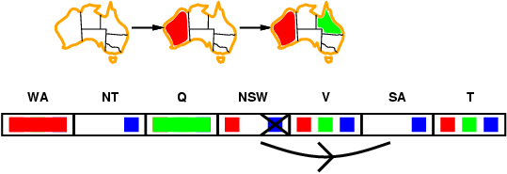
Arc consistency
Simplest form of propagation makes each arc consistent
X →Y is consistent iff
for every value x of X there is some allowed y

Slide 141
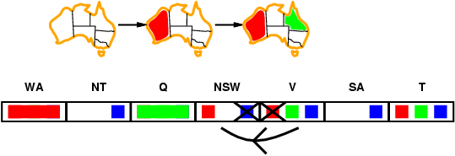
Arc consistency
Simplest form of propagation makes each arc consistent
X →Y is consistent iff
for every value x of X there is some allowed y
If X loses a value, neighbors of X need to be rechecked

Slide 142
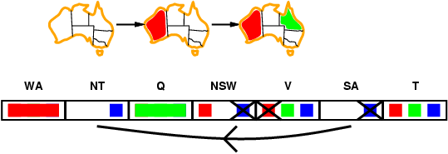
Arc consistency
Simplest form of propagation makes each arc consistent
X →Y is consistent iff
for every value x of X there is some allowed y
If X loses a value, neighbors of X need to be rechecked
Arc consistency detects failure earlier than forward checking
Can be run as a preprocessor or after each assignment

Slide 143
Arc consistency algorithm AC-3
Time complexity: O(n²d³)
Checking consistency of an arc is O(d²)

Slide 144
Arc Consistency: AC3 + Backtracking
Constraint Satisfaction Problems

Slide 145
Arc Consistency: AC3
[R,B,G]
[R,B,G]
[R]
[R,B,G]
[R,B,G]

Slide 146
Arc Consistency: AC3
[ ,B,G]
[R,B,G]
[R]
[R,B,G]
[R,B,G]

Slide 147
Arc Consistency: AC3
[ ,B,G]
[R,B,G]
[R]
[ ,B,G]
[R,B,G]

Slide 148
Arc Consistency: AC3
[ ,B,G]
[R,B,G]
[R]
[R,B,G]
[R,B,G]

Slide 149
Arc Consistency: AC3
[ ,B,G]
[R,B,G]
[R]
[R,B,G]
[R,B,G]

Slide 150
Arc Consistency: AC3
[ ,B,G]
[R,B,G]
[R]
[R,B,G]
[R,B,G]

Slide 151
Arc Consistency: AC3
[ ,B,G]
[R,B,G]
[R]
[ ,B,G]
[R,B,G]

Slide 152
Arc Consistency: AC3
[ ,B,G]
[R,B,G]
[R]
[ ,B,G]
[R,B,G]

Slide 153
Arc Consistency: AC3
[ ,B,G]
[R,B,G]
[R]
[ ,B,G]
[R,B,G]

Slide 154
Arc Consistency: AC3
[ ,B,G]
[R, ,G]
[R]
[ ,B,G]
[R,B,G]

Slide 155
Arc Consistency: AC3
[ ,B,G]
[R, ,G]
[R]
[ ,B,G]
[R, ,G]

Slide 156
Arc Consistency: AC3
[ ,B,G]
[R, ,G]
[R]
[ , ,G]
[R, ,G]

Slide 157
Arc Consistency: AC3
[ ,B,G]
[R, ,G]
[R]
[ , ,G]
[R, , ]

Slide 158
Arc Consistency: AC3
[ ,B,G]
[ , ,G]
[R]
[ , ,G]
[R, , ]

Slide 159
Arc Consistency: AC3
[ ,B,G]
[ , ,G]
[R]
[ , ,G]
[R, , ]

Slide 160
Arc Consistency: AC3
[ ,B,G]
[ , ,G]
[R]
[ , ,G]
[R, , ]

Slide 161
Arc Consistency: AC3
[ ,B,G]
[ , ,G]
[R]
[ , ,G]
[R, , ]
Solution !!!

Slide 162
Constraint Satisfaction problem
Local Search

Slide 163
Local search for CSPs
Note: The path to the solution is unimportant, so we can
apply local search!
Hill-climbing, simulated annealing typically work with "complete" states, i.e., all variables assigned
To apply to CSPs:
allow states with unsatisfied constraints
operators reassign variable values
hill-climb with value(state) = total number of violated constraints
Variable selection:
randomly select any conflicted variable
Value selection:
choose value that violates the fewest constraints
called the min-conflicts heuristic

Slide 164
Example: 4-Queens
States: 4 queens in 4 columns (4⁴ = 256 states)
Actions: move queen in column
Goal test: no attacks
Evaluation: h(n) = number of attacks

Slide 165
Example: 8-queens
State:
Variables = queens, which are confined to a column
Value = row
Start with random state
Repeat
Choose conflicted queen randomly
Choose value (row) with minimal conflicts

Slide 167
Summary
CSPs are a special kind of problem:
states defined by values of a fixed set of variables
goal test defined by constraints on variable values
Backtracking = depth-first search with one variable assigned per node
Variable ordering and value selection heuristics help significantly
Forward checking prevents assignments that guarantee later failure
Constraint propagation (e.g., arc consistency) does additional work to constrain values and detect inconsistencies
Iterative min-conflicts is usually effective in practice

