Slide 1
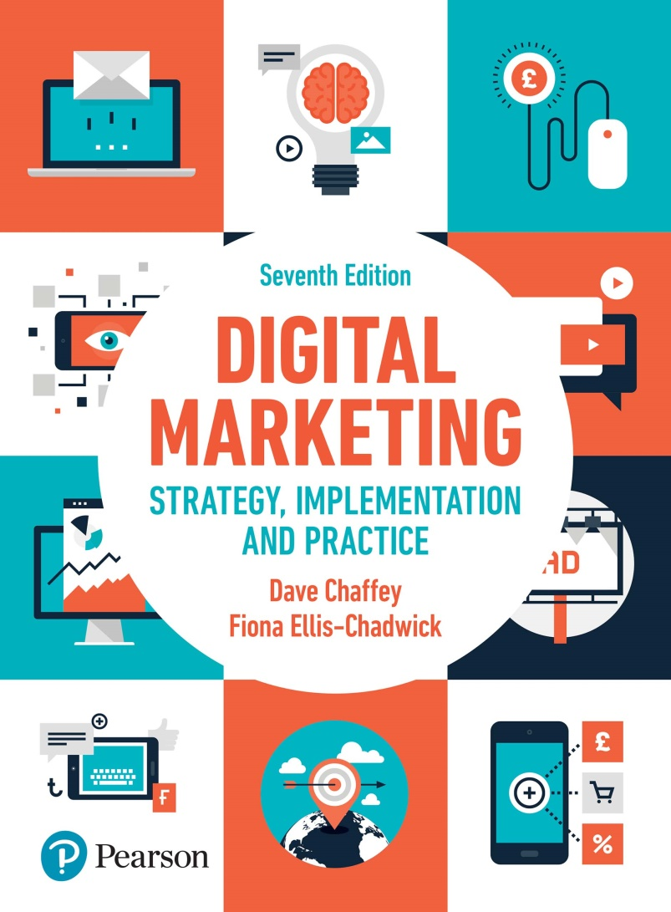
DIGITAL MARKETING STRATEGY, IMPLEMENTATION AND PRACTICE Seventh Edition
Part 1
Digital marketing fundamentals
Chapter 2
Online marketplace analysis: micro-environment

Slide 2
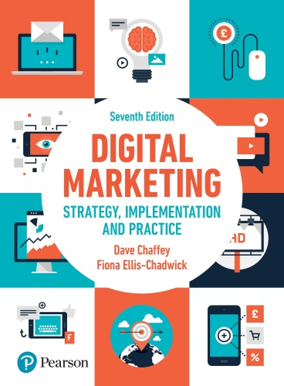
Chapter 2 - Online marketplace analysis: micro-environment
Main Topics:
Situation analysis for digital marketing
Digital marketing environment
Understanding customer in digital markets
Consumer. Choice and digital influence
Customer characteristics
Competitors
Suppliers
New channel structures
Digital business models for e-commerce

Slide 3
Situation analysis for digital marketing
Notes:
Figure 2.1 The digital marketing environment

Slide 4
Understanding customer in digital markets
Customer segments
Search intermediaries
Intermediaries, influencers and media or publisher sites
Destination sites and platforms

Slide 5
Figure 2.2 An example of a customer journey map

Slide 6
Figure 2.3 An online marketplace map

Slide 7
Figure 2.4 Model Showing conversion between the digital channel and traditional channels during the buying process

Slide 8
Consumer choice and digital influence
Customer characteristics:
Demographic variables
Psychographic and behavioural variables
Social media and emotions
Consumer Personas
The buying process

Slide 9
Figure 2.9 Framework for understanding online customer experiences
Source: Rose and Hair (2011)

Slide 10
Figure 2.10 A summary of how digital media can impact on the buying process in a new purchase

Slide 11
Competitors
The shape and nature of online competitive markets
Competitor analysis and benchmarking

Slide 12
Suppliers
Digital marketing intermediaries
Online intermediary sites

Slide 13
New channel structures
Notes:
Figure 2.12 Disintermediation of a consumer distribution channel showing: (a) the original situation; (b) disintermediation omitting the wholesaler; and (c) disintermediation omitting both wholesaler and retailer
Figure 2.13 From (a) original situation to (b) disintermediation or (c) reintermediation or countermediation

Slide 14
Digital business model for e-commerce
Source: SmartInsights.com with permission.
Notes:
Figure 2.14 Example of business model canvas summary

Slide 15
Figure 2.15 Alternative perspectives on business models

Slide 16
Case study; Boo hoo – learning for the largest dot com failure
Questions
Discuss which strategic market assumptions and decisions led to Boo.com’s inevitable failure?
Compare and contrast the marketing strategy of Boo.com with successful online travel and leisure retailer lastminute.com. Suggest what made the difference between success and failure
Use the framework of the marketing mix to appraise the marketing strategy and tactics of Boo.com
In many ways the vision of Boo’s founders was ‘ideas before their time’. Give examples of e-retail techniques adopted by boo.com that are now common place.

